Slide 1
ECE154
Computer Architecture
Lecture #7
Edward Chang
Electrical & Computer Engineering

Slide 2
Today’s Outline
Dynamic Branch Prediction
Memory Disambiguation
Super-scalar Processors
Speculative Execution

Slide 3
Why Branch Prediction?
Suppose prediction accuracy = 90%
Branch delay = 2 cycles
% branch = 20%
Speedup = CPI_{old}/CPI_{new} = ?
Long pipelines
Huge speedup for issue multiple instructions per cycle
  E.g., 4-8 instructions per cycle

Slide 4
Two Major Hardware Methods
Branch Prediction Buffer (BPB)
  Predicting taken/not taken
Branch Target Buffer (BTB)
  Predicting taken/not taken
  Providing the branch target address

Slide 5
Branch Prediction Buffer
Basic Idea
  A table containing branch prediction
  Accessed during the ID stage
  Index the PC into the table to find the prediction
  Assume the prediction is true and fetch instructions on the predicted path
  Update the prediction table after the branch condition is known
  Cancel any instructions that were fetched incorrectly
PC
taken?

Slide 6
Branch Delay
ld R1,#10 IF ID EX MEM WB
subi R1,#1 IF ID EX MEM WB
bneqz R1,#-8 IF ID
IF IF
Case
Prediction
Actual Branch
Delay
1
Taken
Taken
1
2
Taken
Not Taken
2
3
Not taken
Taken
2
4
Not taken
Not Taken
0

Slide 7
Branch Delay
ld F1,#16 IF ID EX MEM WB
dvi.d F1,#2 IF ID EX EX…
bneqz F1,1 IF ID
add.d F1,#8 IF IF
Case
Prediction
Actual Branch
Delay
1
Taken
Taken
1
2
Taken
Not Taken
5
3
-
Taken
5
4
-
Not Taken
0

Slide 8
Branch Prediction Buffer
Reasons for Misprediction
  Aliasing (due to buffer size)
  Wrong prediction
Misprediction: typically twice
  For (i = 0, i < 10; i++)
  a[i] = a[i] + c;

Slide 9
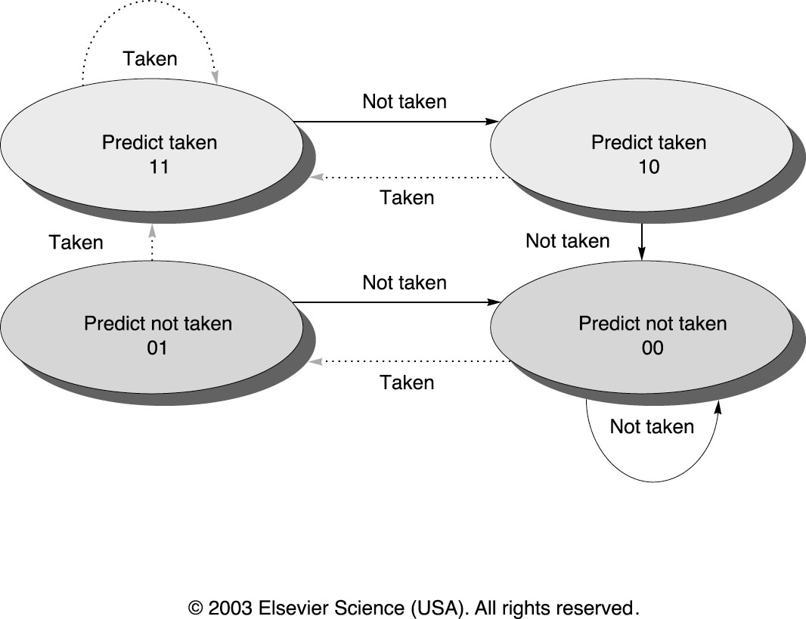
2-bit Predictors

Slide 10
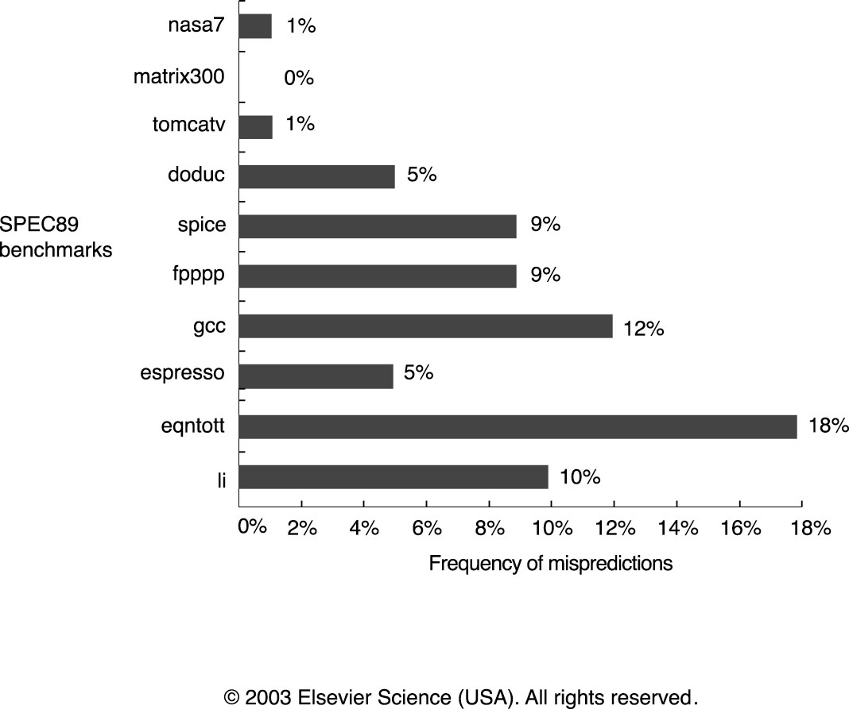
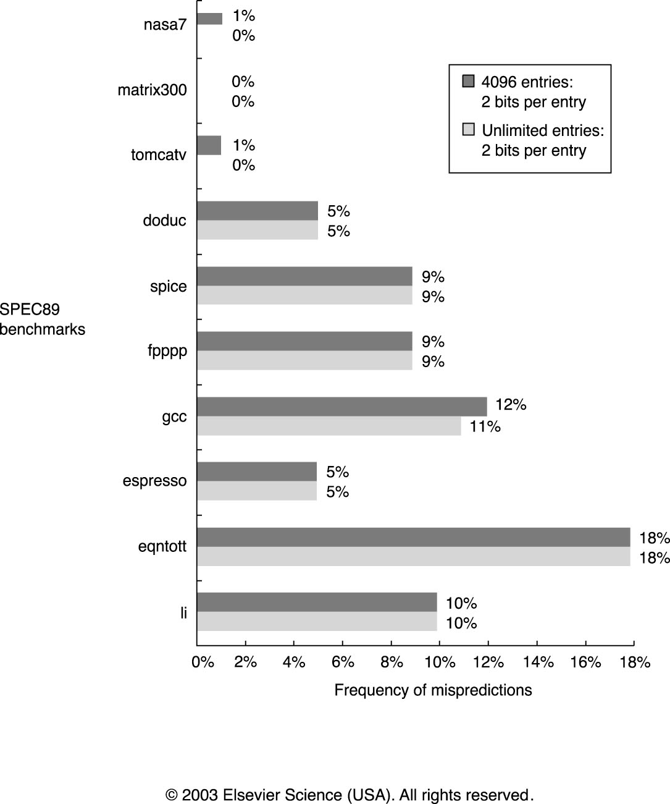
2- vs. infinite- Bit Predictors

Slide 11
Branch Target Buffer
A branch prediction cache that stores predicted address for the next instruction
  Like an instruction cache
  Accessed during IF
    Branch target address known before ID
    (branch prediction buffer is accessed during ID)

Slide 12
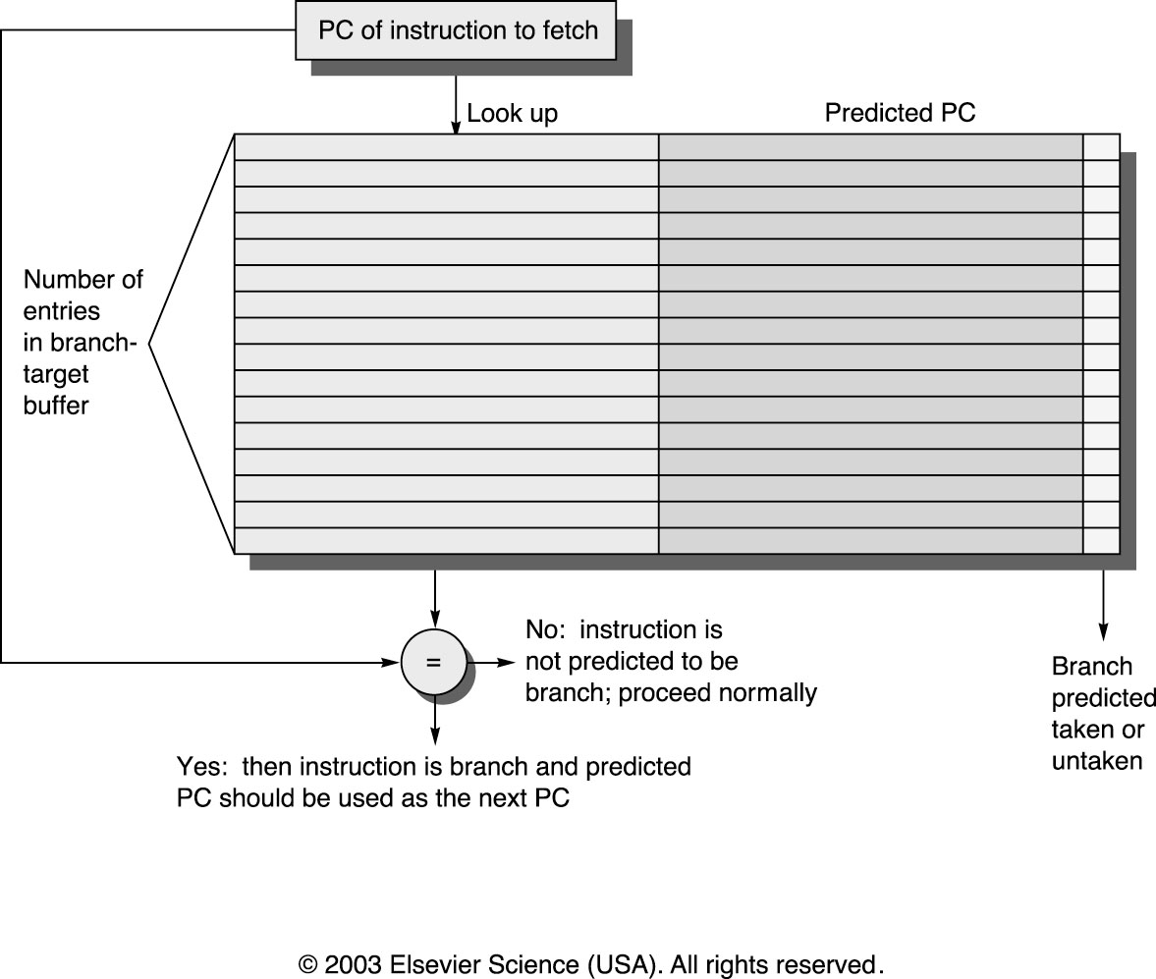
Branch Target Buffer

Slide 13
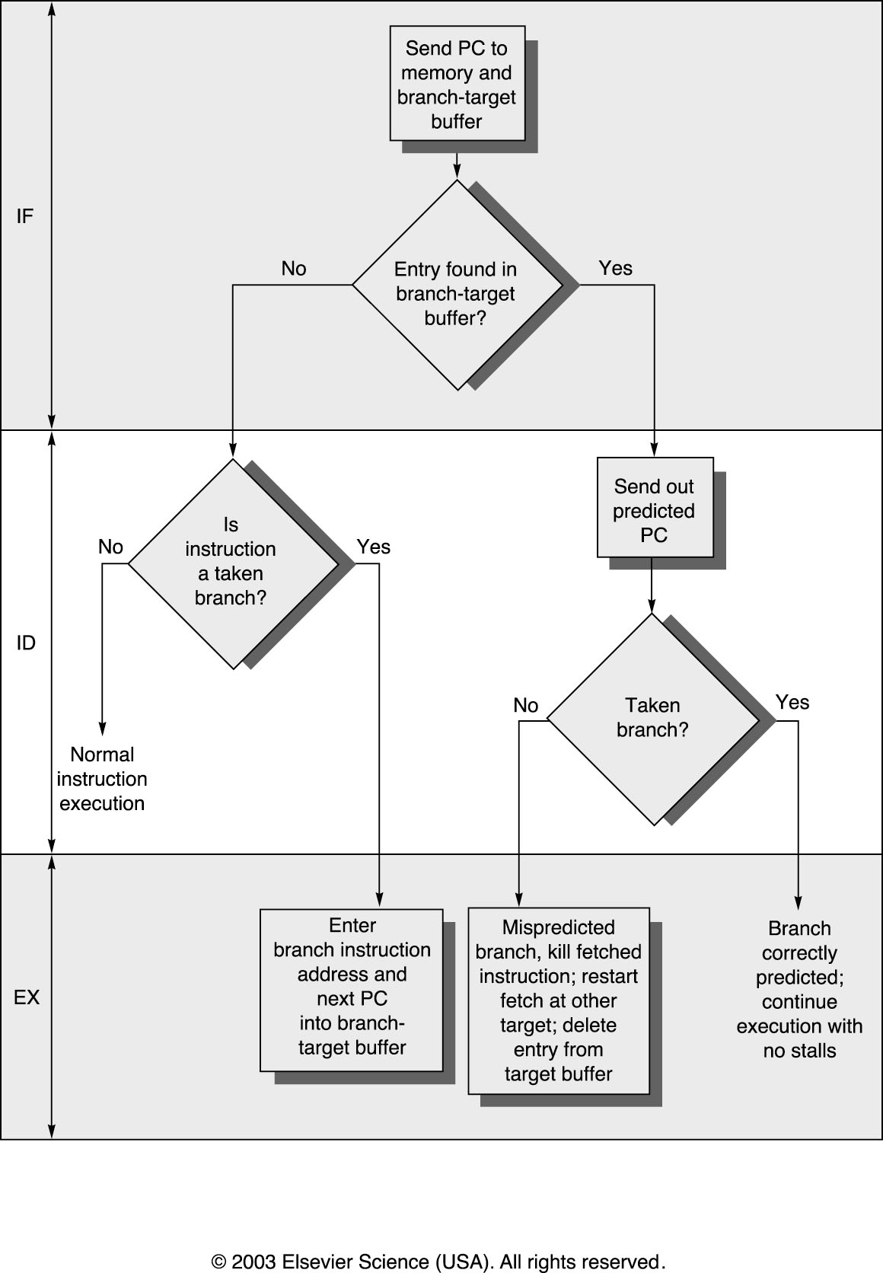
Steps Using BTB

Slide 14
Branch Penalty
Instruction in buffer? | Prediction | Actual Branch | Penalty Cycles
Yes | Taken | Taken | 0
Yes | Taken | Not Taken | 2
No | Not Taken | Taken | 2
No | Not Taken | Not Taken | 0

Slide 15
Branch Penalty Example
Prediction accuracy: 90% (for instructions in the buffer)
Hit rate in the buffer 90% (for branch taken)
Assume 60% taken
Prob (branch in buffer, not taken) = 90% * 10% = 0.09
Prob (branch not in buffer, but taken) = 10%
Branch penalty = (0.09 + 0.10) * 2 = 0.38
missing opportunity

Slide 16
Integrated Instruction Fetch Units
Integrated Branch Prediction
  Branch prediction becomes part of IF
Instruction Prefetch
  Fetch multiple instructions per cycle
Instruction Memory Access and Buffering
Encapsulate the cost of crossing cache blocks
More in Chapter 5…

Slide 17
Return Address Predictor
Return address for functions can be predicted with a stack
Idea:
  On function call, push the return address on the stack
  On function return, pop the return address
Why separate from branch prediction
  With 16-entry stack, get 90% prediction accurately

Slide 18
Memory Disambiguation
Problem
st R5, 100(R2)
ld R6, 0(R3)
Is R3 = R2+ 100
Conservative Solution: Total Ordering
  Keep all loads and stores totally ordered with respect to each other
  Tomasulo Algorithm, reorder buffer

Slide 19
Hardware Solution
Store buffer keeps track of all outstanding stores to memory, in order
  Keep track of address and value, as they become available
  FIFO ordering: will complete stores from this buffer in program order
When issuing a load, record current tail of the store queue
When load address available
  I recorded tail in store queue is still pending, stall load and all following loads
  Or, send load request to memory
Actual stores commit in order

Slide 20
Load Bypassing

Slide 21
Load Forwarding

Slide 22
Today’s Outline
Dynamic Scheduling
Dynamic Branch Prediction
Memory Disambiguation
Superscalar Processors
Speculative Execution

Slide 23
Summary
Dynamic Branch Prediction
Memory Disambiguation
Superscalar Processors
Speculative Execution

