Slide 1
Learning and Measuring Perceptual Distance
Edward Chang
Electrical Engineering
University of California
Santa Barbara

Slide 2
Outline
Motivation
Key Project Components
Demo

Slide 3
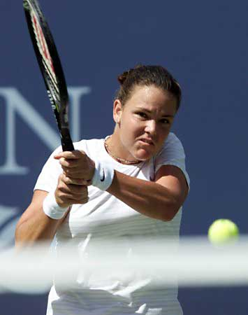
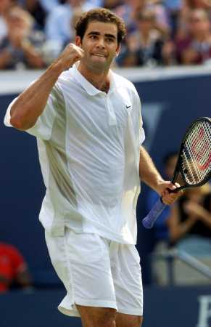
Are They Similar?

Slide 4
Are They Similar?
In terms of what?
Is Tiger Woods more similar to Michael Jordan than to Bill Gates?
Is the paintings of DaVinci more like those of Rubens than those of Raphael?

Slide 5
In Terms of What?

Slide 6
Conveying
In Terms of What
Relational Databases
  Conveyed via Query Languages
Internet Searches
  Conveyed via Keywords
Multimedia Searches
  ???

Slide 7
Image Query Concept
Conveyed by Languages
  colors = blue v pink v white
  textures = coarse v horizontal
  shapes = people + tennis rackets
Conveyed by Examples
  Use a sunset picture to find sunset images
  Where does the perfect example come from?

Slide 8
Challenges
Articulating a Concept is Hard

Slide 9


Slide 10
Challenges
Articulating a Concept is Hard
Articulation can be Subjective
  An image is perceived differently by different people
  Even the perception is the same, different users may use different vocabulary to depict it

Slide 11
Our Solution
Make Search Engines Intelligent
  Develop an Intelligent Search Engine that learns Query Concepts via Active Learning

Slide 12
Related Work in Brief
No existing machine learning and relevance feedback schemes can do it effectively
How come?

Slide 13
Shortcomings of the Current Technologies
Sample Limitation
  Users are impatient to provide a great deal of feedback
Real-time Constraint
  Users are impatient to wait for even a few seconds
Seeding Requirement
  Users have no “good’’ samples to initiate a query

Slide 14
Outline
Motivation
Key Project Components
Demo

Slide 15
Key Components
Learners
Perception-
based
Feature Extraction
High Speed
Indexers

Slide 16
Related Papers
Learners
  ACM MM 2001, ICME 2001, ...
Indexers
  TKDE 2001, ACM CIKM 2001, ACM MIR 2001, EDBT 2002
Perception-based feature extraction
  CBIVR 2000, ICDM 2001, SIAM 2002
Prototypes
  ACM Sigmod demo, ACM MM demo

Slide 17
Key Components
Learners
Perception-
based
Feature Extraction
High Speed
Indexers

Slide 18
Learners
Learn a concept quickly and with minimum number of labeled instances (training data)
Eliminate the seeding requirement
Tolerate model bias and user errors

Slide 19
Learners
MEGA
SVMActive

Slide 20
Admission Example
Predicates: GPA = High, GRE = High
CNF: (GPA = High) ^ (GRE = High) ^ (GPA = High v GRE = High)
DNF: (GPA = High) v (GRE = High) v (GPA = High ^ GRE = High)

Slide 21
Query Concept
DNF
CNF

Slide 22
MEGA Example
CNF: (GPA = High) ^ (GRE = High) ^ (GPA = High v GRE = High)
Sample: (GPA = Low) ^ (GRE = Low)

Slide 23
Traditional Learning Methods
DNF
CNF

Slide 24
MEGA Example
CNF: (GPA = High) ^ (GRE = High) ^ (GPA = High v GRE = High)
Sample: (GPA = High) ^ (GRE = High)

Slide 25
Traditional NN Relevance Feedback

Slide 26
How MEGA Works
Sample Selection (S-step)
  Select most informative samples to eliminate maximum number of irrelevant features
Feature Reduction (F-step)
  Reducing feature space quickly for selecting most informative samples

Slide 27
S- & F-Step

Slide 28
Learners
MEGA
SVMActive

Slide 29
Key Ideas
Query concept and otherwise can be divided by a hyperplane
Find this hyperplane quickly through active learning

Slide 30
Support Vector Machines
Margin

Slide 31
First Key Idea
A query concept and otherwise can be divided by a boundary
  This boundary, when projected to very high dimensional space, is a hyperplane
  SVMactive uses SVMs (Support Vector Machines) to find this hyperplane
  An object that is father to the hyperplane at the query concept side ranks higher (more relevant)

Slide 32
SVMactive

Slide 33
SVMactive

Slide 34
SVMactive

Slide 35
SVMactive

Slide 36
Key Compnoents
Learners
Perception-
based
Feature Extraction
High Speed
Indexers

Slide 37
Perception-based
Perceptual Feature Space
Perceptual Distance Function

Slide 38
Weighted Minkowski Distance
D = (Σ_{j} wi(pi - qi)^{n})^{1/n}
Parameters
  n
  Wi

Slide 40
Related Papers
Learners
  ACM MM 2001, ICME 2001, ...
Indexers
  TKDE 2001, ACM CIKM 2001, ACM MIR 2001, EDBT 2002
Perception-based feature extraction
  CBIVR 2000, ICDM 2001, SIAM 2002
Prototypes
  ACM Sigmod demo, ACM MM demo

Slide 41
Outline
Motivation
Key Project Components
Demo

Slide 42
Key Compnoents
Learners
Perception-
based
Feature Extraction
High Speed
Indexers

Slide 43
Conclusion
Perception-based
Content-based
Keyword-based

Slide 44
Acknowledgment
Stanford Collaborators
  Chen Li and Simon Tong
UCSB Collaborators
  Kingshy Goh, Larry Lai, and Beitao Li
IBM T.J. Watson
  Chung-Sheng Li
Morpho Software Inc.
  Kwang-Ting Cheng, etc.

Slide 45
Online Demo
Http:// www.mmdb.ece.ucsb.edu/corelacm/
http:// www.mmdb.ece.ucsb.edu/corelmega/

