Slide 1
Class Prediction by Nearest Shrunken Centroids, with Applications to DNA Microarrays
Edward Chang
Electrical Engineering
University of California
Santa Barbara

Slide 2
Outline
Motivation
Nearest Shrunken Centriods

Slide 3
Motivation
DNA Microarray

Slide 4
Motivation
Class Prediction with High Dimensional Features
4026 Genes
59 Lymphoma Patients
  DLCL (diffuse large B-cell lymphoma)
  CLL (chronic lymphocytic lymphoma)
  FL (follicular lymphoma)

Slide 5
NN Classification
Compute Training-Set Centroids
  Centroid: average expression of a gene
Compute L2 Distance of Test Point φ to Centroids
C = The Class’ Centriod Nearest to φ

Slide 6
Centroids
K Classes C₁ to C_{K}
n_{k} Number of samples in class k
x_{ik} = ∑_{j∈Ck} x_{ij}/n_{k} (class centroids)
x_{i} = ∑ x_{ij}/n (overall centroids)

Slide 7
Toy Example
2 Classes C₁ and C₂
n₁ = 2
  (4, 3), (6, 5)
n₂ = 3
  (1,1),(2,5), (3,3)
Class Centroids
  x₁₁ = 5, x₂₁ = 4
  x₁₂ = 2, x₂₂ = 3
Overall Centroids
  x₁ = 3.2, x₂ = 3.4

Slide 8
NN Toy Example
0 1 2 3 4 5
0 1 2 3 4 5 6

Slide 9
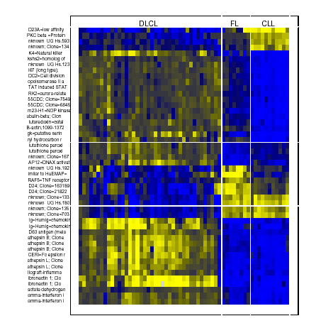

Slide 10
Normalized Centroid Plot
27,5,7
Centroid Contrasts

Slide 11
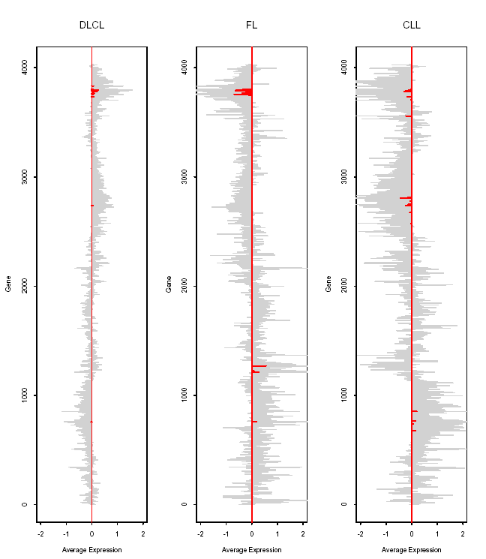

Slide 12
NN Classification
4026 genes
39 training instances
D >> N
Shrunken Centroids
  Reduce D

Slide 13
Result Preview
25 Testing Data for Blue-cell Tumor Testing (Khan et al. 2001)
NN D = 2308 4/25
NN D = 43 0/25

Slide 14
Nearest Shrunken Centroids
K Classes C₁ to C_{K}
N_{k} Number of samples in class k
x_{ik} = ∑_{i∈Ck} x_{ij}/n_{k} (class centroids)
x_{i} = ∑ x_{ij}/n (overall centroids)

Slide 15
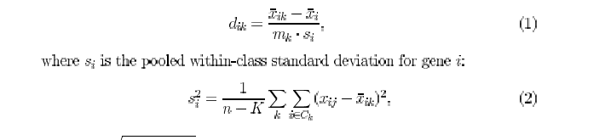

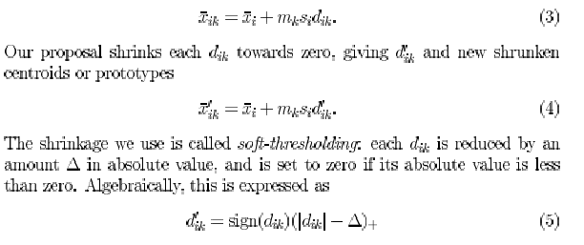
Shrink Class Centroids

Slide 16
t-Statistics
X_{i} ~ N(µ_{X}, σ²) n samples
Y_{i} ~ N(µ_{Y}, σ²) m samples
µ_{X} = µ_{Y}?
  Do not know for sure
  Can estimate its likelihood

Slide 17
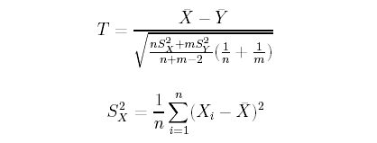
t-distribution

Slide 18
Shrink Class Centroids

Slide 19
Thresholding

Slide 20
d_{ik}
d_{ik} = x_{ik} – x_{i} / m_{k} s_{i}
Favors small variance and large class
Favors “stable” class

Slide 21
Eliminate Featurers

Slide 22
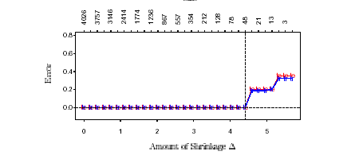

Slide 23
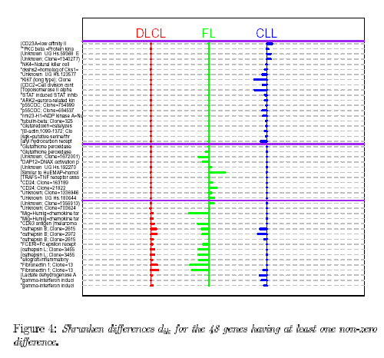

Slide 25
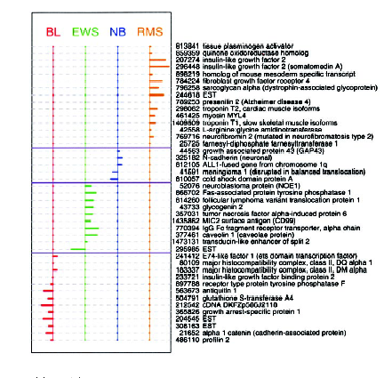

Slide 26


Class Prediction Function

Slide 27
Capturing Heterogeneity
How About X and Y Have the Same Centroids But Different Variability in Expression

Slide 28
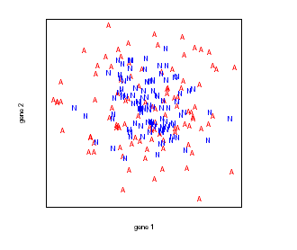

Slide 29
Capturing Heterogeneity
How About X and Y Have the Same Centroids But Different Variability in Expression
X’_{ij} = X_{ij} - M_{i}

Slide 30
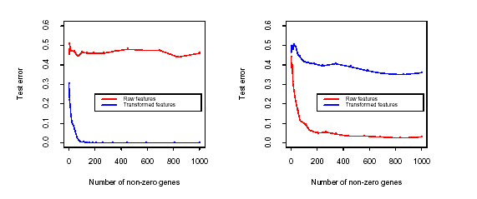

Slide 31
Relationship to Other Approaches
D >> N, W is huge and W⁻¹ is undefined
Shrunken centroids rather than centroids are used

Slide 32
Other Linear Models
LDA
  Find the projection direction which minimizes the overlap for Gaussian data
Separating Hyperplane

Slide 33
LDA

Slide 35
Concluion
A D >> N Classifier
Better Than LDA by avoiding
  Singularity problem
  Curse of dimensionality
  High Variance caused by Overfitting

