Slide 1
Learning Subjective and Complex Image Query Concepts via Intelligent Sampling
Beitao Li
Advisor: Prof. Edward Chang

Slide 2
Outlines
Background and Related Works
MEGA Algorithm and Experiments
Application on Image Dataset
A Novel Distance Function for Multimedia Database Retrieval
Conclusions
Future Work

Slide 3
Background
Increasing network bandwidth enable multimedia content delivery.
Increasing multimedia content:
Digital TV
Digital Cameras

Slide 4
Why a good search engine is important?
Most of the general users do not have the basic training about how to specify query concepts in formal languages, yet they like to reach their target concepts quickly and effortlessly.
Multimedia query concepts are difficult to specify and specifications are usually subjective.

Slide 5
Related Works
Traditional learning methods such as decision trees and neural networks require a large number of training instances (i.e. samples) to learn a concept and thus is not appropriate for online learning. (Bishop 1998, Kearns 1994, Mitchell 1997)

Slide 6
Recent Developments
Relevance feedback and QBE methods are widely used in recent years and representative ones are:
Minder Reader (Ishikawa et al 1998): Using query point movement and query reweighting. Return the top ranked objects to be examined by the user and refine the query based on the user’s feedback.

Slide 7
Problem of Mind Reader
As pointed out by (Huang 2000), Minder Reader failed to analyze the working conditions. Performance decreases dramatically when the number of samples is smaller than the feature dimension, which is usually the case in multimedia database.

Slide 8
A Representative System: MARS
Multimedia Analysis and Retrieval System ( MARS, Ortega et al 1999, Porkaew et al 1999, Mehrotra 1999):
MARS Using nearest neighbor sampling and recent development of MARS introduces query expansion ( Wu et al 2000, Yong et al 2000), Which is a multiple-instance nearest neighbor sampling algorithm.

Slide 9
Other systems
There are also other systems like PicHunter (Cox et al, 2000), IRM ( Li et al, 2000). Most of them employ nearest neighbor sampling and refine the query based on the feedback from the nearest neighbor region.

Slide 10
Problem of NN sampling
However, users may not have a good example to start a query, refining a search around bad examples is analogous to trying to find oranges in the middle of an apple orchard by refining one’s search to a few rows of apple trees at a time.

Slide 11
Seeding Problem
Besides, all traditional relevance feedback methods require seeding the methods with “good” positive examples. (Flickner et al 1995, Gupta et al 1997, Hua et al 1999, Smith et al 1996, Wang et al 1997 …)
For instance, sunset images should be provided as seeds to search for sunset images.

Slide 12
Outlines
Background and Related Works
MEGA Algorithm and Experiments
Application on Image Dataset
A Novel Distance Function for Multimedia Database Retrieval
Conclusions
Future Work

Slide 13
MEGA (Maximizing Expected
Generalization Algorithm)
Our Contributions:
1. No longer require “good” examples to seed searches.
2. Use an intelligent sampling algorithm which maximize the usefulness of each sample and thus expedite the learning process.
3. Can tolerate certain amount of noise ( Including user errors and model bias).

Slide 14
MEGA Algorithm
Model query concepts (QCS) as k-CNF (Conjunctive Normal Form)
Using k-DNF (Disjunctive Normal Form) to bound the sampling space (CCS).
Intelligently select samples which can reduce the version space quickly so that convergence to the target concept can be accelerated.

Slide 15
Outline of the MEGA Algorithm
Start the query concept as complete k-CNF.
Start the sampling bound as complete k-DNF.
Based on statistical calculation, MEGA selects samples between the query concept and the sampling bound.
Get feedback from the user about the sample images.
Use positive examples to refine the query concept (QCS).

Slide 16
MEGA’s Sampling Space
Sampling Space
CCS
QCS

Slide 17
Use negative examples to shrink the sampling space (CCS).
Continue doing intelligent sampling, user feedback, query concept refinement and sampling space shrinking steps.

Slide 18
Intelligent Sampling
The goal is quickly expand the QCS to approximate the target concept. So we need to refine QCS quickly, i.e. reduce the terms in QCS quickly.
It may appear that if we pick an example that has more dissimilar disjunctions (compared to the QCS), we will reduce terms in QCS quickly.

Slide 19

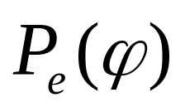
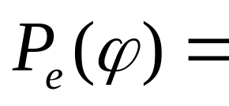
However, it is not true. A sample must be labeled positive by user to be useful for refining QCS. So we should also consider the probability of a sample to be labeled positive.
Suppose the probability of a sample contradicts terms to be labeled positive is
i.e.: P(sample is positive | sample contradicts terms)

Slide 20
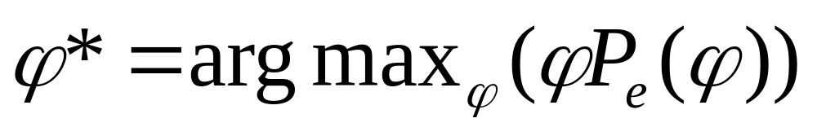


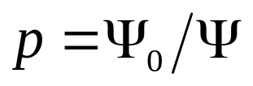
To eliminate maximum expected number of terms in QCS, we need to find , which maximize .
i.e.,
If we suppose the target concept contains
terms and the current QCS contains terms. Then the probability of each term to be in the target concept is:

Slide 21
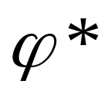
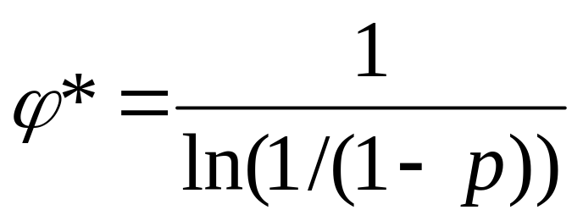
We can solve :
Select samples having dissimilar terms can reduce maximum expected number of terms in QCS.

Slide 22
Experiments on Synthetic Dataset
Synthetic Dataset:
10000 data points. Each data point has 10 features. Different feature distributions (Including Uniform, Gaussian, Skew) are experimented.
First we tested the following concepts: Concept 1: P1∨P2 Concept 2: (P1∨P2) ∧P3 Concept 3: P1∧(P2∨P3) ∧(P4∨P5∨P6) ∧(P2∨P4∨P7 ∨P8)

Slide 23
Sampling schemes tested
We tested six sampling schemes:
Random
B-Random
Aggressive
MEGA
Nearest Neighbor
Query Expansion

Slide 24
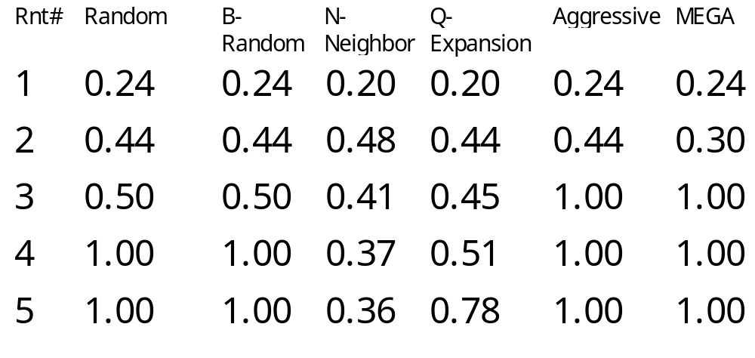
Learning P1∨P2 in Uniform Dataset

Slide 25
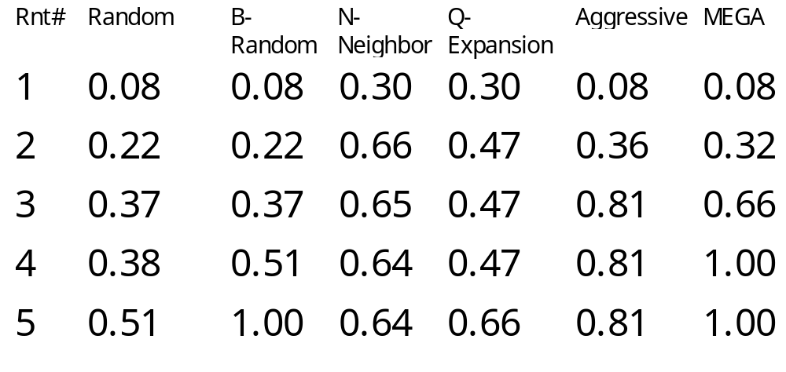
Learning P1∨P2 in Gaussian Dataset

Slide 26
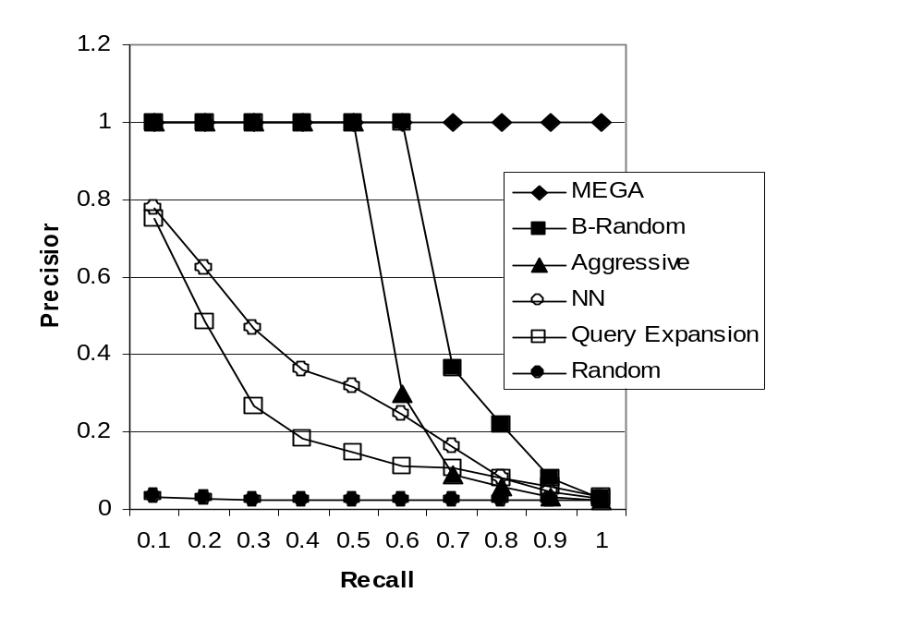
Learning (P1∨P2) ∧P3 ( The third round)

Slide 27
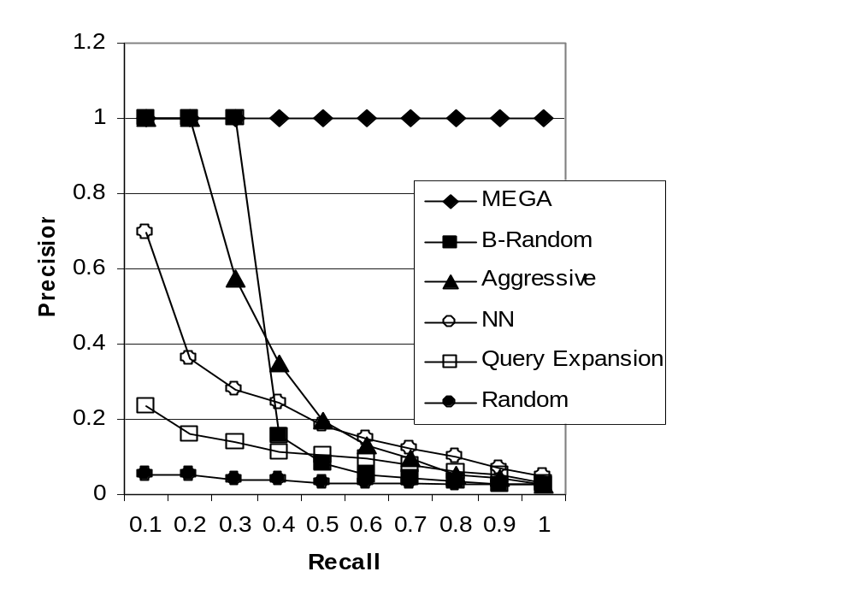

Learning the complex concept
( The third round)

Slide 28
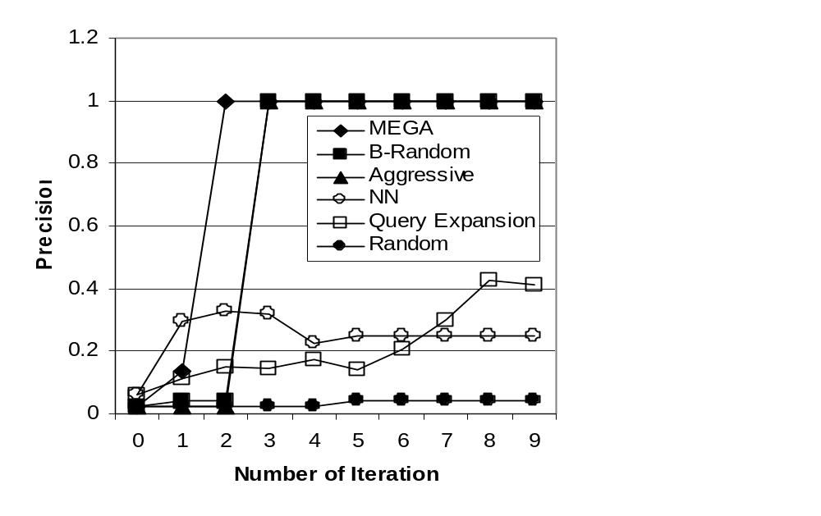
Learning (P1∨P2) ∧P3 ( Trend)

Slide 29
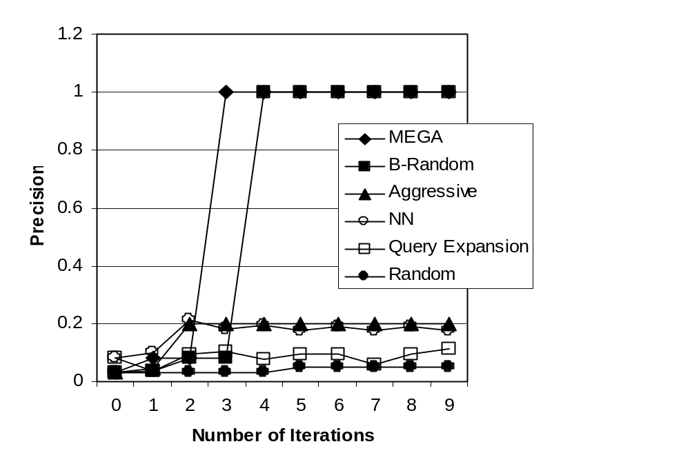
Learning the complex concept (Trend)

Slide 30
Model bias and User error tests
We also experimented under model bias and user error conditions. It is shown that MEGA can achieve a high precision rate in a small number of iterations under model bias condition. MEGA also can tolerate a certain level of user error (0%~15%). For detail, please refer to the publications ( on the end of this slide show).

Slide 31
Outlines
Background and Related Works
MEGA Algorithm and Experiments
Application on Image Dataset
A Novel Distance Function for Multimedia Database Retrieval
Conclusions
Future Work

Slide 32
Application on Image Dataset
Image Dataset:
2300 images from Corel image CDs and the internet. Each image is characterized by 144 features. We tested 18 query concepts: architecture, bears, big cities, clouds, elephants, …, waves.

Slide 33
Special Issues for Image Dataset
Feature dimension is high and if we treat all features simultaneously. We suffer from the “Curse of Dimensionality”. For 4-CNF, there are about 18 million terms in the initial QCS. For 3-CNF, there are still about 0.5 million terms.

Slide 34
Divide-and-conquer
We employed a divide-and-conquer method. Dividing features into G subgroups and only consider the disjunction terms within subgroups.
We will study how to divide features and how each factor affect the retrieval performance.

Slide 35
The effect of Negation
As previous stated, each image is characterized by a 144-dim feature vector. Each feature has a corresponding predicate. We further expanded our method to include negations of these predicates in the k-CNF formulae.

Slide 36
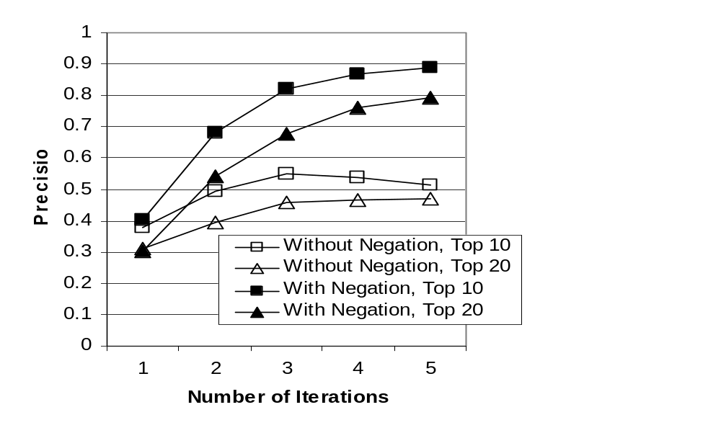

The effect of Negation (2)

Slide 37
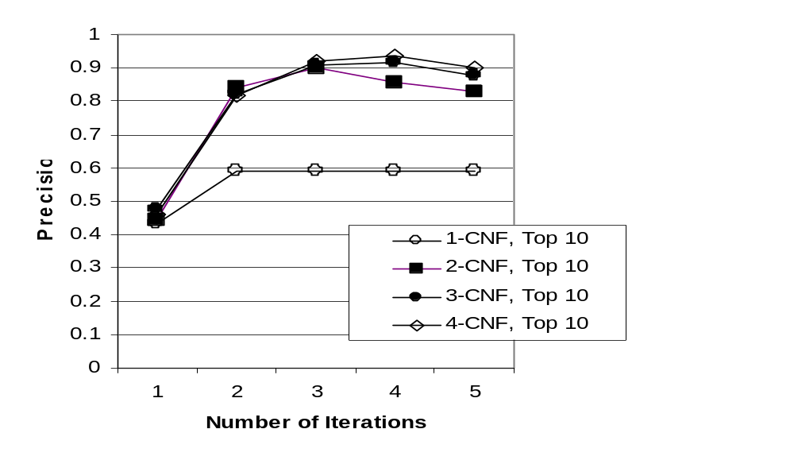
Precision of Top10 retrieval vs k

Slide 38
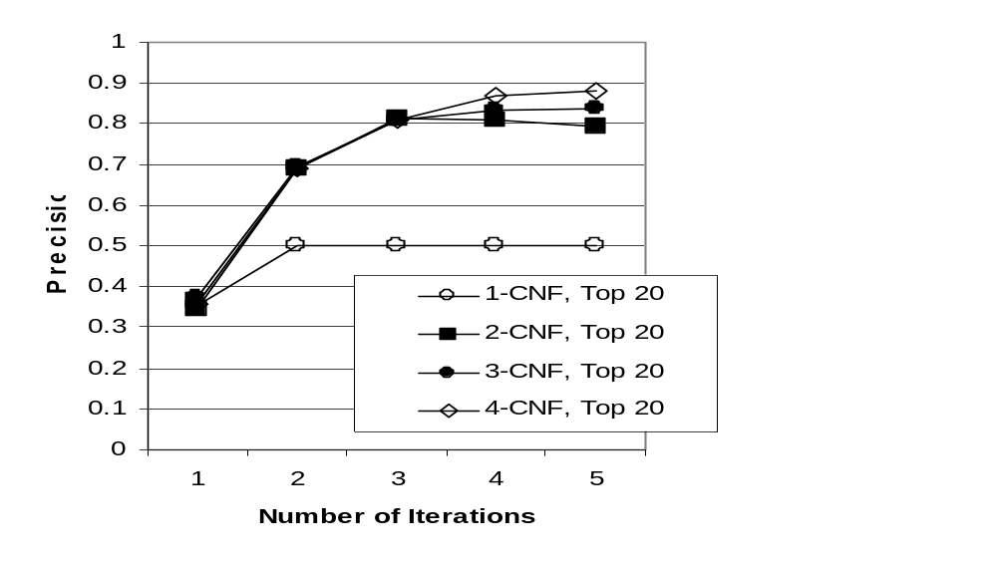
Precision of Top20 retrieval vs k

Slide 39
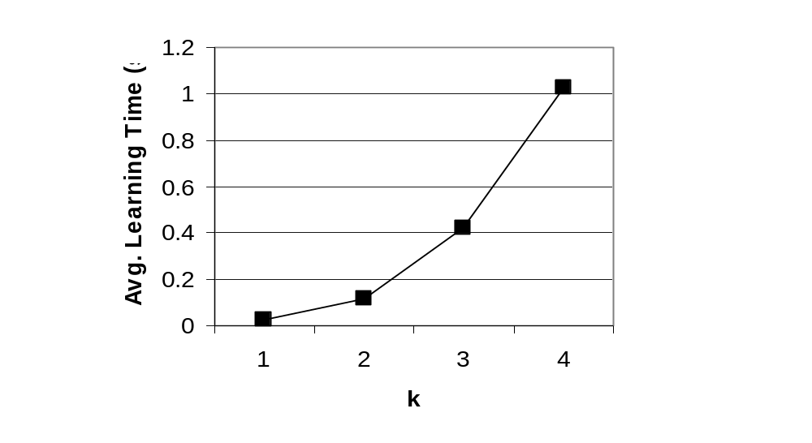
Learning time vs k

Slide 40
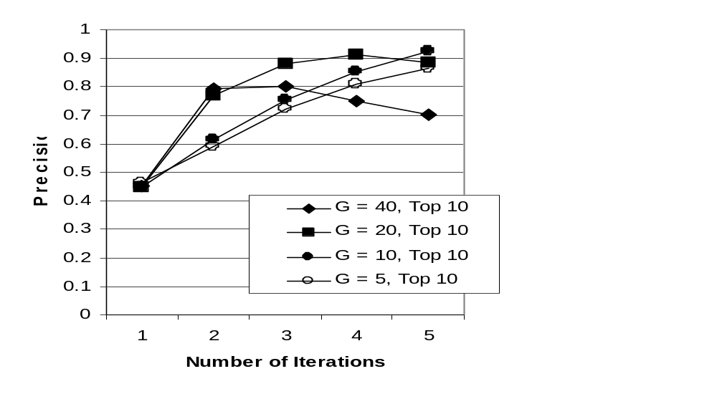
Effect of G

Slide 41
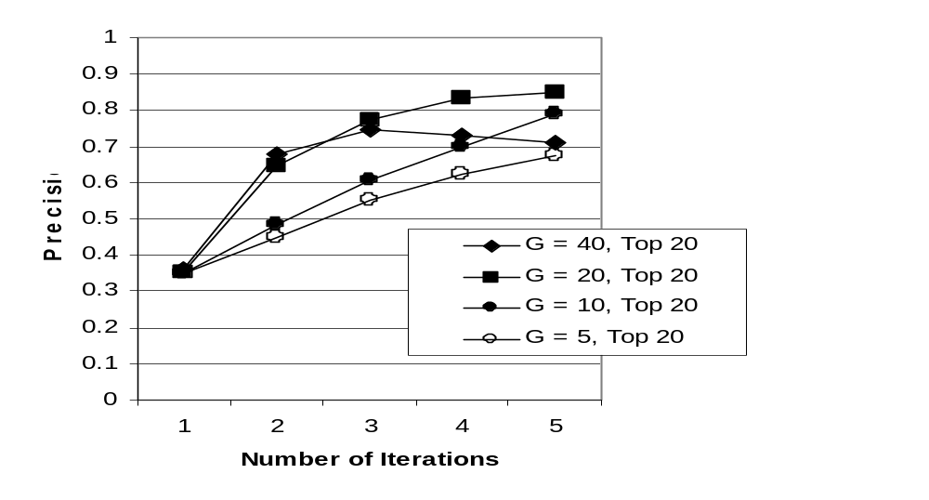
Top20 retrieval precision vs G

Slide 42
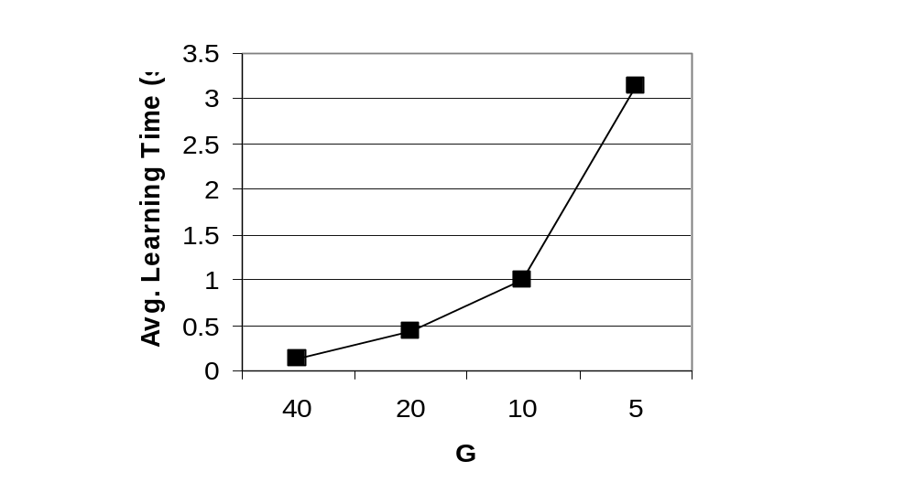
Learning time vs G

Slide 43
Discover Good Grouping
Based on previous experiments, we set G to 20 and model query concepts in 3-CNF. We need to find how to divide features into groups:
We used genetic algorithm to search for good groupings.

Slide 44
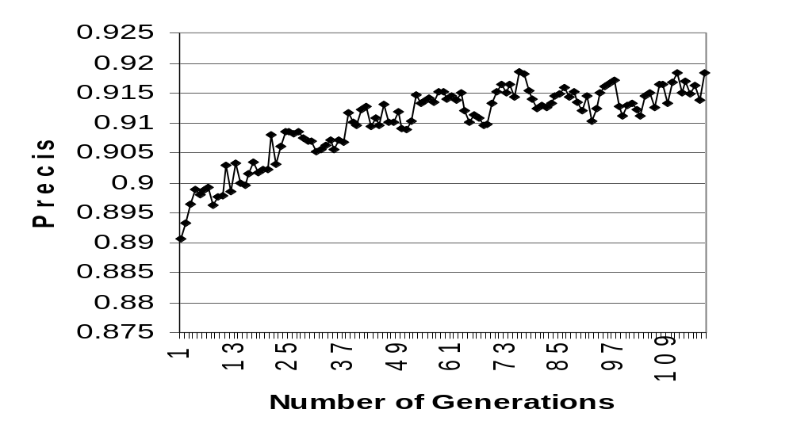
Average of highest precisions for each generation

Slide 45
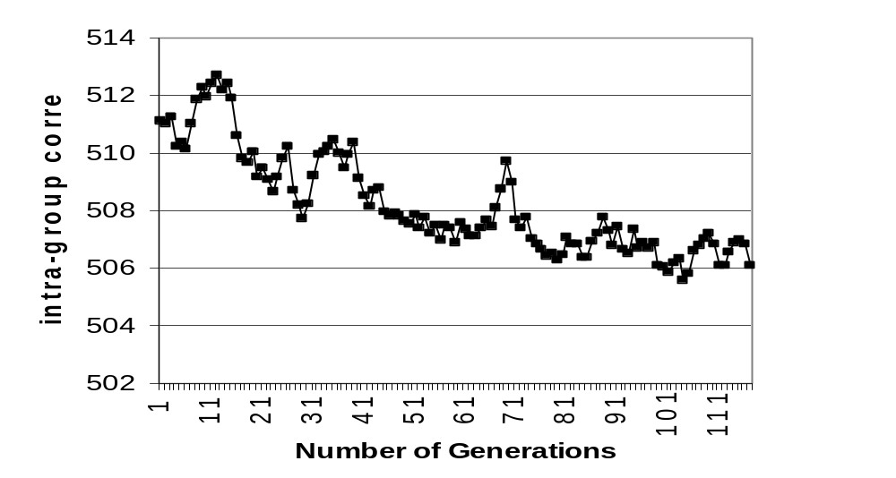
Intra-group correlation Vs. generation

Slide 46
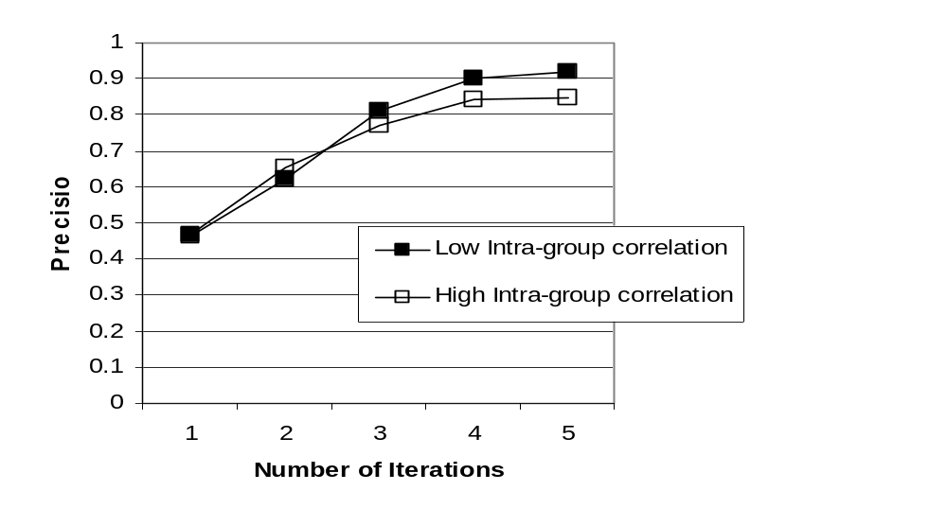

Slide 47
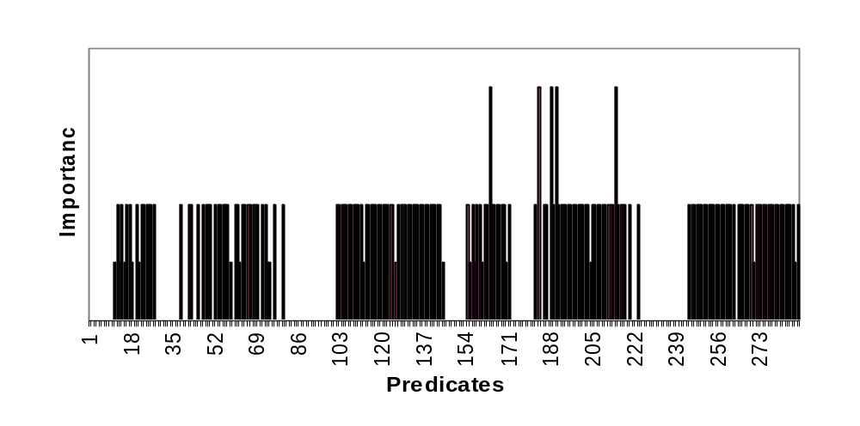
Concepts Learned
(1) Architecture

Slide 48
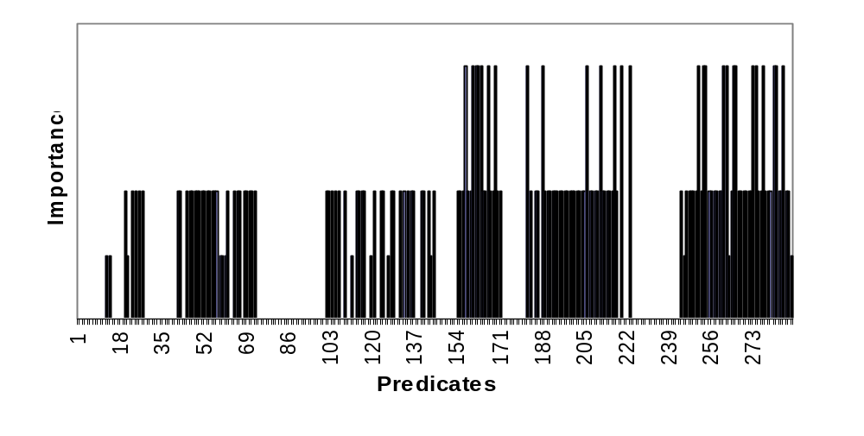
(2) Bears

Slide 49
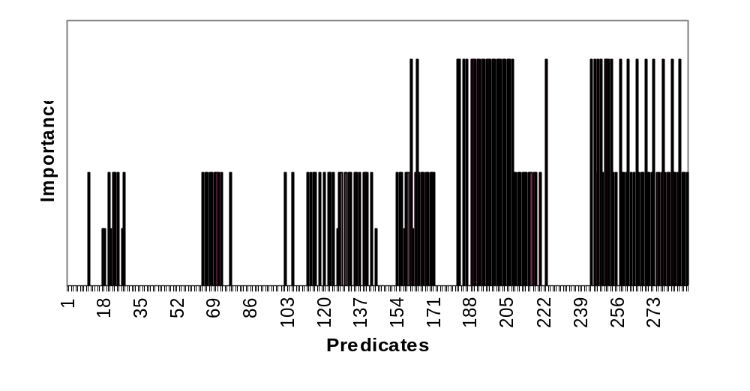
(3) Clouds

Slide 50
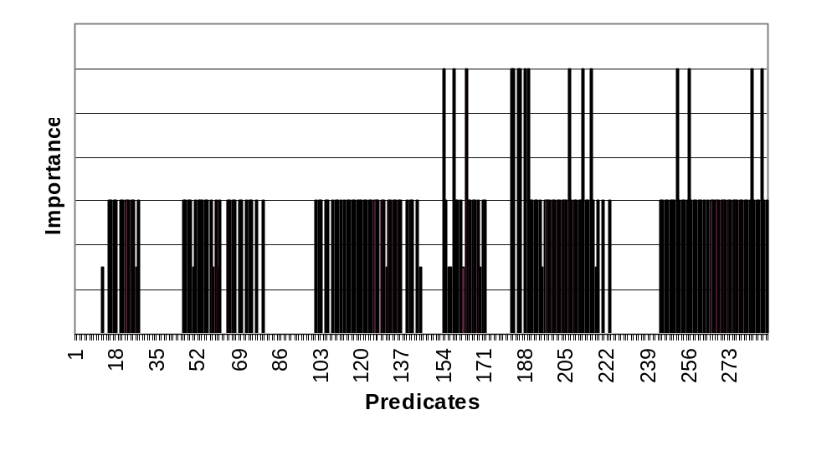
(4) Elephants

Slide 51
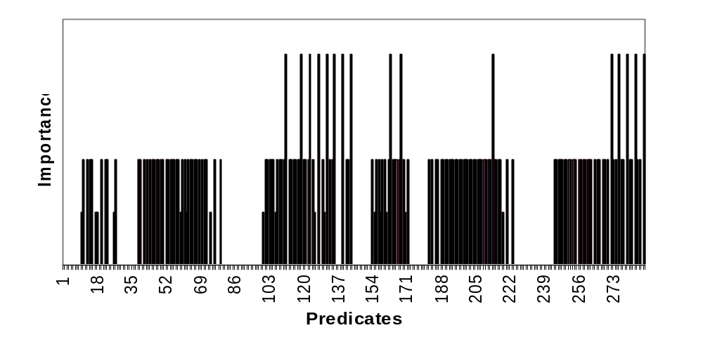
(5) Fabrics

Slide 52
Outlines
Background and Related Works
MEGA Algorithm and Experiments
Application on Image Dataset
A Novel Distance Function for Multimedia Database Retrieval
Conclusions
Future Work

Slide 53
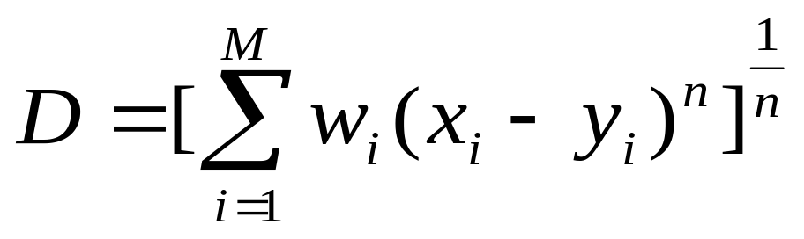
A Novel Distance Function For QBE
The distance between two objects are usually compute to characterize the similarity between them. It can be summarized as:
Where M is the dimension of feature vectors

Slide 54
Image Dataset
We select one image from each of the 18 categories as target image. Then we created 3 duplicate images, 3 rotation images, 5 scale up/down images, 5 cropped images, 1 GIF images and 6 down sampling images from each target image. we also manually select 7 similar images for each target image. So there are 30 relevant images for each target image. Then we put this testbed of 540 images into a 28k image database crawled from the internet.

Slide 55
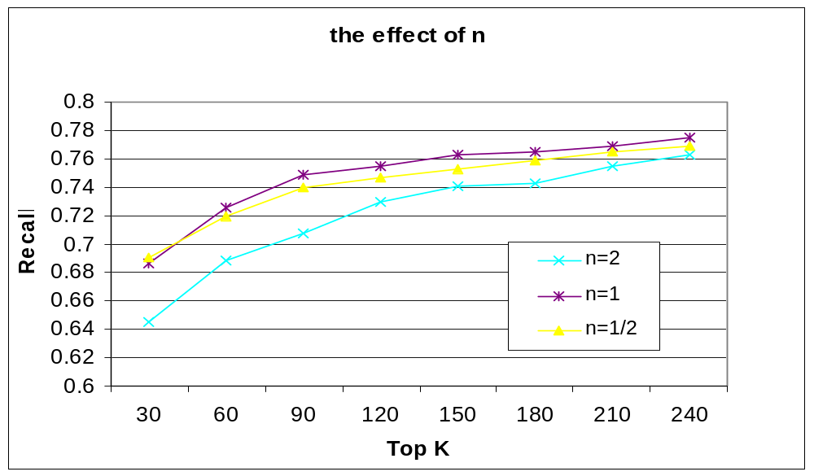
The effect of n

Slide 56
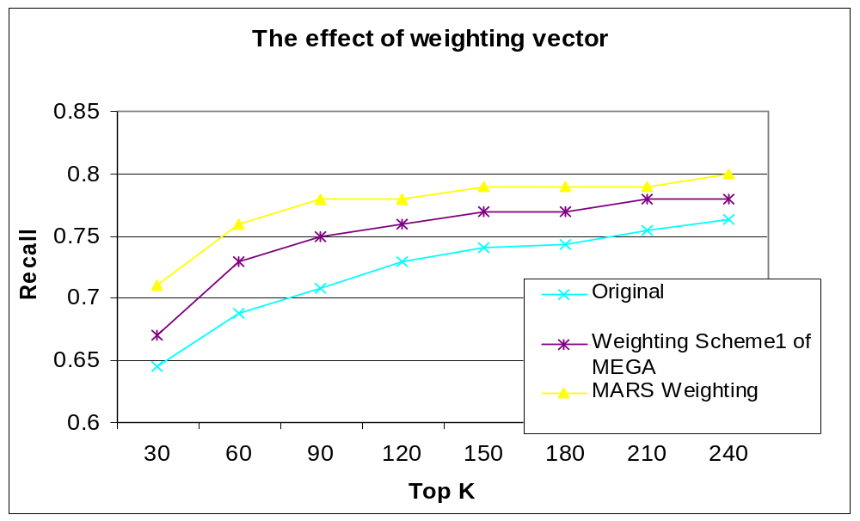
The effect of feature weighting

Slide 57
Observations
Based on extensive experiments, we observed that image transformations usually change certain features dramatically, while doesn’t have much effect on other features.
This motivates us to design distance functions which can take advantage of this property.

Slide 58
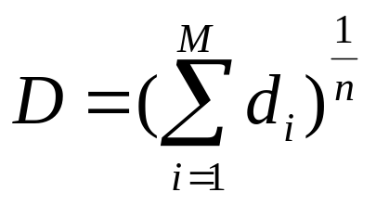
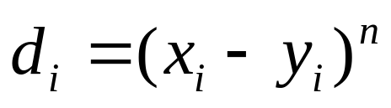
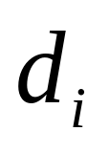
The new distance function
Normal distance is defined as:
Where
We define a new distance function:
D(m)= the sum of the m smallest

Slide 59
m is a tunable parameter which can range from 1 to M (Feature Dimension). The new distance only counts the m smallest
If m<M, it can avoid the situation when a few dramatically changed features dominate the distance measure.

Slide 60
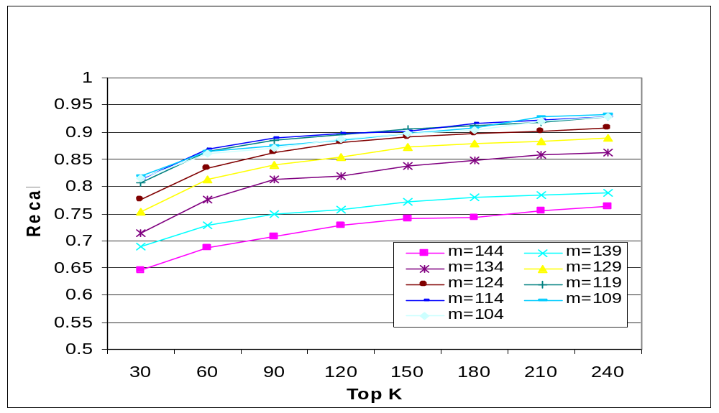
Retrieval Performance

Slide 61
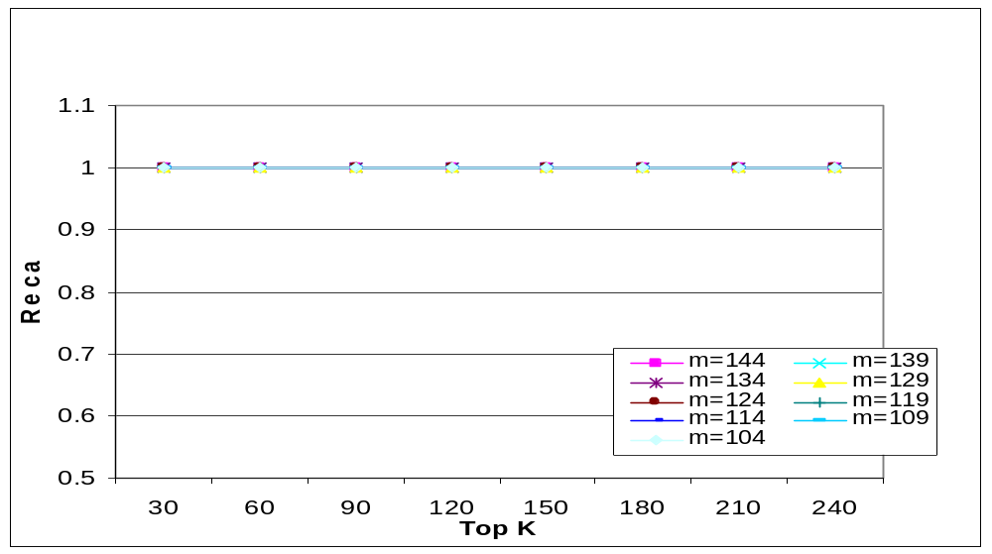
Retrieval Performance
(1) Replication, Rotation, GIF

Slide 62
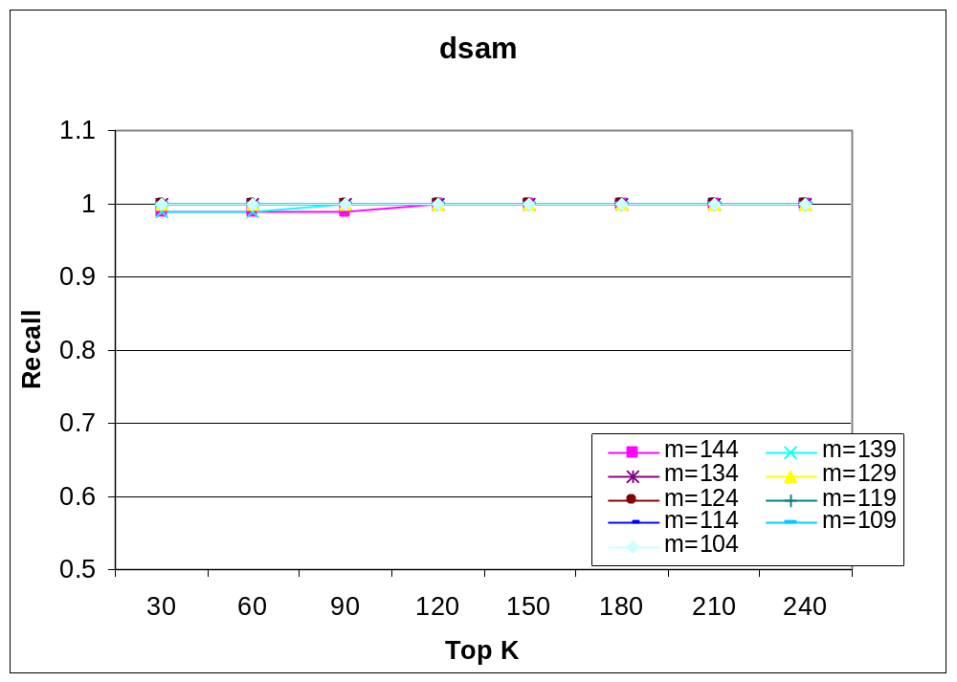
Retrieval Performance
(2) Down Sampling

Slide 63
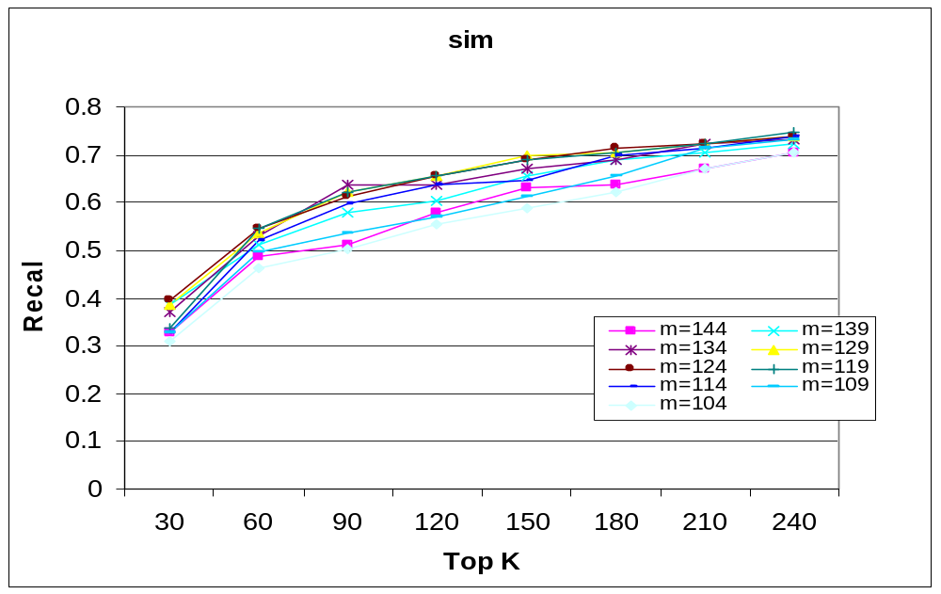
Retrieval Performance
(3) Similar Images

Slide 64
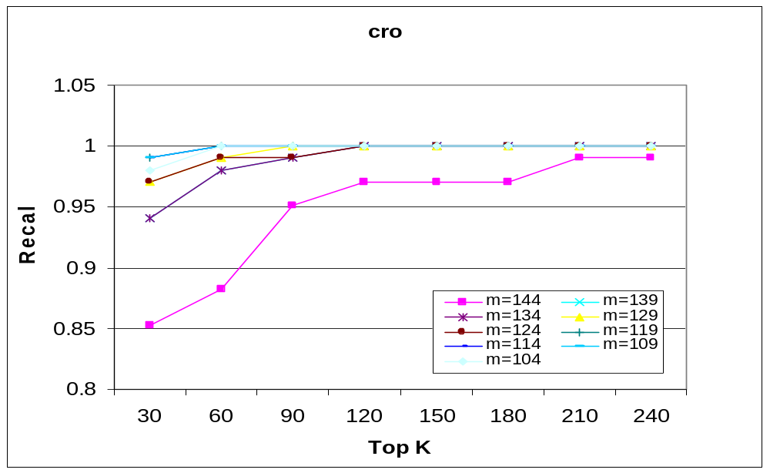
Retrieval Performance
(4) Cropped images

Slide 65
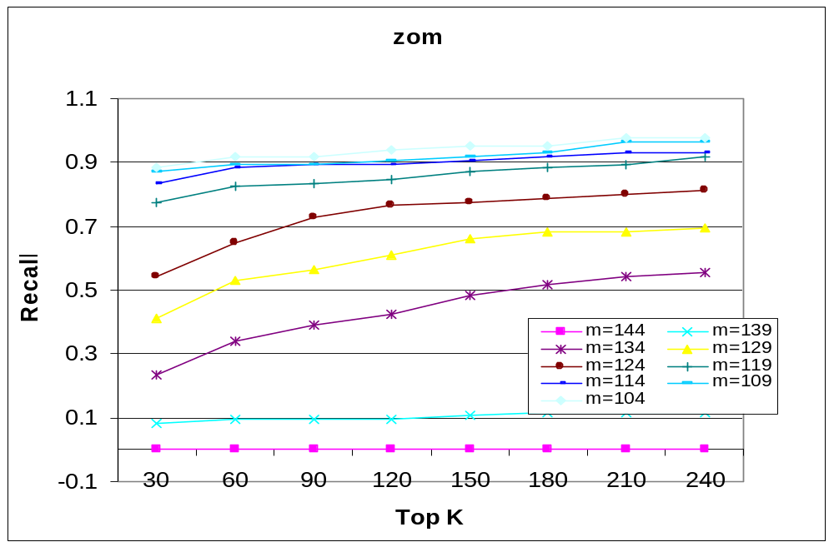
Retrieval Performance
(5) Scale up/down images

Slide 66
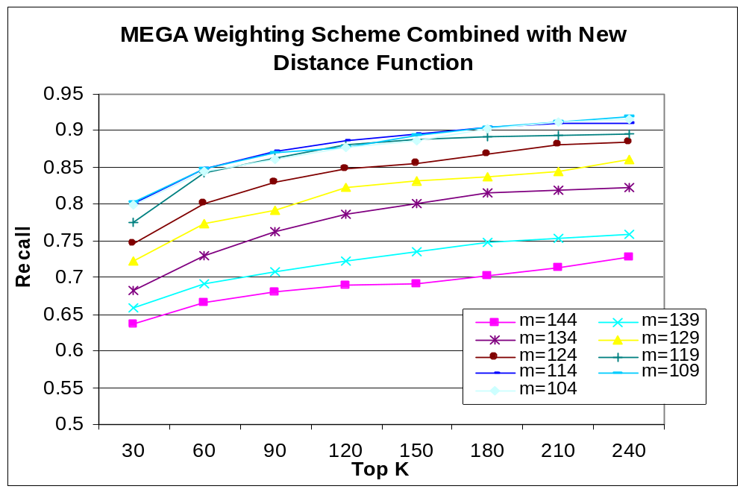
The new distance combined with weighting vector

Slide 67
Outlines
Background and Related Works
MEGA Algorithm and Experiments
Application on Image Dataset
A Novel Distance Function for Multimedia Database Retrieval
Conclusions
Future Work

Slide 68
Conclusions
MEGA converges much faster than other schemes.
MEGA out performs other schemes by a wide margin when the concept is in k-CNF even when a user’s concept is a weighted linear function, MEGA can approximate it pretty well. The fact that MEGA can achieve a high precision in a small number of iterations makes it an attractive online learning scheme.
MEGA does well under noisy conditions, including model bias and user errors.

Slide 69
Conclusion (2)
By setting k and G properly, we can achieve good search accuracy and space/time complexity tradeoff.
It is preferable to keep intra-group correlation small while dividing features into groups.
Genetic algorithm is effective in finding good groupings.

Slide 70
Conclusion (3)
The new distance function is less sensitive to dramatically changed features and thus can yield better performance while searching for transformed images.
The new distance function is effective in improving the performance of the existing weighting schemes.

Slide 71
Outlines
Background and Related Works
MEGA Algorithm and Experiments
Application on Image Dataset
A Novel Distance Function for Multimedia Database Retrieval
Conclusions
Future Work

Slide 72
Future Work
Short and medium Term Future Work:
1. Adaptive Sampling:
Dynamically estimate p in each iteration.
2. MEGA and SVM co-training:
MEGA and SVM can complement each other in sampling stage.
3. Formalize the process of selecting optimal m and n for the new distance function.

Slide 73
Long-Term Future Work:
1. Application of the new distance function on sampling and indexing.
2. Application of MEGA algorithm on video database.
3. Concept Drift Detection and Handling.

Slide 74
Publications
B. Li, W. Lai, E. Chang and T. Cheng, Mining Image Features for Efficient Query Processing, Proceedings of IEEE International Conference on Data Mining, November 2001, San Jose, CA.
B. Li, E. Chang, C-S Li. Learning Image Query Concepts via Intelligent Sampling, Proceedings of International Conference on Multimedia and Exposition, August 2001, Tokyo, Japan.

Slide 75
H. You, E. Chang, B. Li, NNEW: Nearest Neighbor Expansion by Weighting in Multimedia Database Retrieval, Proceedings of International Conference on Multimedia and Exposition, Tokyo, Japan.
E. Chang, B. Li, C. Li, Towards Perception-Based Image Retrieval, Proceedings of IEEE Workshop on Content-based Access of Image and Video Libraries, p.101-105, South Carolina, June, 2000.

Slide 76
B. Li, E. Chang, MEGA -- The Maximizing Expected Generalization Algorithm for Learning Complex Query Concepts, UCSB Technical Report, August 2001. (To be submitted to Journal)
B. Li, E. Chang et al. Renovate Minkowski Distance for Multimedia Database Retrieval. (Working Paper)

Slide 77
Thanks
Special thanks to Prof. Cheng, Larry Lai and Tony Wu.
Also thank all group members for enlightening discussions.
Thank everyone attending my qualifying exam.
Questions?

