Slide 1
Improving Support Vector Machines
Gang Wu
MMDB Group
Department of ECE, UCSB

Slide 2
Outline
Motivation
What We have Done
Related Work
Proposed Solutions
Future Work

Slide 3
Motivation for Improving SVMs
Emerging Applications of Imbalanced Data Sets
  Gene profiling
  Image understanding
Failure of SVM in the Imbalance Case
  High false negatives
Not a Closely Approximation of the Bayes Point

Slide 4
What are the Problems?
The severely skewed class-boundary
The theoretically non-optimal classifier

Slide 5
The Skewed Boundary
The non-target class heavily outnumbers the target class
Excessively high false-negative rate in identifying target objects
The class-boundary severely skewed towards the target class

Slide 6
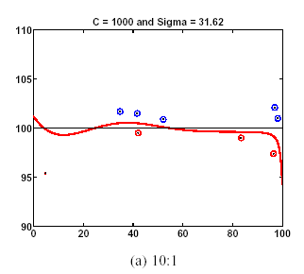
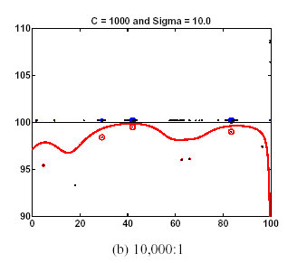
A Checkerboard Example
Boundaries of Different Ratios
Note: Ratio = Negatives/Positives

Slide 7
What are the Problems?
The severely skewed class-boundary
The theoretically non-optimal classifier

Slide 8
The Non-Optimal Classifier
Theoretically, the optimal classifier is the Bayes point.
The Bayes point is closed approximated by the center of mass. [T. Watkin93] [R. Herbrich00]
The SVM solution is the center of the largest sphere contained in “version space”. [J.S. Taylor97]

Slide 9
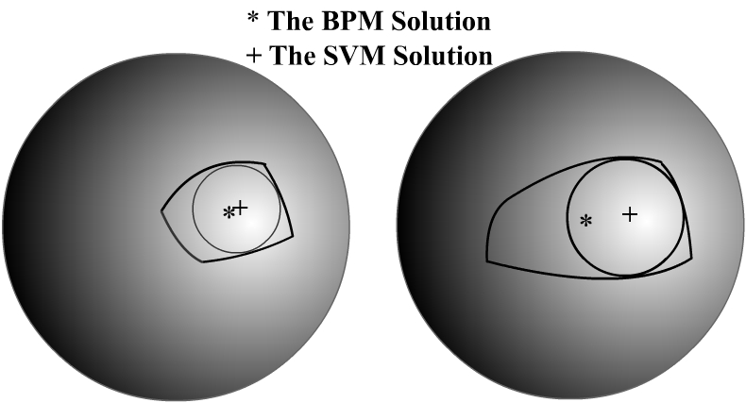
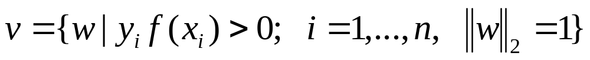
A Version Space Example
Version Space:

Slide 10
Outline
Motivation
What We have Done
Related Work
Proposed Solutions
Future Work

Slide 11
What We have Done(1)
Improving Support Vector Machines for Learning on Imbalance Data sets. [ Submitted to CVPR03]
  Conclude algorithmic and data-processing approaches for imbalance training.
  Propose a Quasi-bagging(QB) approach.
  Modify adaptive conformal transformation(ACT).
  Propose a hybrid algorithm which combines data denoising, QB and ACT together.

Slide 12
What We have Done(2)
Comparing Bayes Point Machines to Support Vector Machines on Image Classification. [Accepted by ICME02]

Slide 13
Outline
Motivation
What We have Done
Related Work
Proposed Solutions
Future Work

Slide 14
Related Work
Imbalance Training
  Sampling methods
  Algorithmic methods
Bayes Point Approximation
  Bayes Point Machines

Slide 15
Sampling Methods
Subsample the majority class: --remove examples in the majority class. [Breiman96] [Kubart97] [Chan98]
Oversample the minority class: --duplicate or interpolate examples in the minority instances. [Breiman84] [N. Chawla00]

Slide 16
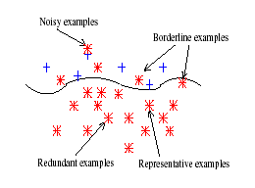
Illustration of Negatives
: Negative (majority) instance
: Positive (minority) instance

Slide 17
Subsampling
Bagging[Breiman96]
  Sample many subsets for both classes
  Reduce prediction variance
  50% without-replacement and 100% with-replacement
One-sided-selection[Kubart97]
  Sample representative majority instances
  Remove noisy and borderline majority instances
  Have a high computational cost
  Be not helpful on a dataset with a larger class skew
Multi-classifier training[Chan98]
  Sample many subsets just from the majority class
  Independent subsets

Slide 18
Oversampling
A “phantom-transduction” method
Assume the neigborhood of a minority instance to be positive in input space.
Assume the instances between two minority instance to be positive in input space.
Assume a new generated positive instance to be meaningful.

Slide 19
Algorithmic methods
Modify training algorithms
  Nugroho et. al[02] suggest to combine competitive learning network and multilayer perceptron.
  Kubart et. al[97] create a SHRINK learning system by modifying the decision-tree generator
  Veropoulos et. al[99] and Lin et. al[02] use different penalty constants for different classes of data.
  Amari et. al[99, 01] propose using conformal transformation to change the spatial resolution at the class boundary

Slide 20
Related Work
Imbalance Training
Bayes Point Approximation

Slide 21

Bayes Point Approximation
Approximate the Bayes Point by the center of mass[T. Watkin93].
Use a Monte Carlo method to sample the center of mass in version space, called a Bayes Point Machine[R. Herbrich00].
  Billiard ball algorithm[Rujan97, 00] --Large computational demands.
  Perceptron learning algorithm[T. Watkin93] --Lower precision.
  Corner algorithm[Rychetsky00] -- O(n³) for inversion of a Gram matrix.

Slide 22
Outline
Motivation
What We have Done
Related Work
Proposed Solutions
Future Work

Slide 23
Proposed Solutions
Tackling the Imbalanced Training
Bayes Point Machines

Slide 24
The Class Imbalance Problem
The class-boundary learned by SVMs can be severely skewed towards the target class. [Kubat97] [P. Chan98] [Karakoulas99] [Veropoulos99] [N. Chaw00] [L. Yi00] [Weiss01], and [Nugroho02]
As a result, the false-negative rate can be excessively high in identifying target objects

Slide 25
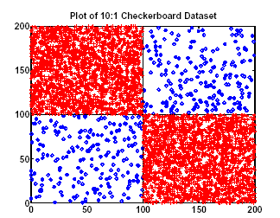
A Checkerboard Experiment

Slide 26
Boundary Bias
Boundaries of Different Ratios
Note: Ratio = Negatives/Positives

Slide 27





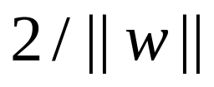
Linear Support Vector Machines(Separable)
Given training data and their lables , where
All the training data satisfy
A separating hyperplane has
Margin =
Maximize margin by minimizing ||w||²

Slide 28
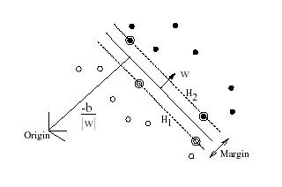
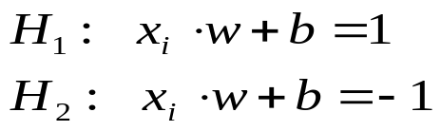
Illustration of Linear SVMs
The support vectors are circled

Slide 29
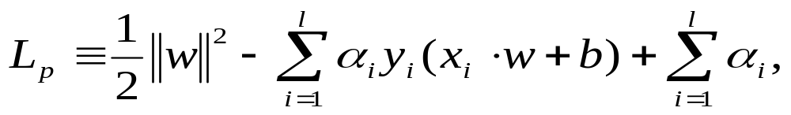


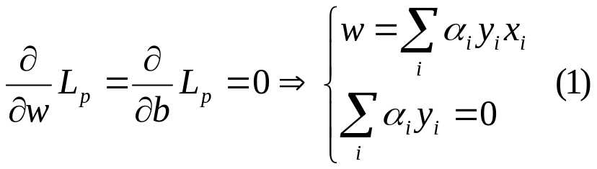
L_{P} Langrangian Formulation
W are solved by minimizing a its primal Lagrangian formulation[Vapnik95]
where are positive Lagrange multipliers.
Then

Slide 30
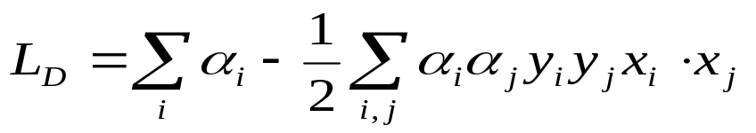

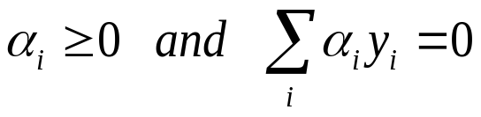
L_{D} Wolfe Dual Formulation
Substitute (1) into L_{P} to give the Wolfe dual L_{D} [Fletcher87]
Support vector training therefore amounts to maximizing L_{D} with respect to , subject to

Slide 31


The Karush-Kuhn-Tucker Conditions
KKT conditions play a central role in constrained optimaization.
For L_{P} and L_{D}, KKT conditions are
The total weights of the positive support vector must be equal to those of the negative support vectors

Slide 32


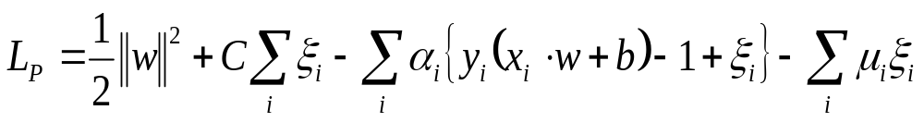
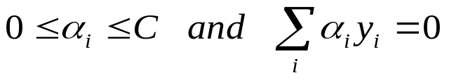
Linear Support Vector Machines(Non-Separable)
Introduce positive slack varaibles [Cortes and Vapnik95]
All the training data satisfy
The primal Lagrangian is:
The Wolfe dual problem becomes:
subject to

Slide 33

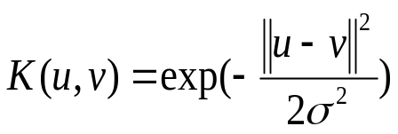
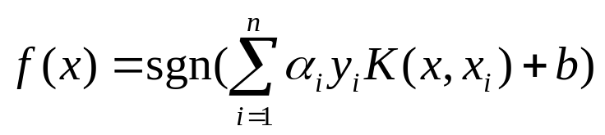
Nonlinear Support Vector Machines
Project the training data in input space S to a higher dimensional feature space F via Mercer kernel operator K.
K(x_{i}, x_{j})=Φ(x_{i})·Φ(x_{j}) , Φ: S-> F.
Some common kernel functions:
Polynomial kernel:
Gaussian RBF kernel:
Prediction function for soft-margin SVMs is

Slide 34
Causes of Skewed Boundary
The imbalanced training-data ratio
The imbalanced support-vector ratio

Slide 35
The Imbalanced Training-Data Ratio
The minority training data might not reside as close to the ideal boundary as the majority training data.
The low presence of the minority training data makes them appear farther from the ideal boundary than the majority training data

Slide 36
Causes of Skewed Boundary
The imbalanced training-data ratio
The imbalanced support-vector ratio

Slide 37
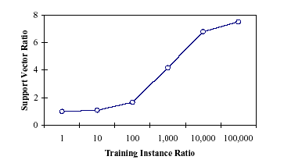
The Imbalanced Support-Vector Ratio
The nearest neighborhood of a testing point, especially when it is near the boundary, is likely to be dominated by negative support vectors

Slide 38
Solutions for the Imbalanced Training
Algorithmic approach
Data-processing approach
A Hybrid approach

Slide 39
Algorithmic Approach
b.

