Slide 1
ECE154
Computer Architecture
Lecture #10
Cache
Edward Chang
Electrical & Computer Engineering

Slide 2
Announcement
HW#4
  Posted today
  Due on 2/24

Slide 3
Outline
ABCs of Cache
Cache Performance
Reducing Cache Miss Penalty
Reducing Cache Miss Rate
Parallelism
Reducing Hit Time

Slide 4
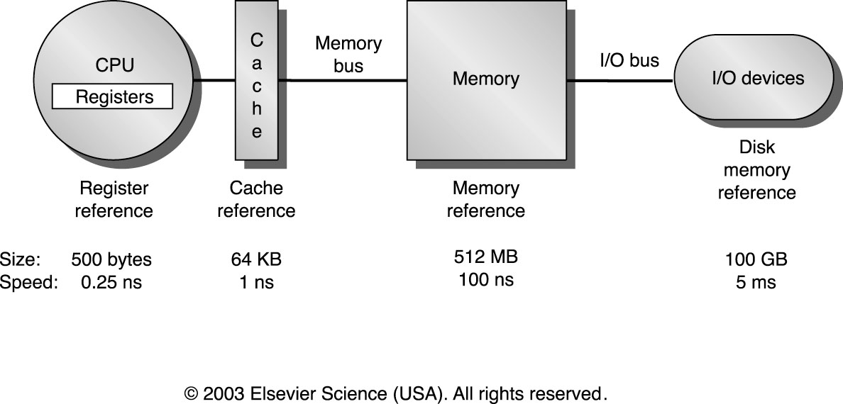
Memory Hierarchy

Slide 5
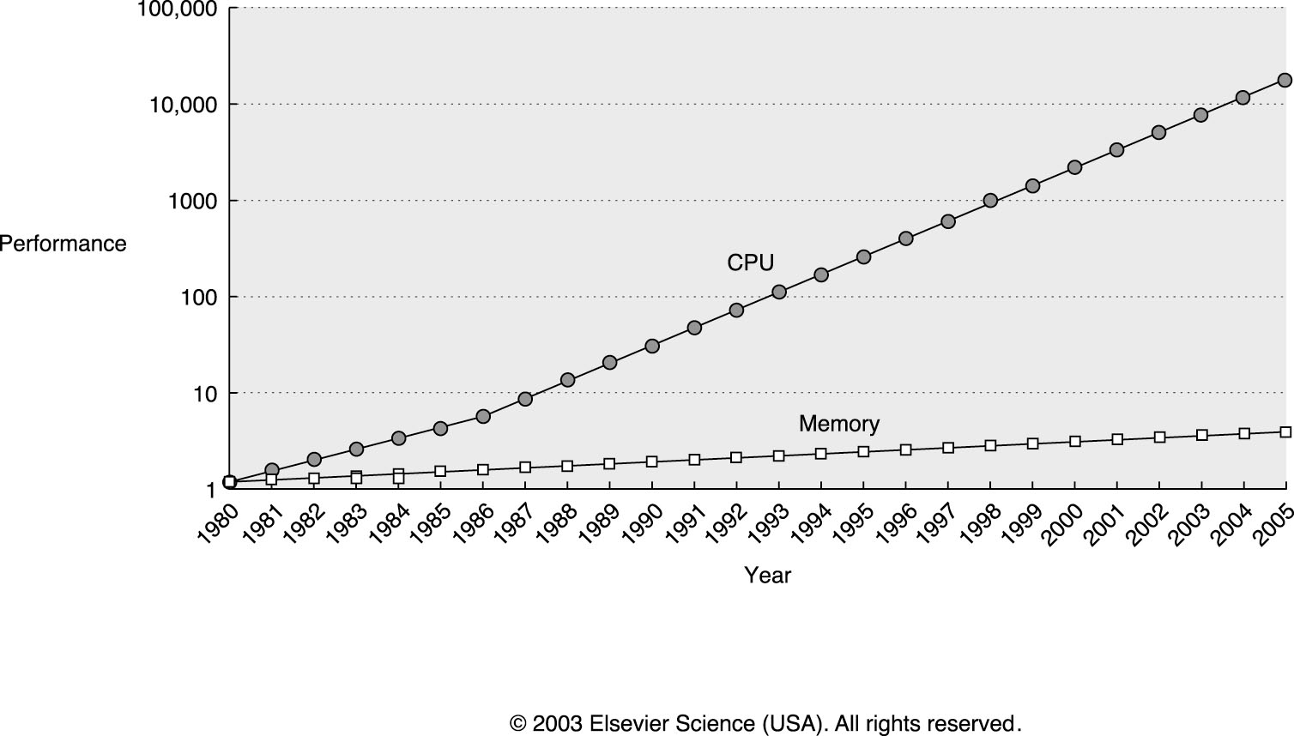
CPU Memory Performance Gap
1.55
200!
1.35
1.07

Slide 6
Quantify in CPU Cycles
CPU Cycle Time
  .5 ns (2 GHz)
DRAM Access
  30 ns
  10-100 CPU cycles
Memory Access
  50-100 ns
  DRAM + overheads (controller, chip crossing)
  25-200 cycles
Disk Access
  10 ms
  10⁶ cycles
Problem Exacerbates
  Memory gets bigger, data larger, clock frequencies faster

Slide 7
Memory Hierarchy
Cache
DRAM
Disk
Fast
Expensive
Slow
Cheap
Ideal memory: as fast as the top, and as cheap as the bottom level

Slide 8
Principle of Locality
A program does not access its instructions uniformly
for (i=1000; i>0; i--)
x[i] = x[i] + s;
Locality
  Spatial locality
  Temporal locality

Slide 9
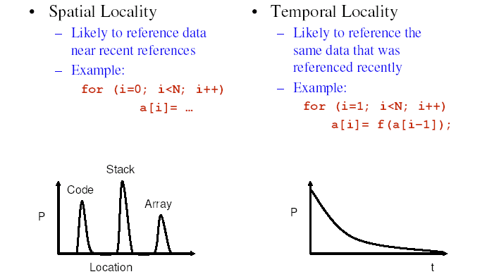
Locality

Slide 10
Cache ABC
Caches
  Organized as collections of memory blocks
  Can have multiple levels
  Can be different at different levels
Block Size
  A multiple of processor word size (64 bits)
  In bytes 2^{k}
Memory Address
  Block address
  Offset

Slide 11
Memory Address
Assume 64-bit address
Examples
  Block size 8 bytes
    3 bits offset
    64-3=61 bits for block address
  Block size 32 bytes
    5 bits offset
    59 bits for block address

Slide 12
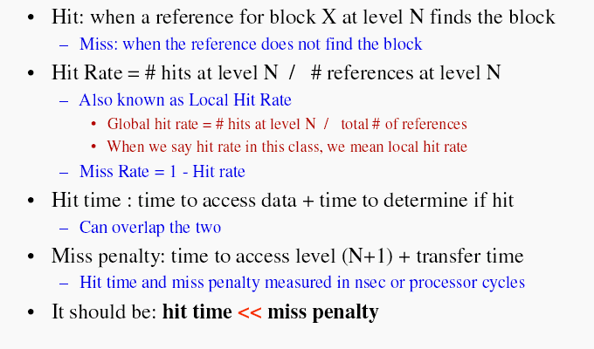
Hit

Slide 13
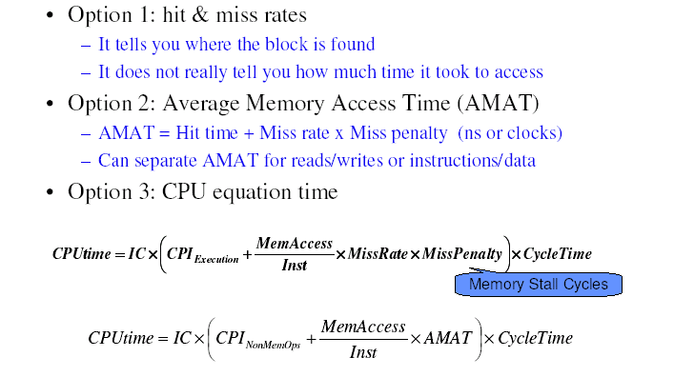
Cache Performance Metrics

Slide 14
Warm-up Example AMAT
Suppose CPI = 1 when all memory accesses hit in the cache. Suppose the miss penalty is 25 cycles and the miss rate is 2%.
What is AMAT ?
  AMAT = 1 + 2% × 25 = 1.5 cycles

Slide 15
Read/Write AMAT
Suppose CPI = 1 when all memory accesses hit in the cache. Suppose the miss penalty for read is 25 cycles and the miss rate is 1% and for write is 40 cycles and 2%.
What is AMAT ?
  AMAT_{read} = 1 + 1% × 25 = 1.25
  AMAT_{write} = 1 + 2% × 40 = 1.8

Slide 16
CPI
Suppose CPI = 1 when all memory accesses hit in the cache. Suppose the miss penalty is 25 cycles and the miss rate is 2%.
Suppose we have a instruction & data integrated cache
Suppose 30% load, 20% store, 40% ALU, and 10% branch instructions
What is the CPI ?
  1 + (30% +20% + 100%) × 2% × 25 = 1.75

Slide 17
Cache Performance Metrics

Slide 18
Example 2
Suppose CPI = 1 when all memory accesses hit in the cache. Suppose the miss penalty is 25 cycles and the miss rate is 2%, and 50% load/store instructions.
How much faster would the computer be if all instructions were cache hit ?
CPU time (perfect) = (CPU clock cycle + memory stall cycles) × clock cycle = (IC × CPI + 0) × clock cycle = IC × 1 × clock cycle
Memory stall = IC × (memory access/#instructions) × AMAT = IC × (1+50%) × .02× 25 = IC × .75
CPUperfect/CPUmiss = (1 + .75)/1 = 1.75

Slide 19
…Continue
Compute Miss per Instruction
Miss rate × #memory accesses/ #instructions
0.02 × 1.5 = 0.030
CPI per instruction = 1 + 0.03 × 25 = 1.75

Slide 20
Four Key Questions
Block Placement
  Where can a block be placed in the upper level?
Block Identification
  How is a block found if it is in the upper level?
Block Replacement
  Which block should be replaced on a miss?
Write Strategy
  What happens on a write?

Slide 21
Block Placement
Direct Map
  Each block has only one place to be placed
  Block address mod number of blocks in cache
Fully Associative
  A block can be placed anywhere in cache
Set Associative
  Cache is divided into sets, and a block can be placed in anywhere of only one selected set
N-way set Associative
  If there is N blocks in a set

Slide 22
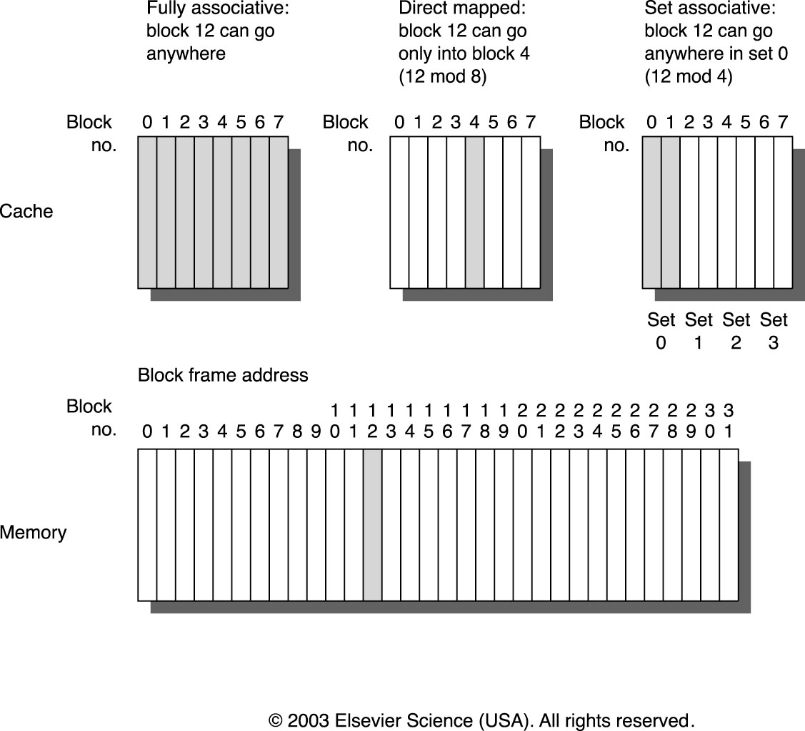
Placement

Slide 23
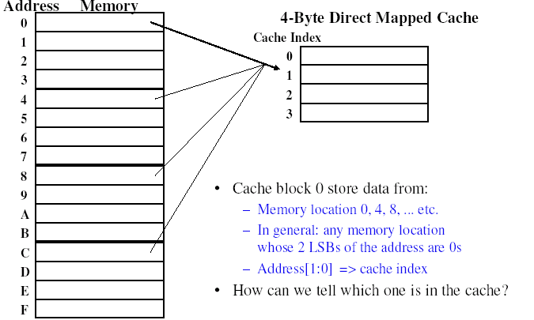
Direct Mapped

Slide 24
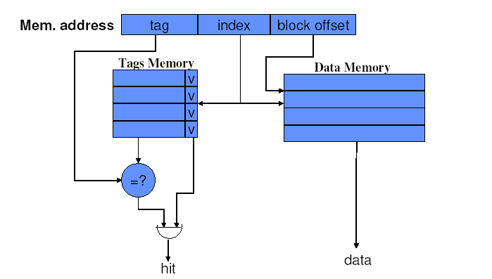
Direct Mapped

Slide 25
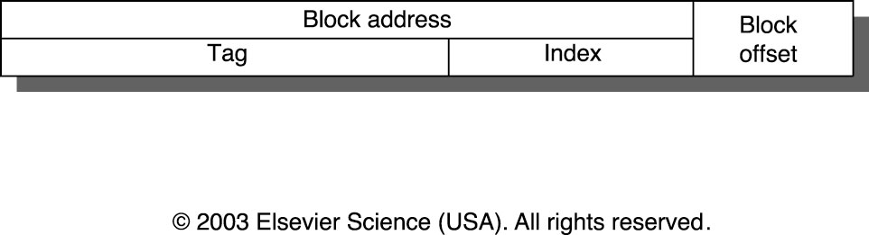
Block Identification
Valid bit
Tag
Index
Block offset
Increased associativity

Slide 26
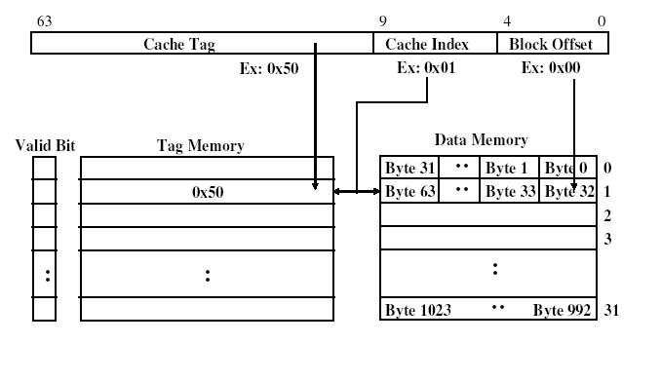
1KB Direct Mapped with 32Byte Blocks

Slide 27
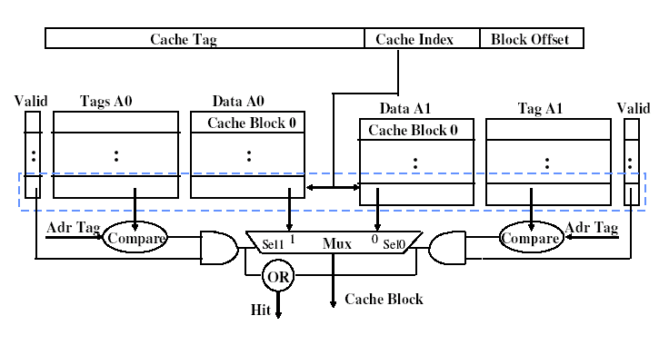
Two-way Associative Cache

Slide 28
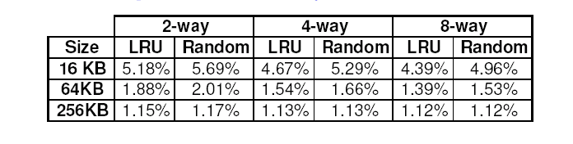
Block Replacement
Cache full, which entry to be replaced?
Direct mapped: simple, no other choices but one
Associative cache: replace the least useful entry
  LRU: least recently used
  Random
  FIFO
Which is the simplest to implement?

Slide 29
Write Policy (Hit)
Write hits are slower than read hits
  Check tag then write data
  For a read, tag check and read can be done in parallel
Write through
  Data written to both the block in the cache and the lower-level memory
  Pros: easy to implement
  Cons: creating a high volume of bus traffic
Write back
  Write only to the cache and mark block dirty
  Writes are faster, but ...

Slide 30
Write Back Pros & Cons
Pros
  Writes are faster,
  Less bus traffic
Cons
  Read misses may generate a write-back for a dirty block
  Main memory is not up-to-date (IO and multiprocessor problems)

Slide 31
Write Buffer for Write Through
Cache
Processor
Memory
Write Buffer
Write through can be bufferred
Write buffer is just a FIFO
  Typically four entries
  Process writes to cache and write buffer
  Memory controller writes from buffer to memory

Slide 32
Write Policy (Miss)
If a word being written is not in the cache, what happens?
No write allocate
  Write to memory without involving cache
  Used by write-through caches
Write allocate, fetch-on-miss
  Fetch the block as if a read miss then treat it as write hit
  Used by write-back caches
Write allocate, no fetch-on-miss

Slide 33
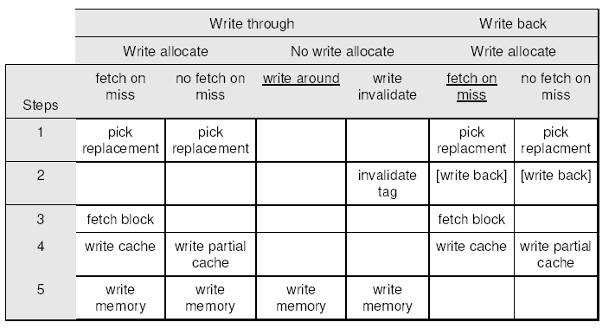
Write Strategy

Slide 34
Improve Cache Performance
AMAT = Hit Time + Miss Rate * Miss Penalty
Options
  Reduce hit time
  Reduce miss rate
  Reduce miss penalty
Comments
  These goals may conflict
  Other factors (clock cycle time) to watch out

Slide 35
Summary
Memory Hierarchy
Basic Cache Options
Next Time
  Cache performance improvement

Slide 36
Midterm Statistics
22
9
15
7
5
2
60 50 40 30 20

Slide 37
References
Textbook figures, publisher
Lecture notes, prof. Kozyrakis, Stanford

