Slide 1


Presentation for Runway Ventures

Slide 2
Business Opportunity
Explosive growth of multimedia content
Growing demands for new technologies and solutions for retrieving, organizing and filtering multimedia data
Notes:
Proliferation of digital input devices (cameras, scanners)
Multimedia-based Web replacing text-based
80B new images created annually
Search tools inadequate: if you can’t find it, is it there?
Open digital access creates issues of appropriateness, bandwidth, liability – and need for controls
Classification task (image → text) is daunting
Internet & web vs. library – physical limitations of access are gone. Questions of apprpriateness up to serious proportions. Congress CIPA.
Legal liability – exposure to harrassment lawsuits, loss of employees, lost productivity
Bandwidth

Slide 3
Vision
To become the leading provider of visual analysis software for multimedia filtering, retrieval and organization applications – serving licensed business partners, private
and public organizations, and the individual.

Slide 4
Founding Spark
“How can we get a computer to recognize pictures the way a person does?”
Perception-Based Image Retrieval (PBIR)
  Creates a perceptual map
  Learns from user feedback
  Artificial intelligence + cognitive psychology
Notes:
May find an image that you otherwise would not have found at all.

Slide 5
Demo
MorphoSeek – Visual Search Engine
Notes:
Perception-Based Image Search Engine
Helps users of image content providers find the desired images visually
Helps shoppers browse & search products visually
Can be integrated seamlessly with existing keyword-based search to substantially shorten search time and effort
Superior to existing content-based solutions

Slide 6
How Does it Work?
Four Horsemen of PBIR
  Feature extraction
  Learner
  Indexer
  Multi-modal weighting
Complex to explain – simple to see
Notes:
Maps 150 ‘features’ into multi-dimensional space
Learns user’s concept quickly – typically 2-4 iterations < 1 min.
High-speed index clustering uses statistical approaches to conduct image search efficiently – small, scalable
Multi-modal weighting: Complex image features, textual hints and learning algorithm
Effectively represent image data and
measure similarity according to human
perception
Eliminate the seeding requirement
Can tolerate model bias and user errors
Scalable dataset size & features, maintains fast retrieval speed (a fraction of a second)

Slide 7
Initial Markets
Visual Search
Image & Website Filtering

Slide 8
Visual Search Customers
Content providers
Ecommerce companies
Search engines
Enterprises with multimedia databases
Notes:
Content Providers:
On-line image library sale (Yahoo! Picture Gallery, Getty Images, Corbis, Masters of Photography)
Visual merchandising and product browsing
Auction sites (sell-side) and on-line shopping sites
Search engines:
Backend service to existing major text-based image search engines (Google, AltaVista, etc.)
Multimedia database
Entertainment, news media, advertising, etc. (CNN, Warner)
Private enterprise image search capability (like Google’s)
Helps users of image content providers find the desired images visually
Helps shoppers browse & search products visually
Can be integrated seamlessly with existing keyword-based search to substantially shorten search time and effort

Slide 9
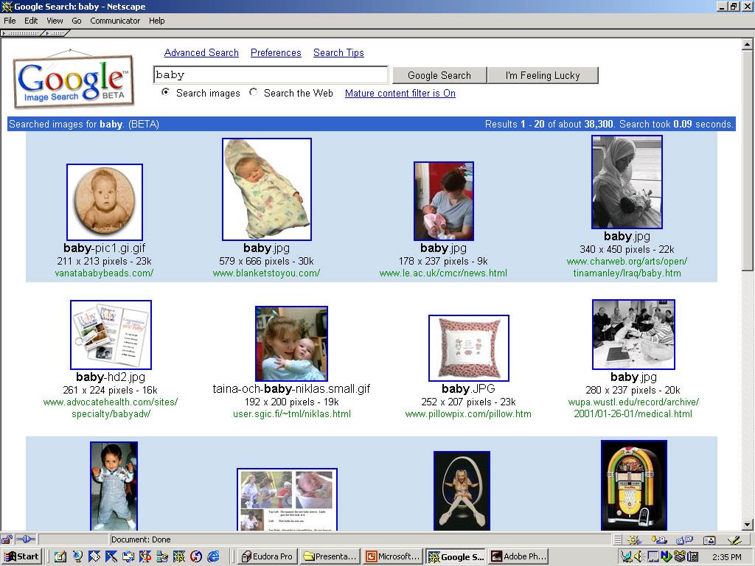
Text-based image search limitations….
Notes:
Google example: search for “baby”:
pillow, spice girls (& brittney) -- and 38,000+ results!
Later: CPU heatsink, elephant, Ford Taurus, etc.
Articulating a concept is hard
Articulation can be subjective
An image is perceived differently by different people
Even the perception is the same, different users may use different vocabulary to depict it
Often too many matches for a popular keyword
Search for “landscape” in Yahoo Picture Gallery returns 1944 images.

Slide 10
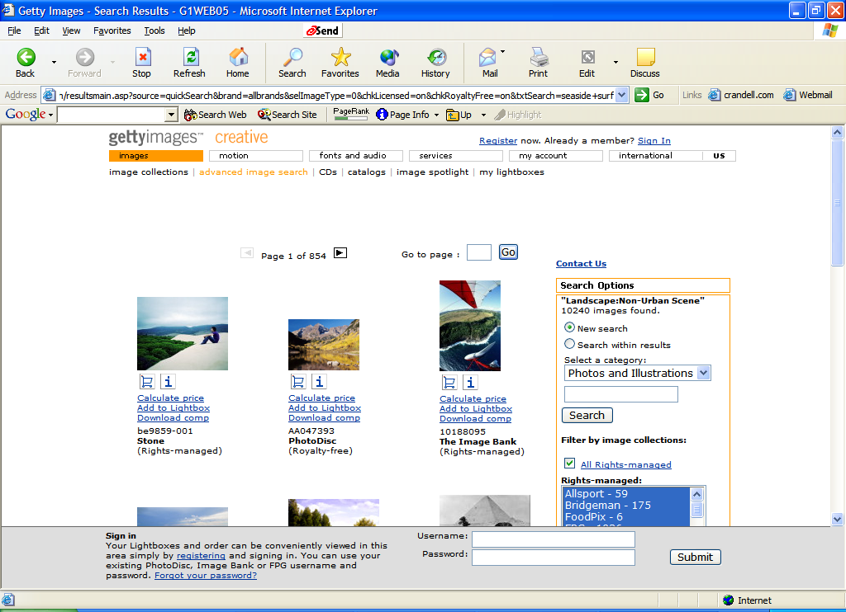

Slide 11
Competition
eVision
LTU Technologies
Convera RetrievalWare
Cobion
Visfinity
Notes:
Who is each funded by – size & focus?
CBIR vs. PBIR
eVision
LTU
Convera
Queried by aspect ratio, brightness, global color, local color, shape and texture attributes
Cobion
Visfinity
DEAD: Oracle8i Enterprise Server
Included Visual Information Retrieval (VIR) developed by Virage.
Queried by global color, local color, shape and texture attributes

Slide 12
Image & Website Filtering
Inappropriate Internet usage at work:
  lost productivity
  bandwidth consumption
  legal risks
Children’s Internet Protection Act (CIPA)
Untapped demand at home to prevent children’s exposure to sexually explicit material
Notes:
During the nine-to-five workday:
70% of all Internet porn traffic occurs (SexTracker).
30 to 40% of Internet surfing is not business-related (IDC).
Children’s Internet Protection Act (CIPA)
Requires public libraries and schools to install filtering software to block access to pornography Web sites
We believe many parents would block smut if it were easy & cheap
Image and Website Filter
For objectionable images (possibly for other types of images)
Flexible for personalization to meet difficult filtering criteria
Suitable for either server-side or client-side filtering

Slide 13
Existing Approaches
Deciding what to block
  Text analysis
  “Room full of people”
“The list always out of date . . . they’re only 60 to 80 percent accurate.” *
*Source: CNET.com, “Porn sneaks past search filters”, July, 2001
Notes:
Existing Approaches:
Text-based:
Analyzing the text naming and surrounding the images
English only
Porn’s lexicon crossover (e.g. wren tits, wood screws, breast cancer)
Porn sites often incorporate text directly into image (jpg/gif) files
Room Full of People:
Each blocked site reviewed by a human being
400-500 new porn site domains per day
“The list always out of date… they’re only 60 to 80 percent accurate”.

Slide 14
Demo
MorphoBlock – Image & Website Filter
Notes:
Image and Website Filter
For objectionable images (possibly for other types of images)
Flexible for personalization to meet difficult filtering criteria
Suitable for either server-side or client-side filtering
Demo:
Turn on site filter in admin console
Verification page
Differentiate faces 1
Neutral vs. porn 2-3
Babies 4-5
Art 6-7
All real time processing

Slide 15
MorphoBlock
Both cached & real-time filtering
Complements security gateways, cache servers
AutoSync block list updater
Notes:
Uses PBIR to ‘pre-learn’ the concept of pornography for filtering
Flexible for personalization to meet different filtering criteria
Better than skin-tone analysis
Combines keywords, text and image contents for accurate website filtering
(e.g. NetScreen, ServGate)
AutoSync: SETI-like

Slide 16
Bandwidth ROI Example
National ChiaoTung Univ., Taiwan
$10M over 2 years
21.5% traffic reduction = $2.15M over 2 years
 | Total | Blocked | Blocked/Total
URLs | 4,167 | 605 | 14.5%
Hits | 103.2M | 15.9M | 15.4%
Traffic Volume | 991.7G | 213.4G | 21.5%
Notes:
Traffic log of 3 proxy servers from National ChiaoTung Univ., Taiwan
Published in: http://proxy.nctu.edu.tw/
30 days traffic log, only sites with > 1,000 hits
TANET: 2 lines of STM1 (I.e. BW = 310Mps) to US

Slide 17
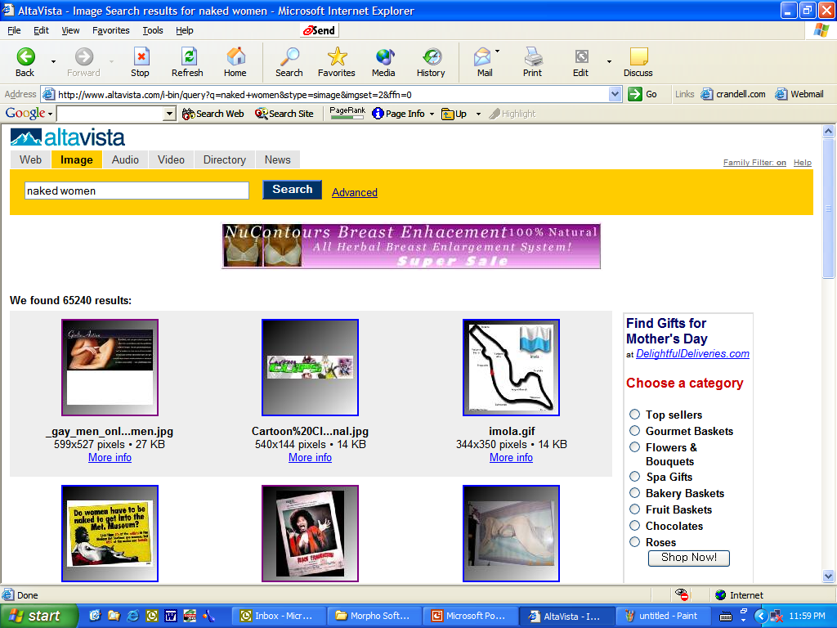
Search “naked women” with family filter on – returns “Girlie Action”

Slide 18
Filtering Customers
IAC Companies
ISPs, portals, large enterprises
Possible free end user product
  Viral effect
  Ensure low support requirements
  Upgrade model
Notes:
Note growth rate etc.
License to$__M /year, 38% CAGR through 2005 [fill in]

Slide 19
Pricing
Image/Website Filters
  per seat per month/year (corp. or ISP)
  per copy plus annual fee for direct sales
  per bundled copy (PC OEM)
Image libraries, auction/shopping sites
  fee per increased sales
  monthly fee based on the size of database
Image retrieval for corporate image database
  r cents per search, or
  $monthly fee based on the size of database

Slide 20
Competition
WebSense
SurfControl
Etc.
Competition may be customers….

Slide 21
Follow-on Markets
Classification & annotation
Video search & filtering
Security (event detection)
Personal image organizer
Image piracy detection
Notes:
Classification
Video search at frame boundaries
FCC mandated TV broadcasted in digital format by 2006
Explosive growth of video contents on the Web
Market for video search/filtering expected to be ready in 1-2 years
Security – not face recognition soon
Personal organizer like iPhoto
Organizing/Searching personal collections of photos and videos for users of digital cameras/camcorders
Software becoming a key differentiator for such consumer electronics.
Piracy detection

Slide 22
Value Proposition
[revise this slide]
Unique ability to provide
High value to customer
Notes:
18-month technology head start
Scalable & adaptable to different verticals
University affilitation – stream of tech. & support
ROI for sales (search), productivity (filter)
Decrease risk (harrassment, security), theft (piracy)
Preserve reputation (filter)

Slide 23
Key Patents
Learner
Perception-
based
Feature Extraction
Personalizable
Information Filter
High Speed
Indexers
Notes:
4 pending & 1 provisional

Slide 24
Management
Tim Cheng, PhD – Co-founder & Chairman
  Professor, ECE, Univ. of California, Santa Barbara
  PhD. UC Berkeley, Fellow of IEEE
Edward Chang, PhD – Co-founder & CTO
  Professor, ECE, Univ. of California, Santa Barbara
  PhD. Stanford
Michael Crandell – VP Business Development
  EVP eFax.com
  B.A. Stanford University
Notes:
Also have business advisors & consultants:
Sean Varah
Mara Winokur
Pete Mountanos

Slide 25
Advisors
Hector Garcia-Molina, PhD – Technical Advisor
  Chairman, Depart. of CS, Stanford University
  Leonard Bosack and Sandra Lerner Professor, Depart. of CS and EE, Stanford Univ.
Jeffrey Ullman, PhD – Technical Advisor
  S. W. Ascherman Professor of Engineering at Stanford University
  Board of Directors, Google, Pharmquest, Viquity, TargetMarketing
Notes:
Also have business advisors & consultants:
Sean Varah
Mara Winokur
Pete Mountanos

Slide 26
Milestones
January 2001 Founded
Feb.-March 2001 Raised Series A fund
December 2001 9 employees/consultants
February 2002 Series B (first closing)
April 2002 Business development
Notes:
Series A: “core technology development and testing, and initial product beta”
Series B: “vertical application product development, beta trials, and initial sales”
Key Milestones:
Getting through beta trials with 2 customers for each of your 2 products
Converting at least one of 2 trial customers of each product to a paying customer within 6 months
Completing market and product research to determine the vertical product strategy for the next suite of products
Starting development of the next suite of products

Slide 27
Runway Ventures
Beneficial to add U.S. VC
Advice & guidance at an early stage
Series B could be extended before May 21
Notes:
Capital structure:
< 23M fully diluted
7.7 Preferred
15M common
0.45 last round of just under $2M, pre-money of $8M
Welcome participation if doesn’t involve long delay

