Slide 1
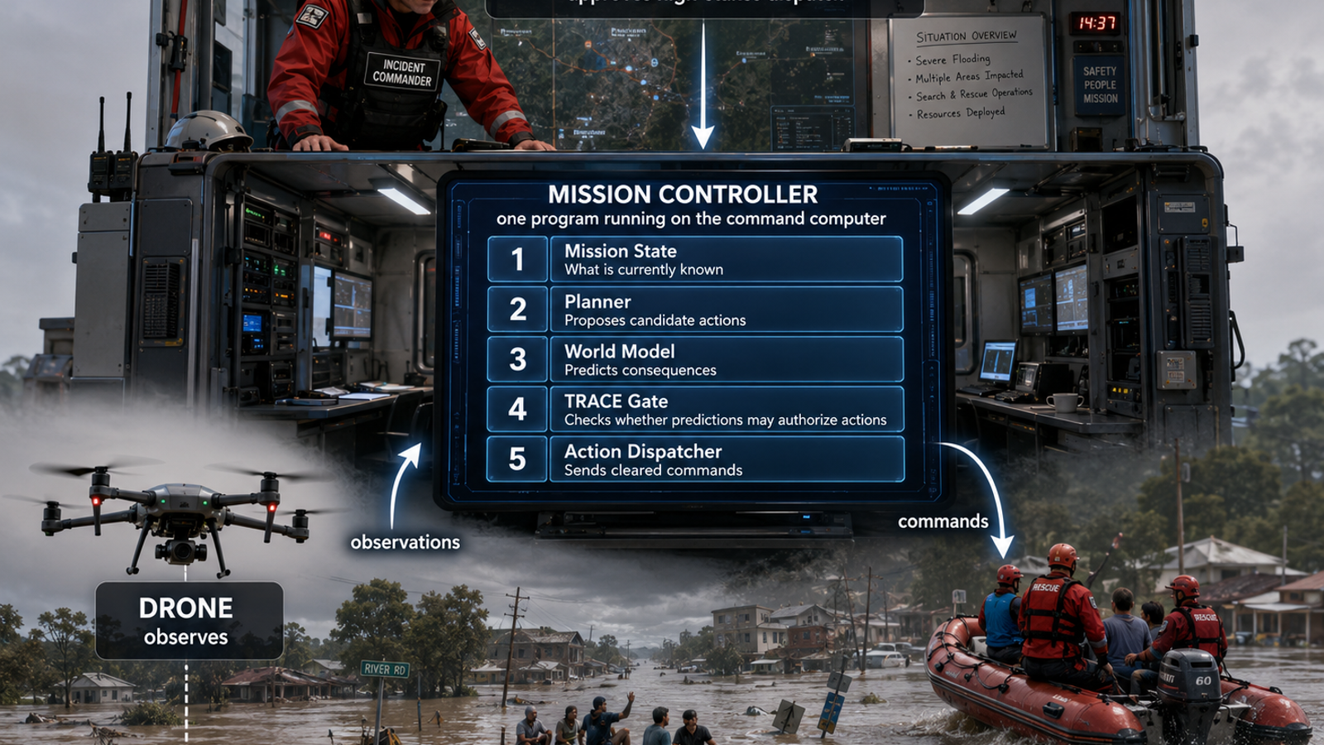
Closing the Loop
Flood-SAR Implementation in Eight Verified Steps
Emergency call → mission state → plans → predictions → TRACE → verification → revision → rescue
Faithfulness rule: every slide points to code that exists; every limitation is labeled.
TRACE-JEPA Flood-SAR · 1
Replacement for the placeholder-heavy walkthrough

Slide 2
What “eight steps” means
These are the eight operational responsibilities from call intake to a recorded rescue outcome.
1
Ground call
2
Build mission state
3
Propose plans
4
Predict + claim
EmergencyCall object
Controller-visible observation
PlanCandidate list
PlanPrediction + Claim
5
TRACE gate
6
Verify
7
Revise + replan
8
Rescue + persist
TraceRecord + decision
Drone outcome
Revision + candidate repair
Commitment + outcome
Do not confuse these with TRACE’s eight general writer stages. The crosswalk later shows which writer operations this domain-specific implementation actually realizes.
TRACE-JEPA Flood-SAR · 2
Eight operational steps; eight writer stages are a separate taxonomy

Slide 3
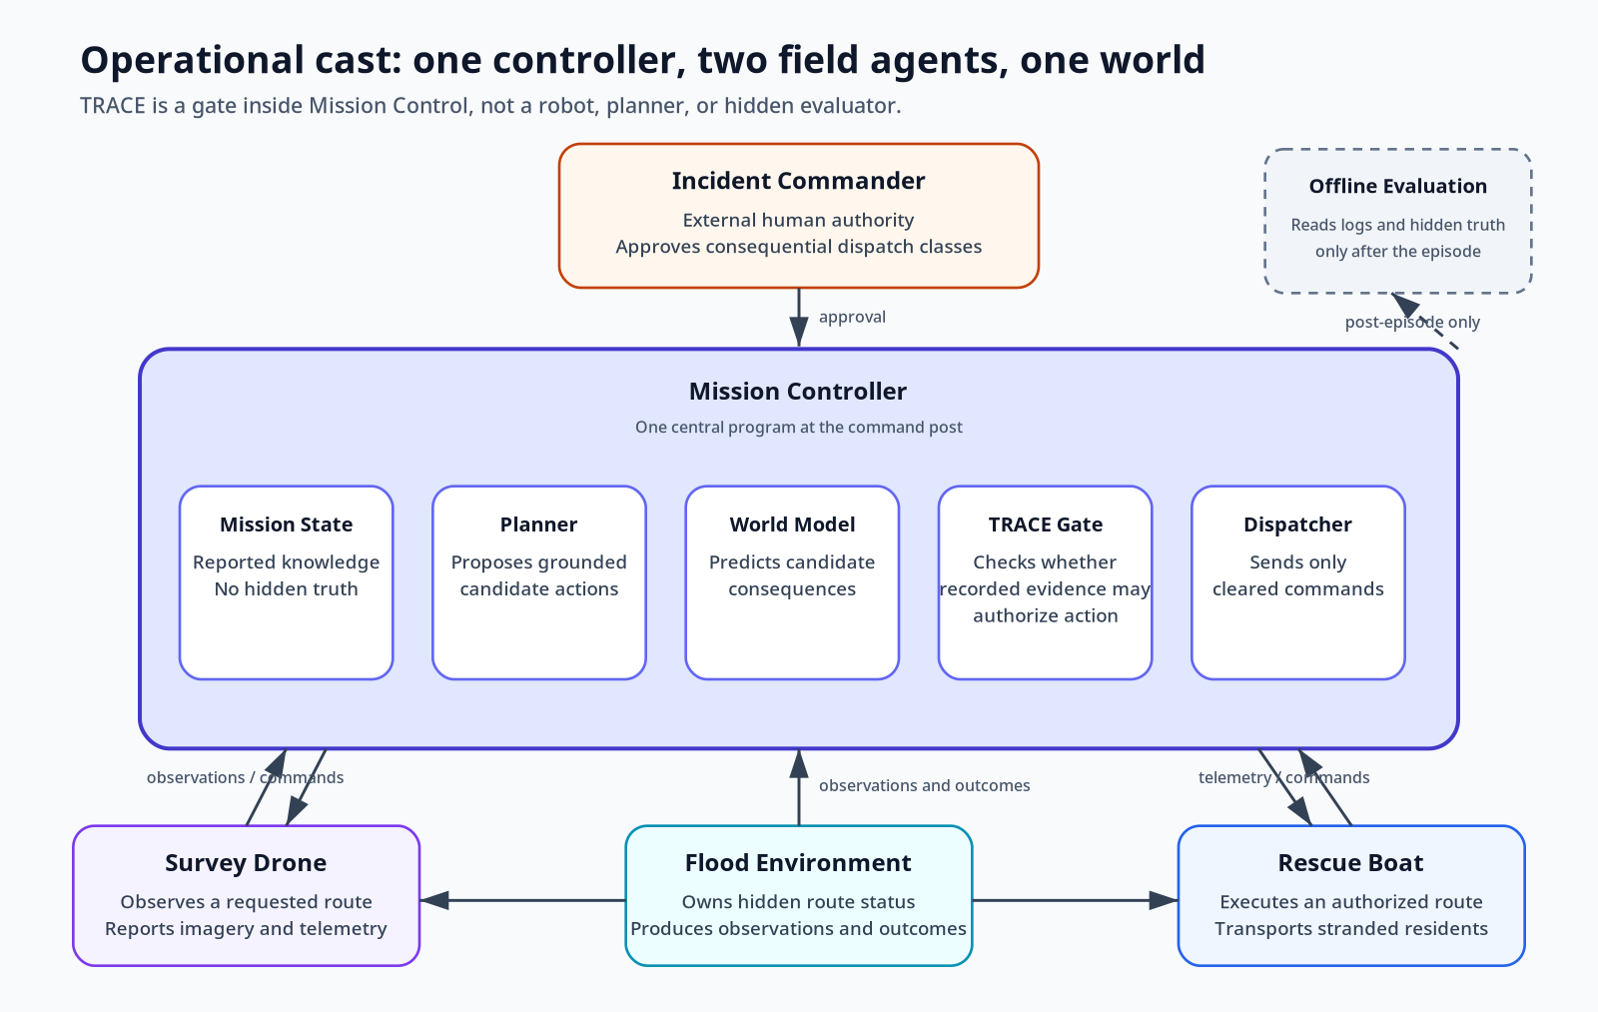
One controller, two machines, one human, one world
The architecture is intentionally simple in the first implementation.
• Flood Environment owns hidden truth and produces observations/outcomes. • Survey drone observes; rescue boat executes. Neither plans. • Mission Controller is one Python process containing planner, predictor, TRACE gate, and dispatcher. • Incident Commander is an external authority boundary. • Offline evaluation scores logs after the episode and sends no commands.
Current honesty note: IncidentCommander.authorizes() is a deterministic teaching stub, not a real human approval interface.
TRACE-JEPA Flood-SAR · 3
Source: src/trace_jepa/controller.py

Slide 4
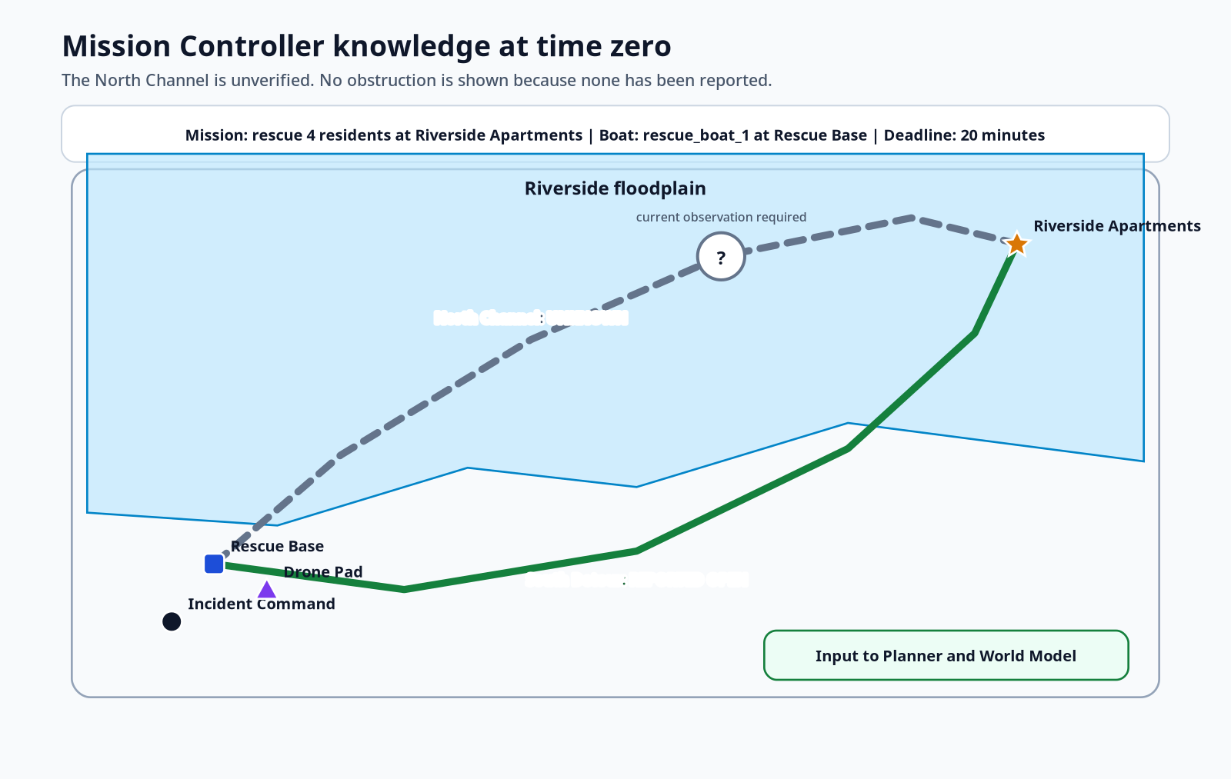
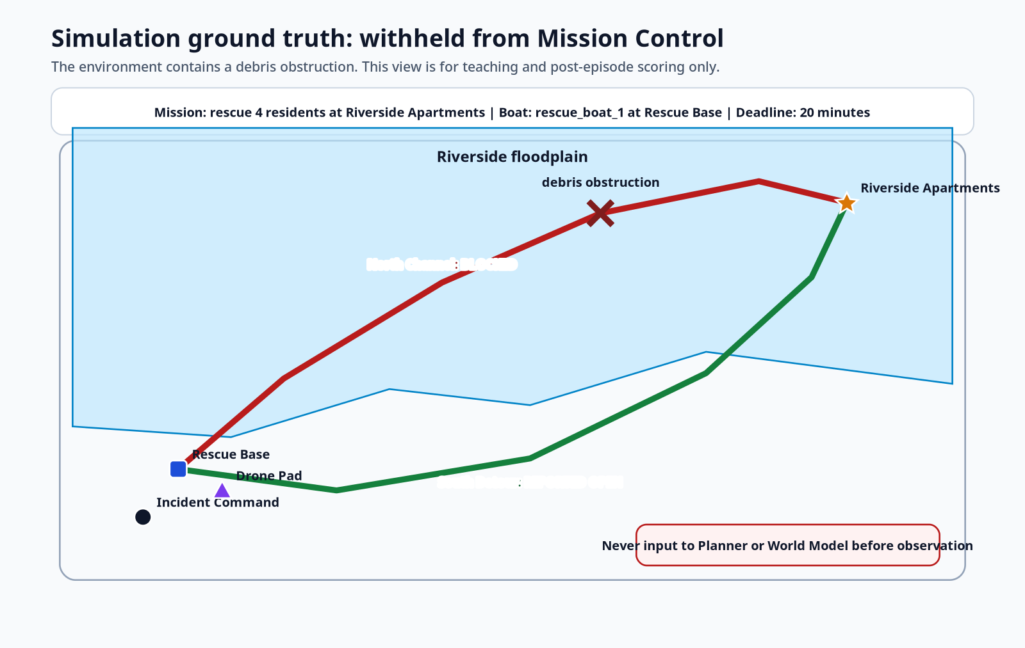
The knowledge boundary makes the episode scientifically valid
The controller knows what has been reported, not everything the simulator contains.
MISSION CONTROLLER KNOWLEDGE
SIMULATION GROUND TRUTH
North Channel = unknown
North Channel = blocked
TRACE-JEPA Flood-SAR · 4
Hidden truth never enters planner/predictor/gate inputs

Slide 5
Run the implementation from a raw emergency call
One command produces the timeline, records, evidence, commitments, summary, and figures.
1 source "$HOME/miniforge3/etc/profile.d/conda.sh" 2 conda activate trace-jepa 3 cd /path/to/trace_jepa_flood_sar_starter 4 python -m pip install -e ".[dev]" 5 pytest 6 7 trace-jepa-call \ 8 --call-file examples/calls/riverside_call.txt \ 9 --output artifacts/runs/call_001
Input
Emergency. Four residents are stranded at Riverside Apartments. Flood water is rising and the road is inaccessible.
Main outputs
emergency_call.json
timeline.txt
summary.json
records/trace.jsonl
evidence/*.json
commitments/*.jsonl
figures/*.svg
SIDE FILE: RUN_EIGHT_STEPS.md
Expected core test state: all core tests pass; the optional PyTorch/V-JEPA test may be skipped until the ML stack is installed.
TRACE-JEPA Flood-SAR · 5
Entry point: trace_jepa.emergency_cli:main

Slide 6
Step 1: Accept and ground the emergency call
Convert raw caller language into an auditable EmergencyCall object without inventing missing fields.
STEP 1
Accept and ground the emergency call
Input
Processing
Output
raw_text
optional --location
optional --people
optional deadline override
closed location alias registry
regex/number-word people count
scenario default deadline
explicit validation errors
EmergencyCall
normalized_location_id
people_count
deadline_s
raw call preserved
• Ambiguous location → stop and request --location. • Missing people count → stop and request --people. • No geocoder is implemented yet. • The call does not reveal route status.
1 Emergency. Four residents are stranded at Riverside Apartments. 2 Flood water is rising and the road is inaccessible.
SIDE FILE: step01_call_intake/S01_intake.py
SIDE FILE: step01_call_intake/S01_emergency_cli.py
TRACE-JEPA Flood-SAR · 6
Output artifact: emergency_call.json

Slide 7
Step 1: Code: parse the call
The slide shows the core logic; the complete source is in the labeled side file.
STEP 1
Code: parse the call
1 def parse( 2 self, 3 raw_text: str, 4 *, 5 location: str | None = None, 6 people: int | None = None, 7 deadline_minutes: int | None = None, 8 caller_name: str | None = None, 9 caller_contact: str | None = None, 10 ) -> EmergencyCall: 11 if not raw_text.strip(): 12 raise EmergencyCallIntakeError("emergency call text cannot be empty") 13 14 location_id, label = resolve_location( 15 self.scenario, 16 raw_text=raw_text, 17 explicit_location=location, 18 ) 19 people_count = parse_people_count(raw_text, explicit_people=people) 20 21 default_deadline_s = int(self.scenario.get("mission", {}).get("deadline_s", 1200)) 22 deadline_s = ( 23 int(deadline_minutes) * 60 24 if deadline_minutes is not None 25 else default_deadline_s 26 ) 27 if deadline_s < 60: 28 raise EmergencyCallIntakeError("deadline must be at least one minute") 29 30 return EmergencyCall( 31 raw_text=raw_text.strip(), 32 reported_location=location or label, 33 normalized_location_id=location_id, 34 people_count=people_count, 35 deadline_s=deadline_s, 36 caller_name=caller_name, 37 caller_contact=caller_contact, 38 )
• Location is normalized against scenario aliases. • People count is parsed independently. • Deadline is explicit and validated. • EmergencyCall is frozen by the Pydantic contract.
Exit test
normalized_location_id = riverside_apartments
people_count = 4
deadline_s = 1200
Faithfulness boundary: this is deterministic text parsing, not speech recognition, NLP extraction, or geocoding.
SIDE FILE: step01_call_intake/S01_intake.py
TRACE-JEPA Flood-SAR · 7
Authoritative source: src/trace_jepa/intake.py

Slide 8
Step 2: Register the incident and build mission state
Create the controller-visible state while preserving hidden simulator truth.
STEP 2
Register the incident and build mission state
1 Mission Controller sees: 2 - destination: riverside_apartments 3 - people: 4 4 - deadline: 1200 s 5 - north_channel: unknown 6 - south_detour: open 7 - drone battery: 0.82 8 - boat capacity: 6
1 Simulator holds: 2 - north_channel: blocked 3 - south_detour: open 4 - stranded_people: 4 5 - rescued: false
Only observe() enters MissionController._assess_observation(). simulation_ground_truth() is retained for tests and post-episode analysis.
SIDE FILE: step02_mission_state/S02_flood_environment.py
SIDE FILE: step02_mission_state/S02_visualize.py
SIDE FILE: step02_mission_state/S02_riverside_flood_v1.yaml
SIDE FILE: step02_mission_state/S02_fusion_state.py
Exit test
Controller north report = unknown
Truth north status = blocked
TRACE-JEPA Flood-SAR · 8
Source: FloodEnvironment.register_emergency_call / observe

Slide 9
Step 2: Code: the information boundary
The key correctness property is that observe() masks the blocked route until verification.
STEP 2
Code: the information boundary
1 def register_emergency_call(self, call: EmergencyCall) -> None: 2 """Ground an emergency report into the active mission. 3 4 The call may change the pickup location, number of residents, and 5 deadline. It does not reveal hidden route truth. 6 """ 7 8 if call.normalized_location_id not in self.scenario["locations"]: 9 raise ValueError( 10 f"unknown scenario location: {call.normalized_location_id}" 11 ) 12 self.active_call = call 13 self.scenario["mission"]["pickup_location"] = call.normalized_location_id 14 self.scenario["mission"]["people_to_rescue"] = call.people_count 15 self.scenario["mission"]["deadline_s"] = call.deadline_s 16 17 def observe(self) -> dict[str, Any]: 18 """Return only information legitimately available to Mission Control.""" 19 20 routes: dict[str, dict[str, Any]] = {} 21 for route_id, route in self.scenario["routes"].items(): 22 verified = route_id != "north_channel" or self.north_route_verified 23 report = self._route_status(route_id) if verified else str(route["initial_report"]) 24 routes[route_id] = { 25 "label": route["label"], 26 "report": report, 27 "verified": verified, 28 "nominal_travel_s": float(route["nominal_travel_s"]), 29 "waypoints": route["waypoints"], 30 } 31 32 assets = { 33 asset_id: dict(spec) 34 for asset_id, spec in self.scenario["assets"].items() 35 } 36 mission = dict(self.scenario["mission"]) 37 38 return { 39 "scenario_id": self.scenario_id, 40 "mission": { 41 "origin_id": mission["origin"], 42 "destination_id": mission["pickup_location"], 43 "people_to_rescue": int(mission["people_to_rescue"]), 44 "deadline_s": int(mission["deadline_s"]), 45 "deadline_minutes": int(mission["deadline_s"]) // 60, 46 },
• register_emergency_call changes mission parameters only. • north_route_verified controls whether truth is exposed. • initial_report is returned while unverified. • simulation_ground_truth is a separate method.
The two SVG maps differ by one hidden fact. This is not cosmetic; it prevents ground-truth leakage.
SIDE FILE: step02_mission_state/S02_flood_environment.py
TRACE-JEPA Flood-SAR · 9
Test: tests/test_entity_model.py and test_emergency_call.py

Slide 10
Step 3: Generate grounded candidate actions
The planner says what is structurally possible; it does not predict or authorize.
STEP 3
Generate grounded candidate actions
North dispatch
Drone verification
South dispatch
rescue_boat_1
rescue_base → riverside_apartments
route=north_channel
irreversible
authority required
survey_drone_1
drone_pad → north_channel
purpose=resolve_route_access
reversible
no dispatch authority
rescue_boat_1
rescue_base → riverside_apartments
route=south_detour
irreversible
authority required
Every PlanCandidate contains an ActionInstance with actor, origin, destination, route, people count, deadline, reversibility, utility, and authority requirement.
SIDE FILE: step03_planning/S03_planner.py
SIDE FILE: step03_planning/S03_flood_actions_v1.yaml
SIDE FILE: step03_planning/S03_contracts_models.py
Exit test
Three initial candidates; no opaque action strings.
TRACE-JEPA Flood-SAR · 10
Planner version: flood-planner-v2

Slide 11
Step 3: Code: propose actions from observed route reports
The planner generates boat dispatches for non-blocked reports and verification actions for unknown reports.
STEP 3
Code: propose actions from observed route reports
1 def propose(self, observation: dict) -> list[PlanCandidate]: 2 mission = observation["mission"] 3 candidates: list[PlanCandidate] = [] 4 5 for route_id, route in observation["routes"].items(): 6 report = route["report"] 7 label = route["label"] 8 9 if report != "blocked": 10 action = ActionInstance( 11 action_type="dispatch_rescue_boat", 12 actor_id="rescue_boat_1", 13 origin=mission["origin_id"], 14 destination=mission["destination_id"], 15 route_id=route_id, 16 parameters={ 17 "people_count": int(mission["people_to_rescue"]), 18 "deadline_s": int(mission["deadline_s"]), 19 }, 20 ) 21 travel_s = float(route["nominal_travel_s"]) 22 utility = max(0.0, 1.0 - 0.35 * travel_s / float(mission["deadline_s"])) 23 plan_id = "north-direct" if route_id == "north_channel" else "south-detour" 24 candidates.append( 25 PlanCandidate( 26 plan_id=plan_id, 27 name=( 28 f"Dispatch rescue_boat_1 from {mission['origin_id']} " 29 f"to {mission['destination_id']} via {label}" 30 ), 31 actions=(action,), 32 utility=utility, 33 reversible_first_action=False, 34 requires_authority=True, 35 metadata={ 36 "route_id": route_id, 37 "route_report": report, 38 "mission_destination": mission["destination_id"], 39 }, 40 ) 41 ) 42 43 if report == "unknown": 44 action = ActionInstance( 45 action_type="verify_route", 46 actor_id="survey_drone_1", 47 origin="drone_pad", 48 destination=route_id, 49 route_id=route_id, 50 parameters={"purpose": "resolve_route_access"}, 51 ) 52 candidates.append( 53 PlanCandidate( 54 plan_id="verify-north" if route_id == "north_channel" else f"verify-{route_id}", 55 name=f"Send survey_drone_1 to verify {label}", 56 actions=(action,), 57 utility=0.90, 58 reversible_first_action=True, 59 requires_authority=False, 60 metadata={ 61 "route_id": route_id, 62 "information_gathering": True, 63 }, 64 ) 65 )
• No prediction values appear in this file. • Unknown is not treated as open. • A blocked route is omitted on replanning. • choose() ranks only CLEAR/QUALIFY candidates.
Current limitation: this is a small deterministic candidate generator, not an HTN/MRTA solver.
SIDE FILE: step03_planning/S03_planner.py
TRACE-JEPA Flood-SAR · 11
Authoritative source: src/trace_jepa/planning/planner.py

Slide 12
Step 4: Predict consequences and formulate claims
The current predictor is a transparent deterministic fixture, not JEPA and not an empirical result.
STEP 4
Predict consequences and formulate claims
Candidate
Success
Support
OOD
Uncertainty
Expected gate
North unknown
0.92
0.28
0.82
0.08
HOLD later
Verify north
0.98
0.97
0.04
0.04
CLEAR later
South open
0.82
0.93
0.08
0.14
CLEAR later
Claim generated for a boat plan: “north_channel is traversable and rescue_boat_1 can reach riverside_apartments before the deadline.”
SIDE FILE: step04_prediction_claims/S04_toy_predictor.py
SIDE FILE: step04_prediction_claims/S04_claim_probe.py
Exit test
Success, support, OOD, uncertainty, horizon, and assumptions remain separate fields.
TRACE-JEPA Flood-SAR · 12
Predictor version: toy-action-prefix-v2

Slide 13
Step 4: Code: the deliberate out-of-support teaching case
The predictor may report high success while also declaring low support and high OOD.
STEP 4
Code: the deliberate out-of-support teaching case
PREDICTOR FIXTURE
TYPED CLAIM PROBE
1 report = route["report"] 2 nominal_travel_s = float(route["nominal_travel_s"]) 3 4 if report == "unknown": 5 # Teaching case: a high numerical success estimate produced outside 6 # the predictor's declared support. TRACE must hold the dispatch. 7 return PlanPrediction( 8 plan_id=plan.plan_id, 9 success_probability=0.92, 10 arrival_time_s=nominal_travel_s, 11 hazard_score=0.12, 12 resource_margin=0.35, 13 model_support=0.28, 14 out_of_distribution_score=0.82, 15 uncertainty=0.08, 16 rollout_horizon=6, 17 assumptions=("map_is_current", "debris_distribution_matches_training"), 18 )
1 elif action.action_type == "dispatch_rescue_boat": 2 text = ( 3 f"{action.route_id} is traversable and {action.actor_id} can reach " 4 f"{action.destination} before the deadline." 5 ) 6 grounding = { 7 "actor_id": action.actor_id, 8 "origin": action.origin, 9 "destination": action.destination, 10 "route_id": action.route_id, 11 "people_count": action.parameters["people_count"], 12 "deadline_s": action.parameters["deadline_s"], 13 "horizon_steps": prediction.rollout_horizon, 14 "action_id": action.action_id, 15 } 16 else: 17 raise KeyError(action.action_type) 18 19 return Claim( 20 layer=ClaimLayer.PREDICTIVE, 21 text=text, 22 grounding=grounding, 23 confidence=prediction.success_probability, 24 confidence_semantics=( 25 "Teaching proxy copied from plan success probability; not a " 26 "separately calibrated claim probability." 27 ), 28 )
The code explicitly labels claim confidence as a teaching proxy copied from plan success probability. It is not presented as a separately calibrated claim probability.
SIDE FILE: step04_prediction_claims/S04_toy_predictor.py
SIDE FILE: step04_prediction_claims/S04_claim_probe.py
TRACE-JEPA Flood-SAR · 13
Faithful limitation: no learned world model is used yet

Slide 14
Step 5: Write TRACE records and apply the policy gate
Evidence is stored first; then a deterministic policy writes verdict, failed gates, missing evidence, repair, and consumer action.
STEP 5
Write TRACE records and apply the policy gate
Claim
Evidence
Policy
TraceRecord
Consumer
predictive + grounded
support/OOD/uncertainty
hard gates
status + repair
CLEAR/HOLD/...
North dispatch
DEFER
HOLD
model_support, out_of_distribution
Drone verification
ACCEPT
CLEAR
none
South dispatch
ACCEPT
CLEAR
none
SIDE FILE: step05_trace_gate/S05_policy.py
SIDE FILE: step05_trace_gate/S05_runtime.py
SIDE FILE: step05_trace_gate/S05_storage.py
TRACE-JEPA Flood-SAR · 14
Policy version: trace-flood-v1

Slide 15
Step 5: Code: hard gates cannot be averaged away
The 0.92 score is not read as permission when support and OOD checks fail.
STEP 5
Code: hard gates cannot be averaged away
1 if evidence.model_support < self.config.min_model_support: 2 failed.append("model_support") 3 missing.append("evidence inside the declared model support") 4 if evidence.out_of_distribution_score > self.config.max_ood_score: 5 failed.append("out_of_distribution") 6 missing.append("current observation or verification for the out-of-support region") 7 if evidence.uncertainty > self.config.max_uncertainty: 8 failed.append("uncertainty") 9 missing.append("narrower calibrated uncertainty") 10 if evidence.rollout_horizon > self.config.max_rollout_horizon: 11 failed.append("rollout_horizon") 12 missing.append("a shorter receding-horizon prefix") 13 if evidence.observation_age_s > self.config.max_observation_age_s: 14 failed.append("observation_freshness") 15 missing.append("a fresh observation window") 16 if claim.layer == ClaimLayer.CAUSAL and "state_sufficiency" not in evidence.assumptions: 17 failed.append("causal_identification") 18 missing.append("state-sufficiency or an explicitly model-conditional causal qualification") 19 20 authority_required = action_name in self.config.require_authority_for 21 if authority_required and not authority_present: 22 return EvaluationResult( 23 status=TraceStatus.DEFER, 24 decision=CommitmentDecision.ESCALATE, 25 failed_gates=tuple(failed), 26 missing_items=tuple(missing + ["incident-command authorization"]), 27 repair="Obtain authorization from the designated incident-command role.", 28 reason="Technical evidence is not sufficient to cross the authority boundary.", 29 ) 30 31 if failed: 32 if reversible and self.config.allow_qualified_reversible_probe: 33 return EvaluationResult( 34 status=TraceStatus.QUALIFY, 35 decision=CommitmentDecision.QUALIFY, 36 failed_gates=tuple(failed), 37 missing_items=tuple(missing), 38 repair=( 39 repair_hint 40 or "Limit the action to evidence gathering; monitor and do not commit the rescue branch yet." 41 ), 42 reason="A bounded reversible probe may proceed to resolve the named uncertainty.", 43 ) 44 return EvaluationResult( 45 status=TraceStatus.DEFER, 46 decision=CommitmentDecision.HOLD, 47 failed_gates=tuple(failed), 48 missing_items=tuple(missing), 49 repair=( 50 repair_hint 51 or "Gather the named evidence or select a supported alternative plan." 52 ), 53 reason="One or more hard technical gates failed.", 54 ) 55 56 return EvaluationResult( 57 status=TraceStatus.ACCEPT, 58 decision=CommitmentDecision.CLEAR, 59 reason="All declared technical gates passed for this action class.",
• Failed technical gates + irreversible action → HOLD. • Failed gates + reversible evidence probe → QUALIFY when enabled. • Authority missing → ESCALATE. • No failed gates → CLEAR.
North result
status = defer
decision = hold
missing = supported/current route evidence
repair = send drone
SIDE FILE: step05_trace_gate/S05_policy.py
TRACE-JEPA Flood-SAR · 15
Test: tests/test_policy.py

Slide 16
How this domain writer maps to TRACE’s eight writer stages
Faithfulness requires stating what is implemented and what is not.
0 Detect
Planner emits an explicit action-licensing claim candidate.
No open-ended argument detector.
1 Intake
Probe + controller fill grounding, evidence, provenance, assumptions.
Implemented structurally.
2 Type
ClaimLayer.PREDICTIVE.
Implemented.
3 Question
Support, OOD, uncertainty, horizon, freshness, contradiction, authority.
Domain-specific question set.
4 Test
PolicyEngine.evaluate runs deterministic checks.
Implemented.
5 Elicit
Failed record names drone verification as missing evidence/repair.
No debate module.
6 Settle
Policy maps tests to record status and consumer decision.
No attack graph.
7 Complete
Runtime writes record, gates, missing, repair, provenance, consumer action.
Implemented.
Conclusion: the current flood code is a conforming structured writer for predictive plan claims. It is not yet the full general-purpose eight-stage natural-language writer.
TRACE-JEPA Flood-SAR · 16
Do not claim debate or attack-graph implementation

Slide 17
Step 6: Select and execute the evidence-seeking action
The highest-utility admissible action is the drone verification, not the held north dispatch.
STEP 6
Select and execute the evidence-seeking action
Candidates
choose()
commit()
execute()
North HOLD
Verify CLEAR
South CLEAR
Rank only CLEAR/QUALIFY
Verify utility 0.90
South utility 0.685
Action + authorizing
record ID/version
Drone battery 0.82→0.74
route_status=blocked
1 [06] ACTION SELECTED survey drone 1 verifies north channel 2 [07] ACTION DISPATCHED authorized command sent to survey_drone_1 3 [08] OBSERVATION RECEIVED north_channel is blocked
SIDE FILE: step06_verification_dispatch/S06_controller.py
SIDE FILE: step06_verification_dispatch/S06_flood_environment.py
Exit test
A route observation exists only after a committed verify_route action.
TRACE-JEPA Flood-SAR · 17
Detailed events 06-08

Slide 18
Step 6: Code: commitment before execution
A durable action is written with the exact record version that authorized it.
STEP 6
Code: commitment before execution
MISSION CONTROLLER
TRACE RUNTIME COMMIT
1 chosen = self.planner.choose( 2 [(plan_by_id[item["plan_id"]], item["decision"]) for item in assessed] 3 ) 4 if chosen is None: 5 raise RuntimeError("no admissible initial action") 6 7 emit( 8 "action_selected", 9 f"Mission Controller selects: {chosen.first_action.short_label}.", 10 plan_id=chosen.plan_id, 11 action=chosen.first_action.model_dump(mode="json"), 12 ) 13 chosen_record = record_by_plan[chosen.plan_id] 14 first_commitment = self.runtime.commit( 15 record=chosen_record, 16 action=chosen.first_action, 17 ) 18 emit( 19 "action_dispatched", 20 f"Authorized command sent to {chosen.first_action.actor_id}.", 21 commitment_id=first_commitment.commitment_id, 22 authorizing_record_id=chosen_record.record_id, 23 authorizing_record_version=chosen_record.record_version, 24 ) 25 first_outcome = self.environment.execute(chosen.first_action) 26 if chosen.first_action.action_type == "verify_route": 27 emit( 28 "observation_received", 29 f"{chosen.first_action.actor_id} reports " 30 f"{first_outcome.observations['route_id']} is " 31 f"{first_outcome.observations['route_status']}.", 32 outcome_id=first_outcome.outcome_id, 33 observations=first_outcome.observations, 34 )
1 def commit( 2 self, 3 *, 4 record: TraceRecord, 5 action: ActionInstance, 6 ) -> Commitment: 7 commitment = Commitment( 8 action=action, 9 authorizing_record_id=record.record_id, 10 authorizing_record_version=record.record_version, 11 consumer_policy_version=self.policy.config.policy_version, 12 ) 13 self.commitments.append(commitment, record) 14 return commitment
The commitment object is the closure link: action ↔ authorizing_record_id/version ↔ consumer policy.
SIDE FILE: step06_verification_dispatch/S06_controller.py
SIDE FILE: step06_verification_dispatch/S06_runtime.py
TRACE-JEPA Flood-SAR · 18
Commitment log enforces closure

Slide 19
Step 7: Revise append-only and locally replan
Reality contradicts the north prediction; the old record remains and a new version rejects it.
STEP 7
Revise append-only and locally replan
Before
Observation
Revision
Replan
North record v2
status=DEFER
consumer=HOLD
repair=verify route
survey_drone_1
route_status=blocked
source and battery recorded
same record_id
record_version=3
status=REJECT
failed_gate=realized_contradiction
blocked north omitted
South candidate remains
verification preserved
Locality in the current code is route-specific candidate filtering. A general HTN dependency graph and arbitrary branch invalidation are future work.
SIDE FILE: step07_revision_repair/S07_controller.py
SIDE FILE: step07_revision_repair/S07_runtime.py
Exit test
Old record readable; revision supersedes it; north dispatch absent after re-observation.
TRACE-JEPA Flood-SAR · 19
Detailed events 09-11

Slide 20
Step 7: Code: append a contradiction instead of editing history
The revision adds outcome evidence, a new status, a failed gate, and a repair.
STEP 7
Code: append a contradiction instead of editing history
RUNTIME REVISION
CONTROLLER CONTRADICTION + REPLAN
1 def revise_with_outcome( 2 self, 3 record: TraceRecord, 4 evidence: WorldModelEvidence, 5 *, 6 new_status: TraceStatus, 7 reason: str, 8 repair: str, 9 ) -> TraceRecord: 10 evidence_ref = self.ledger.put(evidence) 11 revised = record.model_copy( 12 update={ 13 "record_version": record.record_version + 1, 14 "evidence_refs": record.evidence_refs + (evidence_ref,), 15 "final_status": new_status, 16 "failed_gates": record.failed_gates + ("realized_contradiction",), 17 "repair": repair, 18 "supersedes_record_id": record.record_id, 19 "supersedes_record_version": record.record_version, 20 "metadata": {**record.metadata, "revision_reason": reason}, 21 } 22 ) 23 self.repository.write(revised) 24 return revised
1 revisions: list[dict] = [] 2 if ( 3 chosen.first_action.action_type == "verify_route" 4 and first_outcome.observations.get("route_status") == "blocked" 5 ): 6 route_id = chosen.first_action.route_id 7 dispatch_plan_id = ( 8 "north-direct" 9 if route_id == "north_channel" 10 else f"dispatch-{route_id}" 11 ) 12 failed_record = record_by_plan[dispatch_plan_id] 13 failed_plan = plan_by_id[dispatch_plan_id] 14 failed_prediction = prediction_by_plan[dispatch_plan_id] 15 failed_claim = self.probe.build_claim(failed_plan, failed_prediction) 16 17 visual_payload = json.dumps(initial_observation, sort_keys=True).encode("utf-8") 18 state = fuse_state(self.encoder.encode(visual_payload), initial_observation) 19 realized_evidence = self._make_evidence( 20 plan=failed_plan, 21 prediction=failed_prediction, 22 claim=failed_claim, 23 state_hash=state.state_hash, 24 observation_hash=sha256_value(initial_observation), 25 outcome=first_outcome, 26 contradicted=True, 27 ) 28 revised = self.runtime.revise_with_outcome( 29 failed_record, 30 realized_evidence, 31 new_status=TraceStatus.REJECT, 32 reason=( 33 f"{chosen.first_action.actor_id} observed that {route_id} is blocked." 34 ), 35 repair=( 36 "Preserve the completed verification action and replan only " 37 "the rescue-route branch that depended on the failed claim." 38 ), 39 ) 40 revisions.append( 41 { 42 "record_id": revised.record_id, 43 "record_version": revised.record_version, 44 "status": revised.final_status.value, 45 "reason": revised.metadata["revision_reason"], 46 } 47 ) 48 emit( 49 "trace_revised", 50 "TRACE rejects the northern-route claim and preserves the " 51 "completed verification action.", 52 record_id=revised.record_id, 53 record_version=revised.record_version, 54 ) 55 56 second_observation = self.environment.observe() 57 emit( 58 "replanning", 59 "Planner repairs only the route-dependent rescue branch.", 60 ) 61 second_assessed, second_records, _, second_plans = self._assess_observation( 62 second_observation, 63 replanned=True, 64 )
No field in the prior committed record is changed in place.
The re-observed route report becomes blocked, so FloodPlanner.propose() no longer emits the north dispatch.
TRACE-JEPA Flood-SAR · 20
Append-only record semantics

Slide 21
Step 8: Clear the final dispatch and record the rescue outcome
The final boat action is linked to a new TRACE record and the policy version that cleared it.
STEP 8
Clear the final dispatch and record the rescue outcome
Reassess
Authority
Commit
Execute
Persist
South support=0.93
OOD=0.08
CLEAR
IncidentCommander
permits dispatch_rescue_boat
action + record ID/version
written to commitment log
boat uses south_detour
people_reached=4
summary + timeline
records + evidence + figures
1 [12] FINAL ACTION SELECTED boat via South Detour 2 [13] FINAL ACTION DISPATCHED Commander approval + TRACE clearance recorded 3 [14] RESCUE OUTCOME success=True, people_reached=4
Faithfulness boundary: “Commander approval” is currently a deterministic role stub. It demonstrates the authority field and gate, not a human-in-the-loop interface.
SIDE FILE: step08_final_rescue/S08_controller.py
SIDE FILE: step08_final_rescue/S08_flood_environment.py
SIDE FILE: step08_final_rescue/S08_reporting.py
TRACE-JEPA Flood-SAR · 21
Detailed events 12-14

Slide 22
Step 8: Code: final authority, commitment, execution, and summary
The final record closure can be reconstructed from summary.json and the append-only logs.
STEP 8
Code: final authority, commitment, execution, and summary
1 emit( 2 "final_action_selected", 3 f"Mission Controller selects: {final_plan.first_action.short_label}.", 4 plan_id=final_plan.plan_id, 5 action=final_plan.first_action.model_dump(mode="json"), 6 ) 7 final_record = second_records[final_plan.plan_id] 8 final_commitment = self.runtime.commit( 9 record=final_record, 10 action=final_plan.first_action, 11 ) 12 emit( 13 "final_action_dispatched", 14 f"Incident Commander approval and TRACE clearance authorize " 15 f"{final_plan.first_action.actor_id}.", 16 commitment_id=final_commitment.commitment_id, 17 authorizing_record_id=final_record.record_id, 18 authorizing_record_version=final_record.record_version, 19 ) 20 final_outcome = self.environment.execute(final_plan.first_action) 21 emit( 22 "rescue_outcome", 23 f"Rescue completed: success={final_outcome.success}, " 24 f"people_reached={final_outcome.observations.get('people_reached', 0)}.", 25 outcome_id=final_outcome.outcome_id, 26 observations=final_outcome.observations, 27 ) 28 29 summary = { 30 "scenario": self.environment.scenario_id, 31 "emergency_call": ( 32 active_call.model_dump(mode="json") if active_call is not None else None 33 ), 34 "entities": { 35 "environment": "FloodEnvironment", 36 "fleet": ["survey_drone_1", "rescue_boat_1"], 37 "mission_controller": self.version, 38 "incident_commander": self.incident_commander.role_id, 39 "offline_scorer_in_control_loop": False, 40 }, 41 "timeline": timeline, 42 "initial_mission_controller_knowledge": initial_observation, 43 "initial_controller_knowledge": initial_observation, 44 "simulation_ground_truth_at_time_zero": initial_simulation_ground_truth, 45 "simulation_ground_truth_after_run": self.environment.simulation_ground_truth(), 46 "initial_assessments": assessed, 47 "first_selected_plan": chosen.plan_id, 48 "first_commitment_id": first_commitment.commitment_id, 49 "first_commitment": first_commitment.model_dump(mode="json"), 50 "first_action": chosen.first_action.model_dump(mode="json"), 51 "first_outcome": first_outcome.model_dump(mode="json"), 52 "revisions": revisions, 53 "replanned_mission_controller_knowledge": second_observation, 54 "replanned_assessments": second_assessed, 55 "final_selected_plan": final_plan.plan_id, 56 "final_commitment_id": final_commitment.commitment_id, 57 "final_commitment": final_commitment.model_dump(mode="json"), 58 "final_action": final_plan.first_action.model_dump(mode="json"), 59 "final_outcome": final_outcome.model_dump(mode="json"), 60 "rescued": self.environment.rescued, 61 "record_chain_valid": self.runtime.repository.verify_chain(), 62 } 63 64 if output is not None: 65 output = Path(output) 66 output.mkdir(parents=True, exist_ok=True) 67 write_json(output / "summary.json", summary)
• Select supported south plan. • Create final commitment. • Log record ID and version. • Execute simulated boat action. • Write final outcome and summary. • Verify record hash chain.
Exit test
rescued = true
people_reached = 4
record_chain_valid = true
TRACE-JEPA Flood-SAR · 22
Authoritative source: MissionController.run_episode

Slide 23
The detailed fourteen-event log maps cleanly to the eight steps
The CLI stays granular for audit; the deck groups events by architectural responsibility.
STEP 1
01 CALL RECEIVED
intake.py / emergency_cli.py
STEP 2
02 MISSION STATE
flood_env.py
STEP 3
03-05 PLAN ASSESSED
planner.py
STEP 4
03-05 prediction + claim inside assessment
toy.py / probes.py
STEP 5
03-05 TRACE status and decision
policy.py / runtime.py
STEP 6
06-08 select / dispatch / observe
controller.py / flood_env.py
STEP 7
09-11 revise / replan / reassess
runtime.py / controller.py / planner.py
STEP 8
12-14 select / dispatch / outcome
controller.py / reporting.py
The event log is an operational trace, not the TRACE record itself. TRACE records are stored separately under records/trace.jsonl.
TRACE-JEPA Flood-SAR · 23
Audit granularity: event timeline + reasoning records

Slide 24
The episode as it actually runs
This output was reproduced from the packaged code with PYTHONPATH=src.
1 [01] CALL RECEIVED Emergency call reports 4 people at Riverside Apartments. 2 [02] MISSION STATE Mission Controller grounds the incident at Riverside Apartments; North Channel is unknown. 3 [03] PLAN ASSESSED Dispatch rescue_boat_1 from rescue_base to riverside_apartments via North Channel -> HOLD (support=0.28, OOD=0.82). 4 [04] PLAN ASSESSED Send survey_drone_1 to verify North Channel -> CLEAR (support=0.97, OOD=0.04). 5 [05] PLAN ASSESSED Dispatch rescue_boat_1 from rescue_base to riverside_apartments via South Detour -> CLEAR (support=0.93, OOD=0.08). 6 [06] ACTION SELECTED Mission Controller selects: survey drone 1 verifies north channel. 7 [07] ACTION DISPATCHED Authorized command sent to survey_drone_1. 8 [08] OBSERVATION RECEIVED survey_drone_1 reports north_channel is blocked. 9 [09] TRACE REVISED TRACE rejects the northern-route claim and preserves the completed verification action. 10 [10] REPLANNING Planner repairs only the route-dependent rescue branch. 11 [11] PLAN REASSESSED Dispatch rescue_boat_1 from rescue_base to riverside_apartments via South Detour -> CLEAR. 12 [12] FINAL ACTION SELECTED Mission Controller selects: rescue boat 1 dispatches to riverside apartments via south detour. 13 [13] FINAL ACTION DISPATCHED Incident Commander approval and TRACE clearance authorize rescue_boat_1. 14 [14] RESCUE OUTCOME Rescue completed: success=True, people_reached=4.
SIDE FILE: sample_run/timeline.txt
TRACE-JEPA Flood-SAR · 24
No “forthcoming” placeholder on this slide

Slide 25
What one run leaves behind
Every important transition has a durable artifact.
1 artifacts/runs/call_001/ 2 ├── emergency_call.json 3 ├── timeline.txt 4 ├── summary.json 5 ├── records/trace.jsonl 6 ├── evidence/*.json 7 ├── commitments/commitments.jsonl 8 └── figures/ 9 ├── operational_cast.svg 10 ├── mission_controller_knowledge.svg 11 ├── simulation_ground_truth.svg 12 └── action_timeline.svg
Call
Original report + normalized location/count/deadline
Evidence
Versioned model outputs, hashes, assumptions, support
Records
Status, gates, missing items, repair, consumer action
Commitments
Exact action + authorizing record ID/version
Outcomes
What the simulator revealed after execution
TRACE-JEPA Flood-SAR · 25
Closure can be checked from stored files alone

Slide 26
What is implemented, what is a fixture, and what remains future work
A faithful tutorial must not let a clean demo masquerade as a completed research system.
Component
Current status
Boundary
Emergency-call parser
Implemented
Closed alias registry + deterministic count extraction
Flood environment
Implemented teaching simulator
Static scenario; no dynamic hydrology
Planner
Implemented teaching planner
Three candidate patterns; no HTN/MRTA solver
Predictor
Deterministic fixture
No JEPA or learned flood dynamics yet
Claim bridge
Implemented
Predictive claims only in this demo
TRACE policy/runtime
Implemented
Domain-specific gates; no full debate/attack graph
Authority
Teaching stub
No live human approval interface
Dispatcher
Simulated
No physical drone/boat integration
Local repair
Implemented narrowly
Route-specific filtering, not general dependency repair
This is an executable architectural demonstration. It is not yet the AAAI evaluation, a real rescue system, or evidence that JEPA improves flood response.
TRACE-JEPA Flood-SAR · 26
Honest boundary conditions

Slide 27
Verification matrix
Each step has an observable exit condition and at least one relevant test or artifact.
Step
Test / artifact
Pass condition
1 Call
test_emergency_call.py
Call grounds location/count; ambiguity fails explicitly
2 State
test_entity_model.py
Controller view excludes hidden route truth
3 Plans
test_end_to_end.py
Grounded actions and candidate set
4 Prediction
test_end_to_end.py
Separate success/support/OOD/uncertainty
5 Gate
test_policy.py
Unsupported high-confidence dispatch is held
6 Verify
test_end_to_end.py
Verification has commitment and returns route observation
7 Revise
test_end_to_end.py
Old record preserved; revision and south repair
8 Rescue
test_closure.py + end-to-end
Final commitment cites record; chain valid; four reached
1 pytest
Expected: core suite passes; optional PyTorch/V-JEPA adapter test may skip before ML installation.
TRACE-JEPA Flood-SAR · 27
Run tests before modifying the predictor

Slide 28
Code pack and file labels
Long source files are supplied exactly, grouped by the step that uses them.
1 docs/eight_step_deck/ 2 ├── side_files/ 3 │ ├── CODE_MAP.md 4 │ ├── RUN_EIGHT_STEPS.md 5 │ ├── step01_call_intake/ 6 │ ├── step02_mission_state/ 7 │ ├── step03_planning/ 8 │ ├── step04_prediction_claims/ 9 │ ├── step05_trace_gate/ 10 │ ├── step06_verification_dispatch/ 11 │ ├── step07_revision_repair/ 12 │ ├── step08_final_rescue/ 13 │ ├── complete_source/ 14 │ └── sample_run/ 15 ├── build_eight_step_deck.js 16 ├── TRACE_JEPA_Flood_SAR_8_Steps.pptx 17 └── TRACE_JEPA_Flood_SAR_8_Steps.pdf
• Every S01-S08 file is an exact source copy. • CODE_MAP.md maps step → authoritative path → functions. • The deck shows short excerpts only. • complete_source/ mirrors package, configs, and tests. • sample_run/ contains the verified episode artifacts.
Use in class
Students first read the step, run the command, inspect the artifact, then open the side file when the excerpt is insufficient.
SIDE FILE: CODE_MAP.md
TRACE-JEPA Flood-SAR · 28
No code is reachable only by hunting through slides

Slide 29
What comes next after the eight-step baseline
Replace fixtures one seam at a time without moving the TRACE boundary.
A
Real geocoder
Replace closed aliases; retain EmergencyCall contract
B
Real visual encoder
Replace MockVideoEncoder with V-JEPA 2.1 feature cache
C
Learned dynamics
Replace ToyActionPrefixPredictor with flood-domain predictor
D
Calibrated probes
Separate plan success from predicate probability
E
General planner
HTN/MRTA + explicit dependency graph
F
Human interface
Signed Incident Commander approval workflow
G
Evaluation
Fixed scenarios; vary audit substrate; report safety/utility/latency
The baseline is valuable because every replacement can be checked against the same eight-step contract and durable artifacts.
TRACE-JEPA Flood-SAR · 29
Architectural continuity across model upgrades

Slide 30
Definition of done
A reviewer can answer all eight questions from stored artifacts alone.
1. What did the caller report, and how was the location grounded?
5. Which TRACE gates passed or failed, and what repair was named?
2. What did Mission Control know, and what remained hidden?
6. Which evidence-seeking action was authorized and executed?
3. Which candidate actions were structurally available?
7. What observation forced revision, and which branch changed?
4. What did the predictor claim, with what support and uncertainty?
8. Which record and policy authorized the final rescue, and what happened?
Better models may replace the fixtures later. The accountability boundary and these reconstruction questions stay fixed.
TRACE-JEPA Flood-SAR · 30
Eight verified steps, one reconstructable operational history

