Slide 1
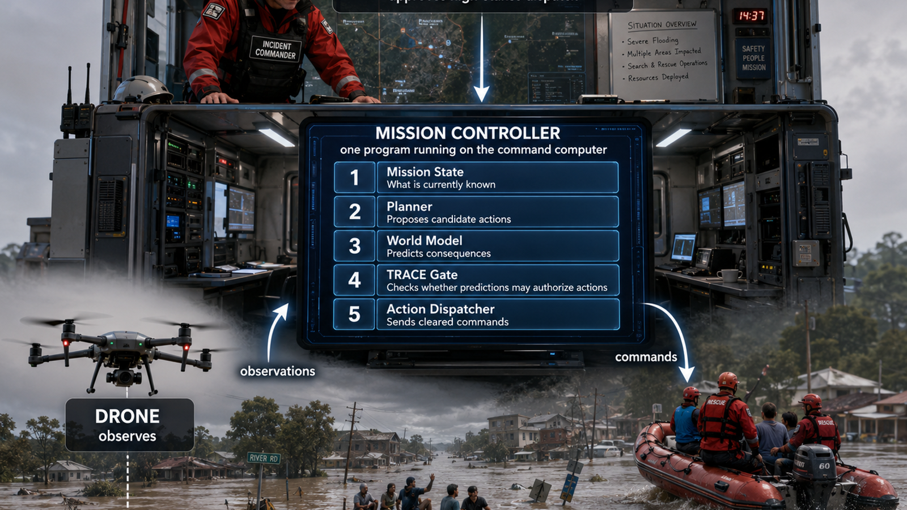
TRACE-JEPA Flood Rescue Implementation
Stages 0-6 · emergency call, mission grounding, TRACE gate, verification, revision, rescue
Teaching rule: build the accountability path before downloading JEPA.

Slide 2
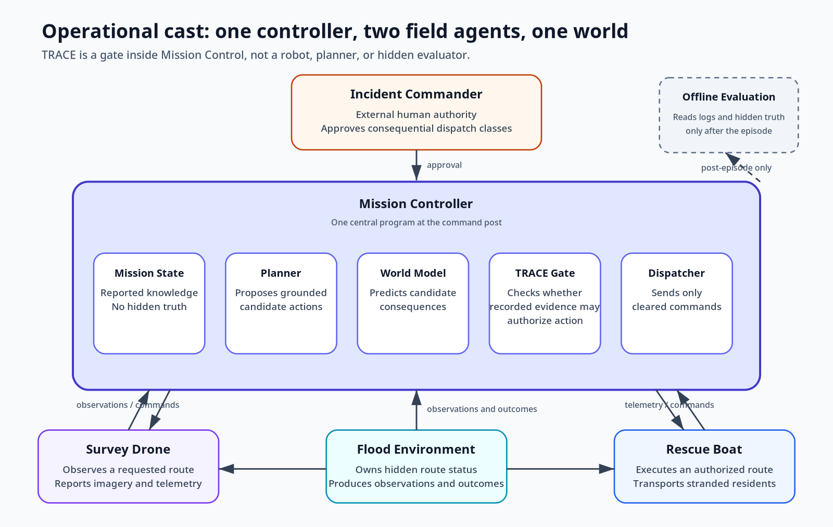
What this demo is about
One central controller, two physical agents, one human authority role, one simulated flood world.
Goal Four residents are isolated at Riverside Apartments. A rescue boat must reach them within 20 minutes.
Conflict The North Channel is shorter but unverified. The South Detour is slower but reported open.
Hidden truth Simulation ground truth contains debris in the North Channel. Mission Control cannot use this until the drone observes it.
• Planner proposes structurally possible actions.
• World Model predicts consequences for each candidate.
• TRACE Gate decides whether the prediction may authorize the action.
• Incident Commander remains the authority for high-stakes dispatch.
TRACE-JEPA flood rescue tutorial · 2
Read: docs/MISSION_BRIEF.md

Slide 3
The operational cast is fixed before code
Avoid ambiguous “evaluator” or “rescue system” language. Use these nouns.
• Flood Environment owns hidden truth and emits observations/outcomes.
• Survey Drone observes a requested route and reports back.
• Rescue Boat executes only authorized rescue dispatches.
• Mission Controller is one program: state, planner, world model, TRACE gate, dispatcher.
• Incident Commander supplies external authority; TRACE cannot synthesize it.
Operational evaluator? No. Offline evaluation scores logs after the run and sends no commands.
TRACE-JEPA flood rescue tutorial · 3
Side file S08 maps names to source files

Slide 4
Stage map for the first implementation block
Each stage has a concrete observable exit condition.
Stage 0
Briefing
Name entities and knowledge boundary
Stage 1
Install
Verifier and tests pass
Stage 2
Visualize
Render Mission Control view vs hidden truth
Stage 3
Scenario + actions
Every action is grounded
Stage 4
Contracts
Evidence and TRACE records round-trip
Stage 5
Policy gate
High confidence cannot override failed support gates
Stage 6
Mock loop
Hold north, verify, revise, clear south
This deck documents the call-to-rescue path directly and gives carefully labeled side files for long code.
TRACE-JEPA flood rescue tutorial · 4
Deck + side files live in docs/tutorial_deck/

Slide 5
Stage 1: laptop-safe install
No PyTorch, no V-JEPA checkpoint, no GPU required yet.
1 # Side file S00_environment_setup.sh 2 git --version 3 uname -m 4 conda info | grep platform 5 6 conda create -n trace-jepa python=3.12 pip -y 7 conda activate trace-jepa 8 python --version 9 which python
• Expected: Python 3.12.x inside the trace-jepa environment.
• Expected: verifier passes and core tests pass.
• Acceptable: optional V-JEPA/PyTorch test skipped.
• Do not install .[jepa] yet.
1 # Side file S01_install_and_verify.sh 2 python -m pip install --upgrade pip setuptools wheel 3 python -m pip install -e ".[dev]" 4 trace-jepa-verify 5 pytest
Exit condition: project commands are available and the core test suite passes.
TRACE-JEPA flood rescue tutorial · 5
Side files S00-S01

Slide 6
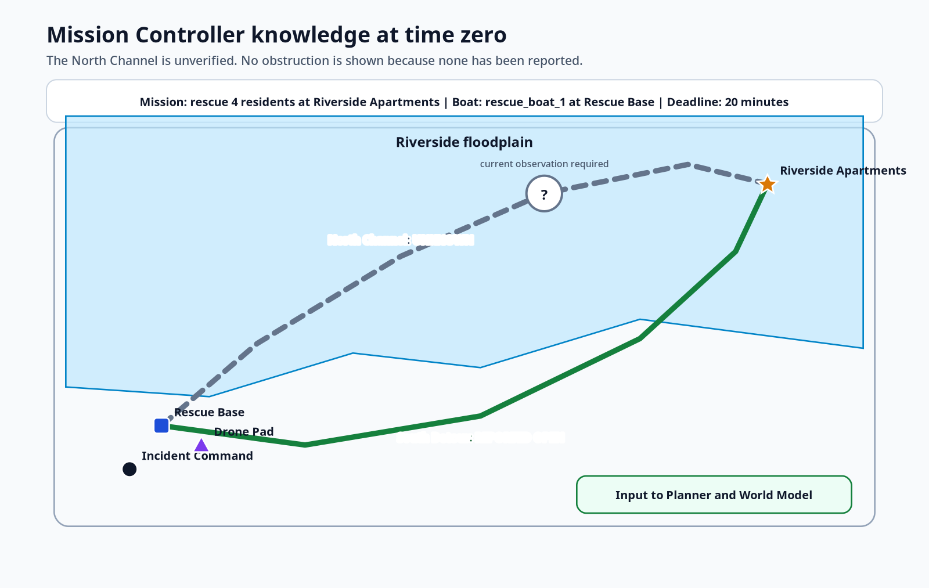
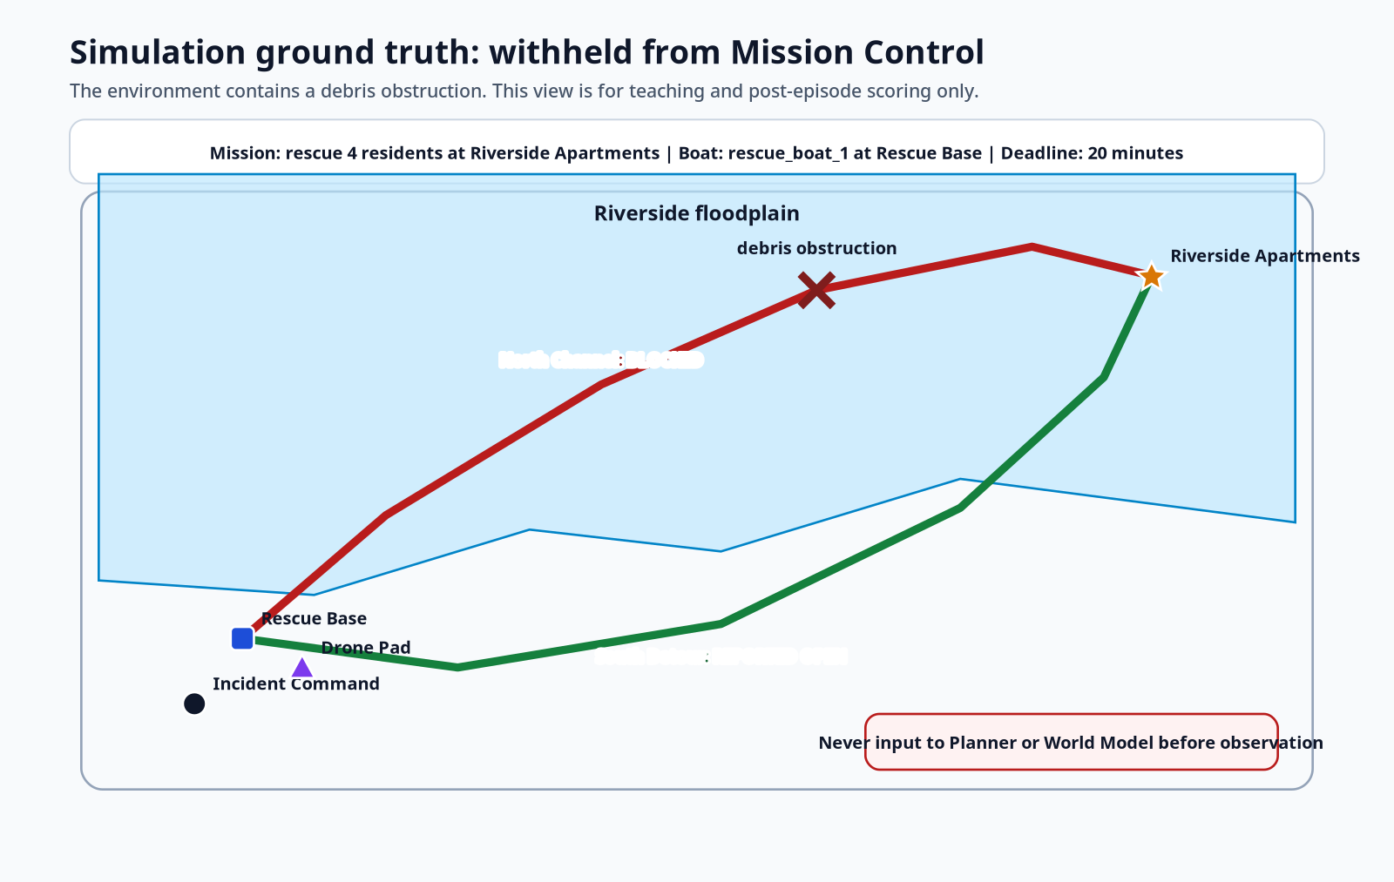
Stage 2: visualize before writing more code
The map forces every action and observation to refer to a concrete place.
1 # Side file S02_visualize_environment.sh 2 trace-jepa-visualize --scenario configs/scenarios/riverside_flood_v1.yaml --output artifacts/runs/scenario_brief 3 4 open artifacts/runs/scenario_brief/operational_cast.svg 5 open artifacts/runs/scenario_brief/mission_controller_knowledge.svg 6 open artifacts/runs/scenario_brief/simulation_ground_truth.svg
Mission Controller knowledge: North Channel unverified
Simulation ground truth: North Channel blocked
• The visualizer reads one scenario file.
• It renders vector SVGs, not raster-only screenshots.
• The same world is shown from two information states.
• The hidden truth view is for debugging and evaluation only.
Never leak simulation ground truth into Mission State.
TRACE-JEPA flood rescue tutorial · 6
Side file S02

Slide 7
Stage 2: the two map views answer different questions
The visual difference is the first safety boundary.
Input to Mission Controller
Used only for labels, outcomes, and offline scoring
TRACE-JEPA flood rescue tutorial · 7
View names replace “agent/evaluator” ambiguity

Slide 8
Stage 3: scenario YAML grounds the mission
Routes carry both what is observed and what is true in the simulator.
1 # Side file S03_riverside_flood_v1.yaml 2 routes: 3 north_channel: 4 label: North Channel 5 waypoints: [[12,16], [24,33], [42,51], [60,64], [78,70], [88,66]] 6 truth_status: blocked 7 blockage_position: [60,64] 8 observed_status: unknown 9 10 south_detour: 11 label: South Detour 12 waypoints: [[12,16], [30,12], [52,18], [72,34], [84,52], [88,66]] 13 truth_status: open 14 observed_status: open
• truth_status is owned by the Flood Environment.
• observed_status is what the Mission Controller can use.
• The North Channel starts unknown, not blocked, from the controller’s view.
• The drone changes observed_status only after verification.
Exit condition: you can explain why the same route has two statuses.
TRACE-JEPA flood rescue tutorial · 8
Side file S03

Slide 9
Stage 3: actions are grounded, not strings
The same action object is read by the planner, predictor, TRACE record, dispatcher, environment, and audit.
1 # Side file S04_flood_actions_v1.yaml 2 actions: 3 dispatch_rescue_boat: 4 requires_authority: true 5 reversible: false 6 parameters: [origin, destination, route_id, people_count, deadline_s] 7 8 verify_route: 9 requires_authority: false 10 reversible: true 11 parameters: [route_id, purpose]
1 # Grounded ActionInstance shape 2 action_type: dispatch_rescue_boat 3 actor_id: rescue_boat_1 4 origin: rescue_base 5 destination: riverside_apartments 6 route_id: south_detour 7 parameters: 8 people_count: 4 9 deadline_s: 1200
Bad: "dispatch_boat_north". Good: actor + route + origin + destination + mission parameters.
• The action object becomes part of the commitment and later evidence chain.
• Every durable dispatch must cite the authorizing record version.
• This is the first step toward plan-branch localization.
TRACE-JEPA flood rescue tutorial · 9
Side file S04

Slide 10
Stage 4: durable contracts before model code
Freeze what will be stored before building the predictor.
1 # Source: src/trace_jepa/contracts/models.py 2 class WorldModelEvidence(FrozenModel): 3 evidence_id: str 4 encoder_version: str 5 predictor_version: str 6 candidate_plan_id: str 7 rollout_horizon: int 8 predicted_claims: tuple[str, ...] 9 uncertainty: float 10 model_support: float 11 out_of_distribution_score: float 12 realized_outcome: dict | None = None 13 14 class TraceRecord(FrozenModel): 15 record_id: str 16 record_version: int 17 policy_version: str 18 claim: Claim 19 evidence_refs: tuple[str, ...] 20 final_status: TraceStatus 21 failed_gates: tuple[str, ...] 22 missing_items: tuple[str, ...] 23 repair: str | None 24 consumer_actions: tuple[ConsumerAction, ...]
• Evidence states what a model version predicted.
• TraceRecord states what claim was evaluated and why it passed or failed.
• ConsumerAction records what the Mission Controller did with the verdict.
• Revisions create new versions; committed records are not edited in place.
Long code is in complete_source/S04_contracts_models.py
TRACE-JEPA flood rescue tutorial · 10
Side file complete_source/S04

Slide 11
Stage 4: first TRACE record by hand
This validates storage and the confidence/support distinction before any automatic policy logic.
1 # Side file S05_first_trace_record.py 2 evidence = WorldModelEvidence( 3 candidate_plan_id="north-direct", 4 predicted_claims=("North Channel is open for dispatch.",), 5 uncertainty=0.08, 6 model_support=0.28, 7 out_of_distribution_score=0.82, 8 rollout_horizon=3, 9 ) 10 11 claim = Claim( 12 layer=ClaimLayer.PREDICTIVE, 13 text="North Channel is open for dispatch.", 14 confidence=0.92, 15 ) 16 17 record = TraceRecord( 18 final_status=TraceStatus.DEFER, 19 failed_gates=("model_support", "out_of_distribution"), 20 missing_items=("A current observation of North Channel.",), 21 repair="Send the survey drone before dispatching the boat.", 22 )
1 $ PYTHONPATH=src python labs/01_contracts_and_log/first_record.py 2 Evidence stored: wm-evidence-lab01-north-route-v1 3 Predicted plan success: 0.92 4 Claim confidence: 0.92 5 Evidence support/OOD: 0.28 / 0.82 6 TRACE status: defer 7 Failed gates: model_support, out_of_distribution 8 Hash chain valid: True 9 Records in repository: 1
Run it twice. Records in repository must remain 1.
• 0.92 is printed so students see the number.
• Support and OOD still determine whether the claim can authorize action.
• The hand-authored record is only a contract/storage exercise.
TRACE-JEPA flood rescue tutorial · 11
Side file lab_scripts/S05

Slide 12
Stage 5: policy gate computes the verdict
The next step removes manual judgment from the first record.
1 # configs/policies/trace_v1.yaml 2 policy_version: trace-flood-v1 3 min_model_support: 0.60 4 max_ood_score: 0.35 5 max_uncertainty: 0.30 6 max_rollout_horizon: 8 7 max_observation_age_s: 120.0 8 allow_qualified_reversible_probe: true 9 require_authority_for: 10 - dispatch_rescue_boat 11 - deploy_ground_team
1 # Source: src/trace_jepa/runtime/policy.py 2 if evidence.model_support < min_model_support: 3 failed.append("model_support") 4 if evidence.out_of_distribution_score > max_ood_score: 5 failed.append("out_of_distribution") 6 7 if authority_required and not authority_present: 8 return ESCALATE 9 10 if failed and reversible: 11 return QUALIFY 12 if failed: 13 return HOLD 14 return CLEAR
Hard gates are lexicographic: a high utility score cannot average away failed support or OOD gates.
TRACE-JEPA flood rescue tutorial · 12
Side file S06 + complete_source/S06_runtime_policy.py

Slide 13
Stage 5: four policy cases students should predict
This is a deterministic test fixture, not an experiment.
Case 1 · support 0.28 / OOD 0.82 · dispatch boat · authority yes → HOLD
Case 2 · support 0.28 / OOD 0.82 · verify route · authority no → QUALIFY
Case 3 · support 0.90 / OOD 0.10 · dispatch boat · authority no → ESCALATE
Case 4 · support 0.90 / OOD 0.10 · dispatch boat · authority yes → CLEAR
1 $ PYTHONPATH=src python labs/01_contracts_and_log/policy_walkthrough.py 2 Case 1: Unsupported irreversible dispatch -> hold 3 Case 2: Unsupported but reversible verification -> qualify 4 Case 3: Supported dispatch without authority -> escalate 5 Case 4: Supported dispatch with authority -> clear
Teaching point: TRACE is not anti-action. It holds the risky commitment but allows evidence gathering.
TRACE-JEPA flood rescue tutorial · 13
Side file lab_scripts/S06

Slide 14
Stage 6 preview: run the closed-loop demo
Now the Mission Controller connects planner, predictor, TRACE gate, dispatcher, environment, and revision.
1 # Side file S07_run_mock_closed_loop.sh 2 trace-jepa-demo --output artifacts/runs/deck_walkthrough 3 cat artifacts/runs/deck_walkthrough/summary.json 4 find artifacts/runs/deck_walkthrough -maxdepth 3 -type f | sort
• North dispatch proposed: high success, low support, high OOD.
• TRACE holds the irreversible northern dispatch.
• TRACE qualifies or clears bounded drone verification.
• Drone observes debris and reports North Channel blocked.
• Revision rejects the northern route claim append-only.
• Planner repairs only the dependent route branch.
• South Detour dispatch clears with authority.
Exit condition: no rescue commitment exists without an authorizing record version.
TRACE-JEPA flood rescue tutorial · 14
Side file S07

Slide 15
Where the long code lives
The deck stays teachable; the side files remain complete and inspectable.
1 Label File Purpose 2 S00 S00_environment_setup.sh Conda/Python setup 3 S01 S01_install_and_verify.sh Editable install and tests 4 S02 S02_visualize_environment.sh Render operational cast and maps 5 S03 S03_riverside_flood_v1.yaml Scenario geometry + route status 6 S04 S04_flood_actions_v1.yaml Grounded action schema 7 S05 lab_scripts/S05_first_trace_record.py First TRACE record 8 S06 lab_scripts/S06_policy_walkthrough.py Automatic gate cases 9 S07 S07_run_mock_closed_loop.sh Pre-filled deterministic episode 10 S08 S08_core_source_file_map.md Core source map 11 S09 S09_emergency_call.txt Example call input 12 S10 S10_run_emergency_call.sh Call-to-rescue command 13 S10-13 complete_source/ Intake, CLI, timeline, controller
Complete source copies are in side_files/complete_source/. Treat them as read-only references.
TRACE-JEPA flood rescue tutorial · 15
docs/tutorial_deck/side_files/README.md

Slide 16
Next live coding checkpoint
After students can explain the cast and run the first scripts, resume at the policy walkthrough.
• Run S05 and explain why confidence = 0.92 is not permission.
• Run S06 and predict all four policy outcomes before executing it.
• Render the two map views and identify which one Mission Control may use.
• Run S07 and inspect the record log, evidence folder, commitments log, and summary.
• Only after the mock loop works do we install PyTorch and cache V-JEPA features.
Teaching mantra: predicted future → typed claim → TRACE record → permitted action → realized outcome → revision.
TRACE-JEPA flood rescue tutorial · 16
Next: close the mock loop, then replace mock visual features

Slide 17
The operational input is an emergency call
The call grounds the incident. It does not contain hidden route truth.
Emergency phone report
Normalized EmergencyCall
1 Emergency. Four residents are stranded at 2 Riverside Apartments. Flood water is rising 3 and the road is inaccessible.
1 raw_text: preserved verbatim 2 reported_location: Riverside Apartments 3 normalized_location_id: riverside_apartments 4 people_count: 4 5 deadline_s: 1200 6 source: emergency_phone
The intake parser may extract location and people count. It may not infer “North Channel is blocked.” That fact belongs to simulation ground truth until observed.
Side input S09 · full parser complete_source/S10_emergency_call_intake.py
TRACE-JEPA flood rescue tutorial · 17
EmergencyCall is a durable typed input

Slide 18
Run from the call and watch actions live
The new command prints every decision and writes an inspectable run directory.
# File input
trace-jepa-call --call-file examples/calls/riverside_call.txt
--output artifacts/runs/call_001
# Inline equivalent
trace-jepa-call --call "Four residents at Riverside Apartments."
--output artifacts/runs/call_002
• If the text is ambiguous, add --location and --people.
• The location must match the teaching scenario registry.
• A later geocoder can replace the resolver without changing the record contract.
• Use a new output folder for each run.
# Inspect results on macOS
cat artifacts/runs/call_001/timeline.txt
open artifacts/runs/call_001/figures/mission_controller_knowledge.svg
open artifacts/runs/call_001/figures/action_timeline.svg
TRACE-JEPA flood rescue tutorial · 18
Side file S10_run_emergency_call.sh

Slide 19
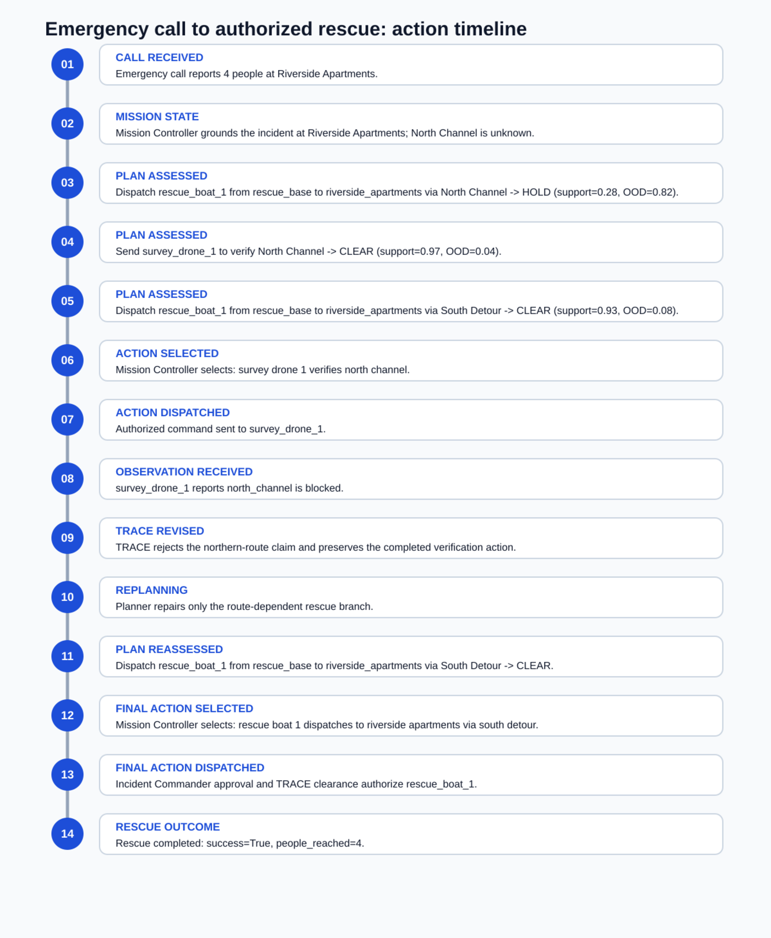
What you should see after the call
The call is followed by assessment, evidence gathering, revision, local repair, and rescue.
• North dispatch: HOLD because support is low and OOD is high.
• Drone verification: CLEAR as a bounded information action.
• Drone reports North Channel blocked.
• TRACE appends a rejecting revision to the north-route claim.
• Planner repairs only the route-dependent branch.
• South Detour: CLEAR with Incident Commander authority.
• Boat reaches four residents; record chain verifies.
TRACE-JEPA flood rescue tutorial · 19
Generated from summary.timeline

Slide 20
Code path: call text to Mission Controller
Short snippets stay on the slide; full source is in labeled side files.
1 call = EmergencyCallIntake(environment.scenario).parse( 2 call_text, 3 location=args.location, 4 people=args.people, 5 ) 6 environment.register_emergency_call(call) 7 controller = MissionController(environment=environment, runtime=runtime) 8 summary = controller.run_episode(output, event_sink=print_event)
S10 intake.py
Ground location and people count; preserve raw call.
S11 emergency_cli.py
Terminal arguments, call file, output directory.
S12 reporting.py
Write timeline.txt and action_timeline.svg.
S13 controller.py
Emit each subsequent action and record transition.
Test: tests/test_emergency_call.py verifies location parsing, first action = drone verification, final action = South Detour, and rescue success.
TRACE-JEPA flood rescue tutorial · 20
Full code: side_files/complete_source/S10-S13

Slide 21
Your next terminal checkpoint
Update the editable install, run one call, and open the action timeline.
cd ~/Projects/trace_jepa_flood_sar_starter
conda activate trace-jepa
python -m pip install -e ".[dev]"
pytest
trace-jepa-call --call-file examples/calls/riverside_call.txt
--output artifacts/runs/call_001
open artifacts/runs/call_001/figures/action_timeline.svg
• Expected tests: all core tests pass.
• Expected first selected action: survey_drone_1 verifies north_channel.
• Expected final selected action: rescue_boat_1 uses south_detour.
• Expected final outcome: four residents reached.
• Expected repository verification: true.
Do not install JEPA yet. First understand every line of the call-to-rescue path.
TRACE-JEPA flood rescue tutorial · 21
Next: replace mock visual features only after this passes

