Slide 1
Exploring the Food Vibe of LA Neighborhoods
Eyan Yeung
Coursera Applied Data Science Capstone
3/11/2020

Slide 2
Distribution of cuisines in LA neighborhoods is useful information to foodies and restaurateurs
Los Angeles is well known for having diverse types of food.
Different cuisine concentrates in different neighborhoods
Foodies are interested in knowing which neighborhood to go to for which kind of cuisine
Restaurateurs need to know the food vibe of the neighborhood before opening in a new neighborhood

Slide 3
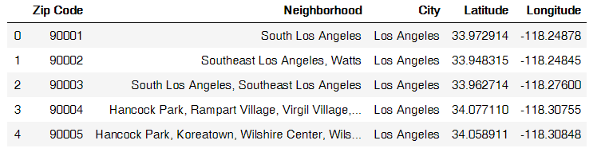
Data Acquisition and Cleaning
Zip code, neighborhood name in LA county from LA almanac.
The longitude and latitude of all areas in California from OpenDataSoft.
Combing the zip code, neighborhood name, city, longitude and latitude information from the two datasets for neighborhoods in the Los Angeles area.
Longitude, latitude and neighborhood name were used as input for the FourSquare API to obtain the top 100 food venues in that neighborhood
Snapshot of the initial dataset used as inputted into the FourSquare API. There are 97 rows (neighborhoods) and 5 columns.

Slide 4
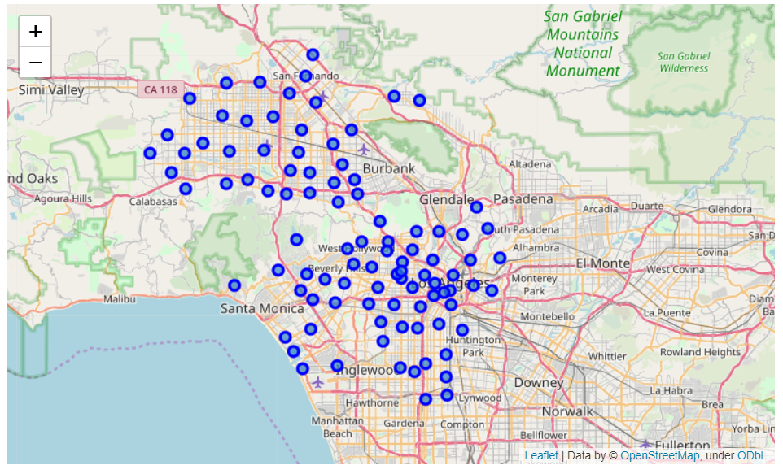
Map showing the geographical distribution of the neighborhoods

Slide 5
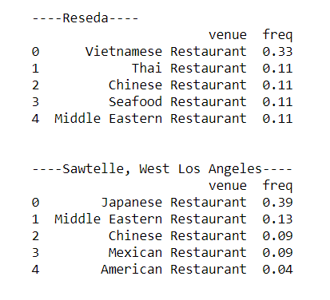
Top neighborhood for different cuisines
The percentage of each cuisine in each neighborhood is calculated
Sawtelle : known for Japanese food
Reseda: the home of a small Vietnamese community
Top 5 cuisines for two of the LA neighborhoods

Slide 6
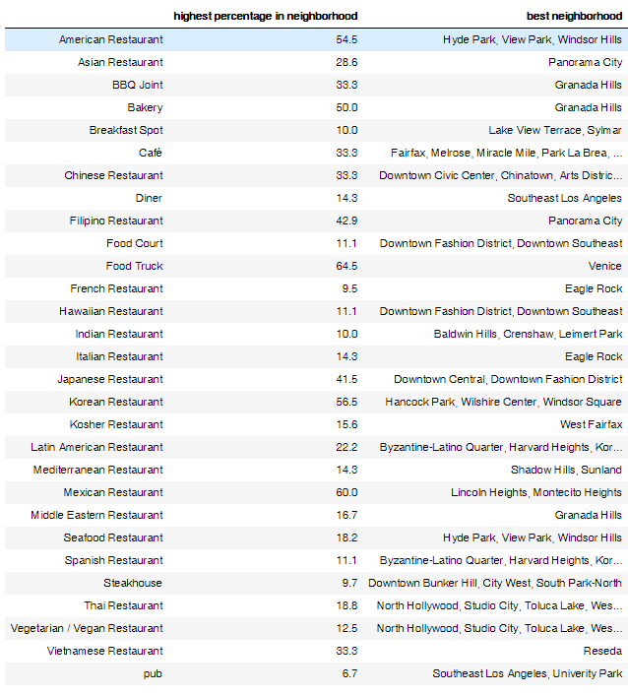
Top neighborhood for different cuisines
The categories (cuisine) of the food venues were combined into 29 general categories.
Venice is highly dominated by food trucks.
Reseda has the highest percentage of Vietnamese food out of all the neighborhoods analzyed

Slide 7
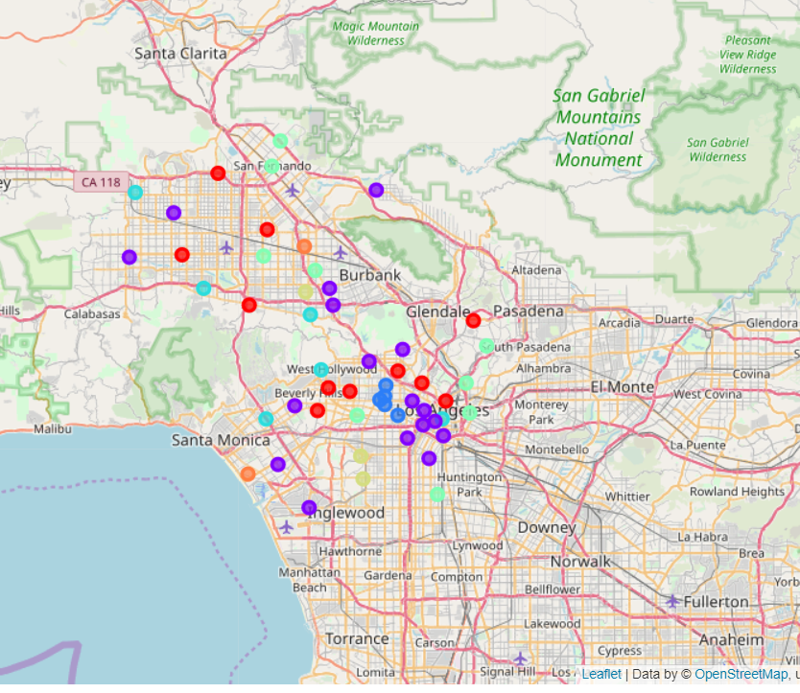
7 clusters with different food vibes from K-mean clustering
Each cluster has high percentage of different food:
Blue: Korean food
Teal : Japanese food
Green: Mexican food
Brown yellow: American food
Orange: food trucks
2 clusters with miscellaneous food vibe
Red and purple

Slide 8
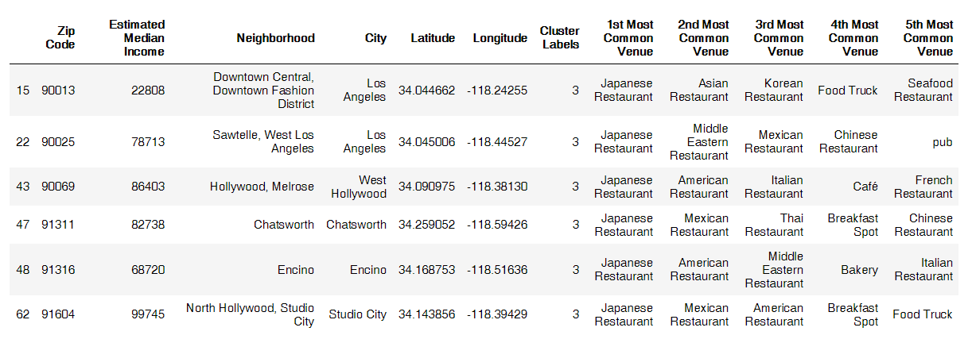
Clusters show neighborhoods that are similar to each other in their food distribution
Suppose you are a Japanese restaurant in Sawtelle.
One day, you decided to open a branch in a different neighborhood with similar competition and food vibe.
You best chance would be to go to neighborhoods belonging to the same cluster as Sawtelle such as Chatsworth, Encino or Metrose.

Slide 9
Conclusion
Clustered 54 neighborhoods into 7 different clusters representing different food vibes.
These clusters show high concentration of different cuisines.
This information can help foodie find new neighborhood to try food, or for restaurateurs to decide where to open their new branch.

