Slide 1

Student Information System (SIS)
A comprehensive console-based software solution designed to digitize and automate core academic administrative processes using C programming language.
CS102 TERM PROJECT
GEBZE TECHNICAL UNIVERSITY

Slide 2

CHAPTER 1
Project Overview & Objectives
Core Mission
Architect a robust system handling complex relational data without external database engines, implementing custom file-based architecture using CSV files with sophisticated parsing algorithms and dynamic memory allocation.
Key Domains
Student Administration - profiles, contact info, academic history
Course Management - curriculum catalog, credits, prerequisites, capacity
Faculty Coordination - professor assignments, workload reports
Academic Records - enrollments, grades, GPAs, graduation eligibility

Slide 3
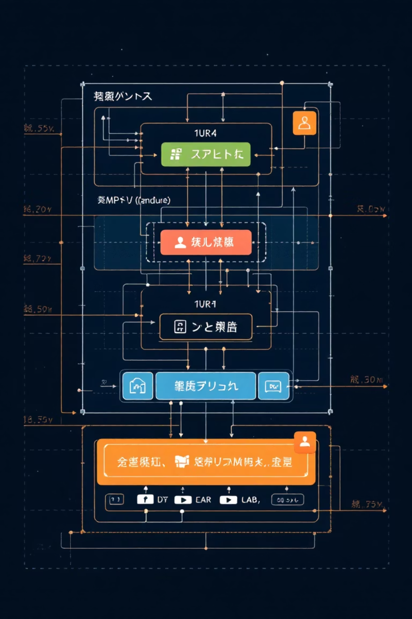
CHAPTER 2
System Architecture Design
Presentation Layer
Console-based UI managed by main.c and menu.c, handling all input/output operations with hierarchical menu system.
Controller Layer
Navigation logic bridging UI and business logic, parsing commands and routing to appropriate backend functions.
Business Logic Layer
Core modules (student.c, course.c, professor.c, enrollment.c, grade.c, curriculum.c) managing entity-specific operations.
Data Persistence Layer
Custom file-based database using CSV format with load/save functions for each module ensuring data preservation.

Slide 4

CHAPTER 3
Technical Features & Innovation
Dynamic Memory Management
Relational Logic
Utilizes malloc and realloc for scalable data arrays, starting with zero records and growing to handle thousands limited only by RAM.
Mimics database behavior with referential integrity through foreign keys and cascade delete functionality preventing orphan records.
Advanced Validation
Curriculum Analysis
Shared utility layer rigorously validates inputs including email formats, unique IDs, semester strings, and duplicate prevention.
Engine analyzes student transcripts against degree requirements to determine graduation eligibility and identify missing courses.

Slide 5
CHAPTER 4
Data Structure & Relationships
01
02
03
Student Entity
Course Entity
Professor Entity
ID (PK), name, email, phone, enrollment year, major, GPA - manages personal profiles and academic calculations.
ID (PK), code, name, credits, capacity, department, prerequisites, instructor_id (FK) - handles curriculum catalog.
ID (PK), name, email, phone, department, title, office - manages faculty records and course assignments.
04
05
Enrollment Entity
Grade Entity
ID (PK), student_id (FK), course_id (FK), professor_id (FK), semester, date, status - links students to courses.
ID (PK), enrollment_id (FK), student_id (FK), course_id (FK), letter grade, numeric grade, semester - tracks performance.

Slide 6
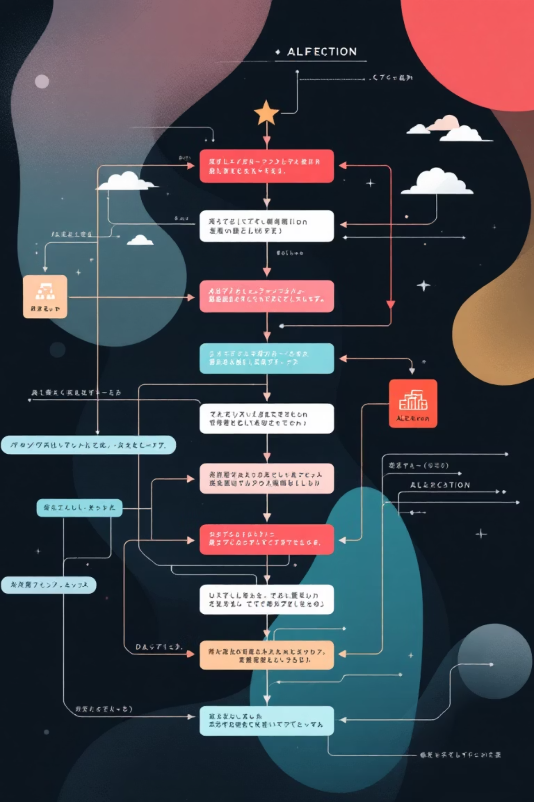
CHAPTER 5
Core Algorithms
Student Enrollment Algorithm
Graduation Check Algorithm
Validate student_id and course_id exist
Load curriculum for student's department
Check for duplicate enrollment in same semester
Check all required courses are passed
Verify prerequisites are met with passing grades
Calculate total earned credits vs minimum required
Check course capacity against active enrollments
Verify GPA meets 2.00 threshold
Create enrollment record with "Enrolled" status
Report eligibility status with deficiencies

Slide 7



CHAPTER 6
Implementation Challenges & Solutions
Circular Dependencies
Dynamic Array Resizing
Input Buffer Handling
Challenge: Course struct needed Enrollment reference while Enrollment needed Course, causing compilation errors.
Challenge: Single pointer caused invalid references when realloc moved memory blocks.
Challenge: scanf left newline characters causing subsequent string inputs to be skipped.
Solution: Adopted double pointer strategy ensuring memory address updates reflected globally.
Solution: Implemented clear_input_buffer() helper and transitioned to fgets with trim function.
Solution: Implemented forward declarations allowing pointers without full struct definitions.

Slide 8

CHAPTER 7
Testing & Validation Results
106
100%
0
Total Test Cases
Pass Rate
Memory Leaks
Comprehensive unit and integration tests across all modules
All assertions passed successfully with zero failures
Valgrind confirmed zero bytes in use at exit
Automated test suite validated Utils (18 tests), Student (13), Professor (7), Course (11), Enrollment (13), Grade (13), and Integration workflows (31 tests). Valgrind analysis confirmed all heap blocks freed with no memory leaks.

Slide 9

CHAPTER 8
LLM Collaboration Analysis
Strategic AI Usage
LLMs served as "force multipliers" for automated testing, concept understanding, and verification rather than code replacement.
Key Successes
Memory management patterns preventing leaks
Reverse loop algorithm for cascade delete
Automated unit test generation with edge cases
Cross-platform compatibility guidance
Critical Limitations
AI occasionally suggested non-standard ANSI C functions (getline, strdup) requiring custom implementations for Windows compatibility.

Slide 10

CONCLUSION
Project Outcomes & Future Vision
Accomplishments
Lessons Learned
Fully functional SIS with robust file-based database, dynamic memory management, relational data model, and comprehensive input validation.
Modular design simplified debugging, early testing saved hours, defensive programming prevented crashes, and double pointers solved memory challenges.
Future Enhancements
Implement Binary Search Tree for O(log n) performance, add GUI using GTK/Qt, introduce role-based access control for Admin vs Student login.
Team Contribution: İbrahim Halil Doğan (50%) - Architecture, Enrollment, File I/O, Course Management. Mert Canoğlu (50%) - Student/Professor Modules, Grading, Testing, Curriculum Logic, Documentation.

