Slide 1


Slide 2

Problem:
Citation process for research is time consuming and may lead to erroneous references
Solution:
To make the citation process for research papers faster, more accurate, and more easily manageable

Slide 3
How:
1) Select citation method
2) Scan a barcode or put link / DOI
to get identifier for source 3) Click 'GENERATE' 4) Citation is produced for you 5) Manage various citations for projects
6) Export the copy to yourself and friends!

Slide 4

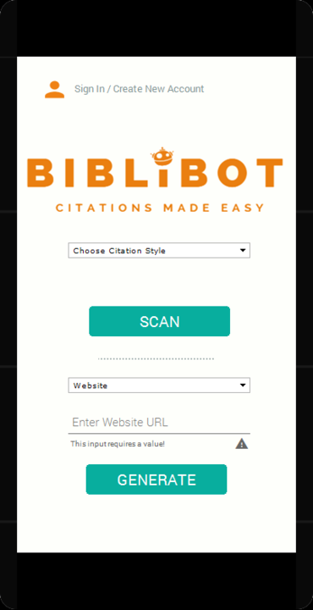
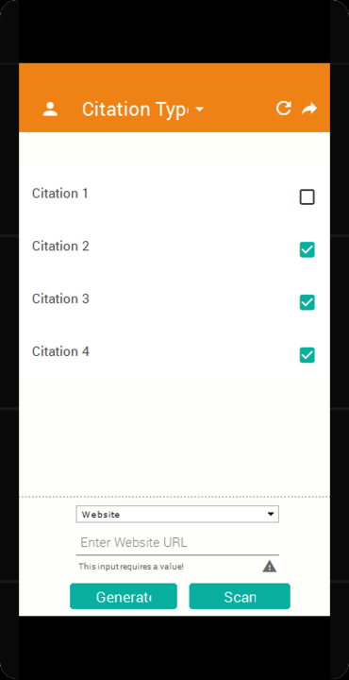
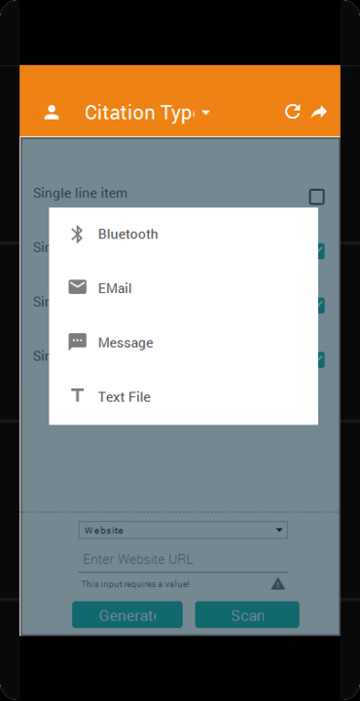

Slide 5

