Slide 1
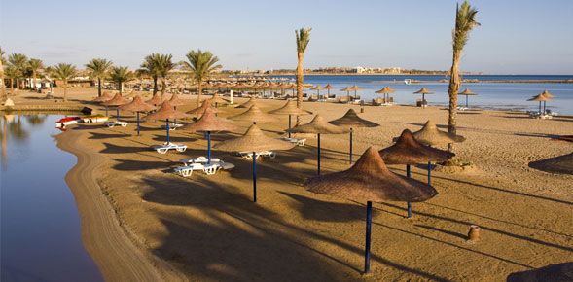
Sample Ghana Tourism Survey

Slide 2

Q1 - Did you travel to Ghana in 2018?
Answer Choices (Single choice only) | No. of Respondents | Percentage %
Yes | 107 | 54
No | 93 | 47
Survey conducted by Survey54
©2020
https//www.survey54.com

Slide 3
Q2 - Where did you travel from?
Answer Choices (Single choice only) | No. of Respondents | Percentage %
USA | 56 | 29
UK | 48 | 24
 | 40 | 20
Europe | 56 | 29
Survey conducted by Survey54
©2020
https//www.survey54.com

Slide 4
Q3 - How much did your plane ticket cost?
Answer Choices (Single choice only) | No. of Respondents | Percentage %
 | 35 | 18
$500-$1000 | 45 | 23
$1000- $2000 | 37 | 19
$2000 + | 46 | 23
Less than $500 | 37 | 19
Survey conducted by Survey54
©2020
https//www.survey54.com

Slide 5
Q4 - What are your thoughts on the price of the ticket and experience on the plane?
Responses (Open ended only) | No. of Respondents | Percentage %
first | 39 | 20
second | 50 | 25
third | 20 | 10
forth | 23 | 12
fifth | 67 | 34
Survey conducted by Survey54
©2020
https//www.survey54.com

Slide 6
Q5 - What kind of accommodation did you stay in?
Answer Choices (Single choice only) | No. of Respondents | Percentage %
 | 46 | 23
Airbnb | 34 | 17
Family/ Friends home? | 40 | 20
Service apartment | 27 | 14
Hotel | 53 | 27
Survey conducted by Survey54
©2020
https//www.survey54.com

Slide 7
Q6 - How did you get around?
Answer Choices (Single choice only) | No. of Respondents | Percentage %
Uber/ Taxify | 42 | 21
Drove my own vehicle | 32 | 16
Private Driver | 38 | 19
Taxi | 43 | 22
Public Transport (Tro Tro) | 45 | 23
Survey conducted by Survey54
©2020
https//www.survey54.com

Slide 8
Q7 - Do you believe it was hard to get around Ghana? In regards to transport
Answer Choices (Single choice only) | No. of Respondents | Percentage %
No | 50 | 25
 | 47 | 24
Yes | 60 | 30
It was ok, but needs to be improved | 43 | 22
Survey conducted by Survey54
©2020
https//www.survey54.com

Slide 9
Q8 - What types of activities did you do/attend?
Answer Choices (Multiple choice only) | No. of Respondents | Percentage %
 | 24 | 12
Clubbing | 29 | 15
Networking | 28 | 15
Tourism | 27 | 14
Night/ Day parties | 31 | 16
Visiting family | 25 | 13
Cultural experiences | 23 | 12
Festival | 13 | 7
Survey conducted by Survey54
©2020
https//www.survey54.com

Slide 10
Q9 - What was your reason for visiting Ghana?
Answer Choices (Single choice only) | No. of Respondents | Percentage %
Cultural visit | 57 | 29
Family/ Friends | 47 | 24
I wanted to party | 56 | 29
Recommendation | 40 | 20
Survey conducted by Survey54
©2020
https//www.survey54.com

Slide 11
Q10 - Was it easy to navigate your way around Ghana?
Answer Choices (Single choice only) | No. of Respondents | Percentage %
Yes | 64 | 32
No | 68 | 34
 | 68 | 34
Survey conducted by Survey54
©2020
https//www.survey54.com

Slide 12
Q11 - What do you think can make Ghana a more attractive place to visit? (I.e Better transport, more tourist sites etc)
Responses (Open ended only) | No. of Respondents | Percentage %
first | 39 | 20
second | 50 | 25
third | 20 | 10
forth | 23 | 12
fifth | 67 | 34
Survey conducted by Survey54
©2020
https//www.survey54.com

Slide 13
Q12 - What kind of activities would you like to do if you visit again?
Responses (Open ended only) | No. of Respondents | Percentage %
first | 39 | 20
second | 50 | 25
third | 20 | 10
forth | 23 | 12
fifth | 67 | 34
Survey conducted by Survey54
©2020
https//www.survey54.com

Slide 14
Q13 - Would you visit again?
Answer Choices (Single choice only) | No. of Respondents | Percentage %
Yes | 114 | 57
No | 86 | 43
Survey conducted by Survey54
©2020
https//www.survey54.com

Slide 15
Q14 - Would you visit in 2019?
Answer Choices (Single choice only) | No. of Respondents | Percentage %
No | 74 | 37
 | 57 | 29
Yes | 69 | 35
Survey conducted by Survey54
©2020
https//www.survey54.com

Slide 16
Q15 - If you are interested in taking more surveys on Africa, please add your email below:
Responses (Open ended only) | No. of Respondents | Percentage %
first | 39 | 20
second | 50 | 25
third | 20 | 10
forth | 23 | 12
fifth | 67 | 34
Survey conducted by Survey54
©2020
https//www.survey54.com

Slide 17

©2020
https//www.survey54.com
Survey conducted by Survey54
©2020
https//www.survey54.com

