Slide 1
Secure Data Hiding in Image Using Steganography
CAPSTONE PROJECT
Presented By : Dipankar Saha
College Name & Department : Maulana Abul Kalam Azad University of Technology, West Bengal - Information Technology (Cyber Security)

Slide 2
OUTLINE
Problem Statement
Technology used
Wow factor
End users
Result
Conclusion
Git-hub Link
Future scope

Slide 3
Problem Statement
In today's digital world, secure data transmission is a major concern. Traditional encryption methods can attract attention, making them susceptible to attacks. This project uses image steganography to securely embed encrypted messages within images, ensuring confidentiality and stealth in communication.

Slide 4
Technology used
Python : The core language for implementing steganography and encryption.
OpenCV (cv2) : Handles image processing, reading, writing, and pixel manipulation for LSB steganography.
Cryptography (Fernet - AES) : Encrypts hidden messages using AES-128 bit encryption, ensuring security even if extracted.
NumPy : Efficiently processes image data as arrays for fast and optimized pixel modifications.

Slide 5
Wow factors
Dual-Layer Security : AES encryption + Steganography ensures highly secure data hiding.
Invisible to the Naked Eye : Hidden messages inside images remain undetectable without the correct decryption process.
Lightweight & Fast Processing : Uses NumPy for optimized pixel manipulation, making encoding & decoding efficient.
Applicable in Cybersecurity : Can be used for secure communications in high-risk environments.

Slide 6
End users
Cybersecurity Professionals – For secure communication.
Journalists & Activists – To protect sensitive information from surveillance.
Government & Defense Agencies – For classified information exchange.
Researchers & Forensic Experts – In digital forensics and data security studies.
Individuals Concerned with Privacy – For personal secure messaging.

Slide 7


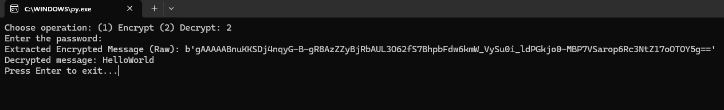
Results
Encryption
Encrypted image output
Decryption

Slide 8
Conclusion
This project successfully implements steganography & cryptography for secure data transmission.
AES encryption ensures only authorized users can extract & read hidden messages.
The method is lightweight, effective, and undetectable, making it ideal for secure communication.

Slide 9
GitHub Link
🔗 GitHub Repository: https://github.com/ezFaith/project_steganography.git

Slide 10
Future scope
Possible Improvements & Enhancements:
Multi-layer encryption for enhanced security.
Graphical User Interface (GUI) to improve usability.
Audio & Video Steganography for wider applications.
AI-based steganography detection & prevention techniques.

Slide 11
THANK YOU

