Slide 1
What is Azure Private Link ?
Azure Private Link enables you to access Azure PaaS Services (ex, Azure SQL Database, Azure Container Registry, Azure Key Vault) and Azure hosted customer-owned/partner services over a private endpoint in your virtual network.
Privately access services on the Azure platform: Connect your virtual network to services in Azure without a public IP address at the source or destination.
On-premises and peered networks: Access services running in Azure from on-premises over ExpressRoute private peering, VPN tunnels, and peered virtual networks using private endpoints.
https://docs.microsoft.com/en-us/azure/private-link/private-link-overview
https://azure.microsoft.com/en-us/pricing/details/private-link
https://docs.microsoft.com/en-us/azure/virtual-network/virtual-network-service-endpoints-overview
https://azure.microsoft.com/fr-fr/blog/announcing-azure-private-link/

Slide 2
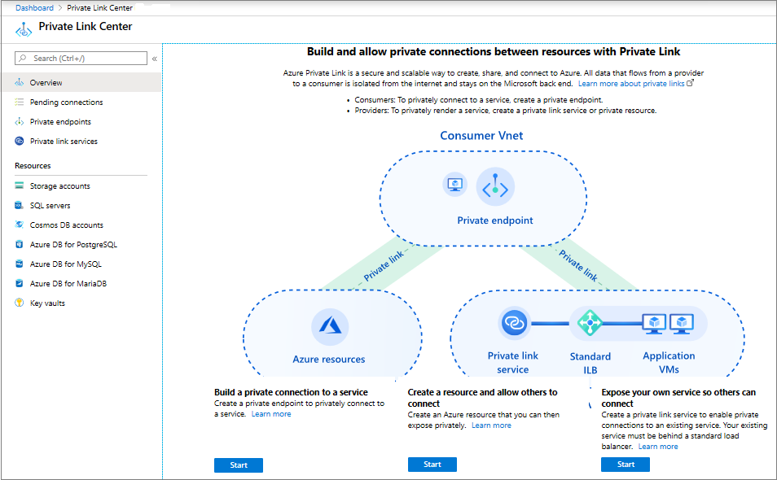
What is Azure Private Link ?

Slide 3

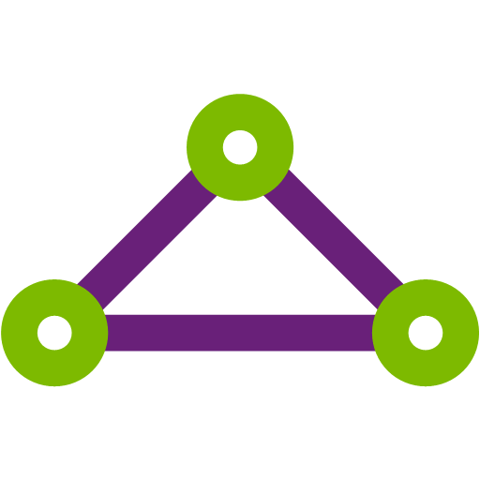


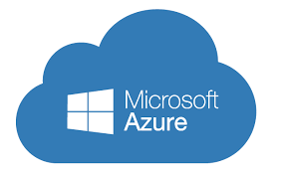






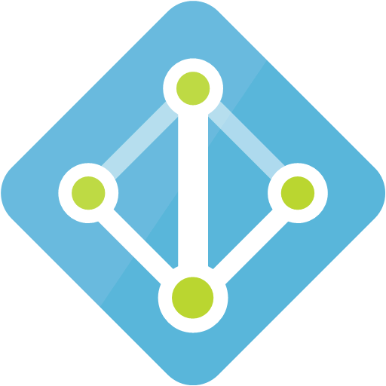
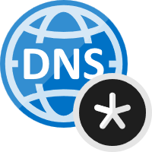




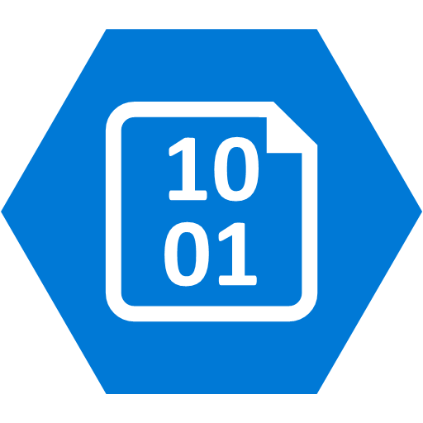










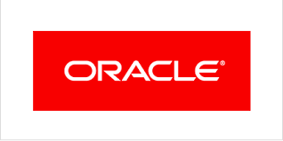

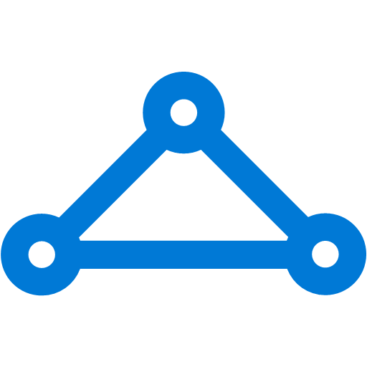









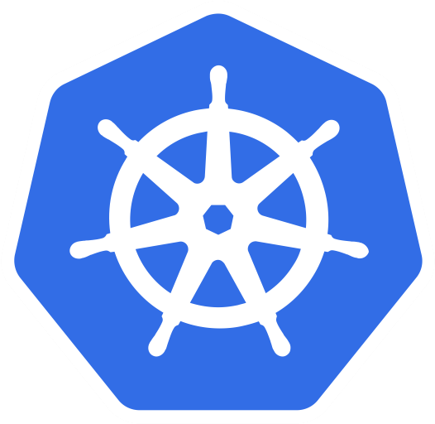




PaaS
Azure board
Azure pipeline
Azure artifacts
Azure Monitor
Azure AD
Azure Private-DNS
Azure BLOB Storage
ACR
Azure DB
KV
APIM
PostgreSQL
ARO cluster: Azure VNET 172.16.0.0/22
Azure Private-Link
IDP – AAD Connector
Control Plane
Master 1
Master 2
Master 3
On-premises infrastructure
Docker Registry ?
P
https://kuberocks-route-kissmy.apps.westeurope.aroapp.io
ARO Masters subnet: 172.16.1.0/24
API
Server
myarostorage.privatelink.blob.core.windows.net
Windows VM
RedHat VM
ORA
Service-X
ARO Workers subnet: 172.16.2.0/24
AD
Router
Oracle
Namespace
OCP
Docker Registry
SVC
CIDR: 10.21.0.0/18
Deployment
Containers
Bare Metal
Registry Storage
Private EP 172.16.2.10
Pod CIDR: 10.42.0.0/18
Worker node 1
Worker node 2
Worker node 3
Builders
Notes:
https://docs.microsoft.com/en-us/azure/storage/common/storage-private-endpoints#conceptual-overview https://docs.microsoft.com/en-us/azure/private-link/create-private-endpoint-storage-portal

Slide 4
ARO Network Architecture

Slide 5
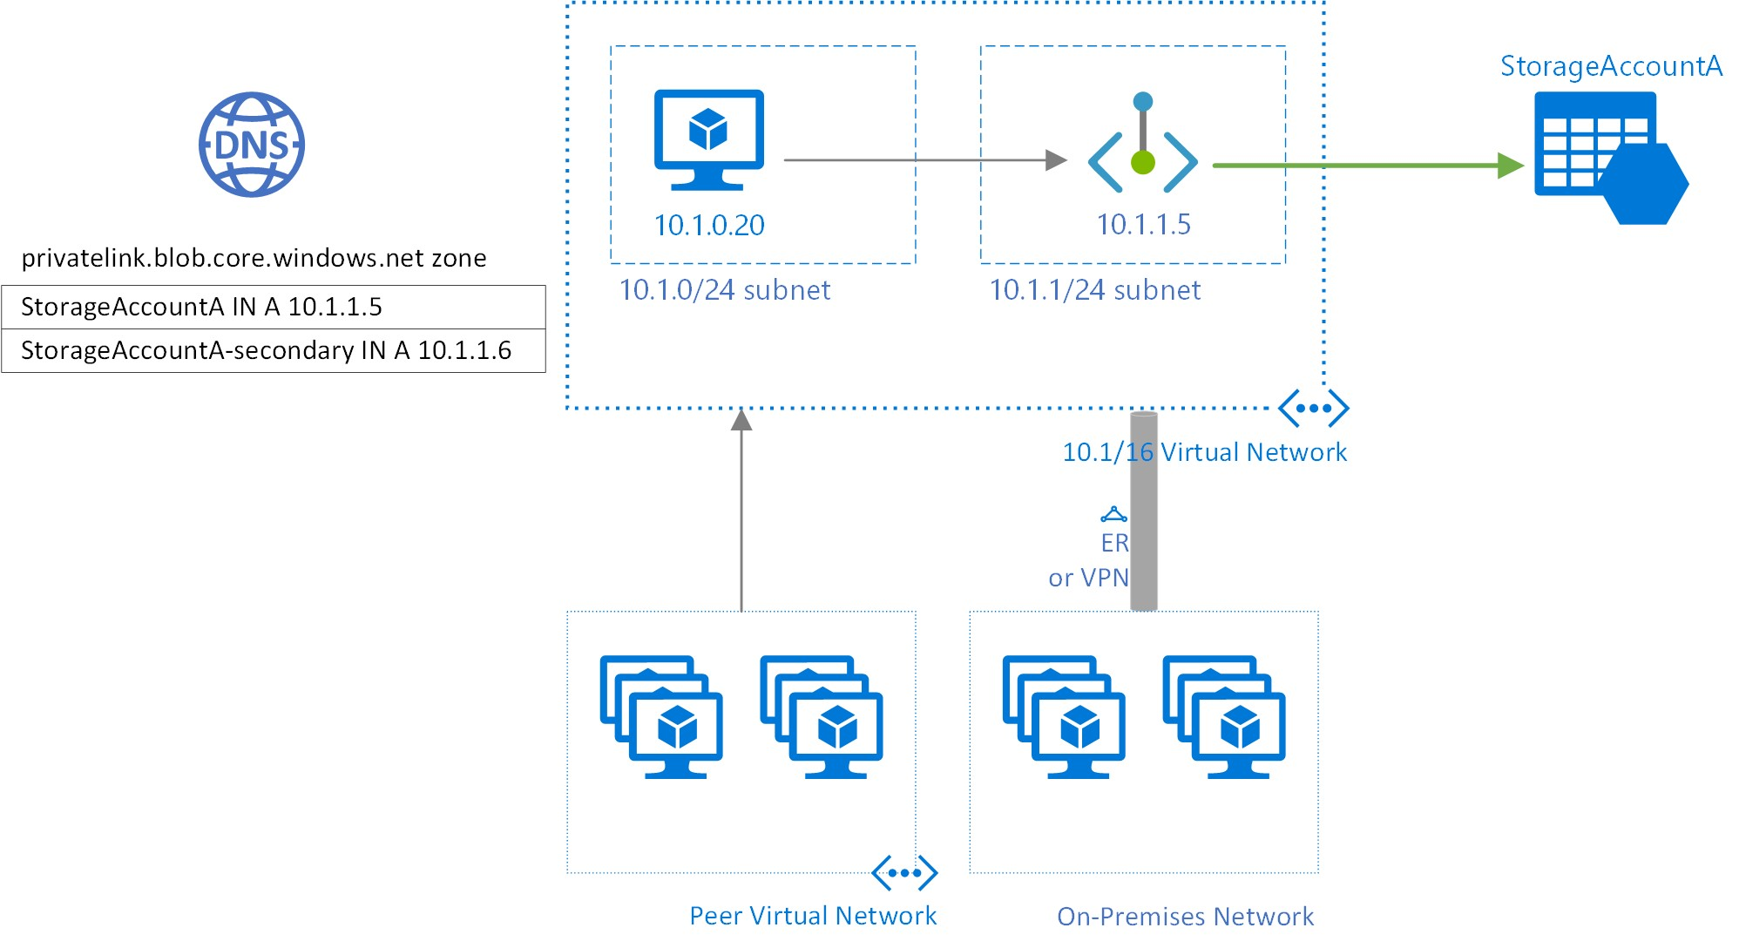
Storage Private-Endpoint

