Slide 1

AZURE
RESOURCE GROUPS

Slide 2

PROVISIONINGSTATE/UNAVAILABLE
Failed to start virtual machine
Failed to start virtual machine 'myDockerVM'. Error: The subscription 'cfcb03ea-255b-42f8-beca-2d4ac30779bb' is disabled and therefore marked as read only. You cannot perform any write actions on this subscription until it is re-enabled.
The virtual machine’s Azure VM agent provisioning state is ‘ProvisioningState/Unavailable’. Ensure that the Azure VM agent is installed on the machine. Refer to https://aka.ms/a2a-agent-install for details. Ensure that the Azure VM agent status is "Ready". You can check the status in 'Virtual Machine > Settings > Properties > Agent status' in Azure portal.
https://account.microsoft.com/?ref=MeControl&refd=portal.azure.com

Slide 3
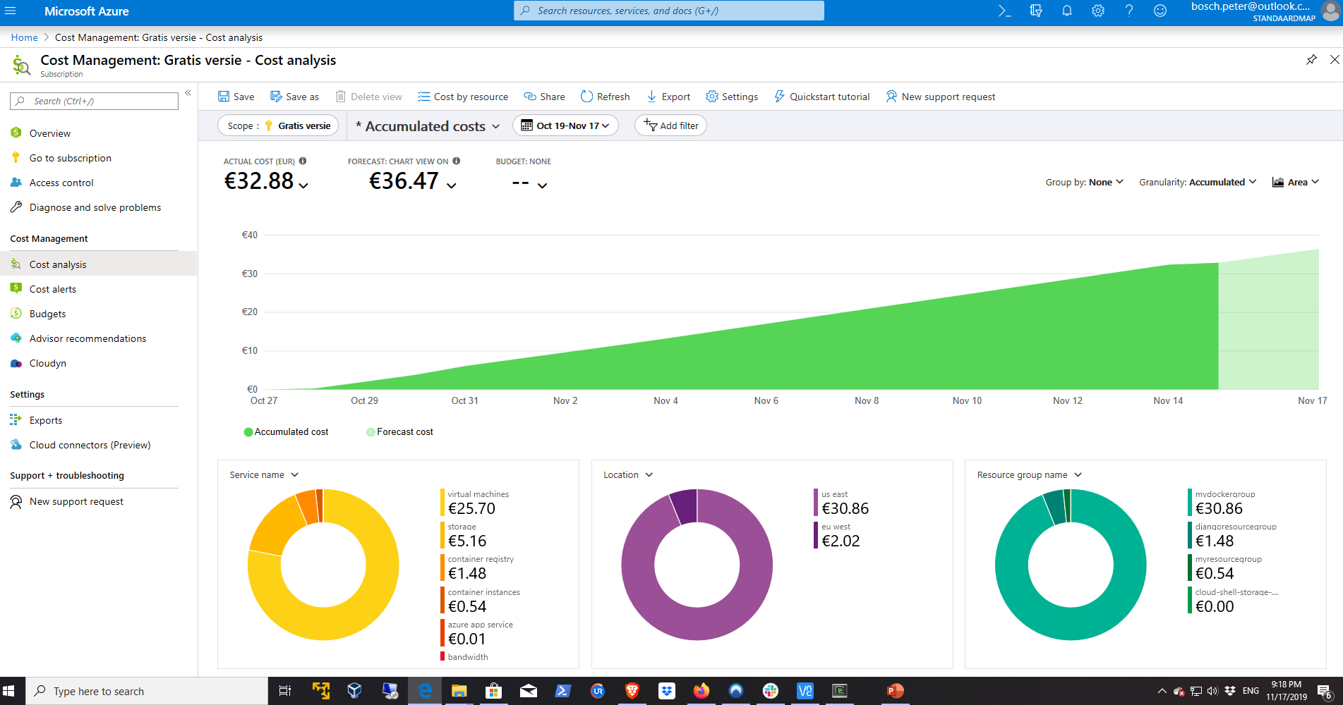
CHECK YOUR CREDIT BALANCE IN THE AZURE PORTAL
Sign in to the Azure portal.
Search for Cost Management + Billing.
Select Azure credits from the left-hand side. ...
The Azure credits page displays the following information: ...
Select Credits list to view list of credits for the billing profile.

Slide 4
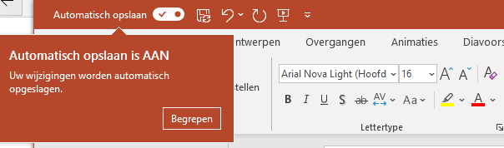
AutoSave is a new feature available in Excel, Word, and PowerPoint for Office 365 subscribers that saves your file automatically, every few seconds, as you work.
AutoSave is enabled by default in Office 365 when a file is stored on OneDrive, OneDrive for Business, or SharePoint Online.
https://support.office.com/en-us/article/What-is-AutoSave-6d6bd723-ebfd-4e40-b5f6-ae6e8088f7a5

Slide 5

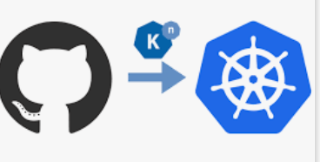
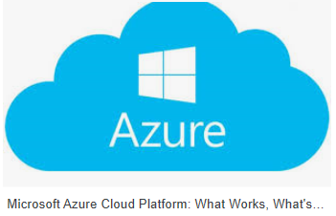







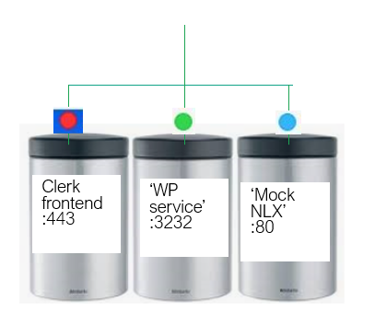


















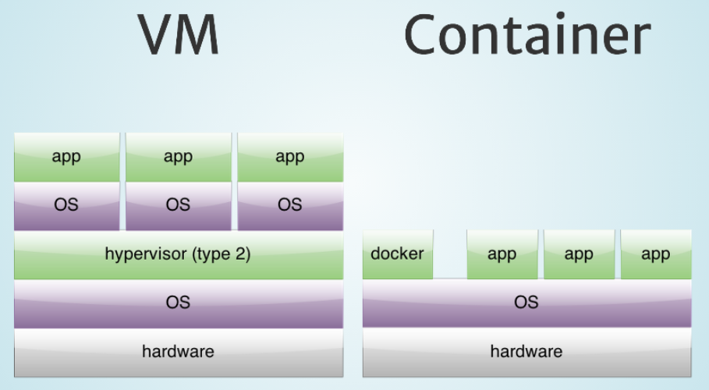

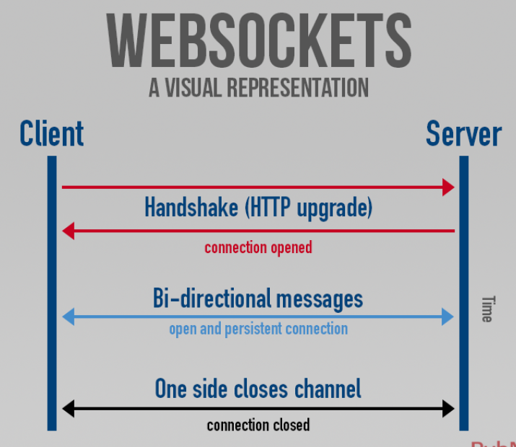



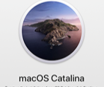
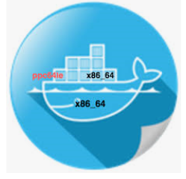















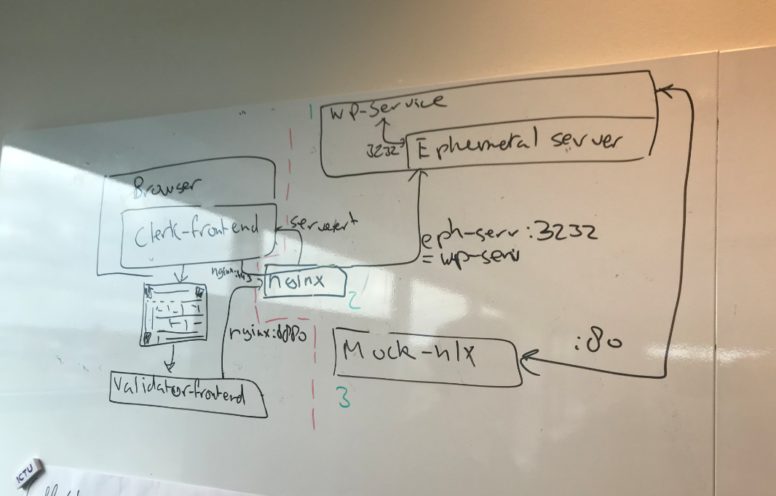


http://hello-django.azurewebsites.net/
Discipl Wigo4it
field architecture
Github docker-compose
dockerHub-pull
Network traffic excl protocol
conversion
Address From NLX Network
17-11-2019

Slide 6
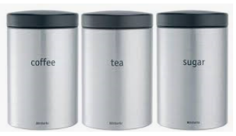
Clerk
frontend
:443
‘WP
service’
:3232
‘Mock
NLX’
:80

