Slide 1
Workshop - IBM Watson Cloud API
Tone Analyzer Service
Isaac Ramirez, MIS.
IBM, Watson Health
Edgar Zamora, Mag.
IBM, GTS
August-September, 2018

Slide 2
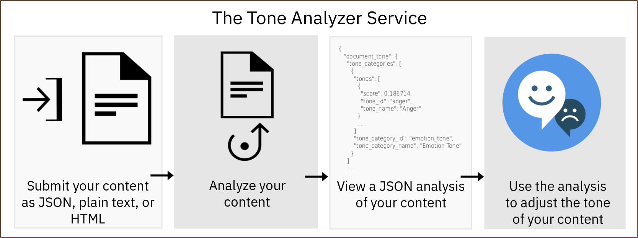
Tone Analyzer Service
It uses linguistic analysis to detect emotional and language tones in written text, at both the document and sentence levels.
Can be used to understand how your written communications are perceived and then to improve the tone of your communications.

Slide 3
Tone Analyzer Service
DEMO #1: General Tone Analysis
(https://tone-analyzer-demo.ng.bluemix.net/)
DEMO #2: Customer engagement
(https://customer-engagement-demo.ng.bluemix.net/)

Slide 4
Tone Analyzer Service: Considerations
Up to 128k of text in a same invocation.
INPUT Text must be in English or French.
Output response can be configured to be in one of several different languages.
Specify charset when required (e.g .UTF-8 for text with symbols).
All reported tones (general, sentence level or utterance) have a score of at least 0.5. Tones with a score of at least 0.75 are likely to be perceived by participants in the conversation.
Service can not be trained.

Slide 5
Tone Analyzer Service: General-purpose endpoint
{
"document_tone": {
"tones": [
{
"score": 0.6165,
"tone_id": "sadness",
"tone_name": "Sadness"
},
{
"score": 0.829888,
"tone_id": "analytical",
"tone_name": "Analytical"
}
]
},
"sentences_tone": [
{
"sentence_id": 0,
"text": "Team, I know that times are tough!",
"tones": [
{
"score": 0.801827,
"tone_id": "analytical",
"tone_name": "Analytical"
}
]
}, ...
Use it to analyze shorter web data, such as email messages or tweets, or longer documents, such as articles or blog posts.
Monitor social media to understand what customers are saying about a brand and to determine whom to target with specific messaging.
The endpoint accepts JSON, plain text, or HTML input.
Anger, Fear, Joy, Sadness, Analytical, Confident, Tentative.
The service returns overall and sentence-level analyses of the tone of the content.

Slide 6
Tone Analyzer Service: Customer-engagement endpoint (POST /v3/tone_chat)
Use it to monitor customer service and support conversations.
Escalate customer conversations when they turn sour or find opportunities to improve customer service scripts, dialog strategies, and customer journeys.
Excited, Frustrated, Impolite, Polite, Sad, Satisfied, Sympathetic
JSON input.
{
"utterances": [
{
"text": "Hello, I'm having a problem with your product.",
"user": "customer"
},
{
"text": "OK, let me know what's going on, please.",
"user": "agent"
}, ...
]
}
JSON output.
{
"utterances_tone": [
{
"utterance_id": 0,
"utterance_text": "Hello, I'm having a problem with your product.",
"tones": [
{
"score": 0.686361,
"tone_id": "polite",
"tone_name": "Polite"
},
{
"score": 0.597795,
"tone_id": "sad",
"tone_name": "sad"
}
]
}, ...

Slide 7
Tone Analyzer Service: Use cases
Social listening and audience monitoring - Monitor social media to understand what customers are saying about your brand in real time. For example, you might determine that your customers in Chicago are sad after the Bulls lost or happy during the Taste of Chicago festival. (General-purpose endpoint)
Personalized marketing - Determine whom to target with personalized messaging and when. For example, a travel company might target happy consumers with "treat yourself" messaging, sad consumers with "escape" messaging, and angry consumers with "relax" messaging. (General-purpose endpoint)
Chat bots - Enable an automated agent to detect customer tones and craft suitable responses. For example, you might respond to sadness with "I'm sorry you are upset about this problem" or to satisfaction with "I'm glad you are satisfied with our service." (Customer-engagement endpoint)
Customer-engagement monitoring and quality assurance - Monitor the overall tone of agent and customer communications, detect anomalies, and highlight opportunities to train agents on how to better communicate. (Customer-engagement endpoint)

Slide 8
Tone Analyzer Service
API Reference
(https://www.ibm.com/watson/developercloud/tone-analyzer/api/v3/java.html?java)

Slide 9
Tone Analyzer Service
Java SDK Code Example
(https://github.com/watson-developer-cloud/java-sdk/tree/master/examples/src/main/java/com/ibm/watson/developer_cloud/tone_analyzer/v3)

Slide 10


