Slide 1
Workshop - IBM Watson Cloud API
Watson Assistant Service
Isaac Ramirez, MIS.
IBM, Watson Health
Edgar Zamora, Mag.
IBM, GTS
August-September, 2018

Slide 2
Watson Assistant Service
Used to build solutions that understands natural-language input and uses machine learning to respond to customers in a way that simulates a conversation between humans.
It is a mesh of previously existing Watson Dialog Service and Natural language Understanding Service.
Smart dialog flow handling.
Language processing capabilities to understand user input.
Learning capabilities to adapt to new users patterns.
Useful for Chatbots:
  A new way to interact with users.
  Alexa skills, Siri, FB Messenger, Slack.
  Chatbot market size is set to exceed USD 1.34 billion by 2024.

Slide 3
Watson Assistant Service
DEMO #1: Simple
(https://watson-conversation-duo-dev.ng.bluemix.net/)
DEMO #2:+ Discovery and Tone Analyzer Services
(https://developer.ibm.com/code/patterns/create-cognitive-banking-chatbot/)

Slide 4
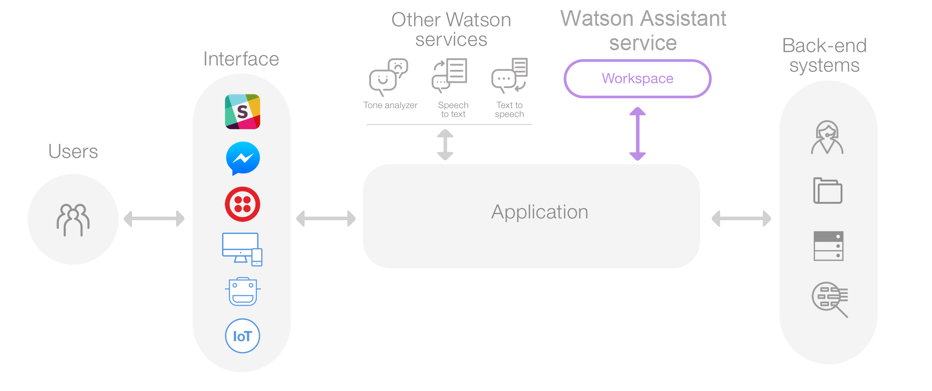
Overall architecture of a complete solution
REST
REST

Slide 5
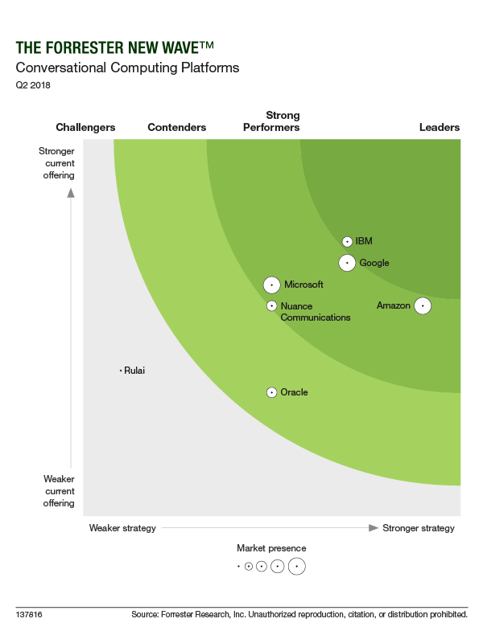
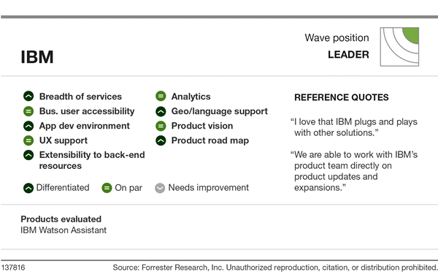
Watson Assistant API
Relevance
https://reprints.forrester.com/#/assets/2/73/RES137816/reports

Slide 6
Implementing a conversation with
Watson Assistant Service

Slide 7
The chatbot we will (try to) create
A very simple chatbot that makes table reservations.
It gets the date, time and number of guest.
Validates fields and ask for confirmation
To create it we need to:
Create the service.
Configure the conversation.
Build a simple Application (Terminal UI by now… =S) that uses the Conversation we configured to get the values from the user and store in a Cloudant database.

Slide 8
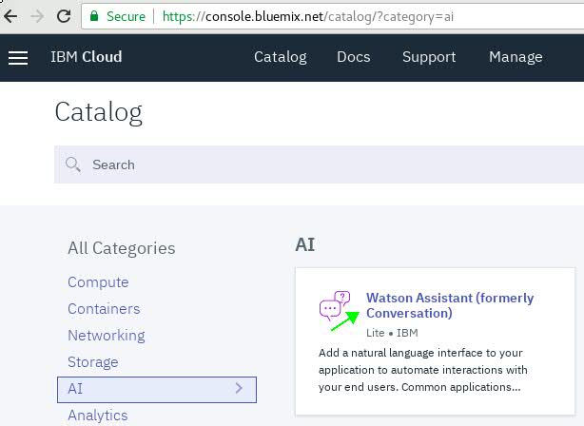
A. Creating the service
Find the service in the Catalog

Slide 9
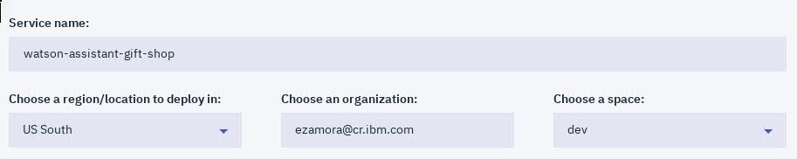
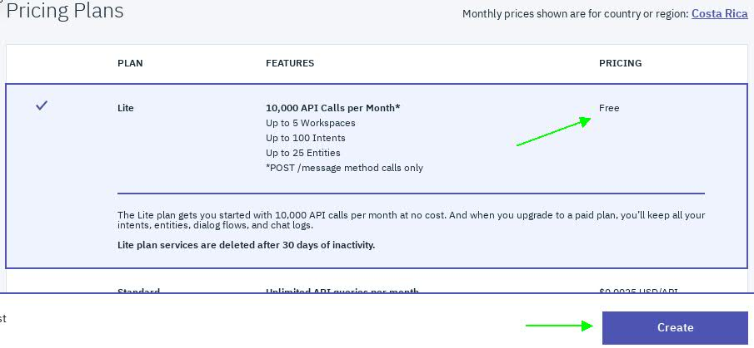
A. Creating the service
Create the service

Slide 10
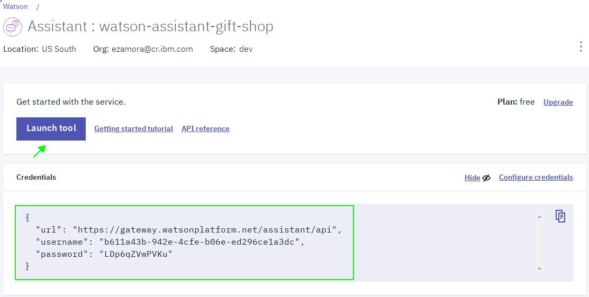
A. Creating the service
The service is provisioned.
The Tool is a web application that will help us to build the conversation.
The credentials will be used for authentication by the Applications or Interfaces that use the conversation.

Slide 11
B. Configuring the conversation: Concepts
Workspace: It is a container for all of the artifacts that define the conversation flow.
A service instance can contain multiple workspaces
Workspace’s artifacts: Intends, Entities, Dialogs

Slide 12
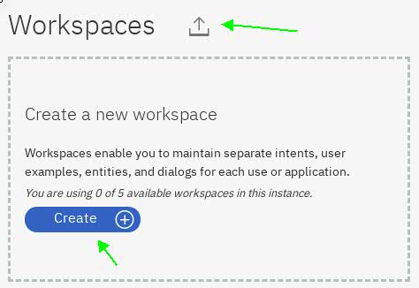
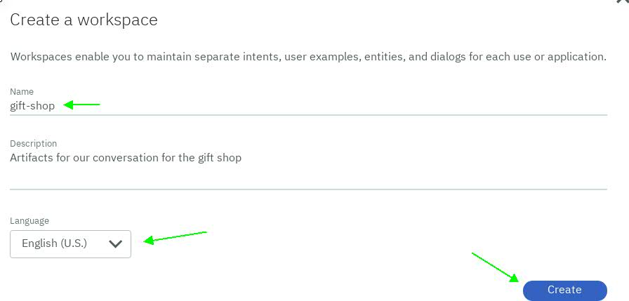
B. Configuring the conversation
Create the workspace
A workspace can be imported from a JSON (file upload has a max size).
Add a meaningful name. No spaces.
Select the conversation language (English is default).

Slide 13
B. Configuring the conversation: Concepts
#Intends: represents the purpose of a user's input:
Examples: greetings, farewell; obtain recommendation, make a reservation, buy, pay; turn on, turn off.
The name of an intent is always prefixed with the # character, no spaces.
To train the workspace to recognize your intents, you supply lots of examples of user input and indicate which intents they map to.
    Example #greetings: Hi, Hello, Good Morning, Good afternoon, Hi there...
Natural language processing will identify which kind of expressions does the persons use to express an intention.
Minimum of five examples by intend.

Slide 14
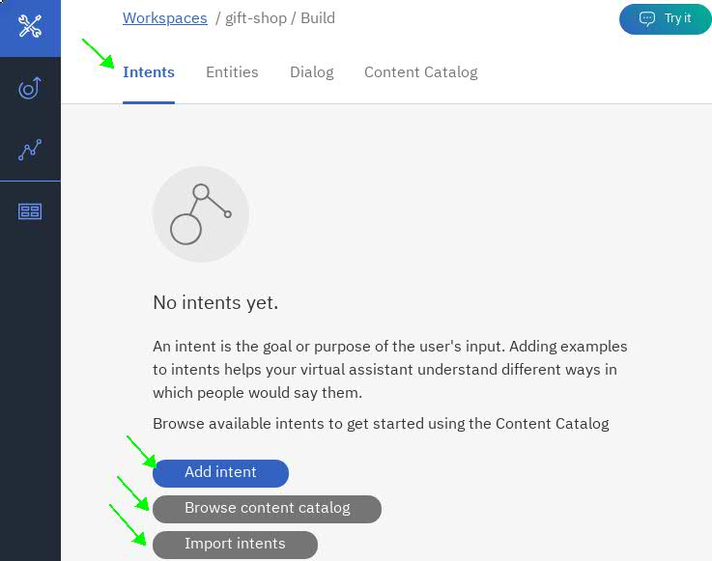
B. Configuring the conversation
Add the intends.
Intends can be imported from a CSV.
Content catalog has commonly used intends for reuse.

Slide 15
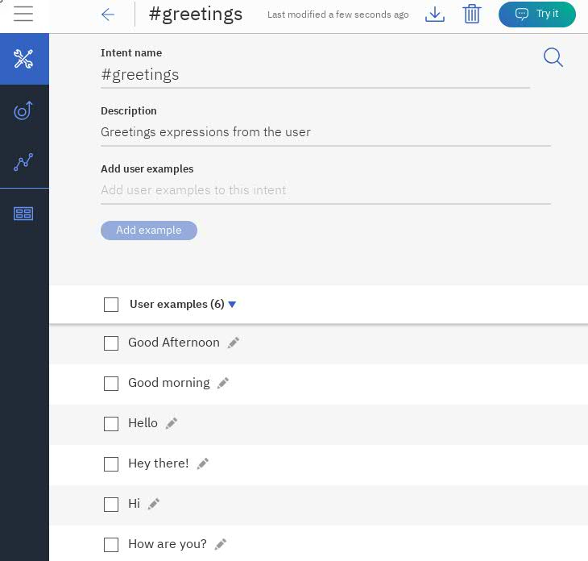
B. Configuring the conversation
Add intent data
Which intents?:
#greetings
#farewell
#make_reservation
#yes
#no
#cancel_reservation (*)
#list_my_reservations (*)

Slide 16
B. Configuring the conversation: Concepts
@Entities: represents a term or object that provides context for an intent.
Example “I want a gift for my son” and “I want a gift for my wife” have the same #suggestions intend, entities “@son” and “@wife” will help to identify which recommendations to do.
The name of an intent is always prefixed with the @ character, no spaces.
Entities have Values. Examples: “son”, “wife”, “friend”
Values have Synonyms Examples “friend: folk, dude”, “son: child, my baby”.
The service already provides common entities: System Entities.
Some System Entities: date, time, number, location, person name.
System entities do not need values.

Slide 17
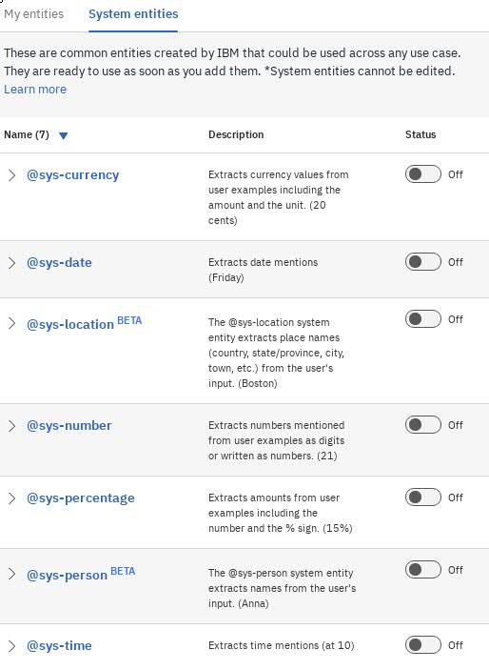
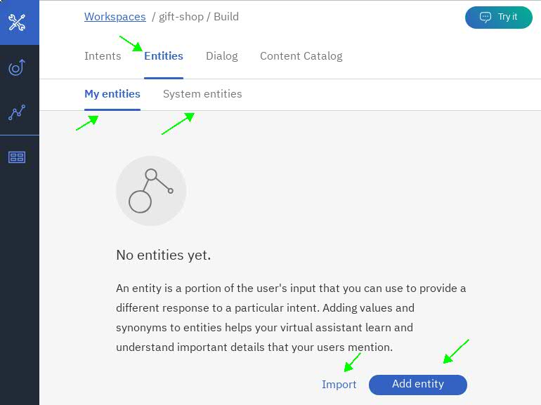
B. Configuring the conversation
Add the entities
Entities can be imported from a CSV (file upload has a max size)
System entities has commonly used entities

Slide 18
B. Configuring the conversation
Write some typical sentences you would do in conversation with the system.
Then, analyse entities for a #gift_suggestions intend:
I want something for my wife’s birthday
What can I give for friends anniversary?
What is a good present for my son’s graduation?
Can you recommend something for San Valentine’s day?
What’s the best gift to demonstrate gratitude?
What’s the best gift to demonstrate friendship?
I want something for my boyfriend.
Entities identified:
@occasion
@recipient

Slide 19
B. Configuring the conversation
How Watson sees the sentences
Which gift for a birthday?
#suggestions
@occassion:birthday

Slide 20
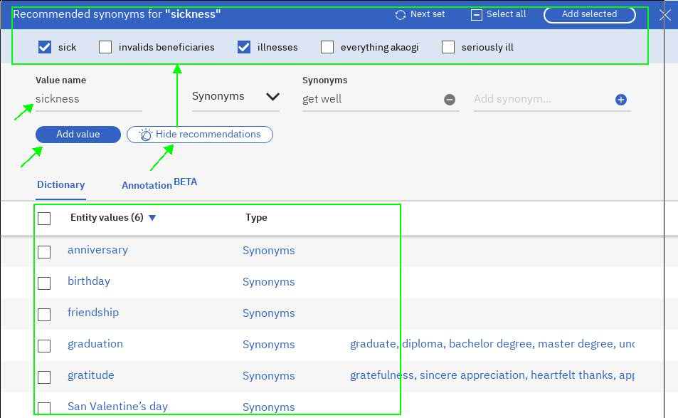
B. Configuring the conversation
Add entities and synonyms
Use recommendations for synonyms

Slide 21
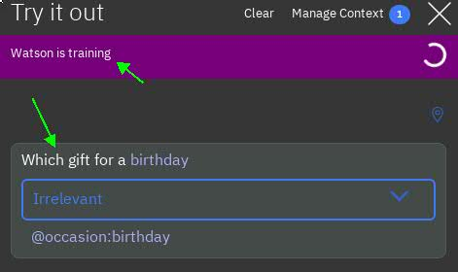
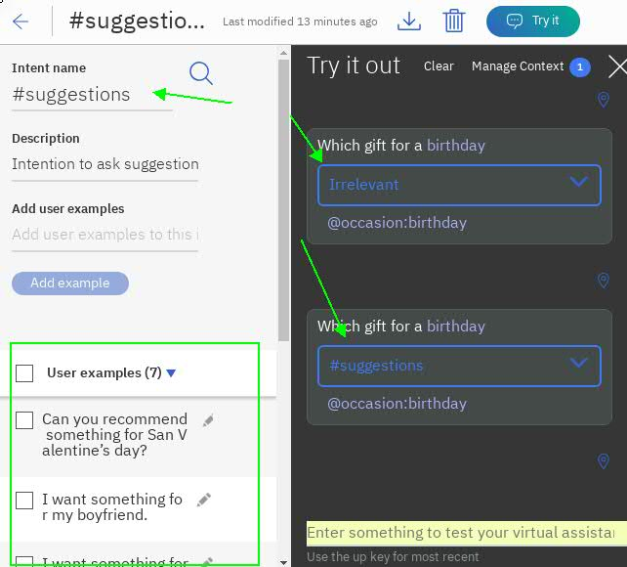
B. Configuring the conversation
“Try Out” panel: Helps to check our “conversation” and train Watson while conversing.

Slide 22
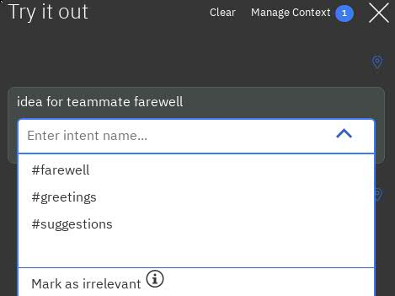
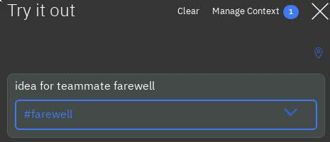
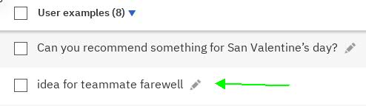
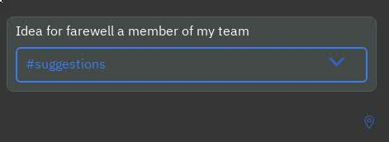
B. Configuring the conversation
“Try Out” panel: Helps to check our “conversation” and train Watson while conversing

Slide 23
B. Configuring the conversation: Concepts
Dialog: a branching conversation flow that defines how the application responds when it recognizes the defined intents and entities.
  It is represented graphically in the tool as a tree.
  Add branches to process each of the intents.
  Then add branch nodes that handle the many possible permutations of a request based on other factors, such as the entities found in the user input or information that is passed to the service from your application or another external service.
Load the dialog:
$git clone https://github.com/ezamorad/WatsonCloudAPIWorkshop.git
In the Watson Assistant Tool import the JSON workspace-WatsonReservation.json

Slide 24
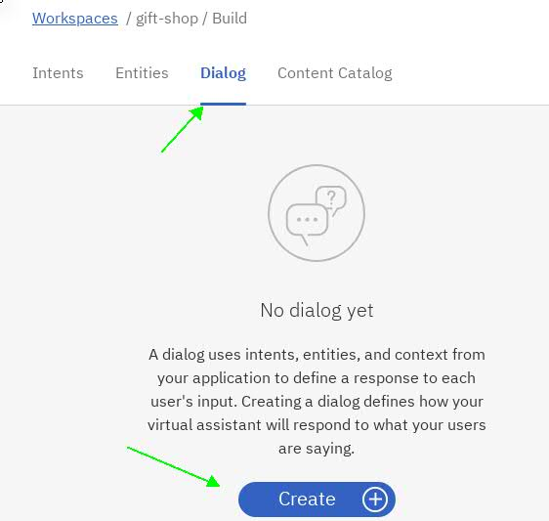
B. Configuring the conversation
Create the dialog

Slide 25
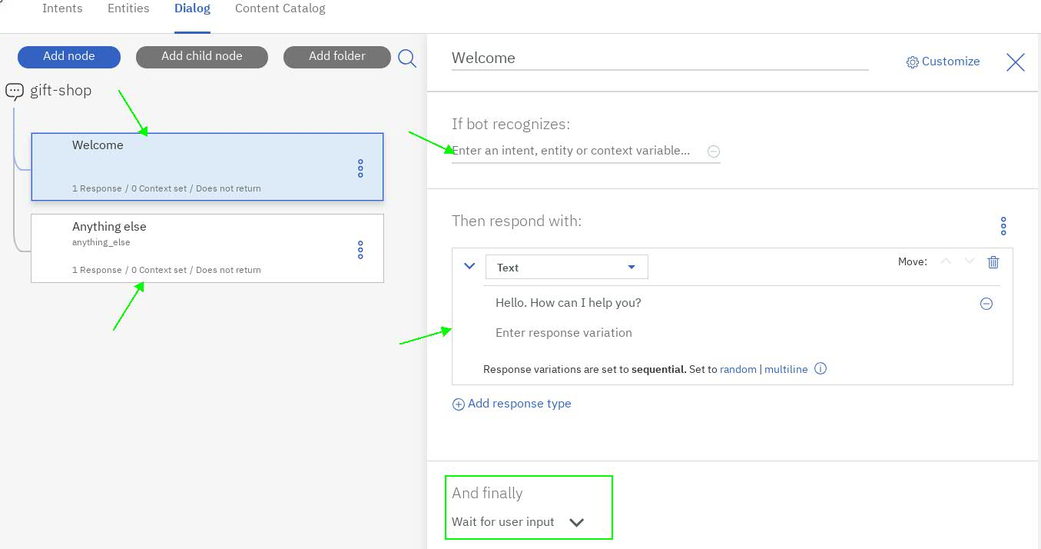
B. Configuring the conversation
Nodes are processed in order
Nodes match user input against #intends, @entities, context variables, others (if… then)
Based on matching results a response is configured or control is passed to the next node

Slide 26
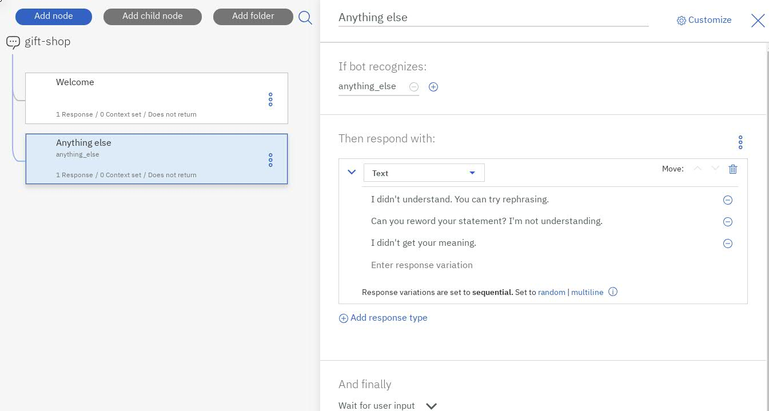
B. Configuring the conversation
Last node should catch any “unknown” condition, so the user is not ignored.
Responses should redirect the user to what the bot can handle.
Variety of responses help to a better UX (non repetitive).

Slide 27
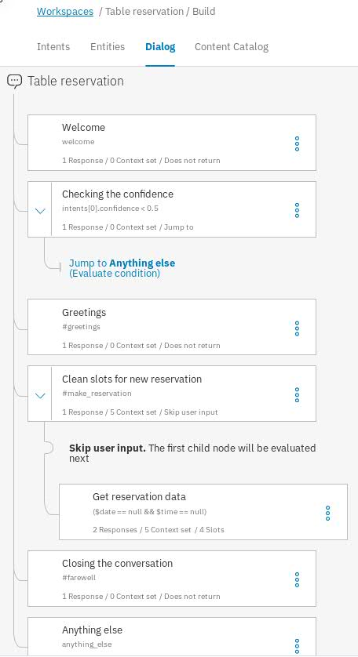
B. Configuring the conversation
Tree main branches nodes check for #intends
Leaves
Check for @entities
Gather data
Validate data

Slide 28
B. Configuring the conversation: Concepts
Slots: provide a structured format through which you can ask for and save multiple pieces of information from a user within a single node.
  They are most useful when you have a specific task in mind and need key pieces of information from the user before you can perform.
Context Variables: conversation specific variables the store data
  Slots can automatically save Entities identified values into Context Variables.
  Context Variables can also be created on-the-fly in the nodes (on in client applications)
Context: Stores the context variables.
  Exists as part of the conversation and travels in the JSON exchage in the runtime conversation client< - >service

Slide 29
B. Configuring the conversation
Checking the Dialog in Detail
  Overall dialog flow
  Enable System Entities
  Getting reservation data with Slots

Slide 30
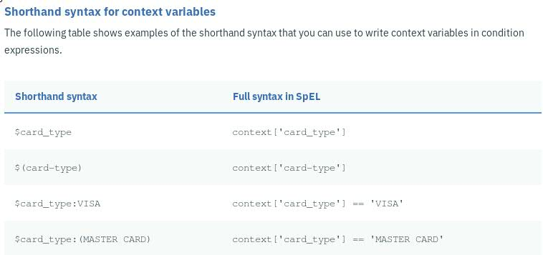
B. Configuring the conversation
{
"output": {
"text": [
"Hello."
],
"nodes_visited": [
"Welcome"
],
"log_messages": []
},
"input": {},
"intents": [],
"entities": [],
"context": {
"conversation_id": "5fc9319b-c3f1-45bd-978b-78b31e61c8da",
"system": {
"dialog_stack": [
{
"dialog_node": "root"
}
],
"dialog_turn_counter": 1.0,
"dialog_request_counter": 1.0,
"_node_output_map": {
"Welcome": {
"0": [
0.0
]
}
},
"branch_exited": true,
"branch_exited_reason": "completed"
}
}
}
Expressions for accessing objects
  The conversation, at runtime, is handled with a JSON that contains several objects: intents and entities identified (with respective confidence %), user input, system output, context, and flags
  Uses the Spring Expression (SpEL) language

Slide 31
B. Configuring the conversation
Format the output format of the variables:
In the Slot config (gear icon), enter the JSON editor
"date": "<? @sys-date.reformatDateTime('EEEE, MMMM d') ?>"
Treat zeros properly (Its JS so “0” is “false” by default … ugh)
  Update condition and JSON to @sys-number || @sys-number:0
Validating user input data.
  Dates in the past: @sys-date.before(now())
  Reservation schedule: @sys-time.after('09:00:00')
  Guests > 0: entities['sys-number']?.value == 0
Add a confirmation slot
  Adding the #Yes and #No
  slot_in_focus: forces scope of the condition to the current slot
  Avoid repetitive slots confirmations

Slide 32
B. Configuring the conversation
Reset the slot context variable values
  Add a parent node for #make_reservation
  Reset context variables in that new parent node
  Change the condition in the child node
Option to cancel the reservation
  Add a handler
  Add #exit
  Handlers: How your virtual assistant will respond when the user's answer to a prompt is not found. These handlers will be checked before trying the "Not found" responses in a slot.
  Enable conditional responses in the node.
  Validate for has_skipped_slots

Slide 33
B. Configuring the conversation
Apply a valid value if the user fails to provide one after several attempts
  Add the $counter to the context in #make_reservation
  In the @sys-time slot config, update the Not Found true response JSON with "counter": "<? context['counter'] + 1 ?>"
  Add a new conditional Not Found response that check the counter
Add a confidence check on Intends
  Watson will always do the best effort to match a Intend
  For low confidence it may be better for the system to ask clarification
  Add a node with condition: intents[0].confidence < 0.5
Configurations in the last three slides are explained here too: https://console.bluemix.net/docs/services/conversation/tutorial-slots-complex.html#tutorial-slots-complex.

Slide 34
B. Configuring the conversation
It is possible to configure the conversation programmatically with the API
API Definition with example code: HERE
API explorer: HERE
In which cases is a better option to use the API methods over the tool?

Slide 35
C. Building a client Application

Slide 36
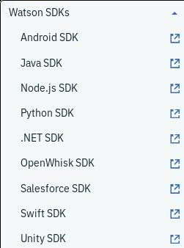
C. Building a client Application
Using the Message API .
Allows to connect the conversation with a Backend and other Services.
There are SDKs (See links HERE)
For our example we will use Java SDK.
  A set of Wrapper classes to access the Message API and its objects. For example:
Assistant;
Context;
InputData;
MessageOptions;
MessageResponse;
RuntimeIntent;

Slide 37
C. Building a client Application
What will we be doing?
Initialize Assistant service (using credentials to authenticate)
Send user messages to the Workspace.
Obtaining the response
Checking the response for Intends, Context
Taking action based on the variables in Context: Save reservation to database.
Setting variables in the Context
Repeat
Let’s go to the Code (Eclipse project downloaded from github)

Slide 38
How would you extend this example?
New #Intentions
New @entities
More customized dialog features.
Connections to other services

Slide 39


