Slide 1
Workshop - IBM Watson Cloud API
Introduction to IBM Cloud
Isaac Ramirez, MIS.
IBM, Watson Health
Edgar Zamora, Mag.
IBM, GTS
August-September, 2018

Slide 2
IBM Cloud Facts
Designed for business.
IBM Cloud supports 47 of the top 50 Fortune 500 companies
Designed for Hybrid Cloud (On-Premise + Cloud -private and public-).
Forrester Research named IBM a leader in its latest Wave report on hybrid cloud
Focus: choice with consistency; hybrid integration; powerful and accessible data and analytics; cognitive solutions and DevOps productivity, security.
60+ global cloud data centers.
140+ APIs and services in 179 countries.
The IBM cloud is open by design, supporting OpenStack, Docker and Cloud Foundry.
100.000+ Certified Developers worldwide (2015-2016)

Slide 3
IBM Cloud Facts
Includes:
Compute: Bare-Metal Servers, Cloud Virtual servers (IaaS)
Storage: object, block, file + backups
Network: domain services, load balancing, security, direct link, CDN…
Management: Logs, Monitoring, Logs Analysis, DevOps Insights, ...
Mobile: development tools and backend services
AI: 16+ Watson Services
IoT platform
Databases: 18 db services
Analytics: Apache Spark, DW, BigData, ...
Security: firewalls, HW security, SSL certificates ...
DevOps: IDE, Continuos Delivery, Availability Monitoring, Code Versioning, …
BlockChain platform
Integration: MQ, API Connect, Secure Gateway, ...

Slide 4
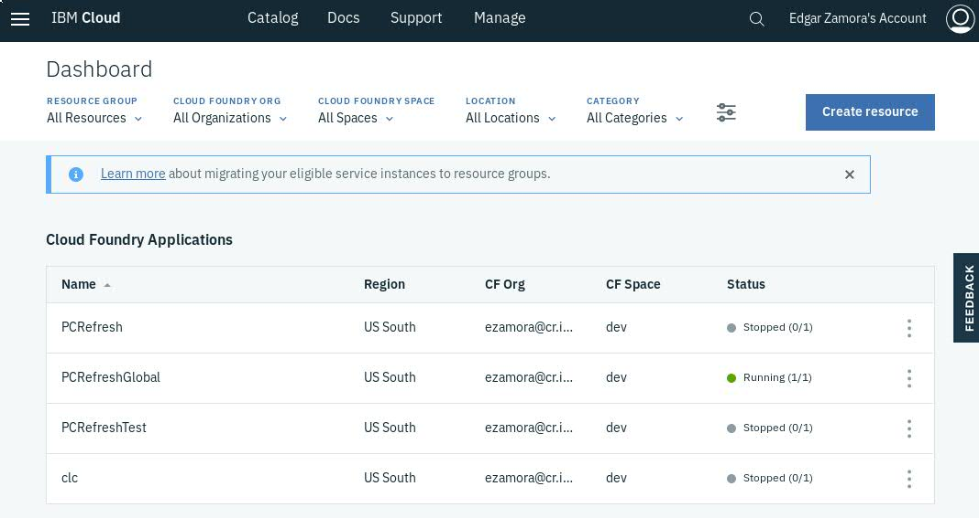
IBM Cloud: Dashboard

Slide 5
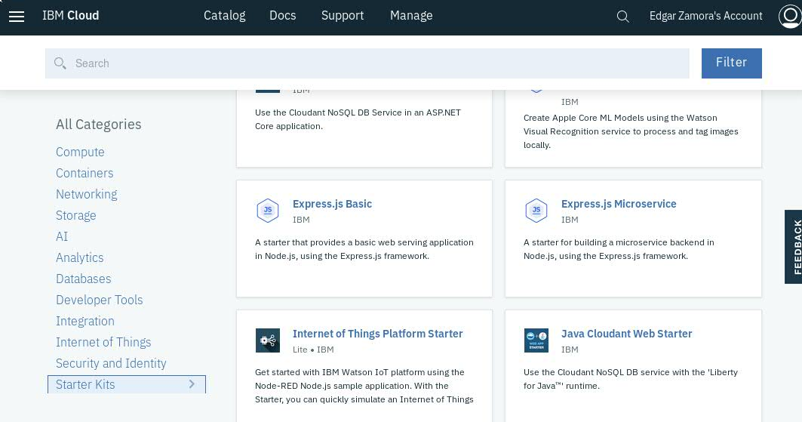
IBM Cloud: Catalog

Slide 6
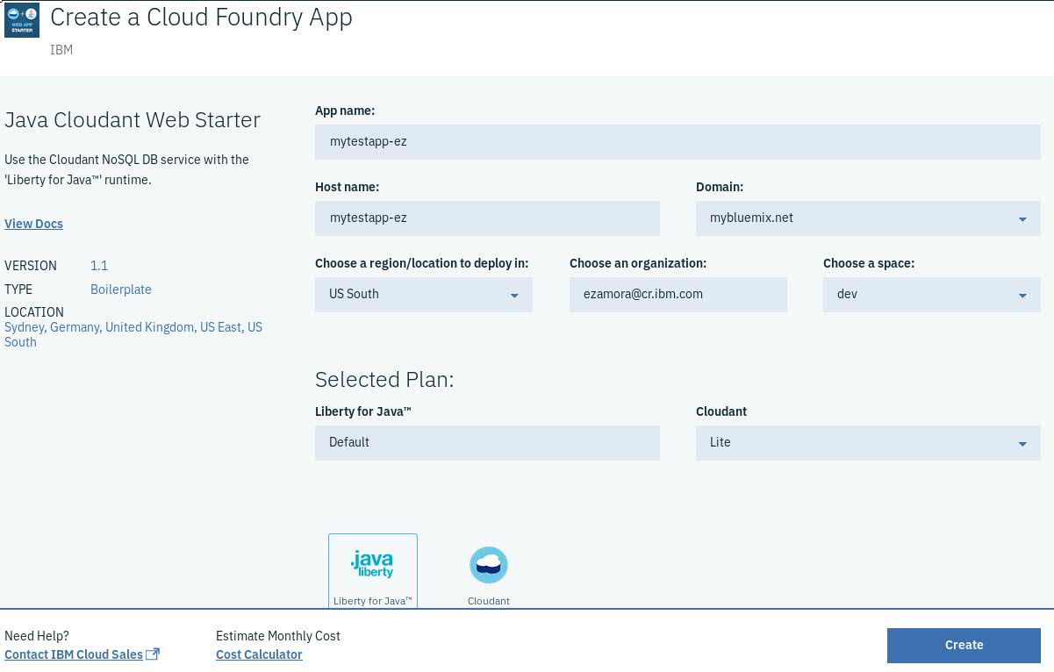
IBM Cloud: Starter Kit for Java Application

Slide 7
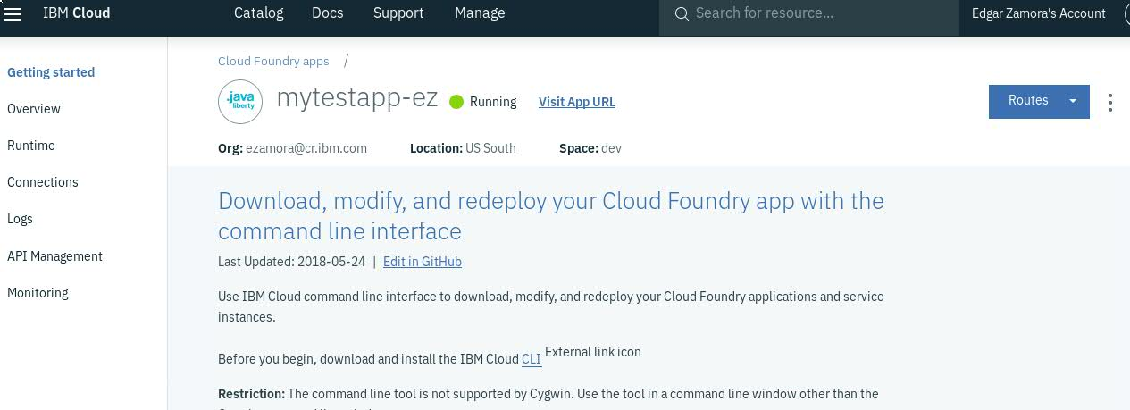
IBM Cloud: Starter Kit for Java Application
A CloudFoundry instance for PaaS was created.
WAS Liberty was provisioned on Cloud Foundry.
The Cloudant database instance and service was provisioned.
A web application was created (with a template) on the WAS.
The web application Java Backend was configured to use the Cloudant service

Slide 8
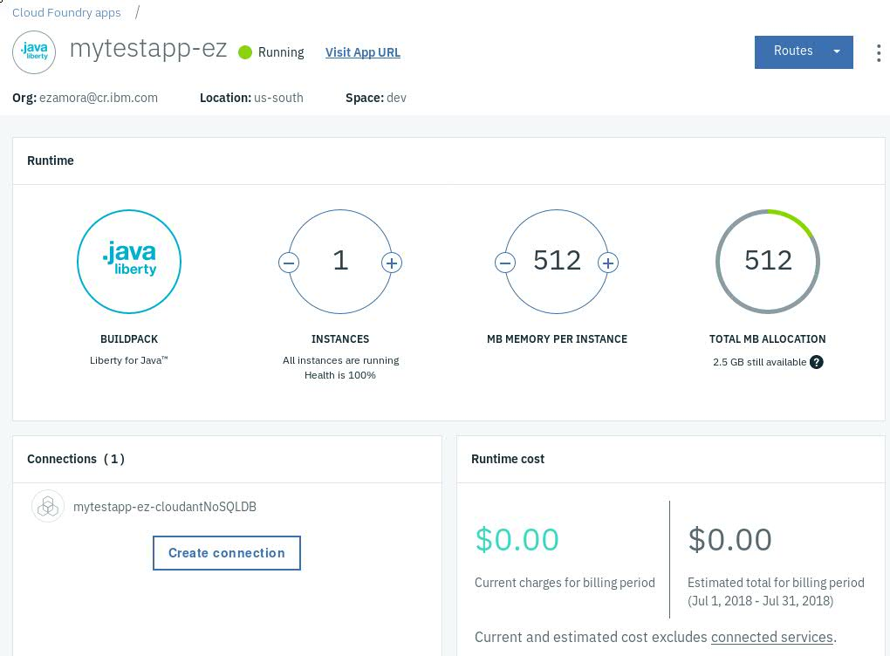
IBM Cloud: Starter Kit for Java Application

Slide 9
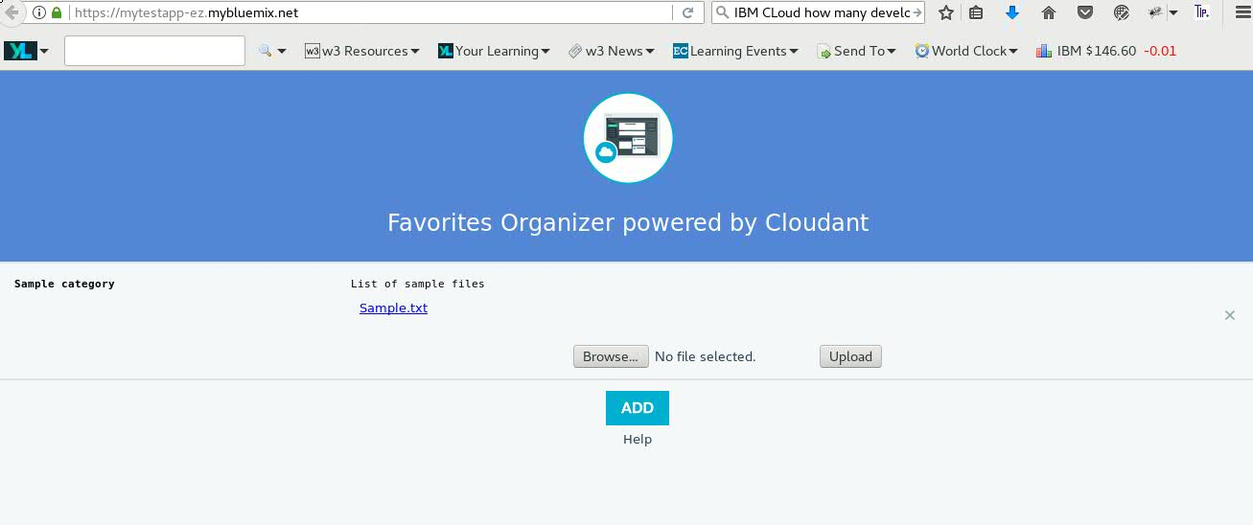
IBM Cloud: Starter Kit for Java Application

Slide 10
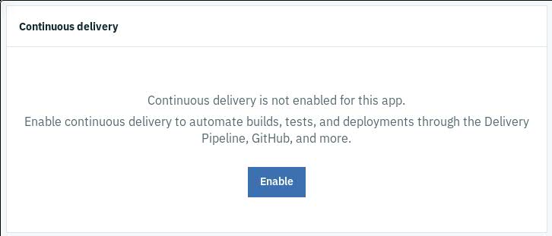
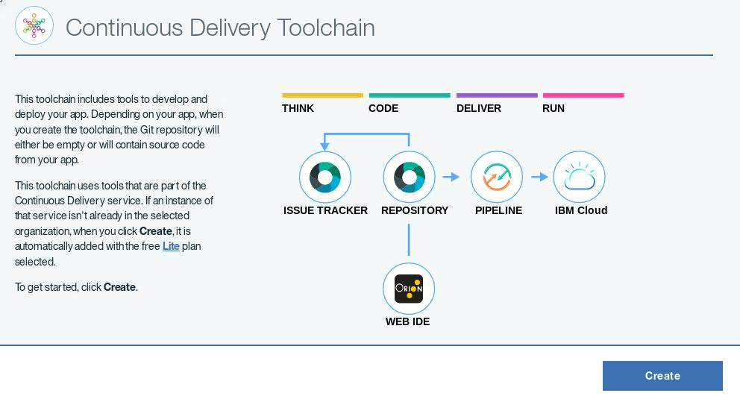
IBM Cloud: Continuous Delivery options

Slide 11
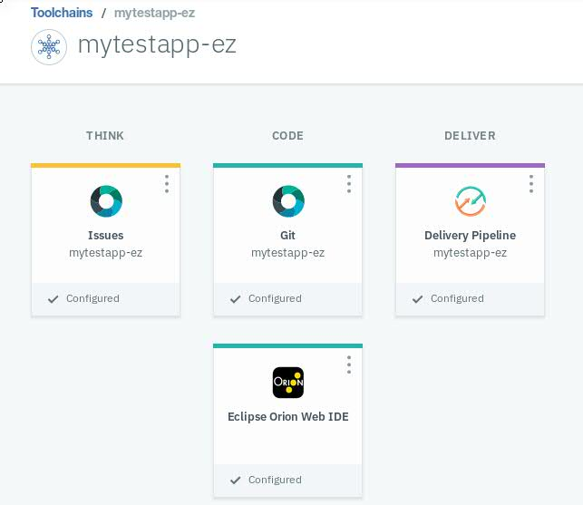
IBM Cloud: Continuous Delivery options

Slide 12
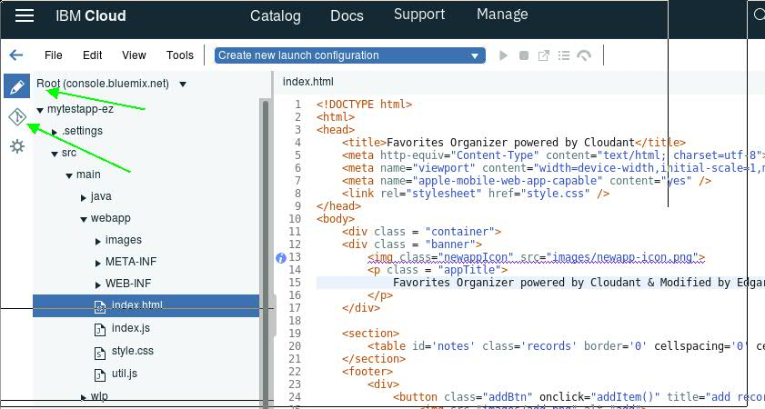
IBM Cloud: Continuous Delivery options
IDE capabilities
Git/Github Integration

Slide 13
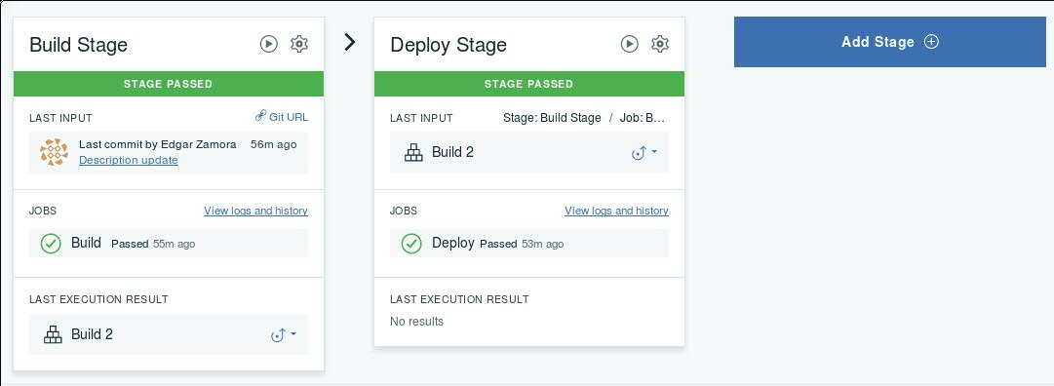
IBM Cloud: Continuous Delivery options
Code push automatically triggers integration tasks (build, test deploy) in different environments

Slide 14
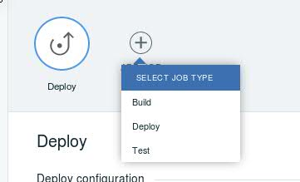
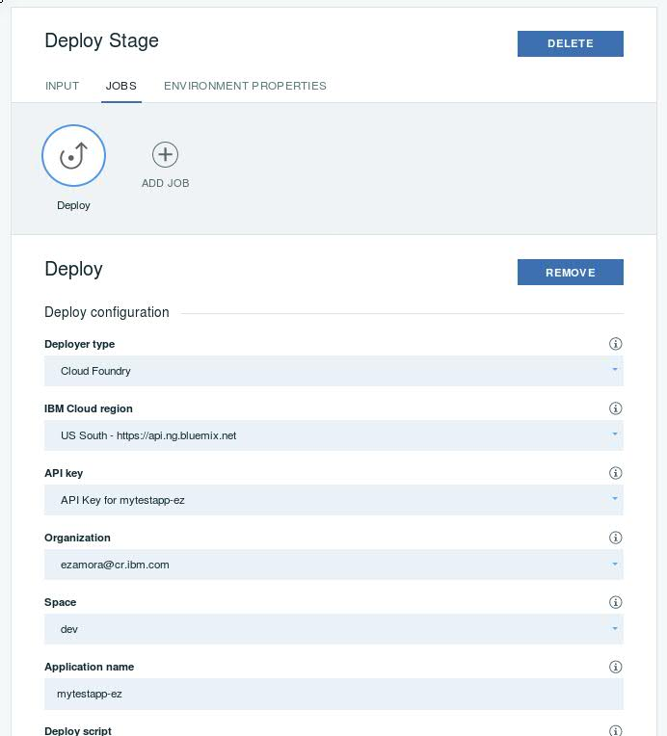
IBM Cloud: Continuous Delivery options

Slide 15
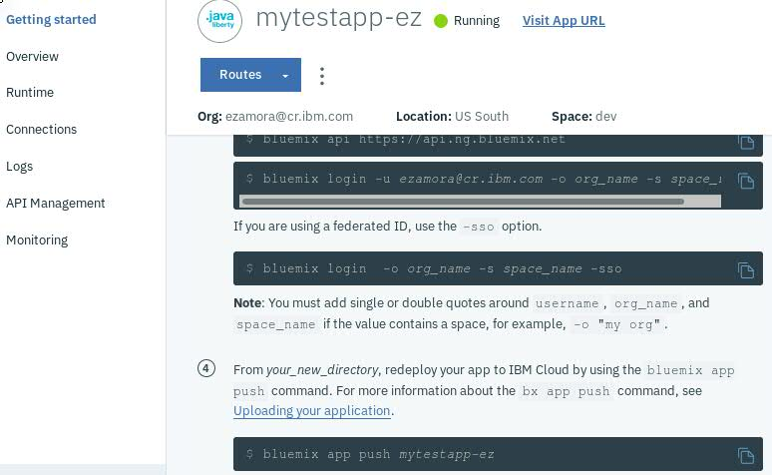
IBM Cloud: Continuous Delivery options
However, you can also use command line (Bluemix CLI) to get the code to your local and push your application changes.
Bluemix tools for eclipse are also available.

Slide 16


