Slide 1
Workshop - IBM Watson Cloud API
Discovery Service
Isaac Ramirez, MIS.
IBM, Watson Health
Edgar Zamora, Mag.
IBM, GTS
August-September, 2018

Slide 2
Discovery Service
DEMO #1:
(https://discovery-news-demo.ng.bluemix.net/)

Slide 3
Discovery Service
Makes it possible to rapidly build cognitive, cloud-based exploration applications that unlock actionable insights hidden in unstructured data — including your own proprietary data, as well as public and third-party data.
By using data analysis combined with cognitive intuition to take your unstructured data and enrich it so you can discover the information you need.
Brings together a functionally rich set of integrated, automated Watson APIs to:
Crawl, convert, enrich and normalize data.
Securely explore your proprietary content as well as free and licensed public content.
Apply additional enrichments such as concepts, relations, and sentiment through Natural Language Understanding (NLU).
Simplify development while still providing direct access to APIs.
Extensive language support

Slide 4
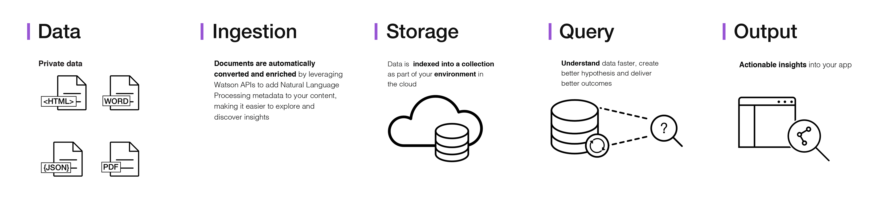
Discovery Service
Architecture of a complete Discovery service solution:
Data ingestion:
API/SDK (programatically), Web Tool, Crawler (standalone tool that moves file to the service), service Connectors (connect to data sources and bring data).
Data Enrichment:
Automatic metadata, Natural Language Understanding, Knowledge Studio (custom models that create knowledge graphs).
Query:
Natural Language or Discovery Language. Keyword + Context search

Slide 5
Discovery Service: Discovery News
It is a public data set that has been pre-enriched with cognitive insights, is also included with Discovery. You can use this public, unstructured data set to query for insights that you can integrate into your applications.
Historical search is available for the past 60 days of news data.
Updated continuously with new articles, and is available in English, Spanish, German, Korean, and Japanese.
The news sources vary by language, so the query results for each collection will not be identical.
English version updated with 300,000+/- new articles daily. Spanish version updated with 60,000+/- new articles daily.
Use cases:
News alerting - Create news alerts by taking advantage of the support for entities, keywords, categories, and sentiment analysis to watch for both news and how it is perceived.
Event detection - The subject/action/object semantic role extraction checks for terms/actions such as "acquisition", "election results", or "IPO".
Trending topics in the news - Identify popular topics and monitor increases and decreases in how frequently they (or related topics) are mentioned.

Slide 6
Discovery Service: Discovery Tooling
The Discovery service includes a complete set of online tools - the Discovery tooling - to help you quickly setup an instance of the service and populate it with data.
The Discovery service tooling has been designed to save time by eliminating the need to use APIs to configure and populate your service.
This lets your application developers concentrate on creating high value ways for end users to experience the Discovery service.

Slide 7
Discovery Service
Basic steps to use the service
Create service instance
Open the Discovery tool (Or use the API methods)
Create a new Environment
Create a new Configuration, or use the default one
Create a new Collection (of documents)
Add Documents to the Collection
Query the collection (with API Methods)

Slide 8
Discovery Service
API Reference
(https://www.ibm.com/watson/developercloud/discovery/api/v1/java.html?java)

Slide 9
Discovery Service
Java SDK Code Example
(https://github.com/watson-developer-cloud/java-sdk/tree/master/natural-language-understanding)

Slide 10


