Slide 1
Workshop - IBM Watson Cloud API
Speech to Text & Text to Speech Services
Isaac Ramirez, MIS.
IBM, Watson Health
Edgar Zamora, Mag.
IBM, GTS
August-September, 2018

Slide 2
Speech to Text Service
DEMO #1:
(https://speech-to-text-demo.ng.bluemix.net/)

Slide 3
Speech to Text Service
APIs that you can use to add speech transcription capabilities to your applications.
The service leverages machine intelligence to transcribe the human voice accurately.
The service combines information about grammar and language structure with knowledge of the composition of the audio signal.
It continuously returns and retroactively updates a transcription as more speech is heard.
The service provides various interfaces that make it suitable for any application where speech is the input and a textual transcription is the output.
Example applications include:
Voice control of applications, embedded devices, and vehicle accessories.
Transcribing meetings and conference calls.
Dictating email messages and notes.

Slide 4
Speech to Text Service: Interfaces
The Speech to Text service offers three interfaces for speech recognition:
  WebSocket: persistent, full-duplex connections with the service.
  HTTP REST: supports both sessionless and session-based calls to the service.
  Asynchronous HTTP interface that provides non-blocking calls to the service.
The service also provides a customization interface. You can use the interface to expand the vocabulary of a base model with domain-specific terminology or to adapt a base model for the acoustic characteristics of your audio.
SDKs are also available to simplify your use of the service in various programming languages.

Slide 5
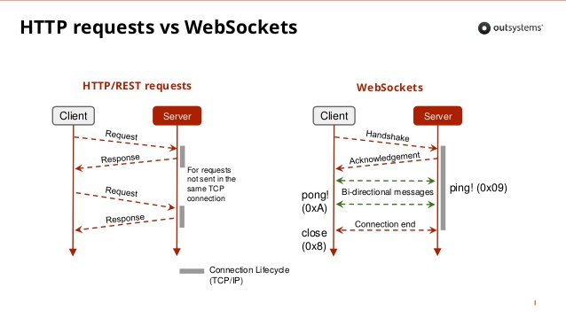
Speech to Text Service: Interfaces

Slide 6
Speech to Text Service: Input features
The service's interfaces share common input features for transcribing speech to text:
Audio formats - You can transcribe Ogg or Web Media (WebM) audio with the Opus or Vorbis codec, MP3 (or MPEG), Waveform Audio File Format (WAV), Free Lossless Audio Codec (FLAC), Linear 16-bit Pulse-Code Modulation (PCM), mu-law (or u-law) audio, and basic audio.
Languages and models - For most languages, you can use transcribe audio by using broadband or narrowband models. Use broadband for audio that is sampled at a minimum rate of 16 kHz. Use narrowband for audio that is sampled at a minimum rate of 8 kHz.
Audio transmission - You can pass as much as 100 MB of audio to the service. You can pass the audio as a continuous stream of data chunks or as a one-shot delivery that passes all of the data at one time. With streaming, the service enforces various timeouts to preserve resources.

Slide 7
Speech to Text Service: Output features
The interfaces also support the following common output features:
Word alternatives request alternative words that are acoustically similar to the words of a transcript.
Word confidence returns confidence levels for each word of a transcript.
Word timestamps return timestamps for the start and end of each word of a transcript.
Profanity filtering censors profanity from US English transcripts.
Smart formatting converts dates, times, numbers, currency values, phone numbers, and internet addresses into more readable, conventional forms in final transcripts. The feature is supported for US English and Spanish audio. For US English, you can also provide keyword phrases to include certain punctuation symbols in final transcripts. (Beta functionality)

Slide 8
Speech to Text Service: Languages
The service offers models for the following languages: Brazilian Portuguese, French, Japanese, Korean, Mandarin Chinese, Modern Standard Arabic, Spanish, UK English, and US English. The service does not support all features for all languages.
The WebSocket, HTTP REST, and asynchronous HTTP interfaces are generally available for all supported languages.
The service offers broadband models, narrowband models, or both for different languages.
Some speech recognition features are available only for some languages.
The language and acoustic model customization interfaces are available for different languages at different levels of support.

Slide 9
Speech to Text Service
API Reference
(https://www.ibm.com/watson/developercloud/speech-to-text/api/v1/java.html?java)

Slide 10
Speech to Text Service
Java SDK Code Example
(https://github.com/watson-developer-cloud/java-sdk/tree/master/speech-to-text)
(Note: Create Service in IBM First and copy the credentials to update the code)

Slide 12
Text to Speech Service
DEMO #1:
(https://text-to-speech-demo.ng.bluemix.net/)

Slide 13
Text to Speech Service
Offers synthesis capabilities to convert written text to natural-sounding speech.
The service streams the results back to the client with minimal delay.
The service offers both HTTP REST and WebSocket interfaces.
Use cases:
The service is appropriate for voice-driven and screenless applications, where audio is the preferred method of output.
Interfaces for the disabled, such as assistance tools for the vision-impaired.
Reading text and email messages aloud to drivers.
Video-script narration and video voice over.
Reading-based educational tools.
Home-automation solutions.

Slide 14
Text to Speech Service: features and capabilities:
Audio formats - Produces audio in Ogg or WebM with the Opus or Vorbis codec, WAV, FLAC, MP3 (MPEG), l16 (PCM), mulaw, or basic format.
Voices - Synthesizes text to audio in various languages, voices, and dialects.
SSML - Accepts plain text or text that is marked up with the XML-based Speech Synthesis Markup Language (SSML).
Expressiveness - Extends SSML with an expressive element that you can use to indicate a speaking style of GoodNews, Apology, or Uncertainty. Available only for the US English Allison voice.

Slide 15
Text to Speech Service: features and capabilities:
Voice transformation - Extends SSML by adding a voice transformation element. You can use the element to expand the range of possible voices by controlling aspects such as pitch, rate, and timbre. Also offers two built-in virtual voices, Young and Soft. Available only for US English voices.
Word timings - With the WebSocket interface, supports the SSML <mark> element and optional word timing information for all strings of the input text. Timing information synchronizes the input text and the resulting audio.
Customization - Provides a customization interface that you can use to specify how the service pronounces unusual words that occur in your input. You can define pronunciations with the International Phonetic Alphabet (IPA) or IBM Symbolic Phonetic Representation (SPR).

Slide 16
Text to Speech Service: Language support
The service supports voices in the following languages: Brazilian Portuguese, English (UK and US dialects), French, German, Italian, Japanese, and Spanish (Castilian, Latin American, and North American dialects).
The service offers at least one male or female voice, sometimes both, for each language. Each voice uses appropriate cadence and intonation for its dialect.

Slide 17
Text to Speech Service
API Reference
(https://www.ibm.com/watson/developercloud/text-to-speech/api/v1/java.html?java)

Slide 18


