Slide 1
Workshop - IBM Watson Cloud API
Natural Language Classifier
Isaac Ramirez, MIS.
IBM, Watson Health
Edgar Zamora, Mag.
IBM, GTS
August-September, 2018

Slide 2
Natural Language Classifier Service
It uses machine learning algorithms to return the top matching predefined classes for short text inputs.
Help your application understand the language of short texts and make predictions about how to handle them.
A classifier learns from your example data and then can return information for texts that it is not trained on. < --- You have to train this API
Language support: English, Arabic, French, German, Italian, Japanese, Korean, Portuguese (Brazilian), and Spanish.

Slide 3
Natural Language Classifier Service
DEMO:
(https://natural-language-classifier-demo.ng.bluemix.net/)

Slide 4
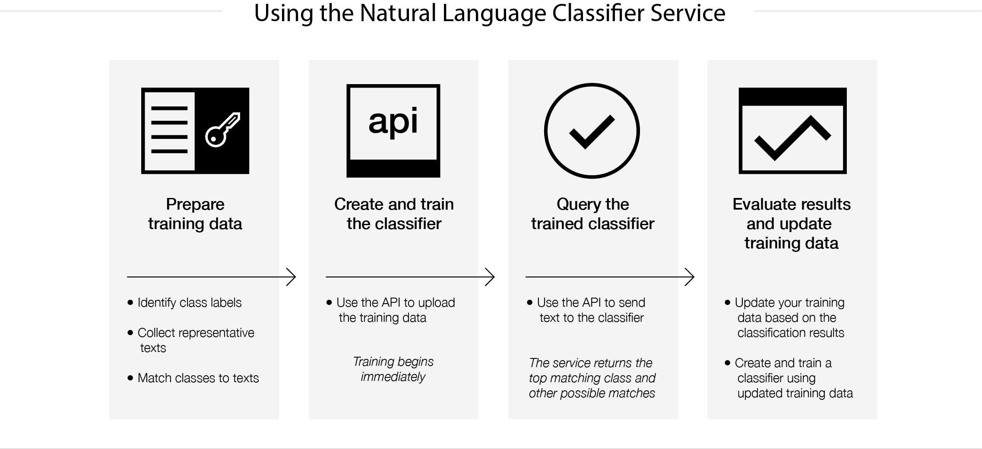
Natural Language Classifier Service
Watson Studio:
New tooling to create
and train classifiers
Starting in Aug 30th

Slide 5
Natural Language Classifier Service: Real life example > Contract Lines Classifier
Each contract has an average of 6000 paragraphs (Very, very complex service contracts)
Each paragraph had to be classified in one area of service
2 weeks 2-to-3 people + revisions
We created a tool that uses NLC
  Experts gathered already processed contracts to create training examples (paragraphs + its areas of service –classifications--. This is our most important asset)
  A service instance was created an a classifier was added to it and trained with the examples
  A NodeJS Tool is the interface that users use to train the classifier and process new contracts. The users provide a CSV with a paragraph per line.
  10 Mins processing 5000 paragraphs contratcs + two days of one person review.
  The service’s classifier is retrained (using the app) when reviews detect incorrect paragraph classifications (one person’s time)

Slide 6
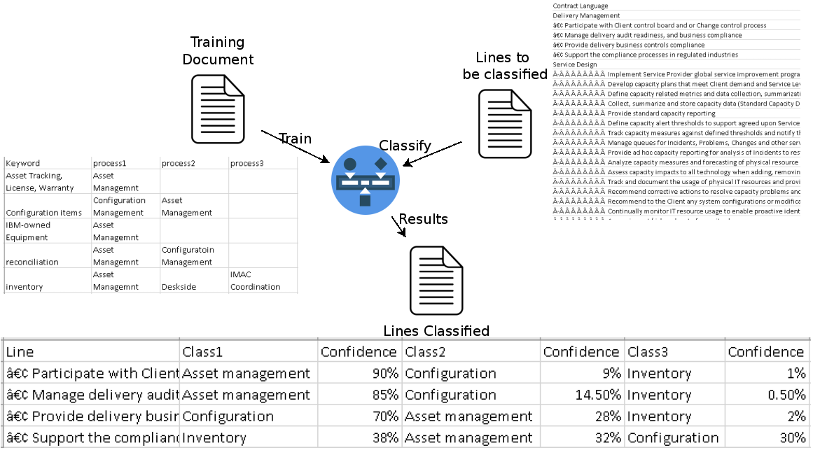
Natural Language Classifier Service

Slide 7
Natural Language Classifier Service: Use cases
Identify Spam email.
Banking and finance: Classify investments, risks, and transactions.
Higher Education and Government: Sort text or documents into categories. Useful for Academia, Law, Non-profit organizations, and other organizations that require classification.
E-commerce and Retail: Help your users choose products by narrowing the choices by theme. Tag products or identify fraudulent items.
Services: Categorize service queries, messages, and responses to help address problems and deploy solutions quicker.
Social media: Organize tweets, email, posts, and shares into categories or themes.
Talent solutions: Analyze resumés and applications to derive deeper meaning.
(**) The data used to train the service is not shared out of your classifier.

Slide 8
Natural Language Classifier: Creating classifiers
A NLC service instance contains classifiers (up to 8) which is piece of ML trained to recognize characteristic of text and identify (with a confidence %) one or more classes.
First, create the NLC service in IBM Cloud using the catalog.
Then, create the classifier. Classifiers can be created:
  Using Watson Studio tool:
    In the catalog in IBM Cloud, create a Watson Studio service.
    Launch the tool Watson Studio tool.
    Select the NLC service you created previously and create a new Model
    Train the model (add sample texts and its classifications or upload a CSV with the text and its classifications)
  Programmatically, by using the SDKs
    Create and train a classifier.
In your app, programatically, use the trained service specifying the classifier id.

Slide 9
Natural Language Classifier
API Reference
(https://www.ibm.com/watson/developercloud/natural-language-classifier/api/v1/java.html?java)

Slide 10
Natural Language Classifier Service
Java SDK Code Example
(https://github.com/watson-developer-cloud/java-sdk/tree/master/natural-language-classifier)

Slide 11


