Slide 1
Human Interaction with the Output of Information Extraction Systems
Erin Zaroukian
Approved for public release, distribution unlimited
Cognitive Scientist
Computational and Information Sciences Directorate
28 JUL 2019

Slide 2

Information Extraction
Unstructured information
Structured information
Notes:
Information Extraction (IE) research has made remarkable progress in Natural Language Processing using intrinsic measures, but little attention has been paid to human analysts as downstream processors. In one experiment, when participants were presented text with or without markup from an IE pipeline, they showed better text comprehension without markup. In a second experiment, the markup was hand-generated to be as relevant and accurate as possible to find conditions under which markup improves performance. This experiment showed no significant difference between performance with and without markup, but a significant majority of participants preferred working with markup to without. Further, preference for markup showed a fairly strong correlation with participants’ ratings of their own trust in automation. These results emphasize the importance of testing IE systems with actual users and the importance of trust in automation.

Slide 3
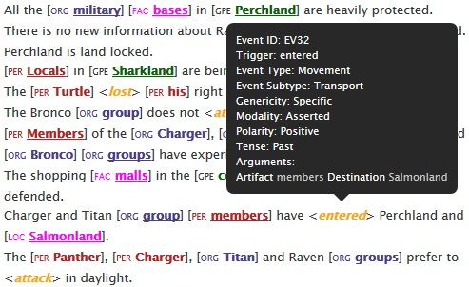
Experiment 1
Markup from an IE pipeline
Notes:
In one experiment, when participants were presented text with or without markup from an IE pipeline, they showed better text comprehension without markup.

Slide 4
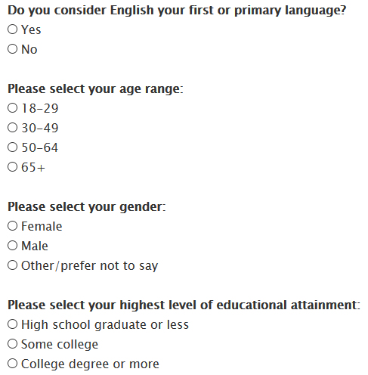
Experiment 1 - Procedure
Demographics

Slide 5
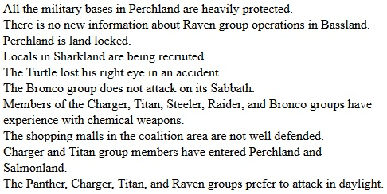
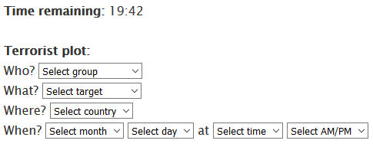
Experiment 1 - Procedure
Scenario text
- With markup -
- Without markup -
…
…

Slide 6
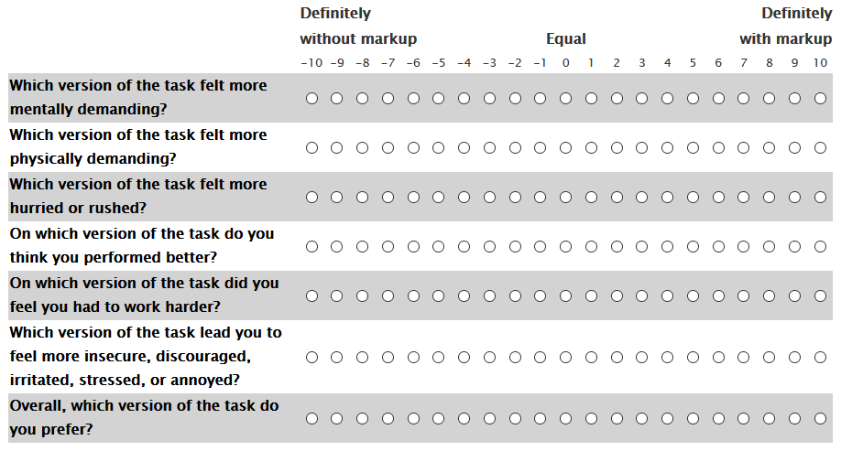
Experiment 1 - Procedure
Workload (NASA-TLX) and preference

Slide 7
Experiment 1 - Results
Plain more accurate, faster
  Note – sizable minority of participants prefer markup, perform better with markup
Lower workload ratings for Plain
Prefer Plain
Notes:
Wilcoxon sign rank test – plain faster, more accurate than markup

Slide 8
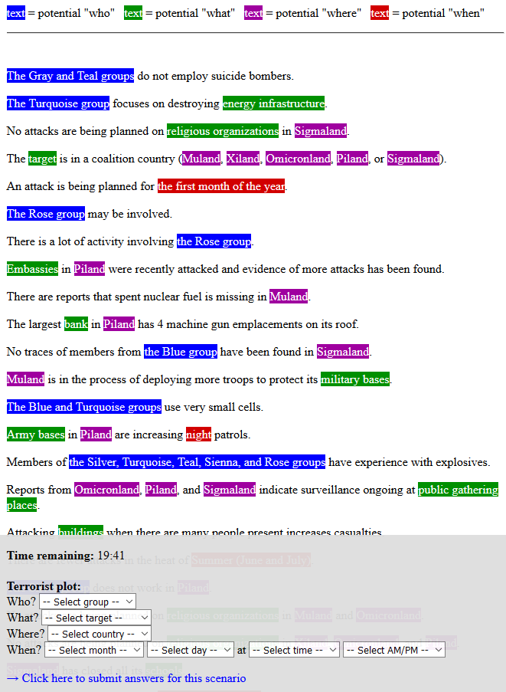
Experiment 2
“Ideal” markup
Notes:
In a second experiment, the markup was hand-generated to be as relevant and accurate as possible to find conditions under which markup improves performance. This experiment showed no significant difference between performance with and without markup, but a significant majority of participants preferred working with markup to without. Further, preference for markup showed a fairly strong correlation with participants’ ratings of their own trust in automation.

Slide 9
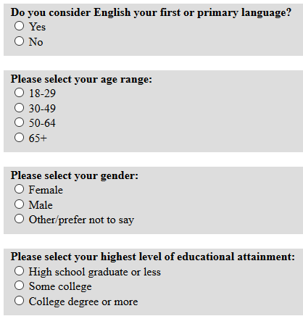
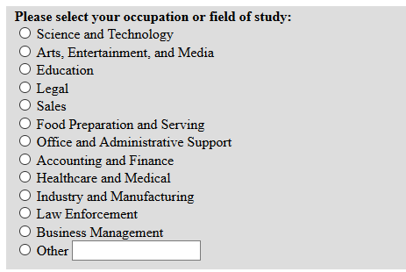
Experiment 2 - Procedure
Demographics

Slide 10
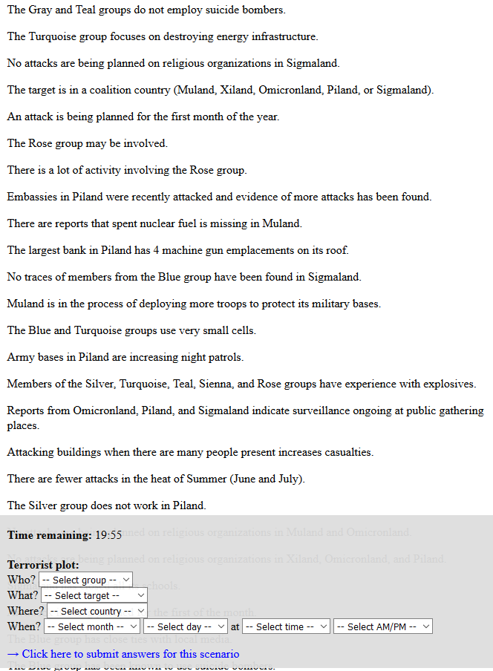
Experiment 2 - Procedure
Scenario text
- With markup -
- Without markup -

Slide 11
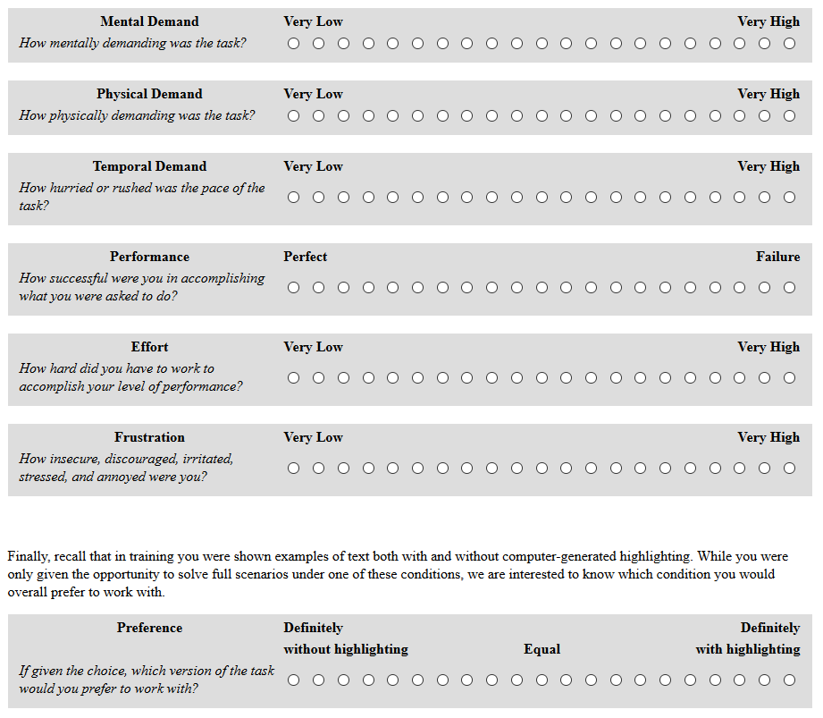
Experiment 2 - Procedure
Workload (NASA-TLX) and preference

Slide 12
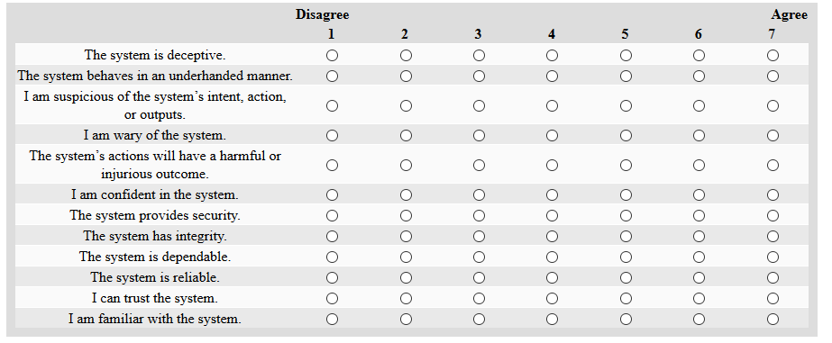
Experiment 2 - Procedure
Trust in automation

Slide 13
Experiment 2 - Results
No significant difference in accuracy, speed
  Again, participants are more accurate when in preferred condition
Felt more successful with Markup
Preferred Markup
Notes:
Concerns about speed and consequent quality of responses were raised in Experiment 1, so for the analyses below only participants with response times of 2 minutes or longer for each test scenario were included (150 out of 200 participants). One additional participant was removed due to a technical failure, leaving 80 participants in the Plain condition and 69 participants in the Markup condition.

Slide 14
Experiment 2 - Results
Demographics and correlation
Trust in automation ~ preference for markup:
  r = 0.39
Trust in automation ~ objective performance measures
  accuracy: r = 0.06
  response time: r = -0.05
Correlation coefficients
Question | Response category | N (All) | N (Filtered)
Language | No | 27 | 16
 | Yes | 172 | 133
Gender | Female | 86 | 66
 | Male | 112 | 82
 | Other/prefer not to say | 1 | 0
Age | 18-29 | 78 | 45
 | 30-49 | 91 | 78
 | 50-64 | 25 | 22
 | 65+ | 5 | 4
Education | High school graduate or less | 20 | 15
 | Some college | 70 | 55
 | College degree or more | 109 | 79
Occupation | Science and technology | 67 | 56
 | Arts, entertainment, and media | 9 | 7
 | Education | 7 | 5
 | Legal | 13 | 13
 | Sales | 17 | 10
 | Food preparation and serving | 12 | 6
 | Office administration and support | 3 | 3
 | Accounting and finance | 20 | 17
 | Healthcare and medical | 7 | 2
 | Industry and manufacturing | 18 | 11
 | Law enforcement | 15 | 9
 | Business management | 11 | 10
 | Other | 0 | 0
Notes:
Neither performance nor preference correlated well with any of the demographic information collected, with the exception of Language, where there is a medium positive correlation between accuracy and being a native speaker of English, as well as a medium negative correlative between response time and being a native speaker of English. Correlation coefficients are shown in Table 3, where one participant (Other/prefer not to say) was dropped from Gender correlations, and Occupation was pooled into Non-science and technology versus Science and technology.
Preference for markup showed a fairly strong correlation with participants’ ratings of their own trust in automation (r = 0.39). The correlation between trust in automation and objective performance measures, however, is very small (accuracy: r = 0.06, response time: r = -0.05).

Slide 15
Discussion
Results summary
  Experiment 1 - Instead of helping, markup hurt performance and was dispreferred to plain text.
  Experiment 2 – Even with “ideal” markup, no difference in performance, but markup preferred.
Warning to researchers trusting that automated IE will be helpful to end user
Objective performance vs. Subjective experience
  Even if markup does lead to better performance, it may improve/hurt experience
Trust in automation
  Correlation with preference
Filtering
  These were responses that were too quick to represent true attempts to read the texts and identify the hypothetical adversary attack.
  These participants were roughly twice as likely to report that English was not their native language, often provided incoherent free-text strategy descriptions.
  Are Turkers generally not willing to put in the work necessary to do well at this task?
    This population does not necessarily predict the performance of any other population, important to include the specific intended end user in the testing cycle.
Notes:
While the markup used in Experiment 2 was hand-generated to be as helpful but realistic as possible, it still did not lead to better performance than plain text.
This is an important warning to researchers trusting that actual automated markup will be helpful. This markup, however, was overall preferred to plain text, which is valuable for the overall user experience.
These results also emphasize that the trust in the automation that is used in an IE pipeline may be important for user experience and for encouraging users to opt to use these pipelines. However, the link between trust in automation and objective performance measures in the current study is very small, and experiments like this demonstrate that the automation need not improve performance. Much remains to be understood about the gap between IE technology and its human user for this technology to truly support human-computer interaction.

Slide 16
Thanks!
Coauthors
  Justine Caylor
  Michelle Vanni
  Sue Kase

Slide 17
Preference
Participants perform qualitatively more accurately in their preferred condition, though Plain is always slower.
Experiment 1
Experiment 2
Preference | N | Condition | Median accuracy count | Median response time (min)
Plain | 66 | Plain | 6 | 6.82
 |  | Markup | 4 | 7.15
Markup | 30 | Plain | 4 | 4.10
 |  | Markup | 5 | 5.25
Preference | N | Condition | Median accuracy count | Median response time (min)
Plain | 70 | Plain | 6 | 7.00
 |  | Markup | 5 | 8.11
Markup | 178 | Plain | 5 | 4.89
 |  | Markup | 6 | 6.39

Slide 18
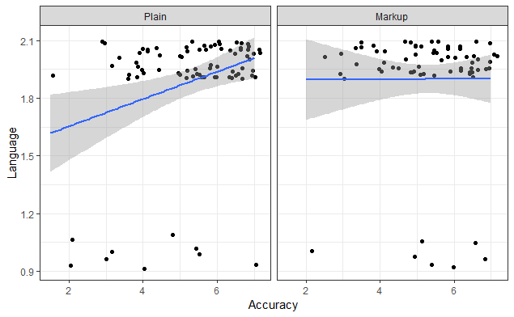
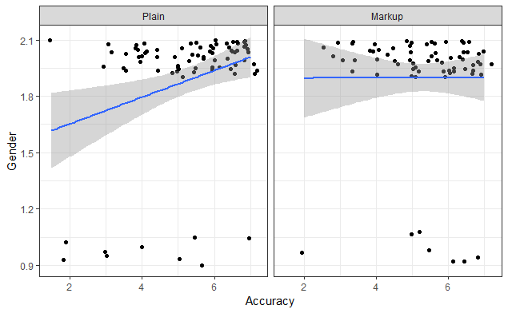
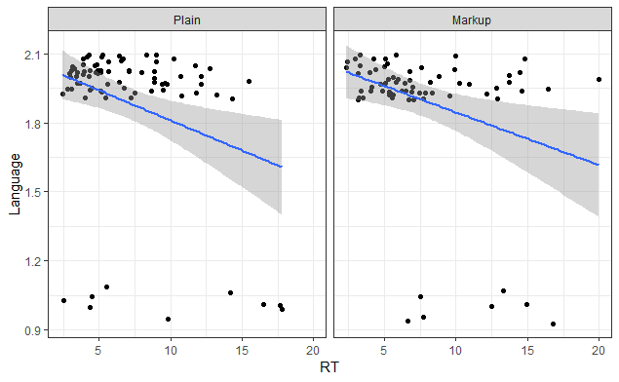
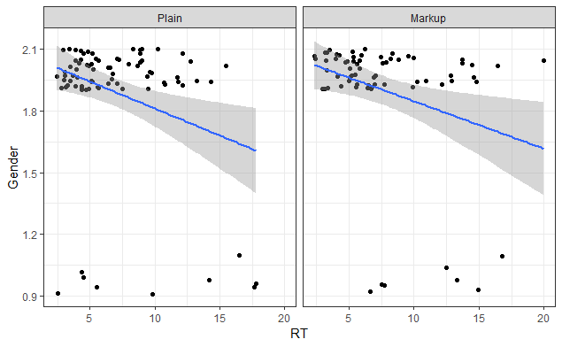
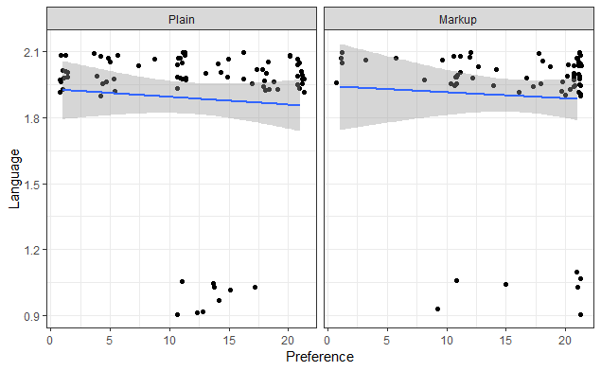
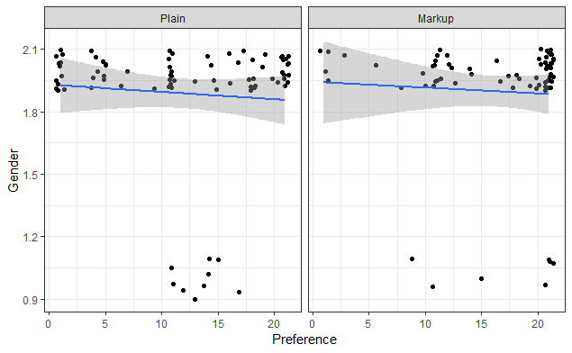
Correlations

Slide 19
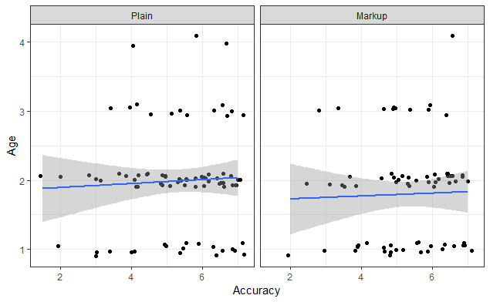
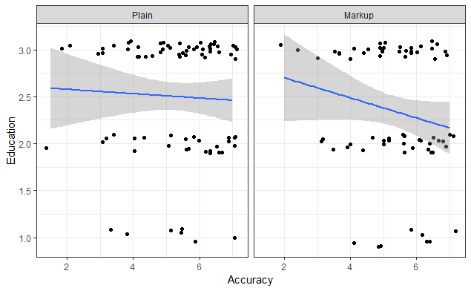
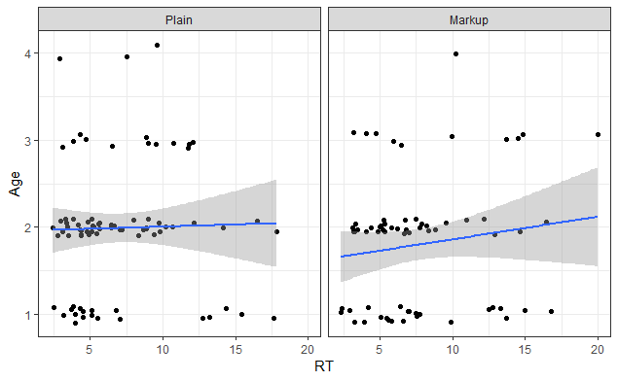
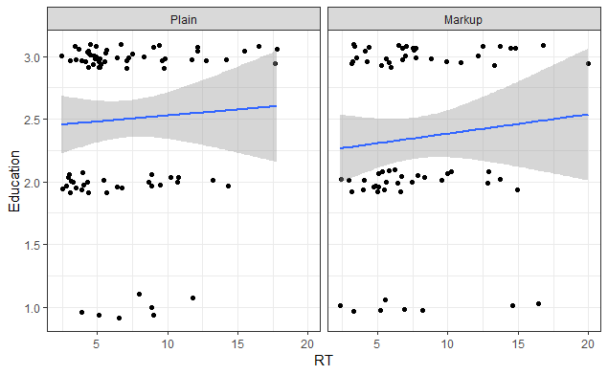
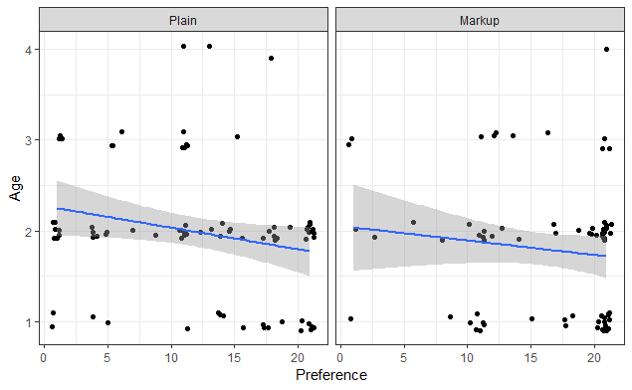
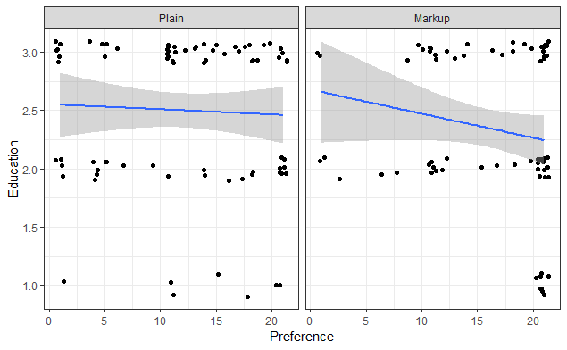
Correlations

Slide 20
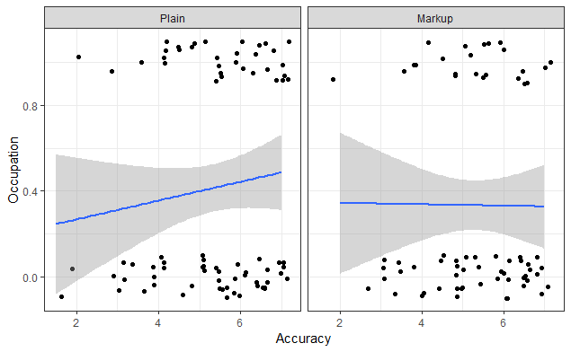
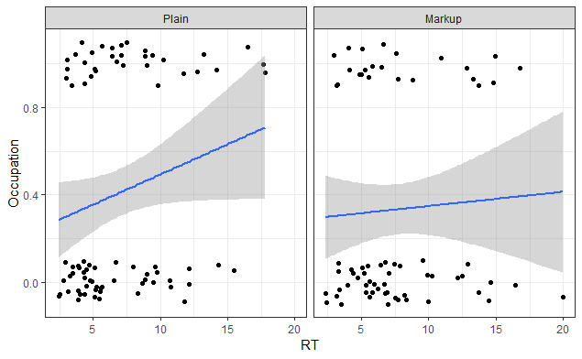
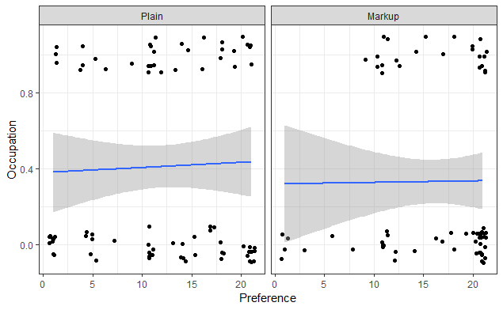
Correlations

Slide 21
SLIDE TITLE GOES HERE
From AHFE submissions website
  In general, the duration of each presentation should last 15 min with 2 min for discussion. The session chairs may, at their discretion, increase the time allocation to each presenter. Prepare and bring your presentation file saved in Microsoft PowerPoint (.ppt), (.pptx) file format. Internet access will NOT be available in the meeting rooms.
  Check in at the Session Room, preferably 30-45 minutes before your session, to submit/upload your files and to preview your presentation. If checking in the day of your session, please arrive by at least 4 hours prior to the start of your session (this refers to the session start time, not the presentation start time). Each room is equipped with a laptop PC and a projection system.
  Session chairs or support team will be available to assist with the upload of your files and provide the opportunity to preview and/or edit the presentation, as necessary.
  Bring a Backup: Be sure to bring a backup copy of your presentation with you to the meeting. Please note, the Final Program may be changed due to speakers attendance, etc.

