Slide 1
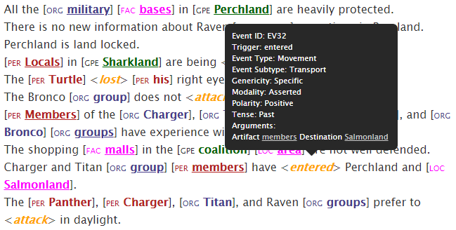
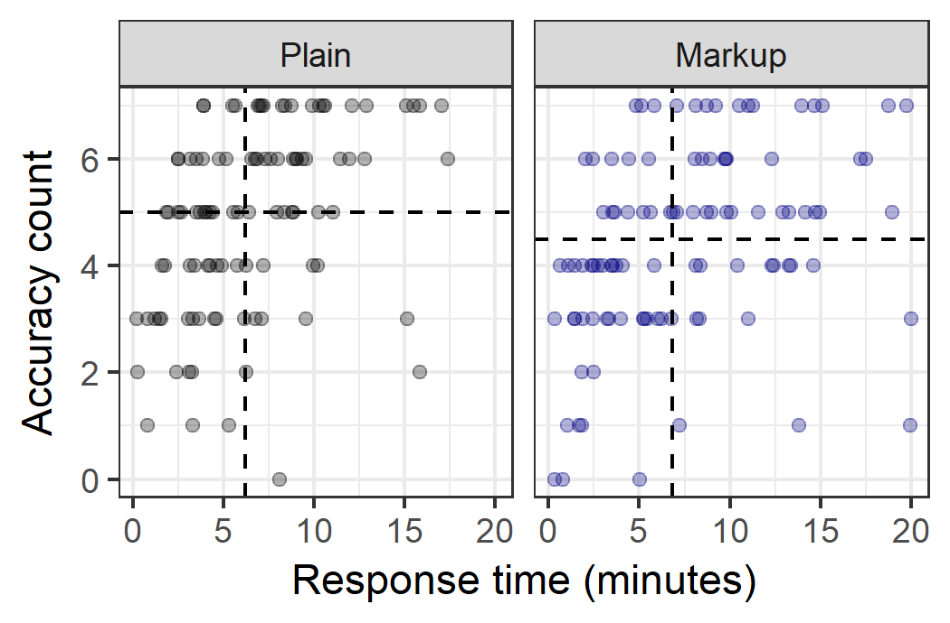
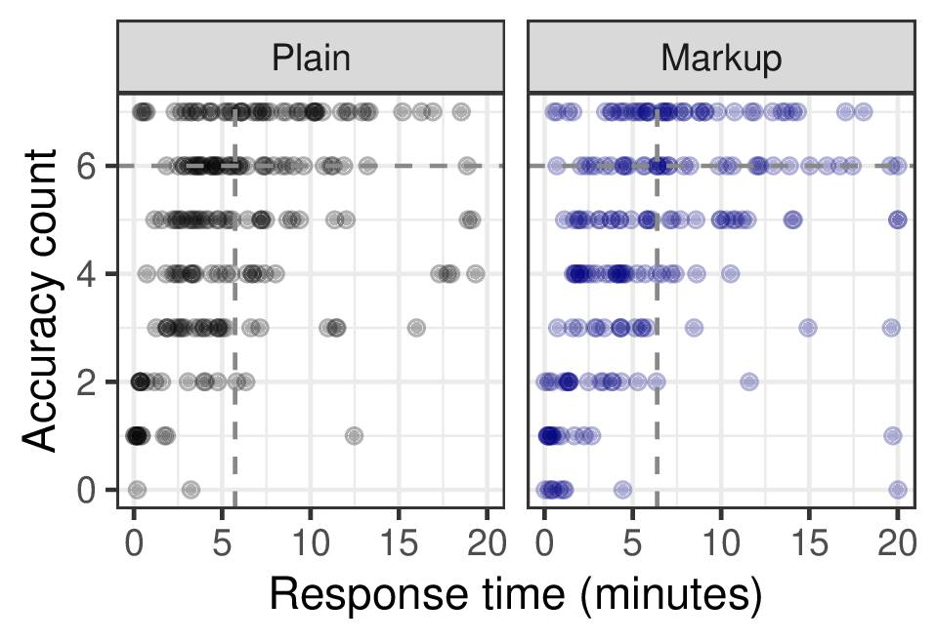
Evaluating Improvement in Situation Awareness and Decision-Making Through Automation
Erin Zaroukian
erin.g.zaroukian.civ@mail.mil
Justine Caylor
Michelle Vanni
Sue Kase
Automated systems such as IE pipelines are designed to facilitate situation awareness by providing human decision makers with relevant information, but beyond the validity of the pipeline itself, designing the output of the pipeline for optimal human understanding should be a goal.
The below experiments compare comprehension of text documents with and without markup from a (simulated) IE pipeline in a simulated intelligence task. Does incorporating this output of an IE pipeline improve human problem solving?
Experiment I
Experiment II
Discussion
Is subjective preference reason enough to use?
Direction of results suggests that further changes that may lead to improved performance and SA
Actually designing “ideal” markup
Computational plausibility
Low-level features (e.g., color)
Density (how much markup is helpful)
Task:
Identify hypothetical adversary attack in text with or without markup
Adding markup from existing IE pipeline to plain text leads to worse performance!
Adding “ideal” markup to plain text does not hurt performance, but doesn’t help much either
More accurate without markup | Accuracy | NS
Faster without markup | Response time | NS
Lower workload without markup | Workload | NS
Preferred without markup | Preference | Preferred with markup
NA | Trust in automation | Experience with markup did not significantly change trust ratings
NA | Strategies | Markup: Attending to highlighted text, process of elimination focus on ‘easier’ question Plain: taking notes Ctrl/Cmd+F
E. Zaroukian, “Information extraction for optimized human understanding and decision making,” Proceeding of the 23rd ICCRTS, Pensacola, FL, November 2018.

