Slide 1
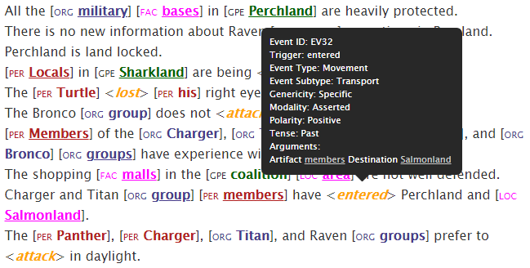
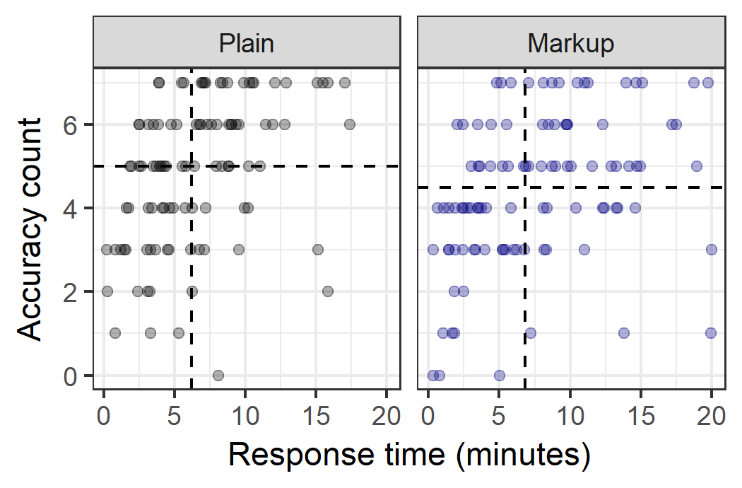
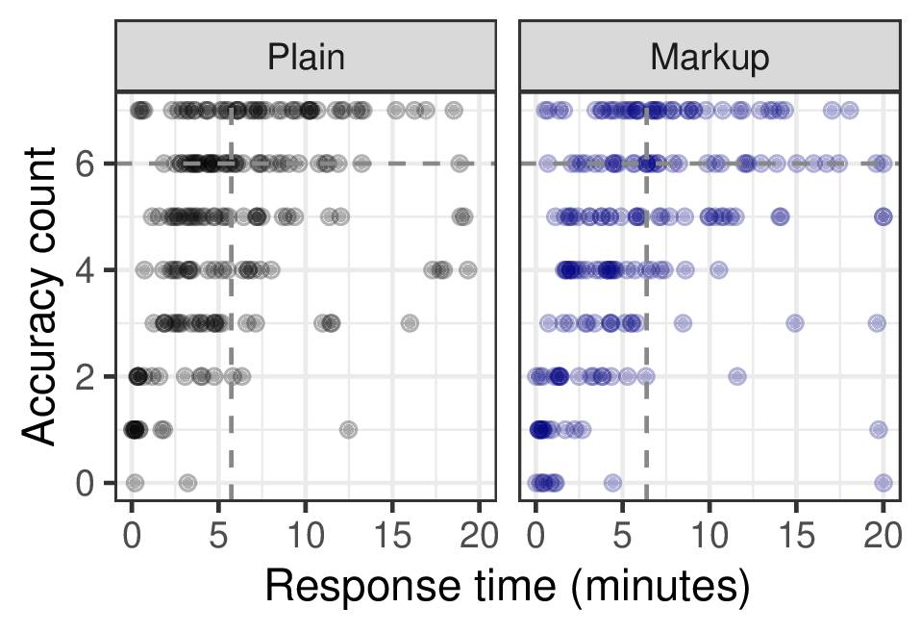
Evaluating Improvement in Situation Awareness and Decision-Making Through Automation
Background: Automated Information Extraction is designed to facilitate situation awareness by providing human decision makers with relevant information, but the real challenge is designing the output for optimal human understanding. This project compares the comprehension of text documents with / without automated markups and explores the existence of an optimal markup solution.
Experiment I
(automated markup)
Experiment II
(ideal markup)
Discussion
Automated markup led to worse performance on all measured factors. Adding “ideal” markup to plain text did not significantly improve / hinder performance. Is subjective preference reason enough to use?
Strategies uncovered:
process of elimination
focus on ‘easier’ question
Popular strategies for plain text:
taking notes
Ctrl/Cmd+F
Direction of results suggests that further changes that may lead to improved performance and SA:
Task-relevant wrt to mission value
Computational plausibility
Low-level features (e.g., color)
Density (how much markup is helpful)
Results
More accurate without markup | Accuracy | No Significant Change
Faster without markup | Response time | No Significant Change
Lower workload without markup | Workload | No Significant Change
Preferred without markup | Preference | Preferred with markup
NA | Trust in automation | No significant change in trust rating
NA | Strategies | See Discussion
POC: Dr. Erin Zaroukian
CCDC Army Research Laboratory
erin.g.zaroukian.civ@mail.mil

