Slide 1

An Imbalance-Aware, Threshold-Aware and Explainable Machine Learning Framework for Telecom Customer Churn
Presented by
Md Ezaz Mahmud
ID: 2023-1-60-000 | Course: CSE 475
Department of CSE, East West University
Submitted to:
Dr. Md. Atiqur Rahman
Assistant Professor, Department of CSE

Slide 2
Background: Why Churn Matters
CONTEXT
Customer churn means a subscriber leaves the telecom service provider
02
Business Motivation
Machine Learning Role
Our Shift
Retaining existing customers is often more cost-effective than acquiring new customers. Churn prediction helps telecom providers identify high-risk customers early.
ML models can learn patterns from customer contract, billing, tenure and service information to estimate churn risk.
This project moves beyond only predicting churn and studies how predicted probabilities become retention decisions.
Prediction
Risk score
Retention decision

Slide 3
Problem Statement & Research Gap
GAP
A churn model can look good by metrics but still miss many actual churners
03
Common Limitation
Our Research Gap
Many churn studies focus on accuracy, F1-score or ROC-AUC. However, operational retention decisions depend on the threshold and the cost of missed churners versus false alarms.
Limited integrated analysis of class imbalance + threshold adjustment + FN/FP decision cost + explainability under a leakage-safe evaluation framework.
Core idea: evaluate churn prediction as a decision problem, not only as a prediction problem.

Slide 4
Research Questions
RESEARCH DESIGN
The study is organized around three questions
04
RQ1
RQ2
RQ3
How do class-imbalance strategies affect churn prediction performance?
How does threshold adjustment change the trade-off between missed churners and false alarms?
Which customer features most influence the final model’s churn predictions?
Imbalance
Threshold + Decision Cost
Explainability

Slide 5
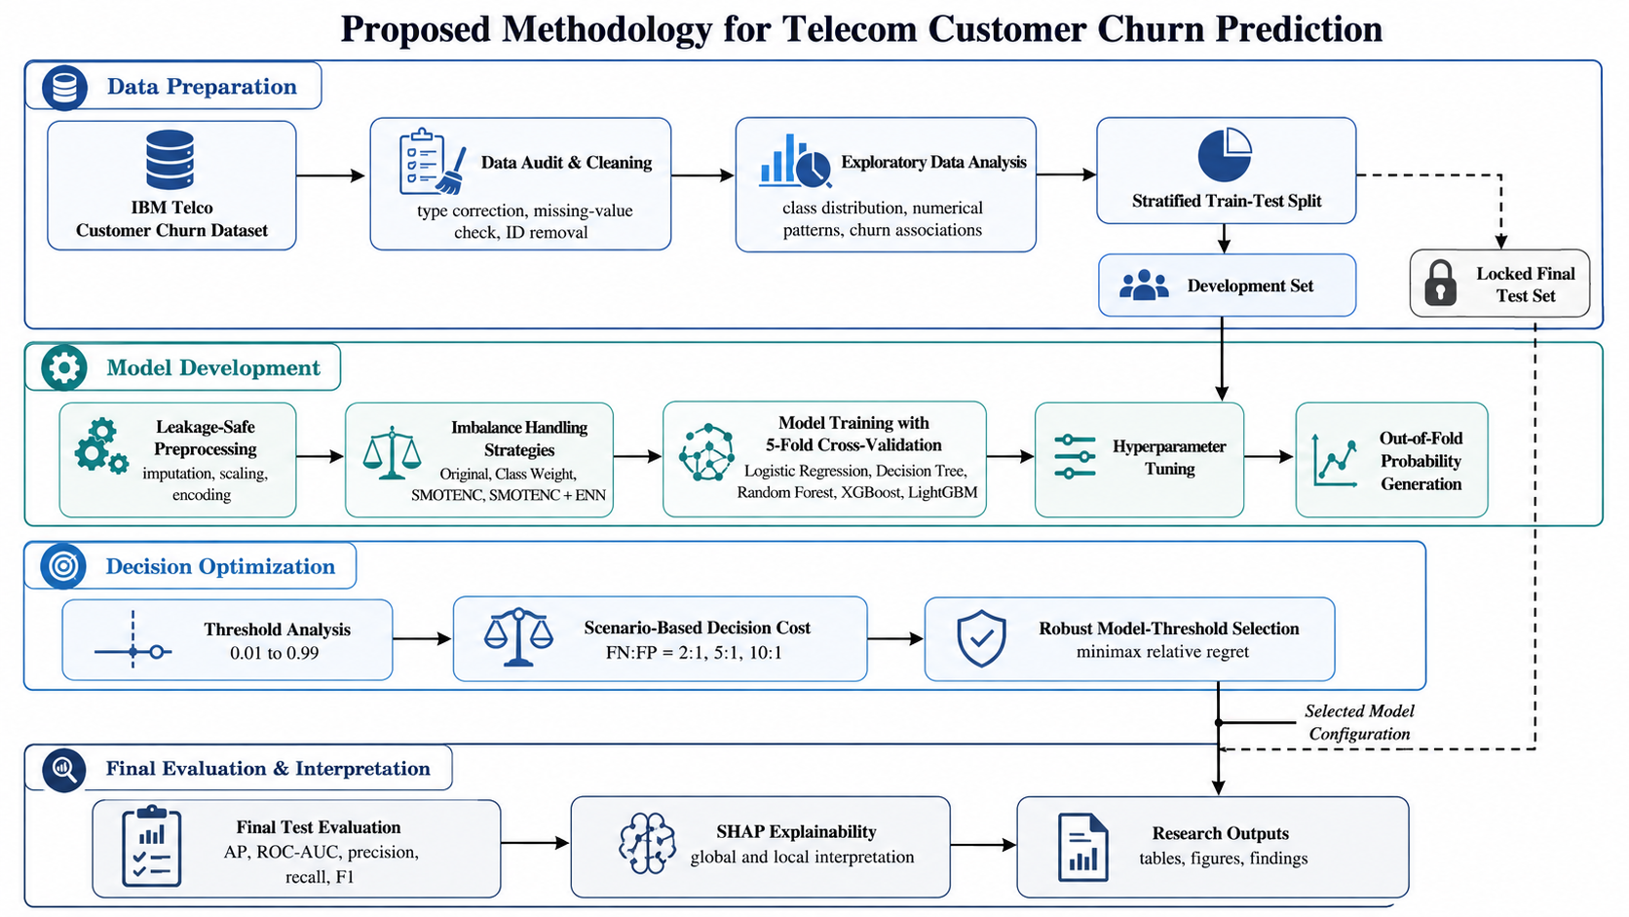
Proposed Research Workflow
METHODOLOGY
05

Slide 6
Dataset Overview
DATA
IBM Telco Customer Churn Dataset
06
7,043
21
Churn
Binary
Total Customers
Total Columns
Target
Problem Type
Target Distribution
Key Insight
Non-Churn
5174
The target is imbalanced: non-churn customers are much higher than churn customers. Therefore, accuracy alone can be misleading.
Churn
1869
Telecom Customer Churn Prediction | CSE 475 | East West University

Slide 7
Data Preparation & Leakage Safety
DATA
The final test set was locked before model development
07
Removed customerID because it is only an identifier
Leakage Safety Rule
Converted TotalCharges from object to numeric
All preprocessing, tuning, threshold search and decision-cost analysis used development data only. The final test was opened once after model and threshold selection.
Encoded target: No = 0, Yes = 1
Used stratified 80/20 development-test split
Development set: 5,634 customers
Locked final test: 1,409 customers
Md Ezaz Mahmud

Slide 8
Models and Imbalance Strategies
EXPERIMENTS
Baseline design compared 20 model-strategy combinations
08
Five Models
Four Imbalance Strategies
• Logistic Regression
• Decision Tree
• Random Forest
• XGBoost
• LightGBM
• Original
• Class Weight
• SMOTENC
• SMOTENC + ENN
5 models × 4 strategies = 20 baseline combinations | Primary metric: Average Precision

Slide 9
RQ1: Model Selection and Tuning
RESULTS
Average Precision was used as the primary ranking metric
09
Best Tuned Candidate
Why AP?
Key Insight
Model: XGBoost
Strategy: Original
Mean CV AP: 0.6714
OOF AP: 0.6682
Accuracy can hide weak minority-class detection. AP focuses on precision-recall behavior, which is more suitable for imbalanced churn data.
Class Weight increased churn recall at 0.50, but it did not improve ranking ability compared with Original XGBoost.
Tuned XGBoost Original vs Class Weight

Slide 10
Threshold and Decision-Cost Framework
DECISION ANALYSIS
Changing the threshold changes retention actions
10
Threshold Scan
Decision Cost
Scenarios
Default threshold: 0.50
Scanned range: 0.01 to 0.99
Metrics: precision, recall, F1, FN, FP
Cᵣ(t) = [r × FN(t) + FP(t)] / N
r = relative importance of false negatives
FN:FP = 2:1
FN:FP = 5:1
FN:FP = 10:1
No actual monetary cost was claimed.

Slide 11
Final Model and Threshold Selection
SELECTION
Selected before opening the final test set
11
Selection Rule
Locked Final Configuration
Minimax relative regret selected one model-threshold combination that performs robustly across 2:1, 5:1 and 10:1 scenarios.
XGBoost
Original
Model
Strategy
0.18
No further model, parameter or threshold changes after this point.
Threshold

Slide 12
Final Locked-Test Results
FINAL VALIDATION
First true held-out evaluation on 1,409 customers
12
0.665
0.847
0.861
0.599
0.693
Average Precision
ROC-AUC
Recall
F1-score
Accuracy
Confusion Matrix at Threshold 0.18
Predicted Non-Churn
Predicted Churn
Interpretation
At the selected threshold, the model detected 322 out of 374 churners and missed only 52 churners.
Actual Non-Churn
655
380
Actual Churn
52
322

Slide 13
Default 0.50 vs Selected 0.18
FINAL VALIDATION
Threshold changed the type of mistakes the model made
13
Metric
Default 0.50
Selected 0.18
Main Trade-off
Recall
0.5321
0.8610
The selected threshold reduced missed churners from 175 to 52, but increased false positives from 97 to 380.
F1-score
0.5940
0.5985
False Negatives
175
52
False Positives
97
380
Threshold selection is a business decision, not only a machine learning decision.

Slide 14
Decision-Cost Findings
DECISION ANALYSIS
The selected threshold is useful when missing churners is more costly
14
FN:FP Scenario
Cost Change
Interpretation
No threshold is universally best. When false negatives are highly costly, threshold 0.18 provides better decision utility. When false positives are relatively important, it may be worse.
2:1
8.28% worse
5:1
34.16% better
10:1
51.27% better
Final decision depends on business cost assumptions.

Slide 15
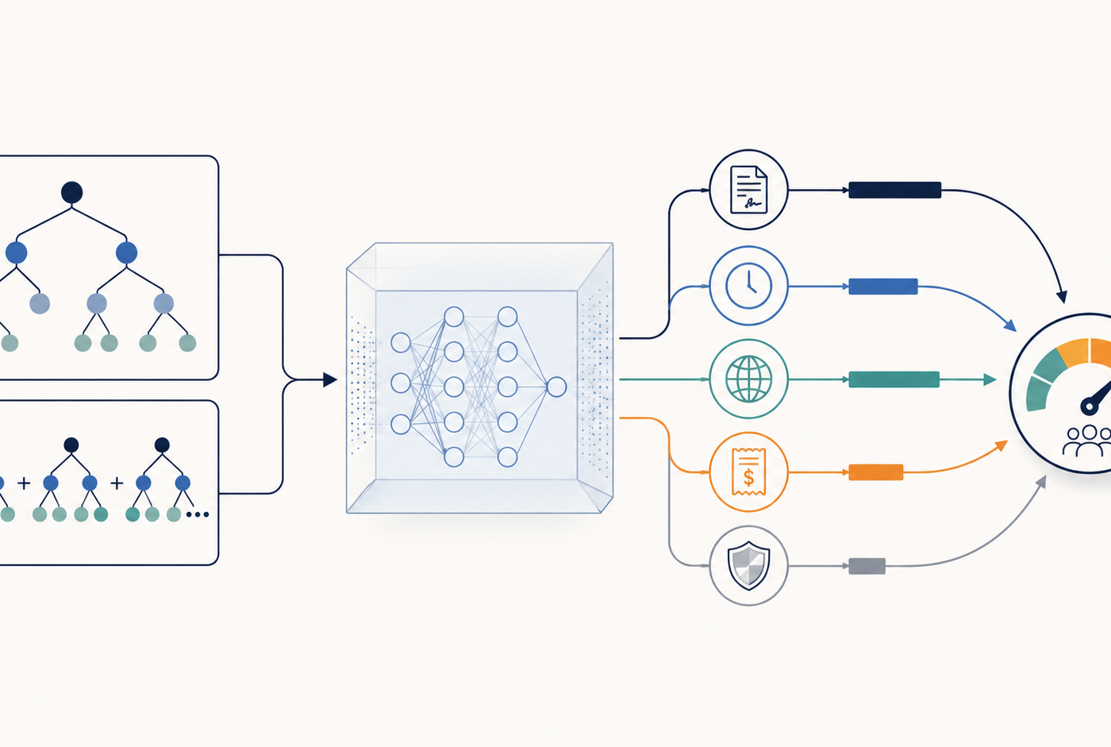
SHAP Explainability
EXPLAINABILITY
SHAP explains how features contributed to the final model’s predictions
15
Top Original Features
1. Contract
2. tenure
3. InternetService
4. MonthlyCharges
5. OnlineSecurity
6. PaymentMethod
7. TechSupport
8. PaperlessBilling
9. MultipleLines
10. TotalCharges
Important: SHAP shows model-level associations, not causality.

Slide 16
Key Findings & Limitations
FINDINGS
What the study shows and what it does not claim
16
Key Findings
Limitations
• Imbalance strategies changed model behavior
• Default 0.50 threshold missed many churners
• Selected 0.18 reduced FN from 175 to 52
• Decision usefulness depends on FN/FP cost assumptions
• Contract and tenure were strongest SHAP drivers
• Single public telecom dataset
• No actual customer lifetime value
• No real retention campaign cost
• FN:FP ratios are hypothetical
• SHAP is not causal
• No external validation dataset

Slide 17
Conclusion
CONCLUSION
A churn model should be evaluated as a decision-support system
17
Final Message
Accuracy or ROC-AUC alone is not enough. In churn prediction, the selected threshold strongly affects how many churners are detected and how many non-churners are unnecessarily targeted.
Leakage-safe data
Imbalance-aware models
Threshold-aware decisions
Decision-cost analysis
SHAP explanation
Final model: XGBoost + Original strategy + threshold 0.18
The framework moves from predicting churn to supporting retention decisions.

Slide 18
References
REFERENCES
Harvard-style references used in the paper
18
Manzoor et al. (2024), IEEE Access
Chang et al. (2024), Algorithms
Sikri et al. (2024), Scientific Reports
Poudel et al. (2024), Machine Learning with Applications
Saleh and Saha (2023), SN Applied Sciences
Wagh et al. (2024), Results in Control and Optimization
Asif et al. (2025), Results in Engineering
Ouf et al. (2024), Journal of Big Data
Alotaibi and Haq (2024), ETASR
AlShourbaji et al. (2023), Scientific Reports

Slide 19
THANK YOU
Questions?

