Slide 1
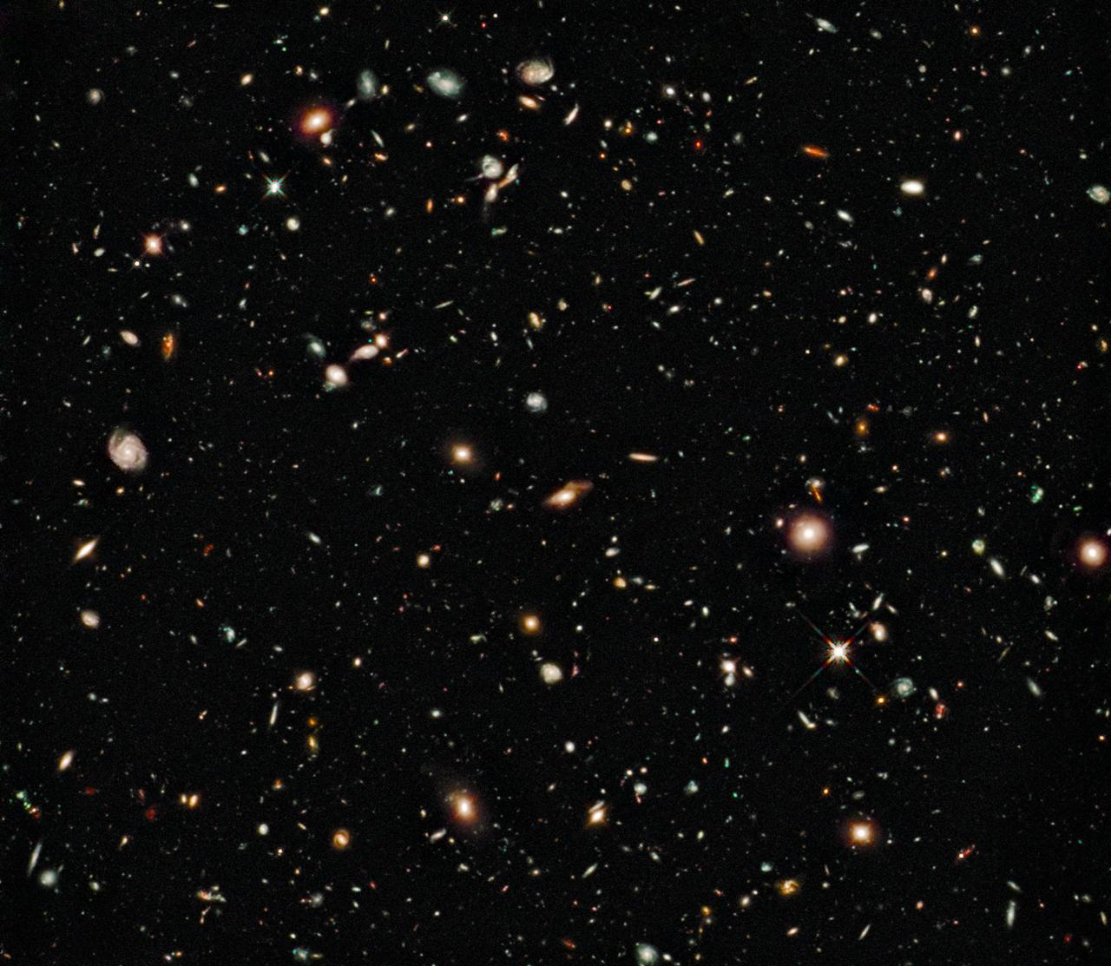
Notes:
Hubble ultra deep feed, only two stars in this entire image! The universe is filled with galaxies!

Slide 2
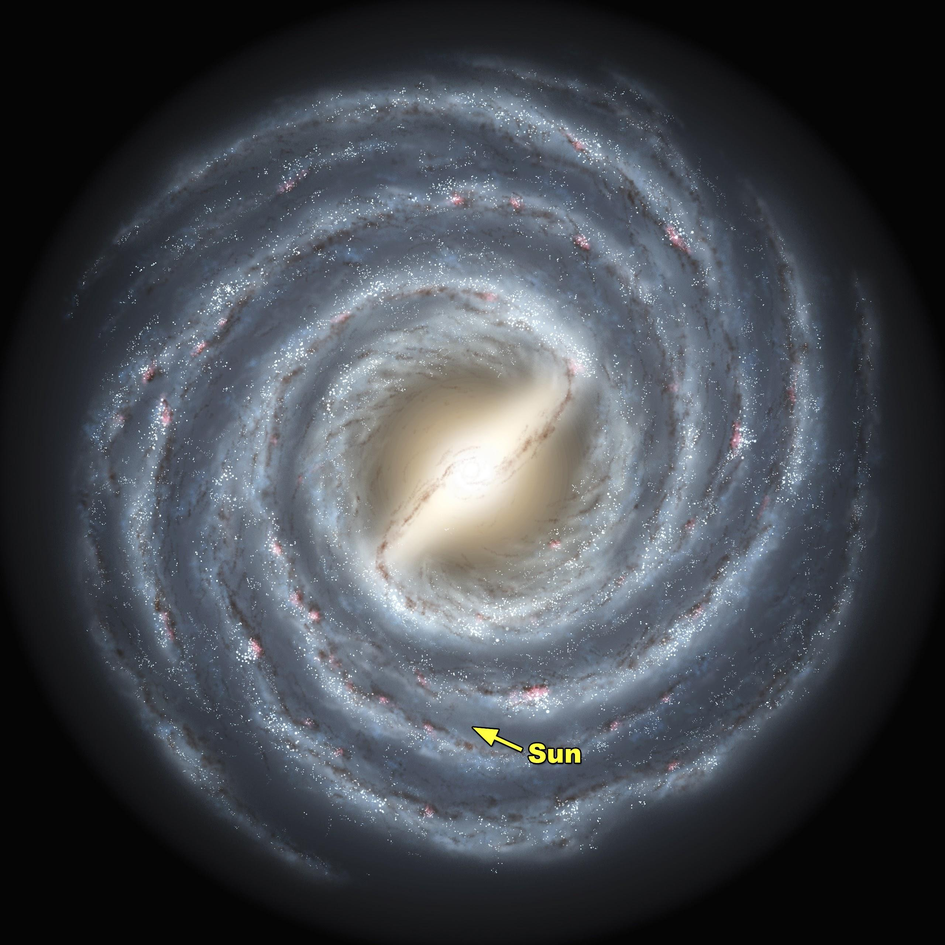
Notes:
Artist conception of the Milky Way. We can see a bulge and stellar arms. MW is ~100,000 ly in diameter (~30,000 pc). Given our current technology we will never be able to see this for real… why not?
→ We are in the disk and we would have to travel far away (many 10’s of 1000’s of light years) to get this picture.

Slide 3
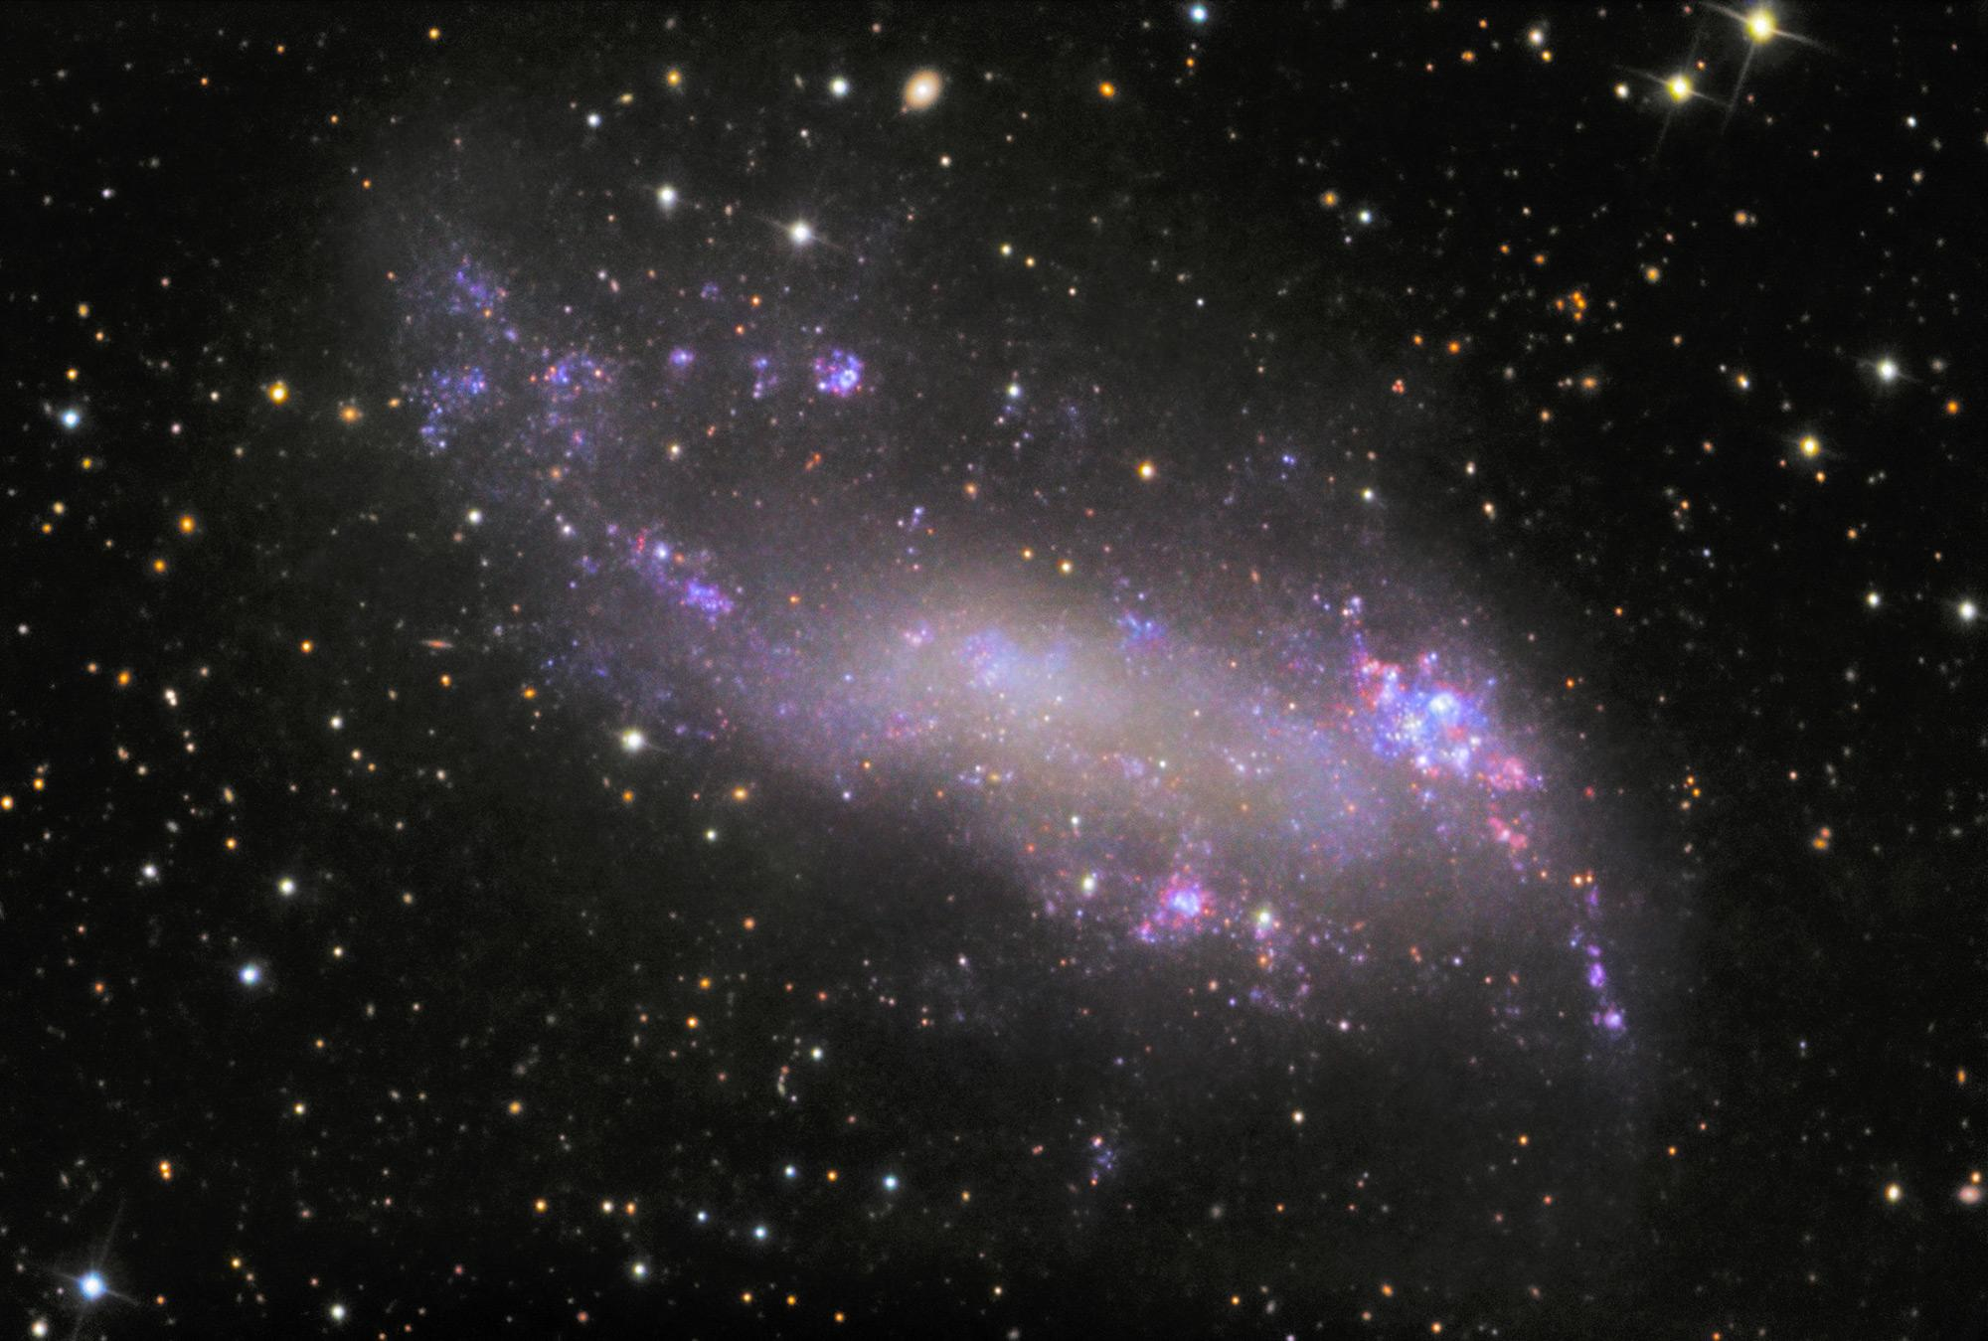
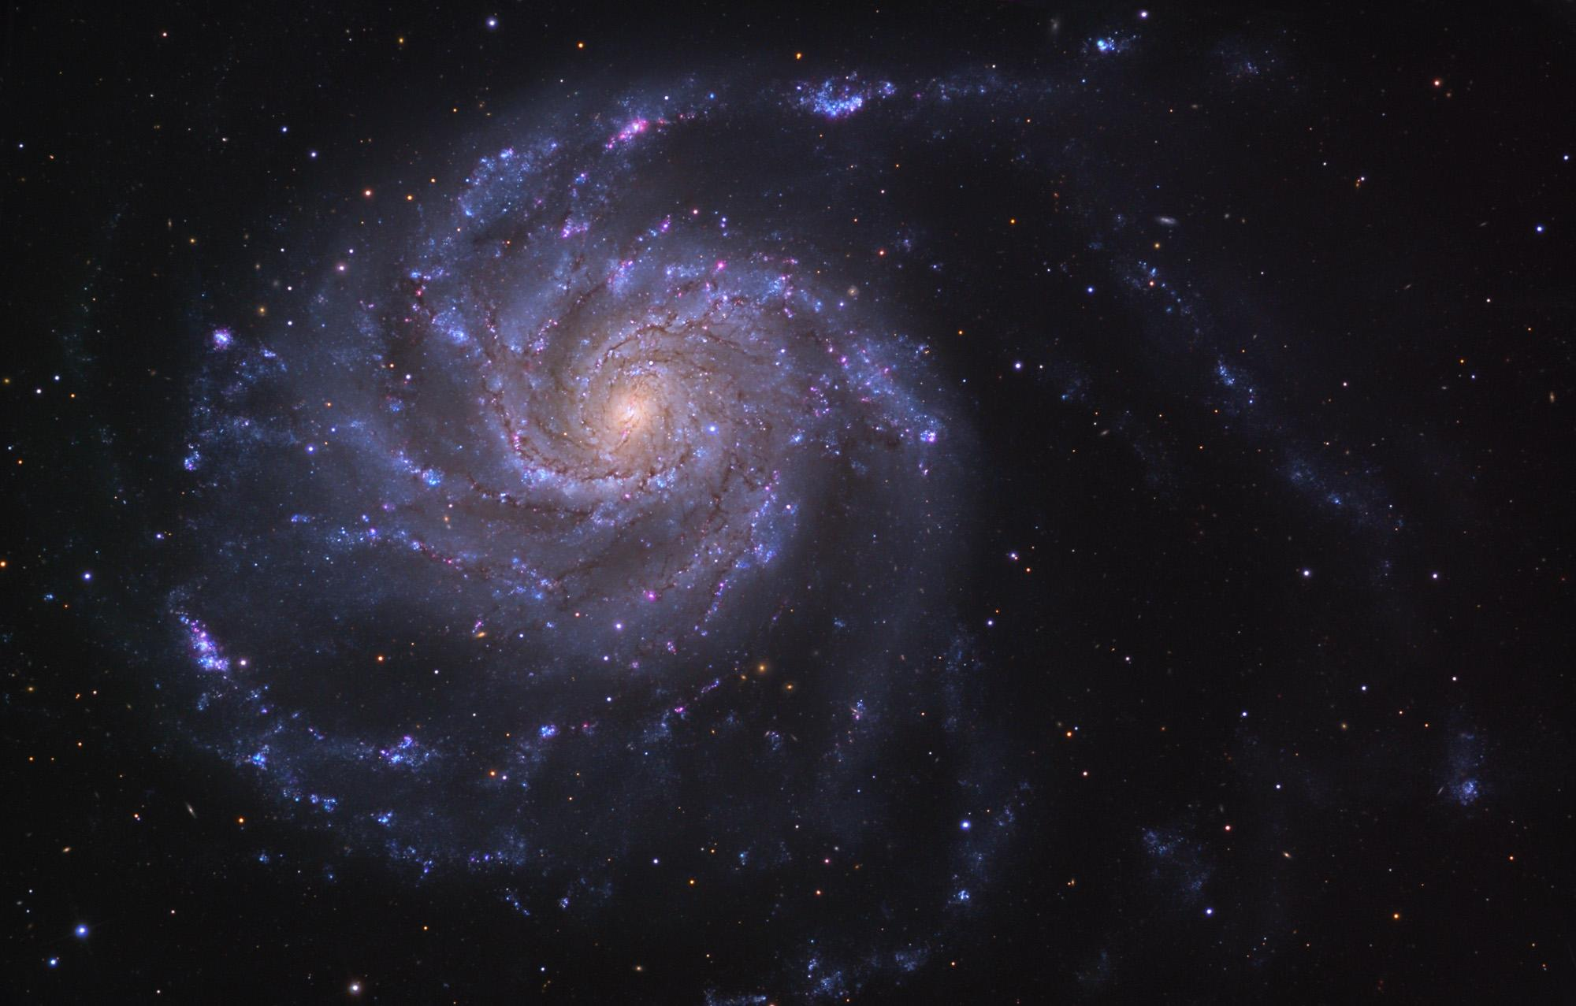
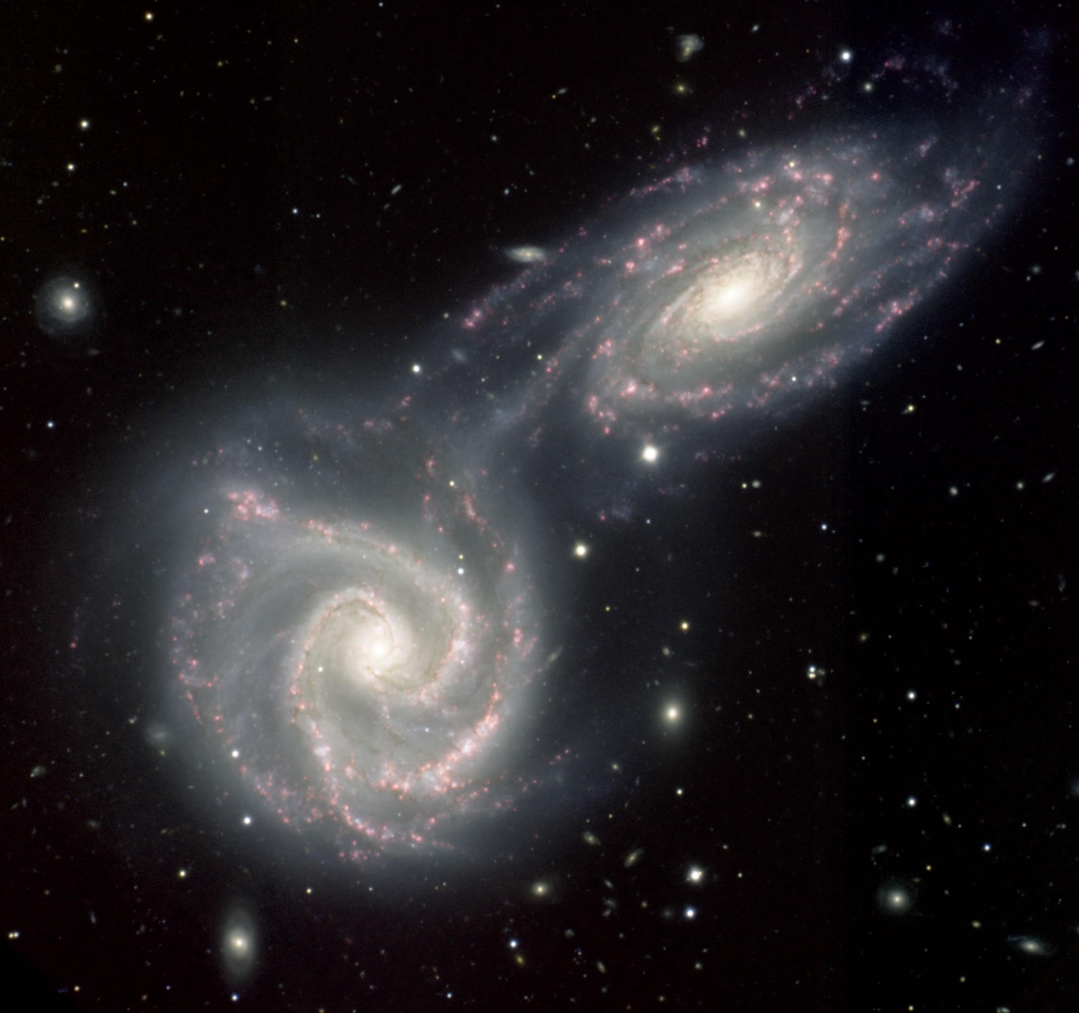
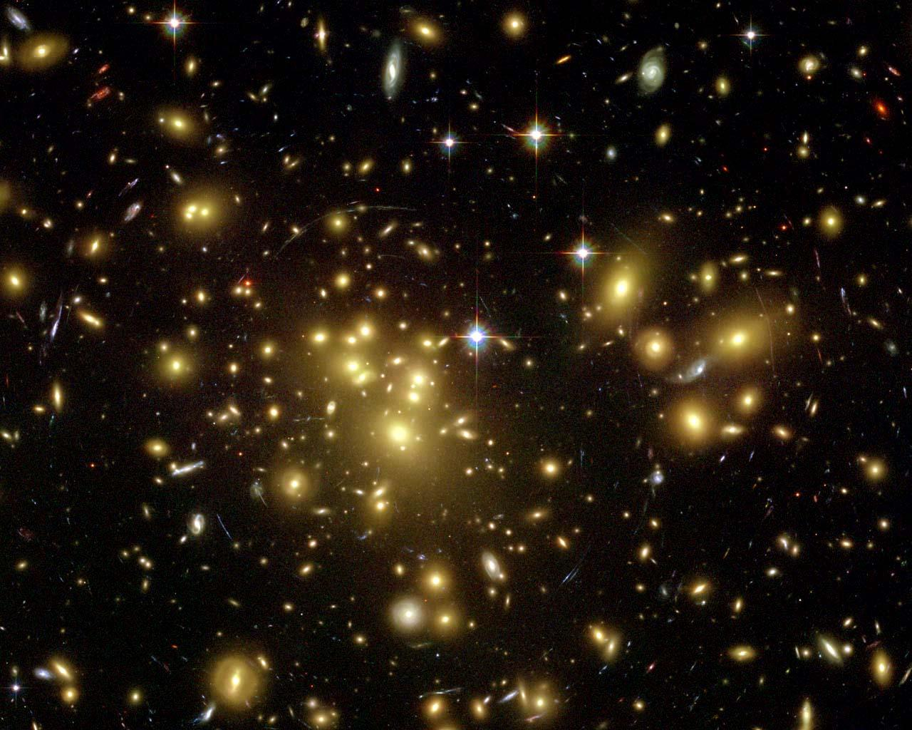
IC 2574
M 101
Arp 271
Abell 1689
Notes:
IC 2574: Irregular galaxy, M 101: Spiral galaxy, Arp 271: Interacting galaxies, Abell 1689: Cluster of Elliptical galaxies

Slide 4
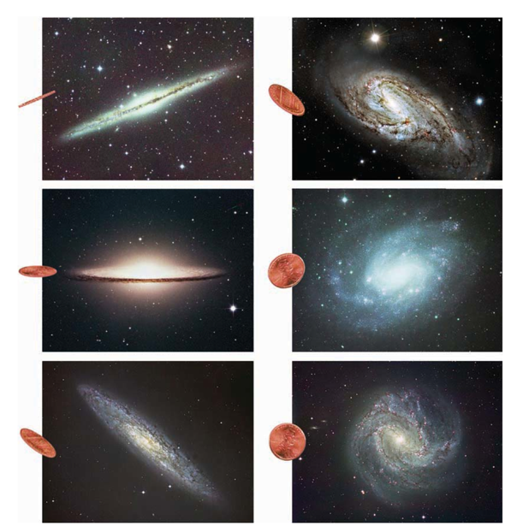
Notes:
Galaxies are seen at many different orientations

Slide 5
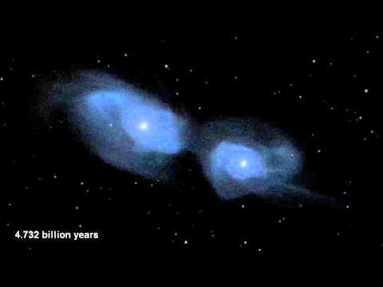
Notes:
Milky Way and Andromeda colliding

Slide 6
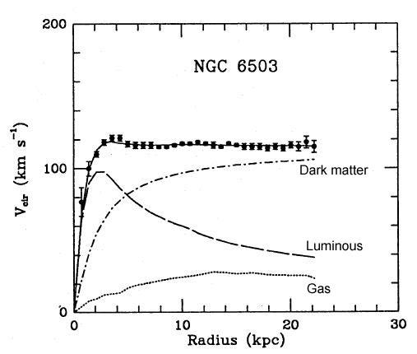
Notes:
A real rotation curve

Slide 7
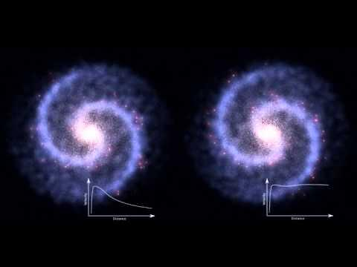
Notes:
The differences between these two rotation curves: Left what we think should happen with no DM, right: What we really observe

Slide 8
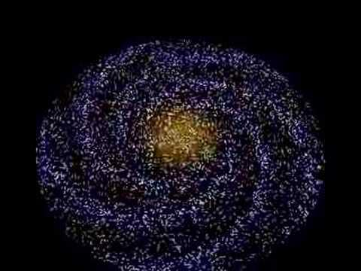
Notes:
Density wave theory: stars move into and out of spiral arms.

