Slide 1






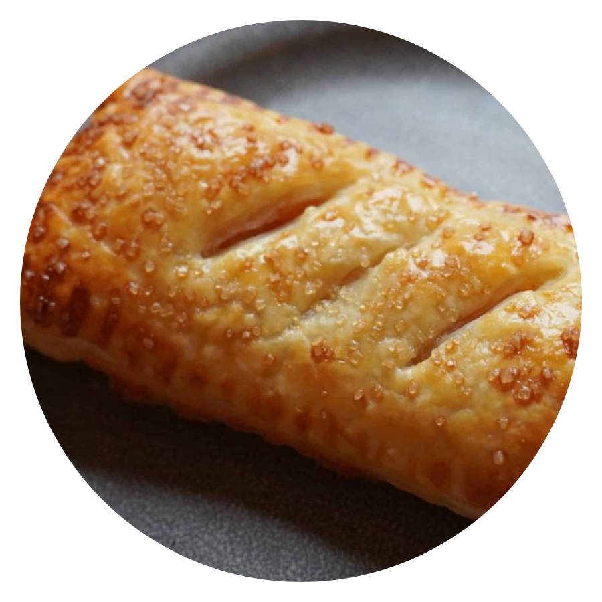
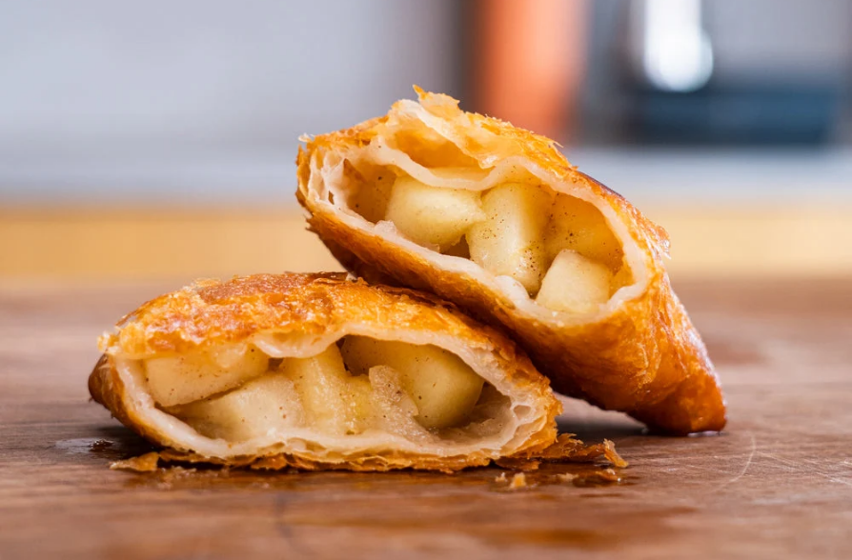





COOKING
CLASS
McDonald’s Apple Pie
INGREDIENTS
✓
Ready-made puff pastry
Massa folhada pronta (retangular ou em rolo)
✓
Chopped apples
Maçãs picadas
✓
Sugar and ground cinnamon
Açúcar e canela em pó
✓
Cornstarch
Amido de milho
✓
Lemon juice and a little water
Suco de limão e um pouco de água
✓
Beaten egg (for brushing)
Ovo batido (para pincelar)
KITCHEN UTENSILS
✓
Saucepan
✓
Spoon
Panela
Colher
✓
Knife
✓
Plate
Faca
Prato
✓
Small bowl
✓
Fork
Tigela pequena
Garfo
✓
Pastry brush
✓
Air fryer
Pincel de cozinha
Air fryer
16.10
19:30
|
Online · Zoom Meeting

