Slide 1
CSE 497 Engineering Project Presentation
USING HIERARCHIES IN REINFORCEMENT LEARNING FRAMEWORK WITH
NON-STATIONARY ENVIRONMENTS
Group Members
Kutalmış Coşkun
Ezdin Aslancı
Advisor
Assoc. Professor Borahan Tümer

Slide 2
Outline
Project Description
Project Goals
Related Work
Scope
Methodology and Technical Approach
Tasks Accomplished
Difficulties Encountered
Tasks to be Completed in the Second Semester
Notes:
– Here is our outline for the presentation.
– We will explain our project on these titles.

Slide 3
Project Description
“Using Hierarchies in Reinforcement Learning Framework with Non-Stationary Environments”
Few questions pop up:
  What is Reinforcement Learning?
  What is Hierarchical Reinforcement Learning?
  What is a non-stationary environment?
  How to detect changes in the environment?
Notes:
– When someone reads our title, few questions pop up in her mind. We would like to answer these questions in order to describe what we do.
– Read the questions.

Slide 4
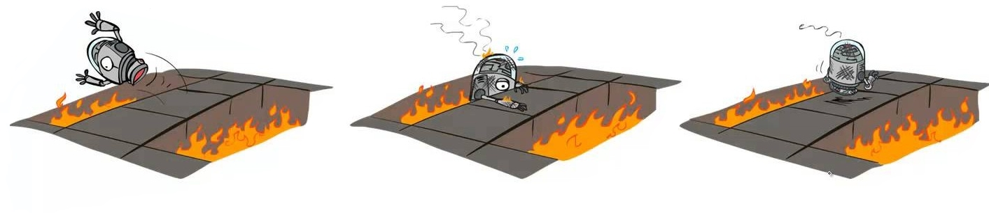
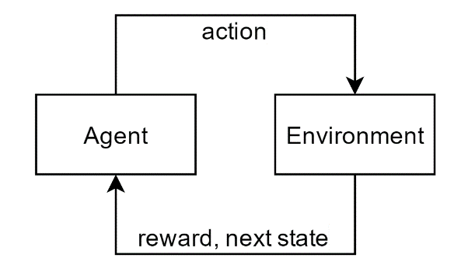
Reinforcement Learning (RL)
RL is a behavioral learning approach to solve sequential decision making problems.
Notes:
– As you can see in the figure, RL is a behavioral learning approach to solve SDM problems.
– There are few concepts that we want to explain to express what RL is.
– The agent observes the environment, selects and takes an action. Receives a reward value and the information for the next state from the environment. This loop continues until the agent reaches the goal state.

Slide 5
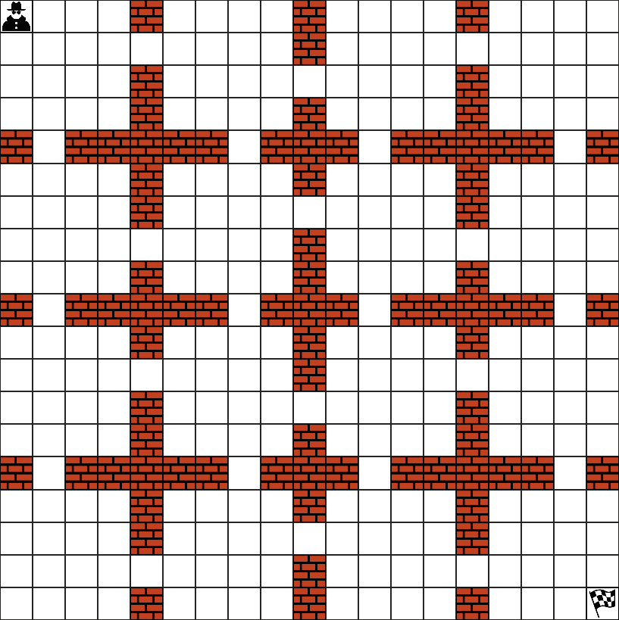
Hierarchical Reinforcement Learning (HRL)
RL becomes infeasible when the state space is large or continuous.
Idea: Divide the problem into solvable independent tasks
How?: Define and use options together with actions.
Notes:
– Then the curse of dimensionality strikes…
– This process becomes infeasible if the state space is too large or continuous.
– Then luckily, a brilliant idea saves the day. Why dont we divide the task into smaller, independently solvable subtasks? After solving each small subtask, we can combine the solutions of these to form a solution to the main task. This is adding a hierarchy and it helps a lot to solve these kind of problems.
– But how we can apply this on a grid like this? We should first define options. Options are temporally extended actions and represented with blue arrows on the grid. By using options, the agent quickly passes through the doors between halls and reaches the goal.

Slide 6
RL in Non-Stationary Environments
Real world problems are often non-stationary.
Following properties hold for non-stationary environments:
  Multiple stationary regimes with distinct dynamics
  Regimes,
        change independently of agent’s actions
        change relatively infrequently
        are not directly observable
Notes:
– Generally, RL environments are assumed to be stationary. This assumption can be considered as optimistic since most of the real world problems are non-stationary. We also work on non-stationary environments.
– The most important difference between dynamic and non-stationary environments is, a non-stationary environment is a linear combination of stationary segments, which we call regimes or modes.
– Here are some assumptions we have for non-stationary environments.
– Read the list.

Slide 7
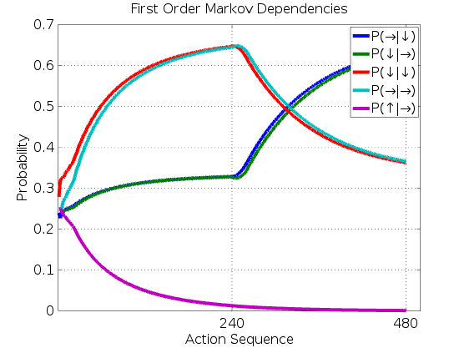
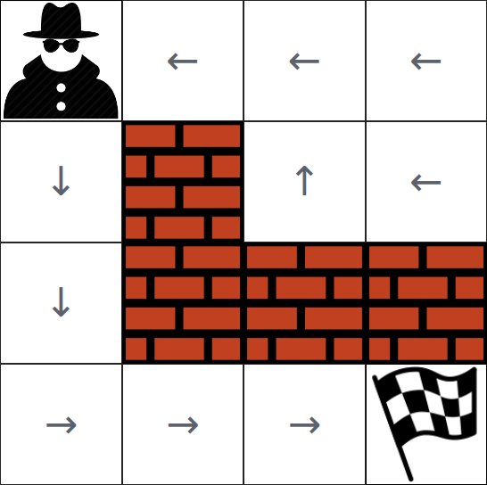
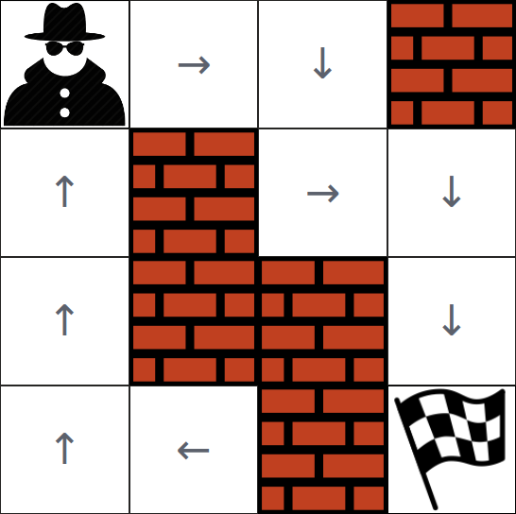
Detecting Changes in Non-Stationary Environments
Idea: Stationary behaviors (i.e. regimes) of the environment can be distinguished by tracking the action sequence.
Environment 1
Environment 2
Optimal Path:
↓↓↓→→→
Optimal Path:
→→↓→↓↓
environment
changed (1 → 2)
t
Notes:
– But how can we detect regime changes?
– Here is the idea we came up with. This is also our novelty.
– Here is a result of one of our experiments on a non-stationary environment which is a combination of two stationary environments.
– This graph shows First order markov dependencies of the action sequence that the agent generates.
– Time t is the regime switching point and at time t, the FOM dependencies change drastically and the switching point can be detected by tracking FOM dependencies of the action sequence.

Slide 8
Project Goals
Hierarchical Reinforcement Learning (HRL)
Change Detection Algorithm (SCD)
Notes:
– Our main goal is to use our algorithm for detecting changes together with HRL to improve learning performance.

Slide 9
Related Work
Between MDPs and semi-MDPs: A framework for temporal abstraction in reinforcement learning
Sutton, R.S., Precup, D. & Singh, S.
Dealing with Non-Stationary Environments using Context Detection
Silva, B.D. da, Basso, E.W., Bazzan, A.L.C. & Engel, P.M.
Hierarchical Reinforcement Learning with Context Detection (HRL-CD)
Yücesoy, Y.E. & Tümer, B.
Notes:
– Here are some closely related papers.
– First one is about hierarchical approach on RL.
– Second one is about RL on non-stationary environments with context detection.
– Third one improves the second one by using hierarchies.
– We want to improve the third one by using a more sensitive change detection algorithm.

Slide 10
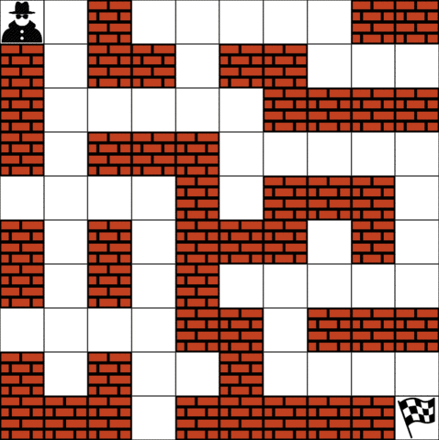
Scope
Deterministic
Discrete
Non-Stationary
Notes:
– On our project, we focus on grid world simulation of deterministic, discrete and non-stationary environments.
– Continuous or stochastic environments are not in our scope but we plan work on them as a future work.

Slide 11
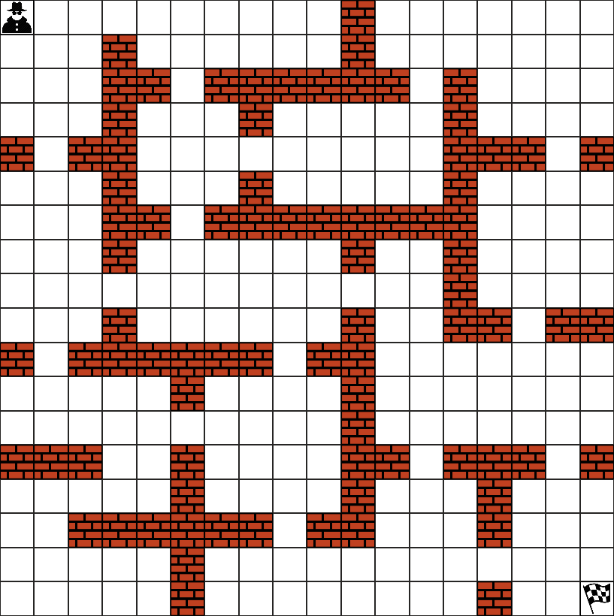
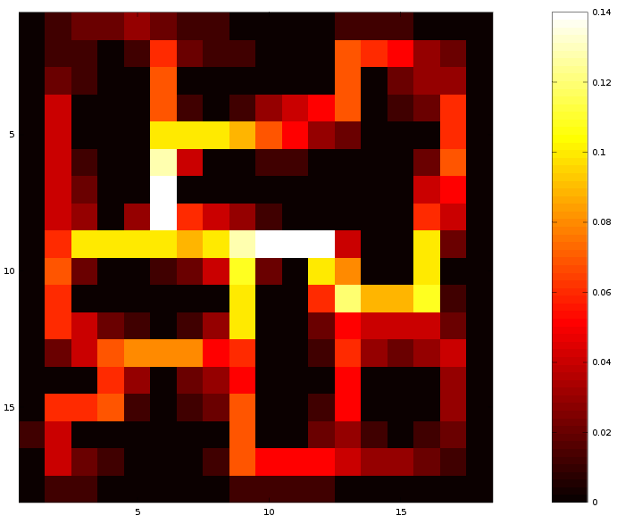
Methodology and Technical Approach
Subgoal Detection with Betweenness Centrality
Notes:
– Here you can see a grid with small halls. In order to apply HRL, we need to detect subgoals first. (show on grid). These subgoals can be thought as doors leading the agent from one hall to another. Detecting these bottlenecks is important because they are possible subgoals.
– These subgoals can be detected by using betweenness centrality values. The heatmap on the right side shows the corresponding bc values of each state. States with higher bc values are possible subgoals.

Slide 12
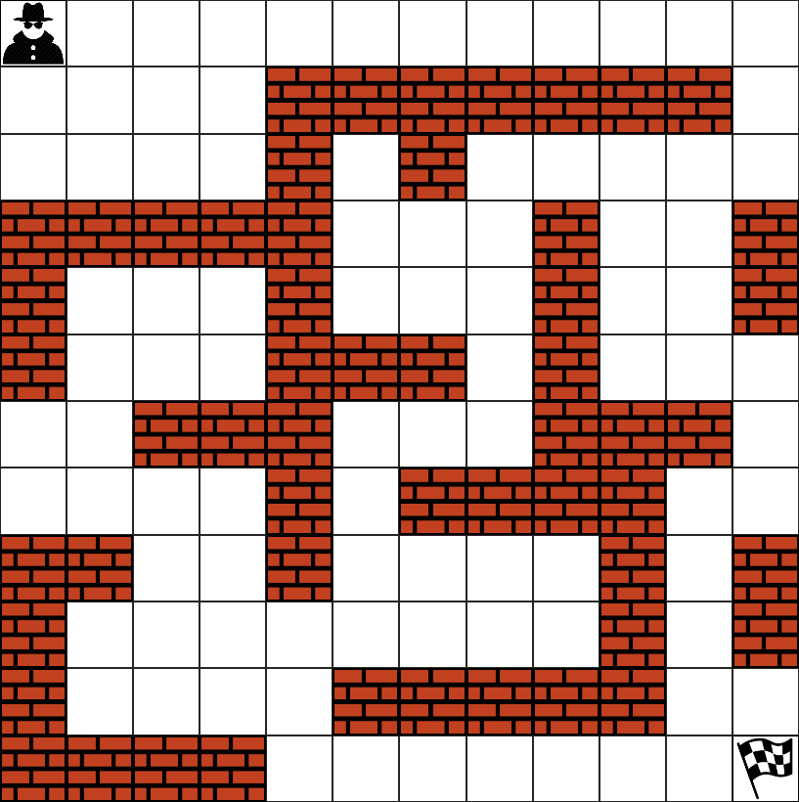
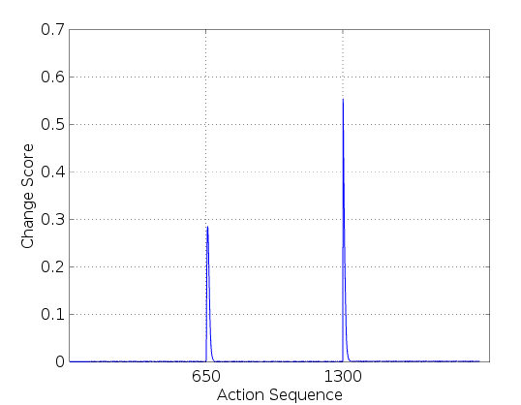
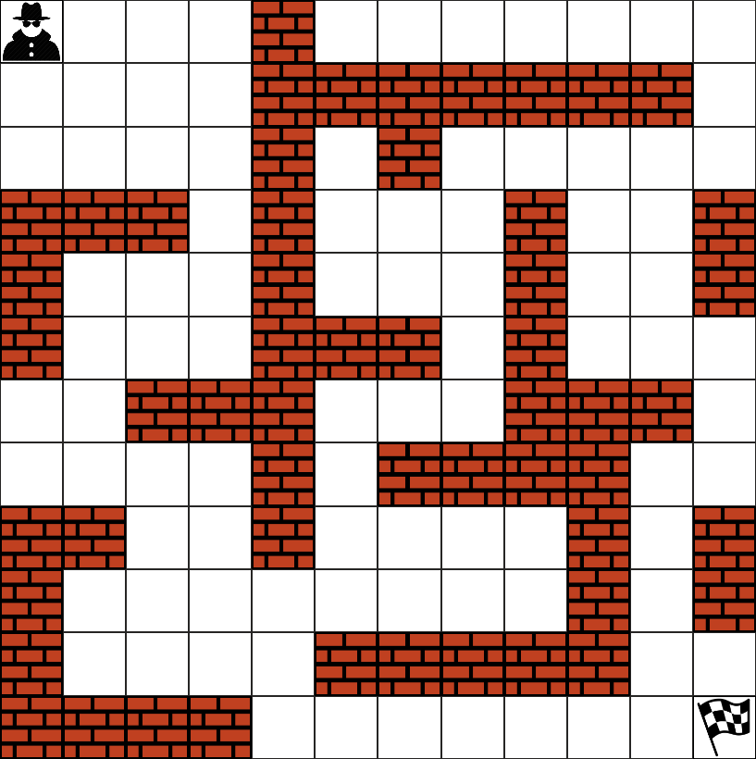
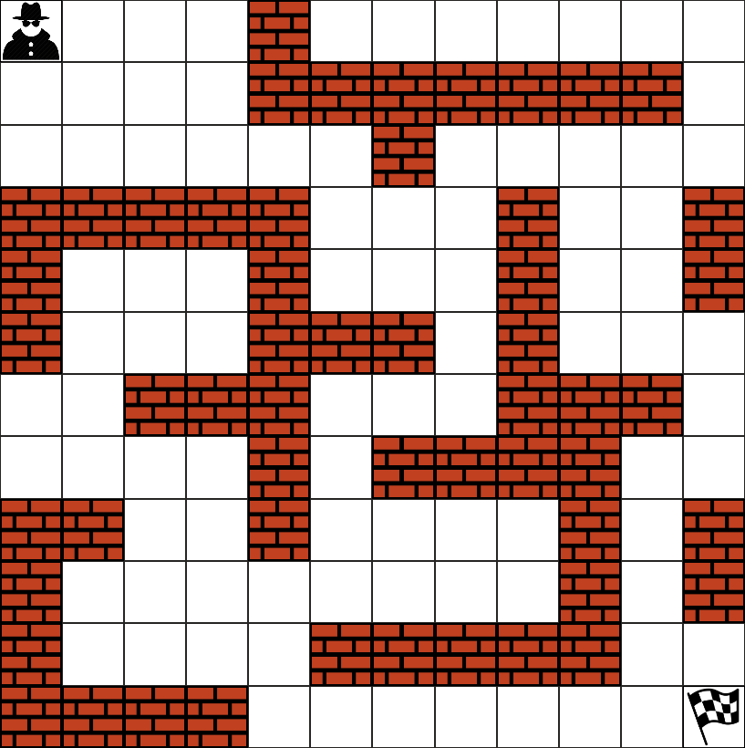
Methodology and Technical Approach
An experiment on a non-stationary environment with 3 regimes:
Notes:
– Here is the result of one of our experiments with a non-stationary environment which has 3 different behaviors. You can see these on grid representations.
– On the graph, you can see that the change score curve has 2 peaks. These peaks indicate the switching points between consequent regimes.
– We obtain change scores by applying analytical methods to detect sudden changes in FOM dependencies of the action sequence.
– It is possible to relate the dissimilarity between regimes with the height of the peak on switching point.

Slide 13
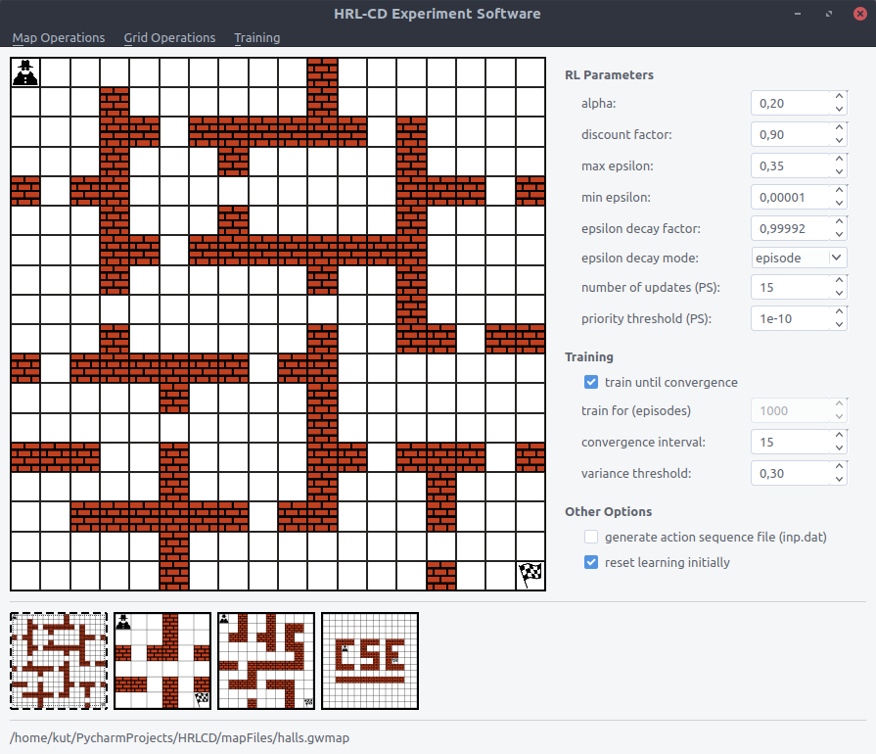
What we achieved so far?
We have found a way to detect changes.
(even slight ones)
We have implemented:
      Change Detection Module
      Experiment software with multiple environment support
      Q-Learning and Prioritized Sweeping Algorithms
      Betweenness centrality analysis module

Slide 14
Difficulties Encountered
Plans for Second Semester
How to detect changes?
Billions of actions
HRL implementation
Generating a significant structure for each regime
Using previous experiences on new environments

Slide 15
References
Silva, B.D. da, Basso, E.W., Bazzan, A.L.C. & Engel, P.M., Dealing with Non-Stationary Environments using Context Detection. 23rd International Conference on Machine Learning (ICML) , 2006.
Sutton, R.S., Precup, D. & Singh, S., Between MDPs and semi-MDPs: A framework for temporal abstraction in reinforcement learning. Artificial Intelligence , pages 181-211, 1999.
Sutton, R.S. & Barto, A.G., Reinforcement learning. Learning 3, 322, 2012.
Yücesoy, Y.E. & Tümer, M.B., Hierarchical Reinforcement Learning with Context Detection (HRL-CD). International Journal of Machine Learning and Computing , 7763, 2015.
Oommen, B.J. & Rueda, L. Stochastic learning-based weak estimation of multinomial random variables and its applications to pattern recognition in non-stationary environments. Pattern Recognition 39, 328-341, 2006.

