Slide 1
Predicting Water Pump Functionality in Tanzania
Gabriel Eze

Slide 2
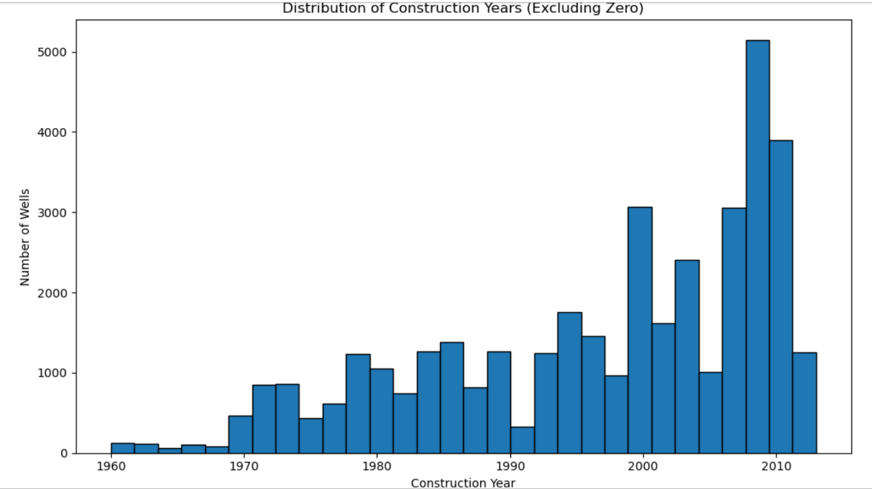
Feature Insight & Engineering

Slide 3
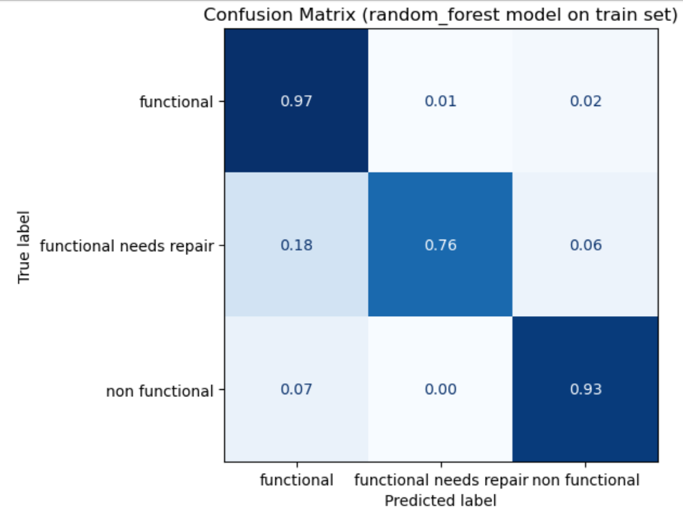
Model Summary - Random Forest Wins

