Slide 1
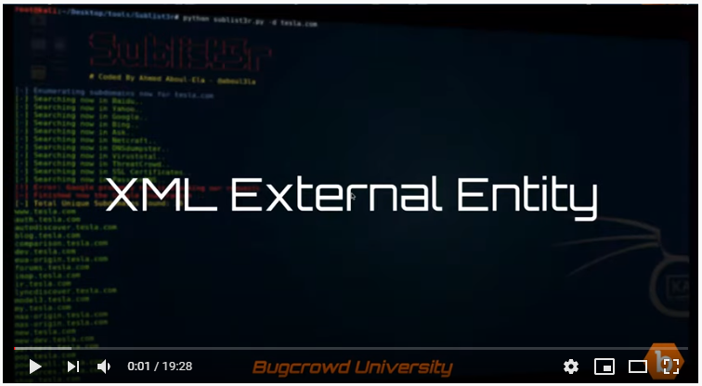

Slide 2
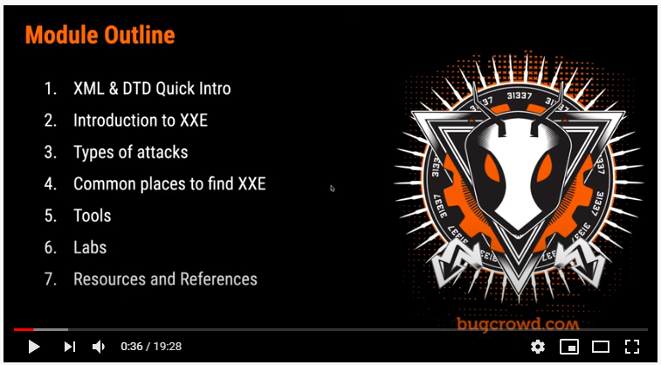

Slide 3
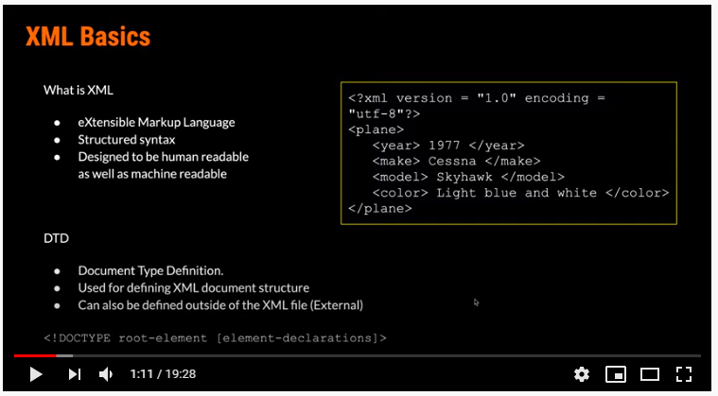

Slide 4
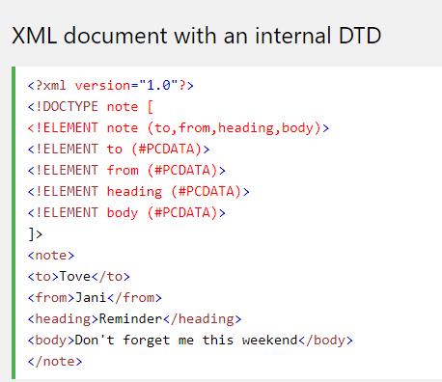
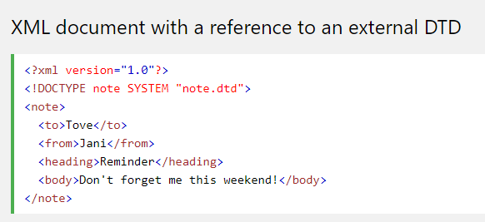

Slide 5
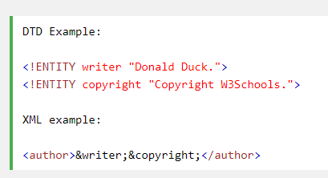

Slide 6
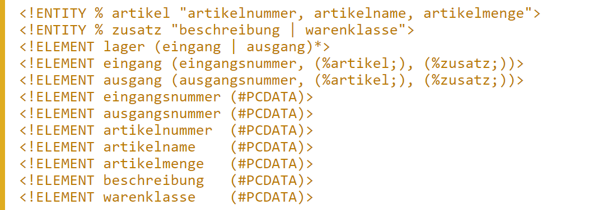
https://wiki.selfhtml.org/wiki/XML/DTD/Entities#Parameter_Entities_f.C3.BCr_komplexere_DTDs

Slide 7
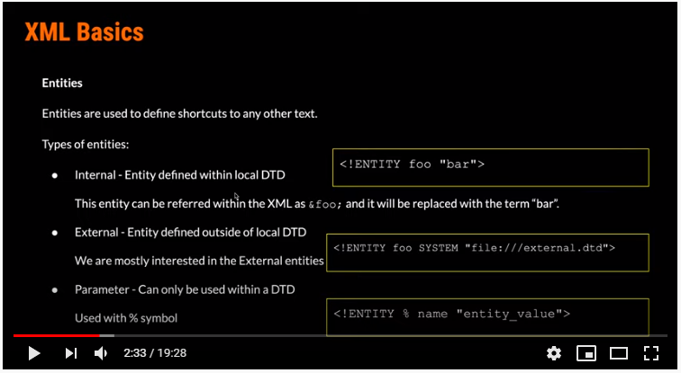

Slide 8
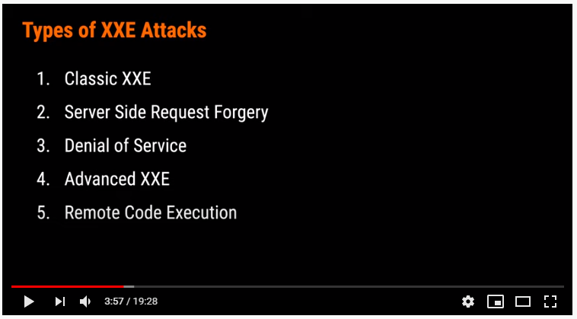

Slide 9
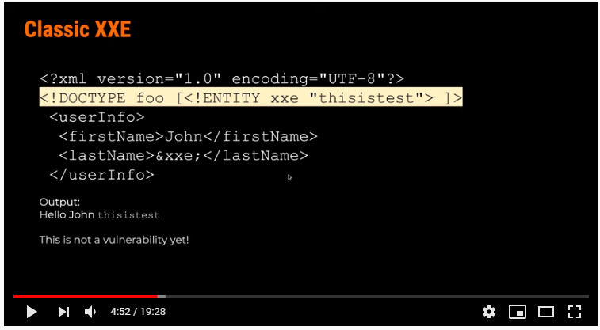

Slide 10
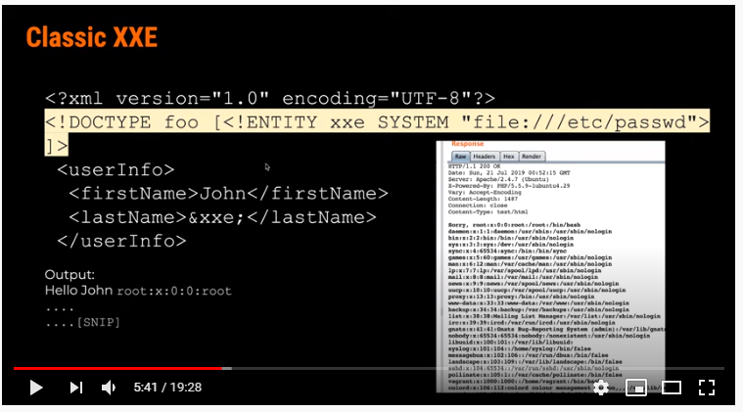

Slide 11
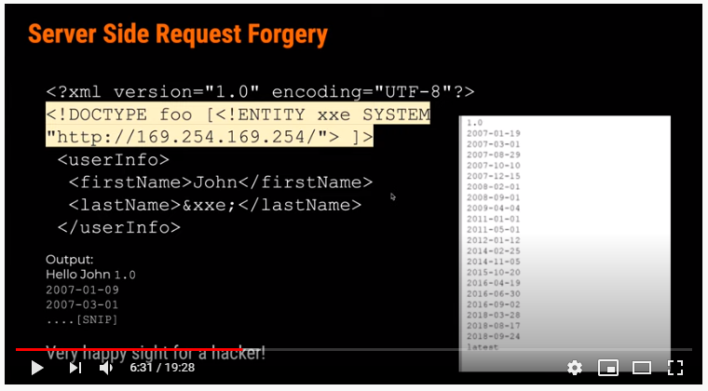

Slide 12
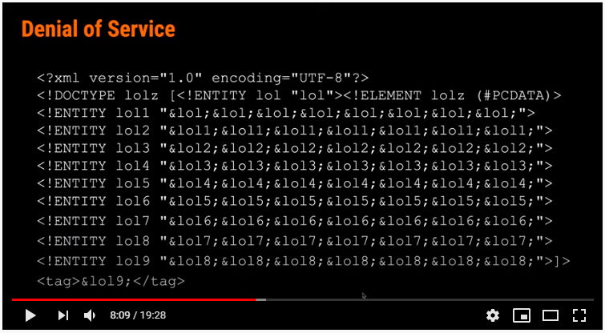

Slide 13
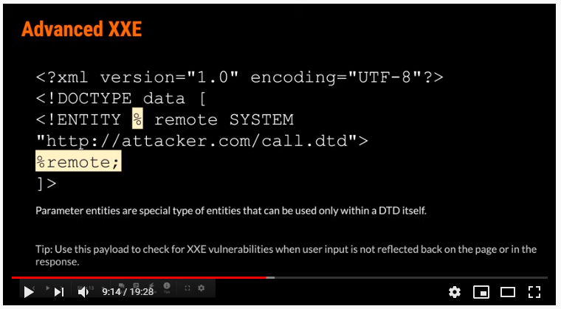

Slide 14
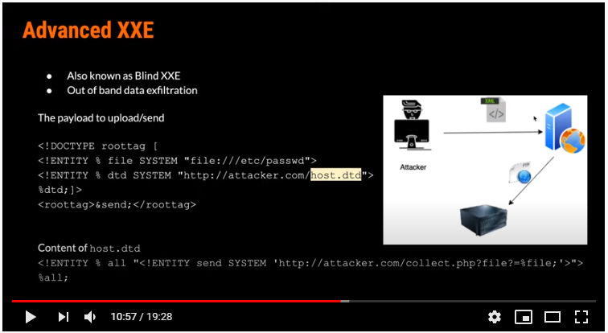

Slide 15
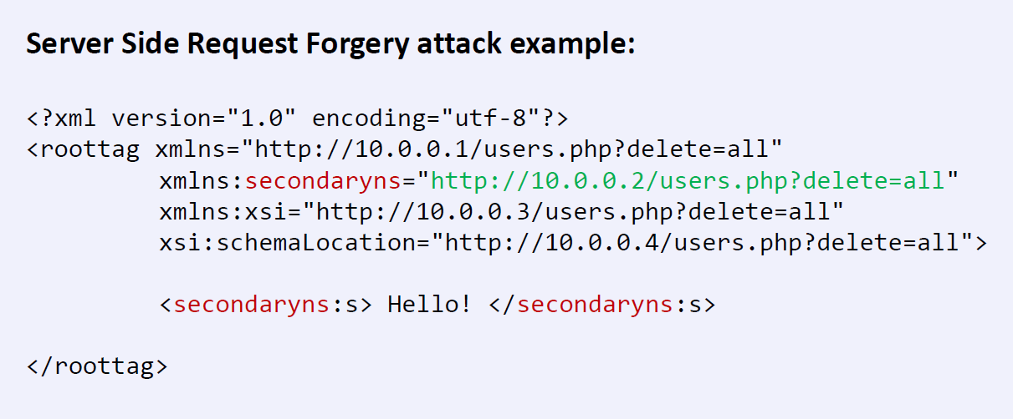
XSD: similar issues

Slide 16
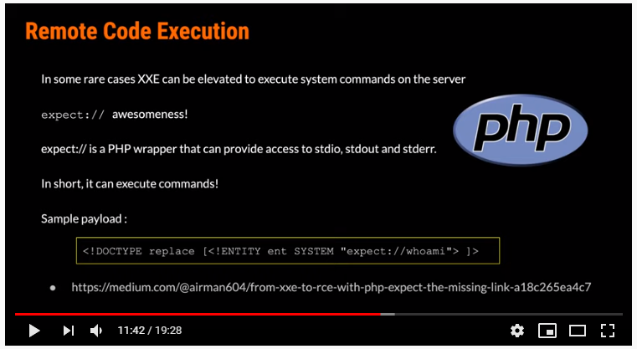

Slide 17
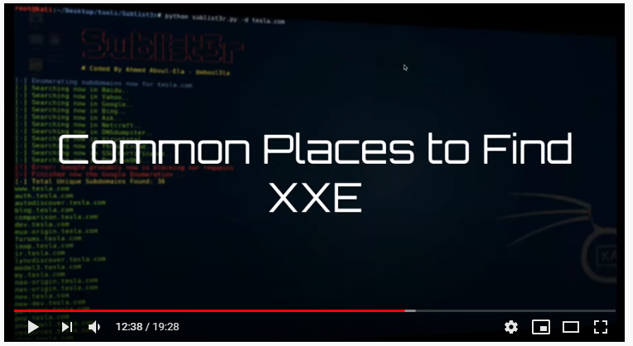

Slide 18
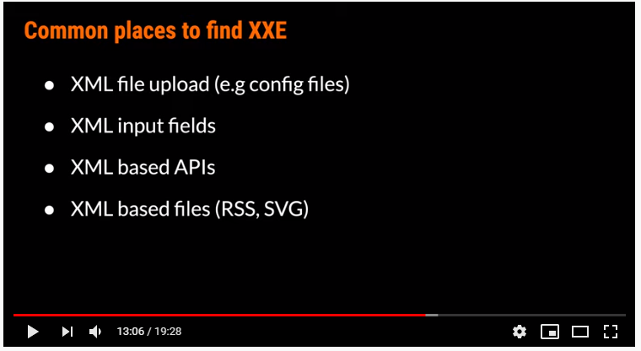

Slide 19
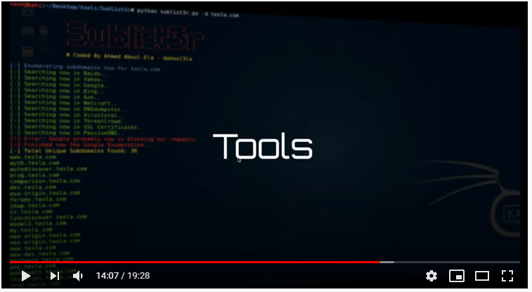

Slide 20
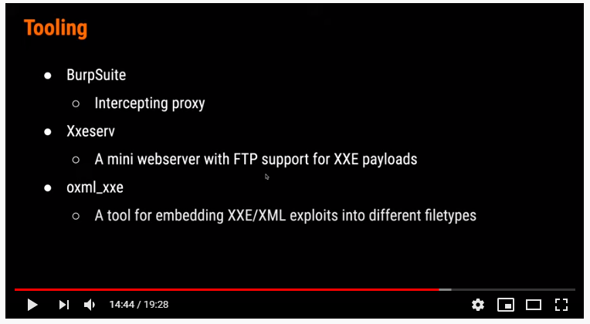

Slide 21
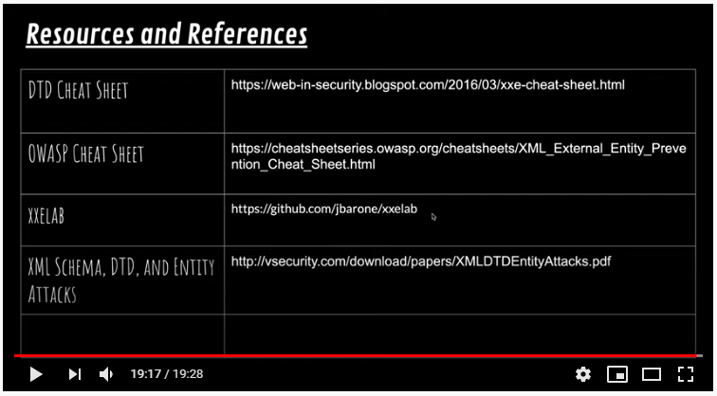

Slide 22
Input Validation Data from all potentially untrusted sources should be subject to input validation, including not only Internet-facing web clients but also backend feeds over extranets, from suppliers, partners, vendors or regulators, each of which may be compromised on their own and start sending malformed data.
https://cheatsheetseries.owasp.org/cheatsheets/Input_Validation_Cheat_Sheet.html

Slide 23
Input Validation
Whitelisting vs blacklisting
Prüfen, ob der Input dem entspricht was erwartet wird.

