Slide 1
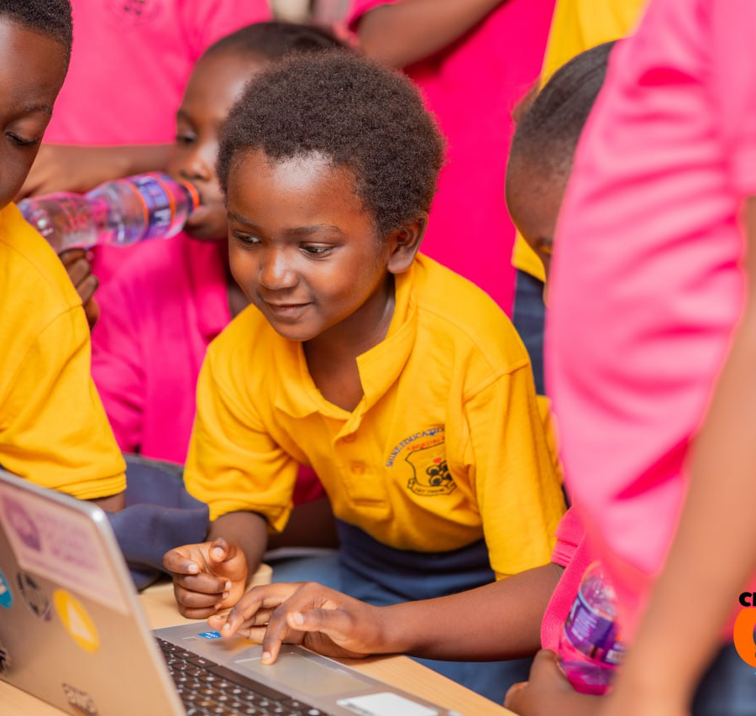
CHILD-
IN-TECH
A look inside the experiences
we create for children
MTN GAMING CONFERENCE
Notes:
Child-In-Tech booth visual story. Photo: local website gallery IMG-6668.jpg.

Slide 2
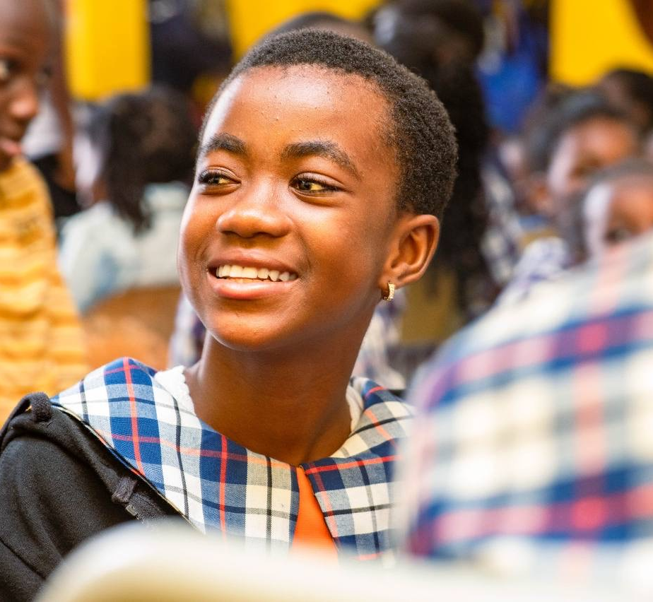
01 / CURIOSITY
The first
spark
Technology feels possible when a child gets to explore it up close.
Notes:
A child at a Child-In-Tech event. Photo: local website gallery IMG_3868.JPG.

Slide 3
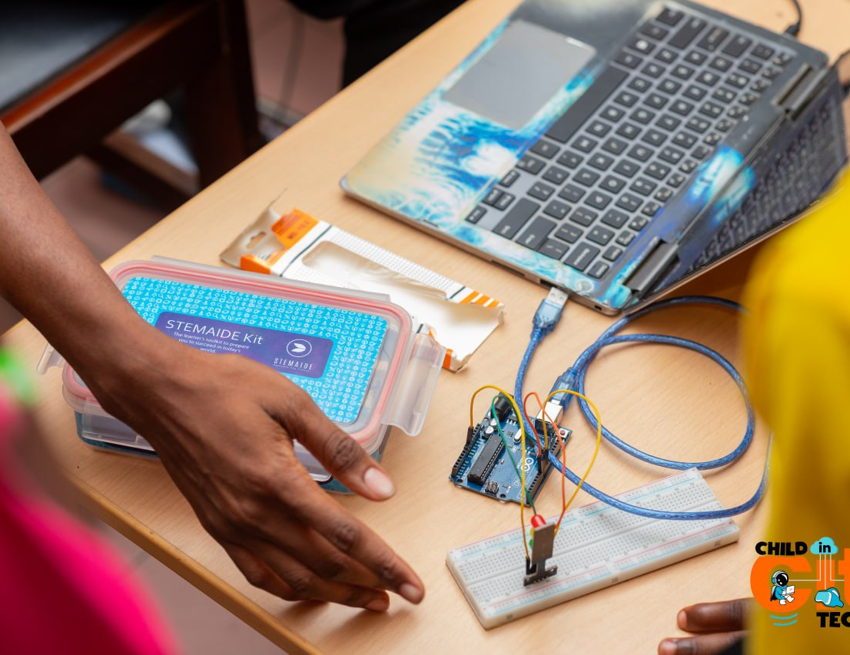
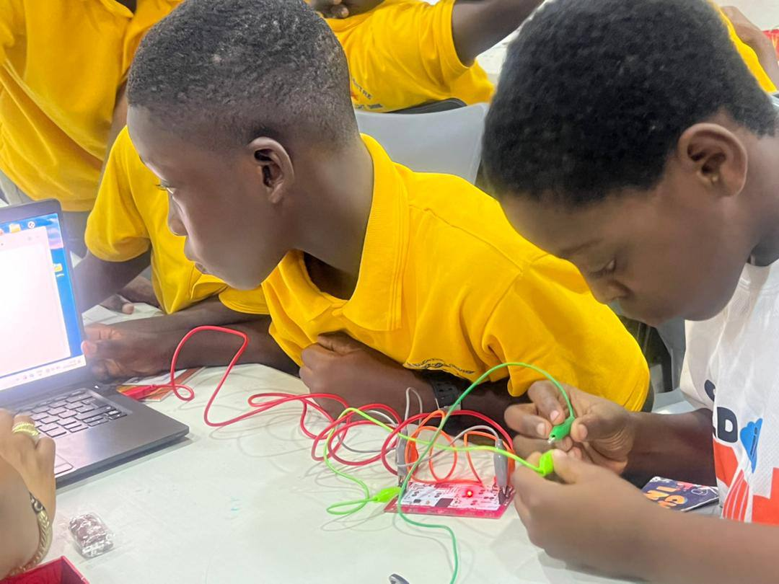
02 / STEM
Circuits in their hands
Notes:
CIT demonstrates hands-on STEM, including Arduino and simple circuits. Photos: local website gallery IMG-6663.jpg and IMG-6685.jpg. The visible kit in IMG-6663 is labeled STEMaide; do not claim children built it.

Slide 4
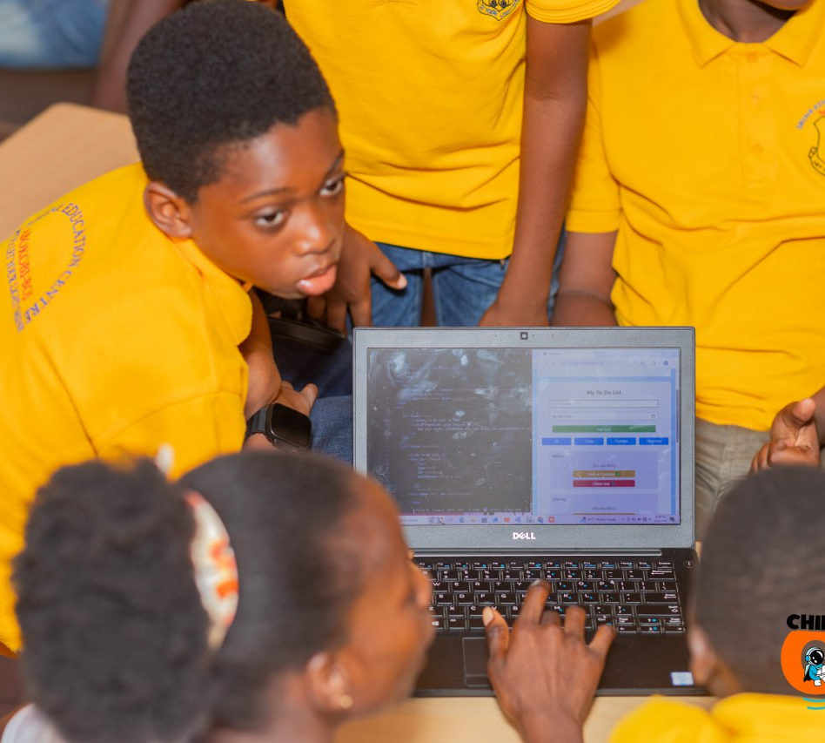
03 / CODE
Their first
lines of code
We introduce children to coding and game creation through accessible tools.
Notes:
CIT lists Software & Game Development among its LearnLab programmes: https://childintechhq.com/programs.html . Photo: local website gallery IMG-6670.jpg.

Slide 5
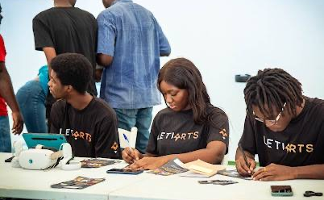
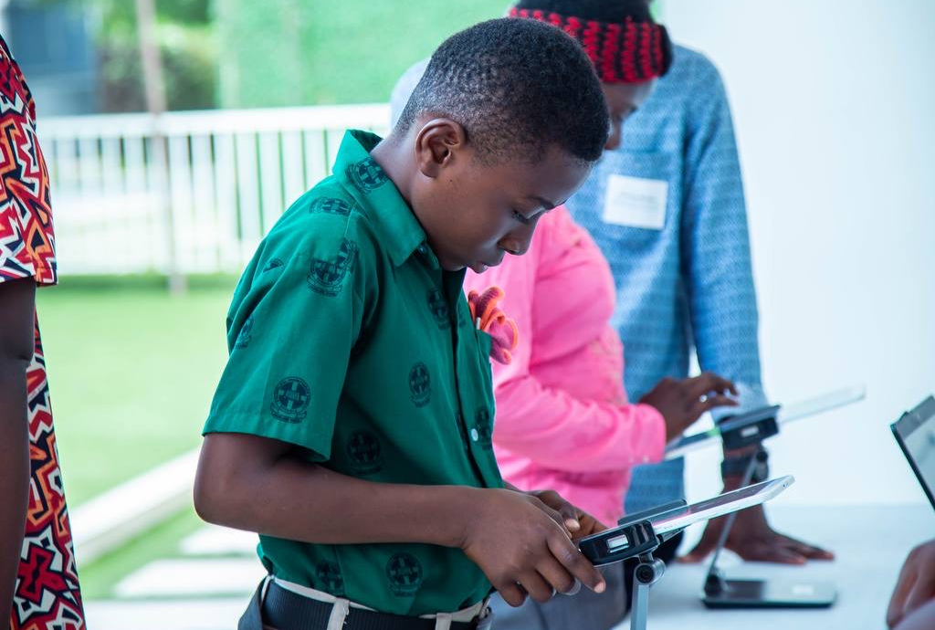
04 / INDUSTRY
Meet the makers
A chance to see the people behind the games they play.
Notes:
Left: LetiArts team, local website gallery IMG_3855.JPG. Right: child with digital device, IMG_3885.JPG. The CIT event page lists LetiArts: https://childintechhq.com/events.html . Do not imply the child in the right photo was at the LetiArts table.

Slide 6
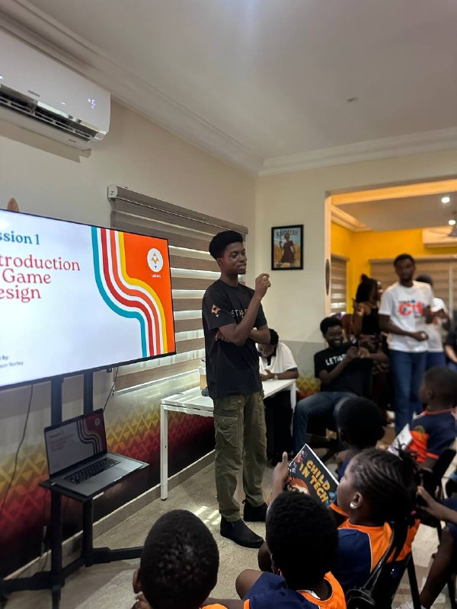
05 / GAME DESIGN
Game design
with LetiArts
Children hear how a game begins: with an idea, rules and challenges.
Notes:
User-provided photograph 5890780361137000234.jpg. The screen reads Introduction to Game Design. The related session photo shows LetiArts staff.

Slide 7
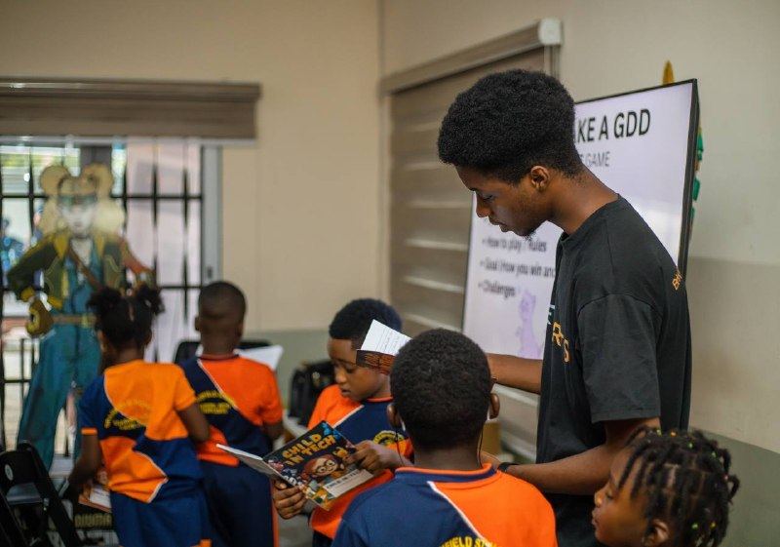
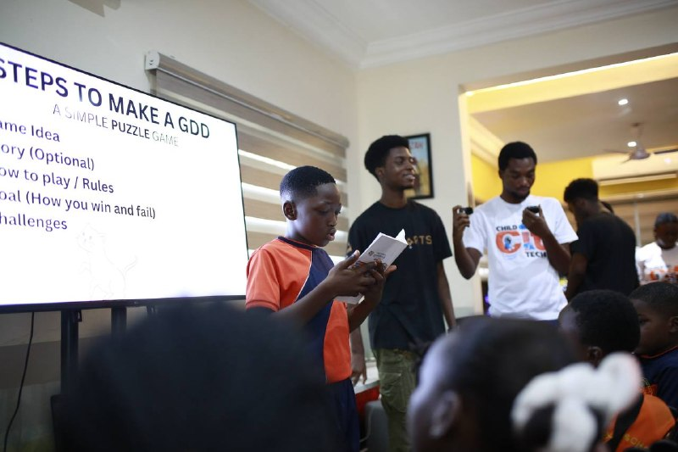
06 / THE PROCESS
An idea takes shape
From the game brief to sharing their own thinking.
Notes:
User-provided photographs 5890780361137000232.jpg and 5890780361137000236.jpg. The screen in the latter shows steps to make a simple puzzle game GDD.

Slide 8
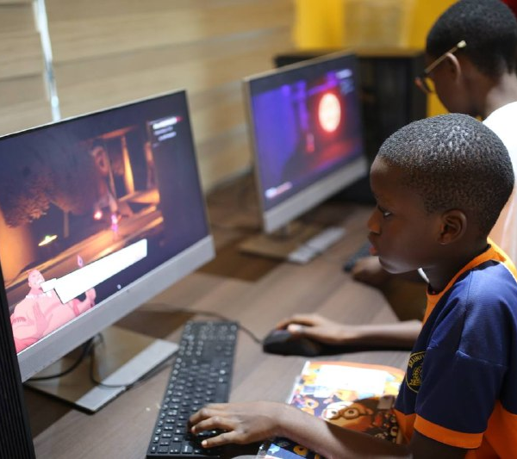
07 / PLAY
Time to
play
Children explore games at the computers.
Notes:
User-provided photograph 5890780361137000237.jpg. Shows children at gaming computers.

Slide 9
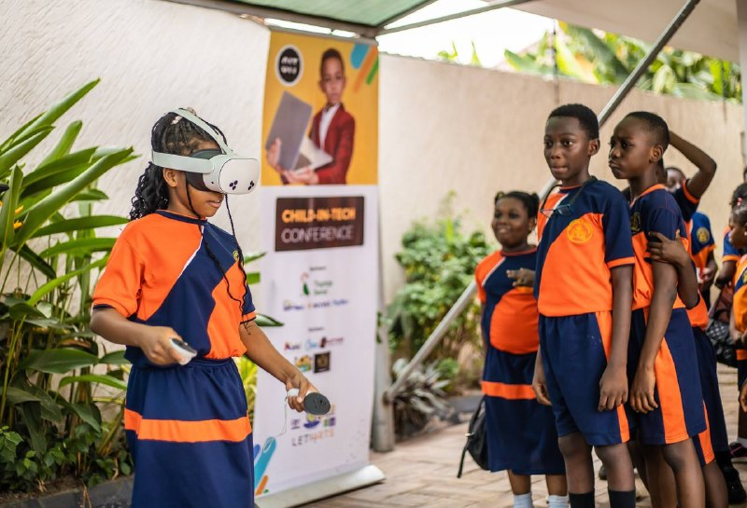
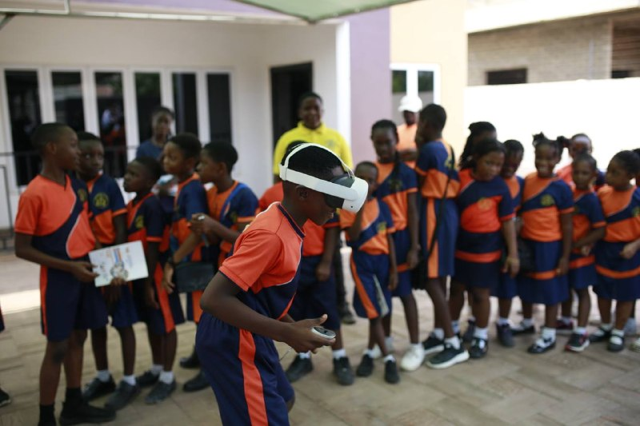
08 / VIRTUAL REALITY
Inside virtual worlds
Children take turns trying VR.
Notes:
User-provided photographs 5890780361137000233.jpg and 5890780361137000235.jpg. Both show children using VR headsets at a CIT event.

Slide 10
WHAT CHILDREN EXPLORE
Coding
Robotics
Drones
Cybersecurity
Games
Digital creativity
CIT programmes and events introduce children to a range of technology fields.
Notes:
CIT website lists coding, robotics, cybersecurity, game development and creative technology: https://childintechhq.com/programs.html . The about page mentions drones: https://childintechhq.com/about-us.html .

Slide 11
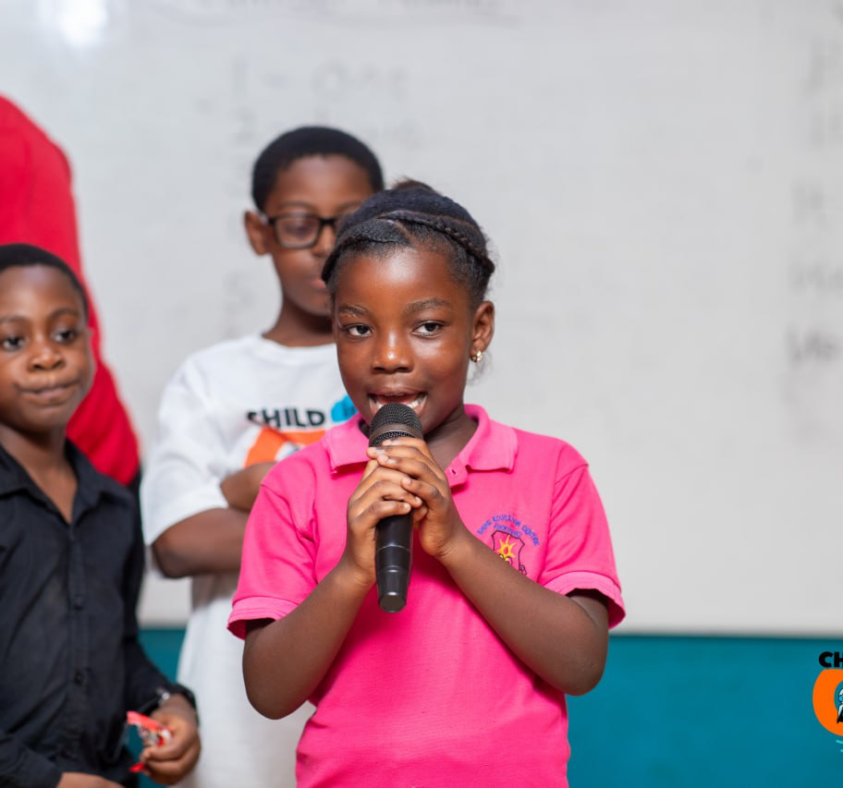
09 / CONFIDENCE
Their ideas
have a voice
Children share what they discover with others.
Notes:
Child speaking at a CIT session. Photo: local website gallery IMG-6677.jpg.

Slide 12
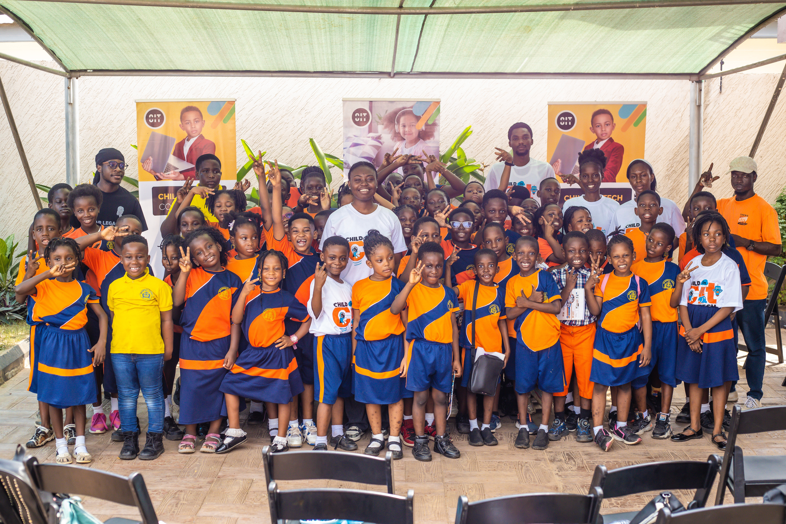
7,300+
children reached
across Ghana
Notes:
CIT website reports 7,300+ children reached: https://childintechhq.com/about-us.html . Group photo: local website gallery IMG_6594.JPG. Confirm the current total with CIT leadership before the event if a newer figure exists.

Slide 13
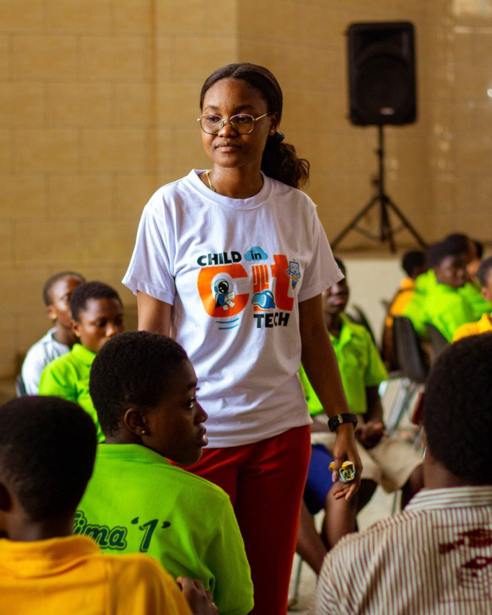
Let more children
get this close
to technology
Let’s talk about a school visit, a tech experience or a partnership.
childintechhq.com
Notes:
Website: https://childintechhq.com/ . Photo: local website gallery IMG_3824.JPG.

