Slide 1
External Interrupt-Based Emergency Stop
and Event Counter System
ATmega32 Microcontroller | CT 321 PBL 07 | Project 7
Group 7
Department of Computer Engineering

Slide 2
Problem Statement & Objective
Problem Statement
• Embedded systems must respond immediately to events such as emergency stops, sensor pulses, and alarms.
• Polling can miss short input pulses when the program is busy with another task.
• External interrupts let the ATmega32 pause normal execution and respond the instant an event occurs.
Project Objective
• Design and implement an interrupt-based emergency stop and event counter system using the ATmega32.
• Count external events during normal operation using INT1.
• Enter emergency-stop mode immediately when the emergency button (INT0) is pressed.
• Recover back to normal mode using a dedicated recovery interrupt (INT2).
CT 321 PBL 07 - Group 7 - ATmega32 External Interrupt Event Counter System
2

Slide 3
Expected System Operation
Two operating modes: NORMAL and EMERGENCY-STOP
Input / Event | Expected System Response
System powered ON | Green LED ON - normal mode
Event pulse detected (INT1) | Event count increases
Recovery / reset button (INT2), normal mode | Event count resets to zero
Emergency stop button (INT0) | Red LED ON, buzzer ON, counting stops
Recovery button (INT2), emergency mode | Buzzer OFF, system returns to normal mode
CT 321 PBL 07 - Group 7 - ATmega32 External Interrupt Event Counter System
3

Slide 4
Main Hardware Components
Inputs
Outputs & Support
• ATmega32 microcontroller (8 MHz)
• Emergency stop push button - INT0
• Event pulse push button - INT1
• Recovery / reset push button - INT2
• Green LED - normal mode indicator
• Red LED - emergency-stop indicator
• Buzzer - emergency alarm (transistor driver)
• 10 kΩ pull-up resistors on interrupt inputs
• 330 Ω current-limiting resistors for LEDs
• Serial / USART terminal for event count display
CT 321 PBL 07 - Group 7 - ATmega32 External Interrupt Event Counter System
4

Slide 5
ATmega32 Pin Mapping
ATmega32 Pin | Function | Connected Device
PD2 / INT0 | External Interrupt 0 | Emergency stop button
PD3 / INT1 | External Interrupt 1 | Event pulse button / sensor
PB2 / INT2 | External Interrupt 2 | Recovery / reset button
PB0 | Digital Output | Green LED (normal mode)
PB1 | Digital Output | Red LED (emergency mode)
PB3 | Digital Output | Buzzer
PD1 / TXD | USART Transmit | Event count to serial terminal
CT 321 PBL 07 - Group 7 - ATmega32 External Interrupt Event Counter System
5

Slide 6
Interrupt Configuration
Trigger Mode
• All three interrupts (INT0, INT1, INT2) are configured for falling-edge triggering.
• Buttons are active-LOW: pin is HIGH when released, goes LOW when pressed.
Debounce Logic
• Timer0 generates a 1 ms system tick (8 MHz clock, prescaler 64, OCR0 = 124).
• Each interrupt line tracks its own last-accepted timestamp.
• An interrupt is accepted only if at least 200 ms passed since the previous accepted event on that line.
ISR Behaviour
Interrupt | Action
INT0 - Emergency | Sets emergency_mode = 1; red LED + buzzer ON; counting locked
INT1 - Event | Increments event_count only if emergency_mode == 0
INT2 - Recovery / Reset | Returns to normal if in emergency; resets count if already normal
CT 321 PBL 07 - Group 7 - ATmega32 External Interrupt Event Counter System
6

Slide 7
Firmware Structure
Event-driven design: Main loop + Interrupt Service Routines
Main Program
• Initializes GPIO (LEDs, buzzer), Timer0, USART, and external interrupts.
• Enables global interrupts and continuously updates LED / buzzer outputs based on current state.
• Prints status (mode + event count) over UART on every event and on a periodic heartbeat.
Interrupt Service Routines
• ISR(INT0_vect) - emergency stop: enters emergency mode immediately.
• ISR(INT1_vect) - event counter: increments count only in normal mode.
• ISR(INT2_vect) - recovery / reset: exits emergency mode, or resets count in normal mode.
• ISR(TIMER0_COMP_vect) - 1 ms system tick used for debounce timing.
CT 321 PBL 07 - Group 7 - ATmega32 External Interrupt Event Counter System
7

Slide 8
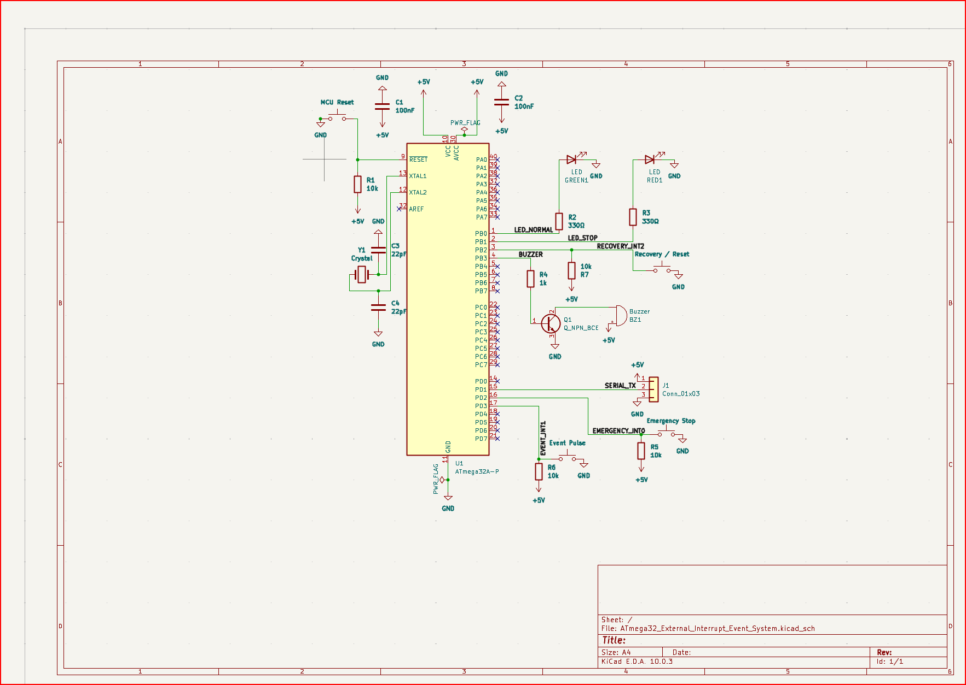
KiCad Schematic Design
CT 321 PBL 07 - Group 7 - ATmega32 External Interrupt Event Counter System
8

Slide 9
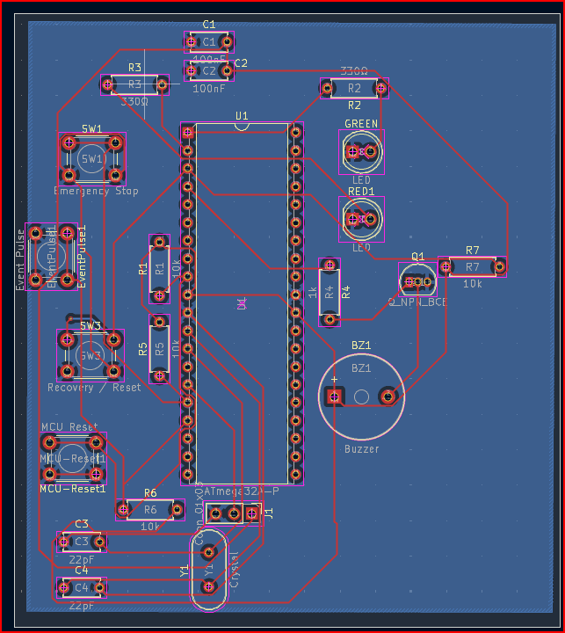
KiCad PCB Layout
Routed PCB - ERC and DRC passed with zero errors
CT 321 PBL 07 - Group 7 - ATmega32 External Interrupt Event Counter System
9

Slide 10
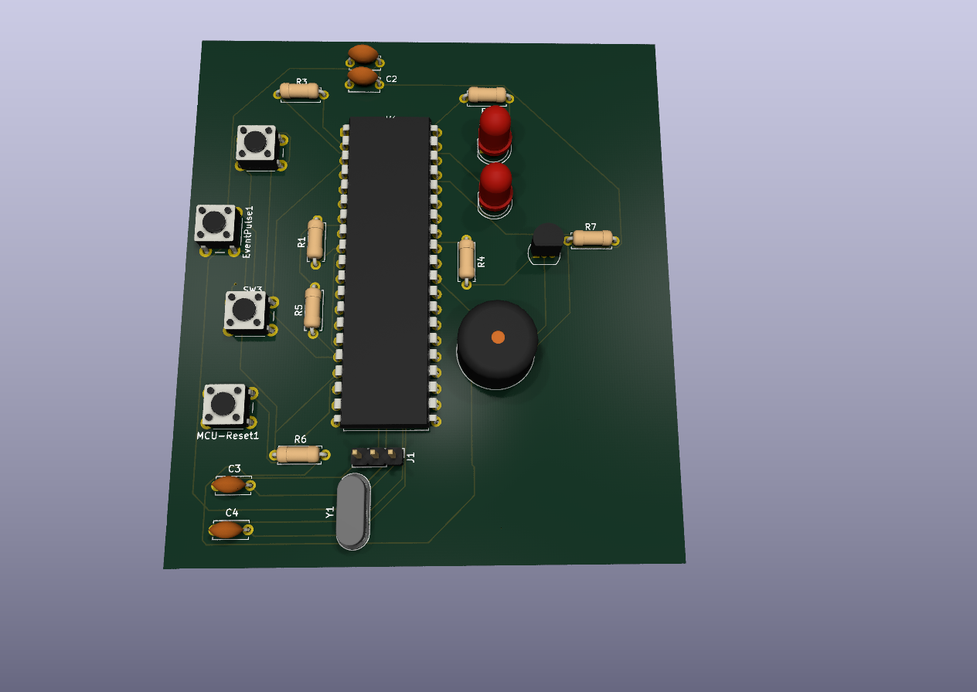

PCB 3D View
CT 321 PBL 07 - Group 7 - ATmega32 External Interrupt Event Counter System
10

Slide 11
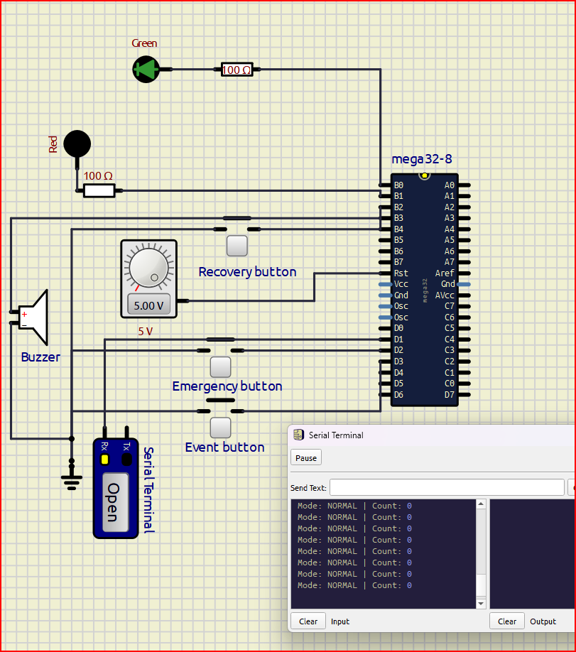
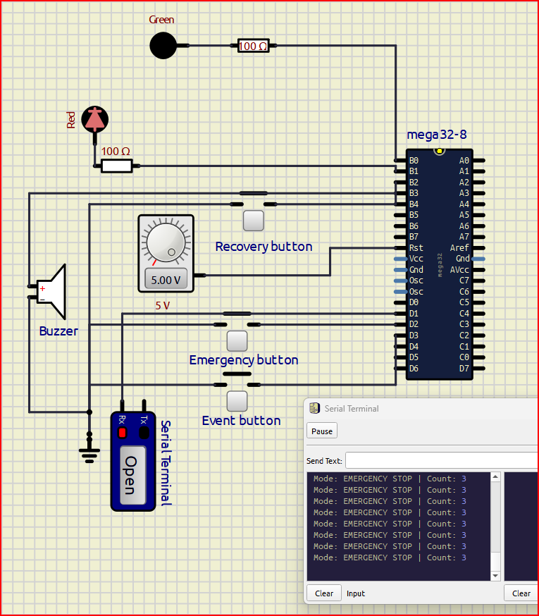
SimulIDE Simulation - Normal Mode & Emergency Stop
Normal startup - Green LED ON, count 0
Emergency stop - Red LED + buzzer ON
CT 321 PBL 07 - Group 7 - ATmega32 External Interrupt Event Counter System
11

Slide 12
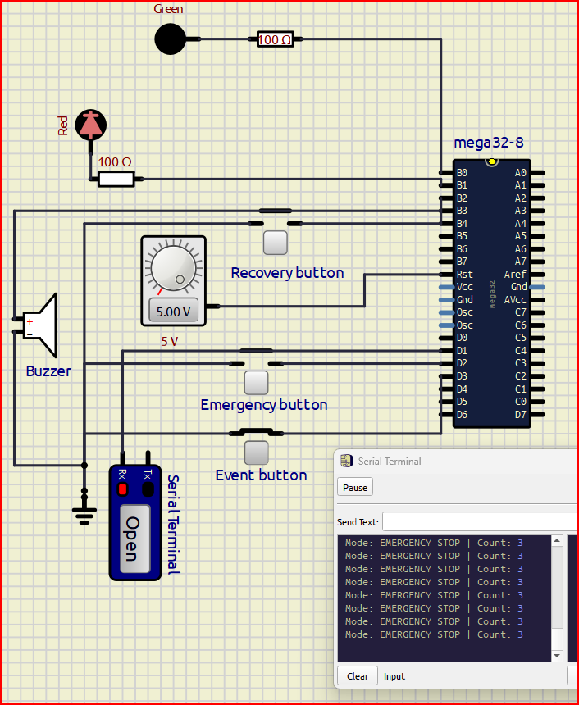
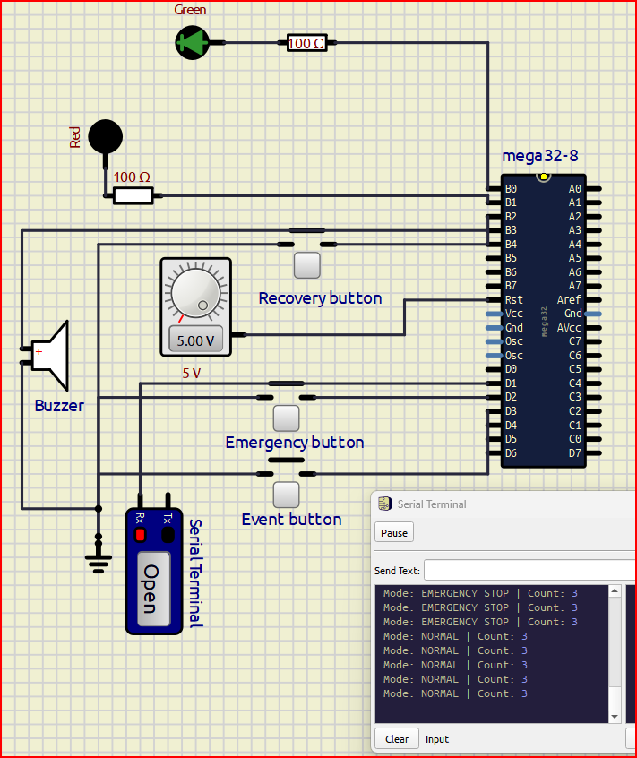
SimulIDE Simulation - Counting Lockout & Recovery
Event press during emergency - count does not change
Recovery - returns to normal mode, count preserved
CT 321 PBL 07 - Group 7 - ATmega32 External Interrupt Event Counter System
12

Slide 13
Test Results Summary
All 7 functional tests executed in SimulIDE - 8 MHz, UART 9600 8N1
# | Test Case | Result
1 | Normal startup | PASS
2 | Single event pulse | PASS
3 | Multiple event pulses | PASS
4 | Emergency stop | PASS
5 | Event during emergency (lockout) | PASS
6 | Recovery mode | PASS
7 | Reset in normal mode | PASS
CT 321 PBL 07 - Group 7 - ATmega32 External Interrupt Event Counter System
13

Slide 14
Conclusion
• Successfully implemented an interrupt-driven emergency stop and event counter using INT0, INT1, and INT2.
• Demonstrated correct event-driven behaviour: immediate emergency response, accurate event counting, and reliable recovery.
• Verified debounce logic prevents false triggering from mechanical switch noise.
• Validated the design end-to-end: KiCad schematic and PCB (zero ERC/DRC errors), AVR-GCC firmware, and SimulIDE simulation.
• Confirms that external interrupts are well suited for fast, reliable response to safety-critical events in embedded systems.
Thank You

