Slide 1

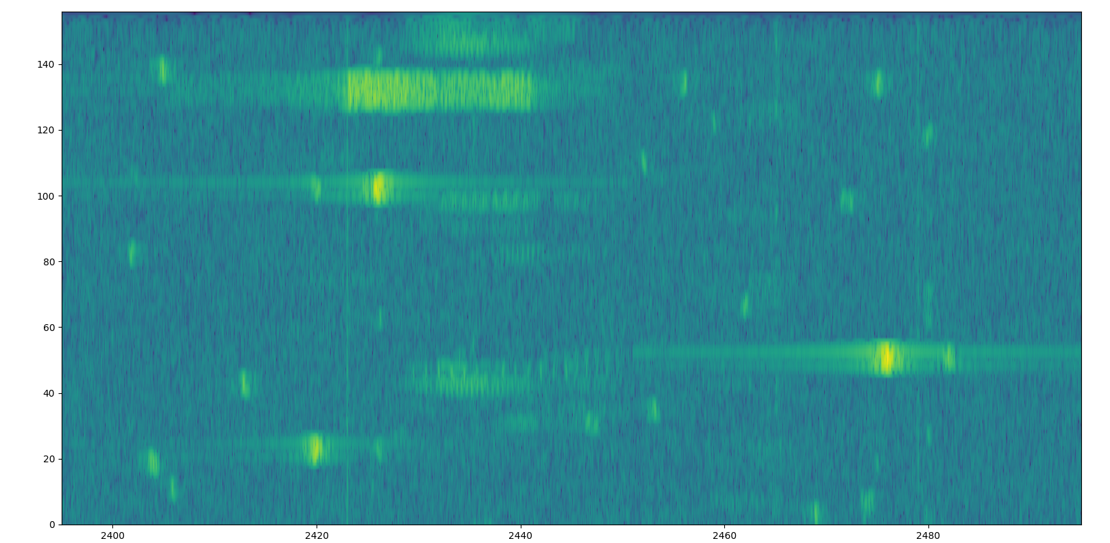
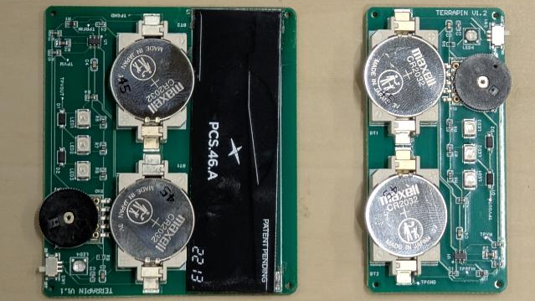
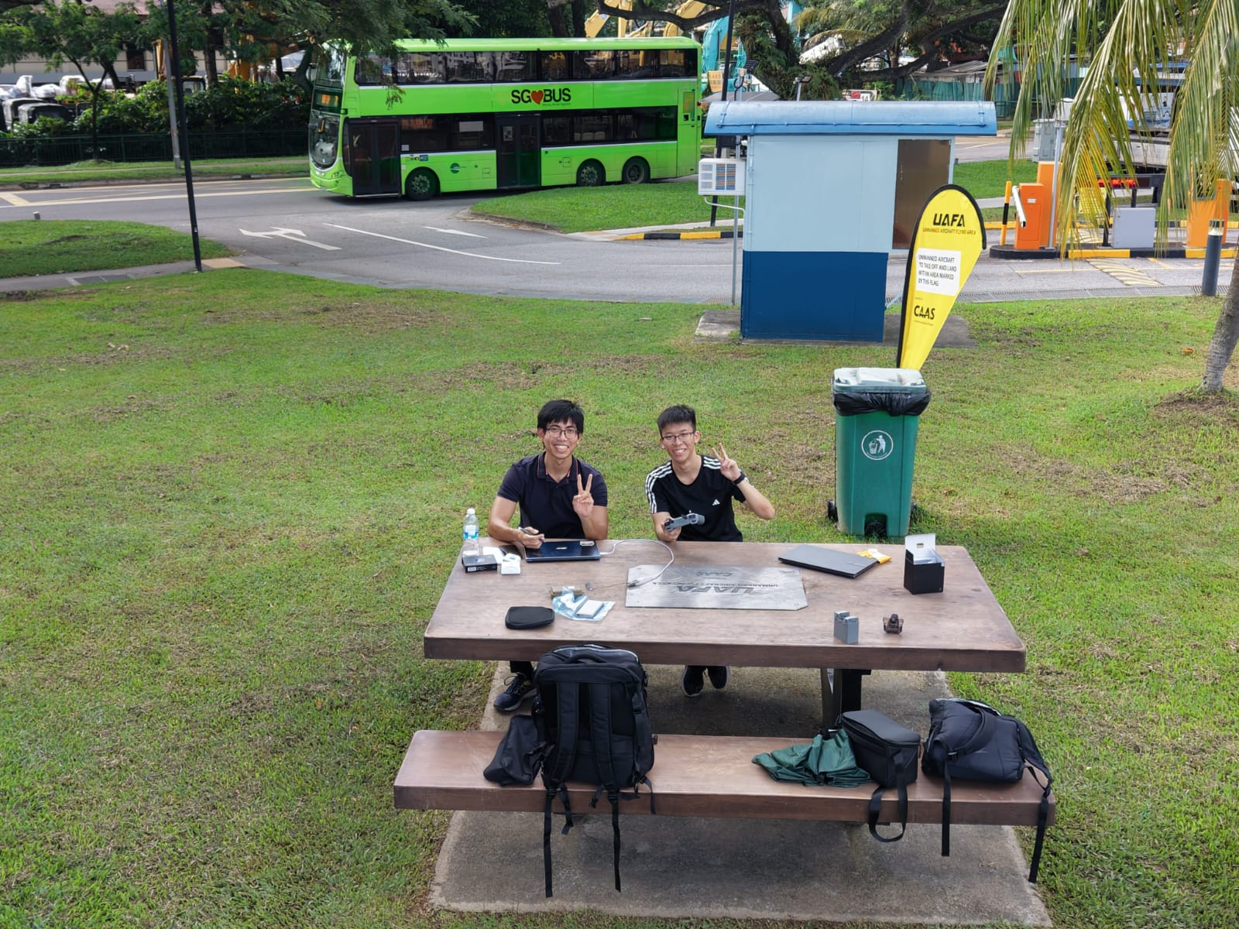
Defence Science and Technology Agency (DSTA)
COMPANY PROFILE:
The Defence Science and Technology Agency (DSTA) is a technology organization crucial to the security and defence of Singapore.
Supports Singapore Armed Forces (SAF) and Singapore Ministry of Defence (MINDEF) through the acquisition, development, and integration of systems.
KEY AREAS OF RESPONSIBILITIES :
Develop and engineer solutions
Testing of RF technologies range tests of transmitters
Design and verify hardware circuits
Observe trials and aid in the collection of RF data.
ACHIEVEMENTS:
Creation of machine learning models for anomaly detection
Assisted with the creation of PCB for detecting radio frequency signals
INTERNSHIP EXPERIENCE:
Throughout the internship, I had the opportunity to work on projects which can contribute back to the company by providing software and hardware solutions to the identified problems
Such projects include the machine learning model and radio frequency signal detector
Outside of developing and engineering solution I had to assist with testing of RF technologies
Attend DSTA events like Intern Day and Learning Day
Additionally, I was brought onto various sites such as the Changi Air Base to learn how equipment is set up, as well as aid in the collection of RF data
PROJECT TITLE & SYNOPSIS:
Machine Learning for Spectrum Sensing
The radio frequency spectrum has become more congested in the urban landscape
There is a need to ensure that malicious agents do not disrupt secure channels.
Machine learning can be used to identify the presence of anomalous signals.
REFLECTIONS:
From the internship, I was able to expand upon knowledge learnt at SP for the projects.
I had the chance to improve technical skills through projects where I applied the CDIO framework to assist in its completion
I also had the opportunity to improve soft skills like communication and collaboration by working with others and assisting with projects
Student : Choy Ning Jun Dion I Class : DCPE/FT/3B/02
Company : Defence Science and Technology Agency (DSTA)
Company Supervisor : Mr Ng Wei Lun Waylon
LO : Ms Soo Bee Hong

