Slide 1

INTERNSHIP
A Gamified Study-Habit App Powered by an Exam-Paper Extraction Pipeline
Ezell Low Qing Wei
DCPE/FT/3B/99 · Diploma in Computer Engineering
Curious Lab (Educational Technology)

Slide 2
COMPANY BACKGROUND
Curious Lab Pte. Ltd.
A Singapore educational-technology (EdTech) company that builds digital tools to help students study more effectively.
Grew out of tuition teaching, and the founder still teaches classes, so products are shaped by how students actually behave.
Building towards an ecosystem of learning products rather than a single tool, including planned parent report cards and teacher analytics.
BUSINESS MODEL & CULTURE
Business model is subscription access, sold to private-tuition students and parents, with a longer-term goal of selling into MOE schools.
Culture is small and lean, with no approval chains, so decisions are made in days.
High autonomy, and because the founder still teaches, an idea can go from a conversation to a live class within the same week.

Slide 3
THE INDUSTRY & CAREERS
Singapore's private tuition market is worth S$1.8 billion a year, with 70%+ of students tutored
WHO CURIOUS LAB COMPETES WITH
Geniebook, AI worksheets and live classes (~US$18M funded).
KooBits, gamified primary maths (closest to our P6 Math).
1,000+ tuition centres, and free general-purpose AI tools.
MOE's Student Learning Space (SLS), a competitor and a route into schools.
S$1.8B
tuition market
360
MOE schools by 2030
COMPANY CAREER PATH
As a small company there is no formal HR or graduate pipeline, so hiring is based on demonstrated coding and AI ability and on fit.
In my case I joined through a referral from a former teacher, though that is only one way in.
Growth is measured in ownership rather than a job ladder, so a junior can go from a single script to owning a whole product.
5
levels I shipped

Slide 4
OVERVIEW
What I did during my internship
Ooka is a gamified study app built on real examination questions. Working with the founder and my supervisor, I helped shape the idea from a problem they saw in class, then designed and built the whole system over 22 weeks, an automated pipeline that turns exam papers into a question bank and an app that gives students instant feedback, and deployed it for students to use.
The work ran across the four CDIO stages.
Conceive
Design
Implement
Operate
Shaped the idea with the founder from a problem seen in class.
Chose the architecture and reasoned through the key trade-offs.
Built the extraction pipeline and the Ooka app.
Deployed to the cloud and tested with around 22 students.
22 WEEKS

Slide 5
CONCEIVE
THE PROBLEM THE FOUNDER SAW IN HIS OWN CLASSES
Homework is tedious, and it gives no immediate feedback.
A student is unsure if an answer is right, has to note it down, and often never raises it in class, so the misunderstanding goes uncorrected.
Teachers have little visibility of who is struggling, because it depends on students speaking up.
Delivering a solution meant solving two problems: a supply problem (real questions at scale) and an engagement problem (a reason to return daily).
IMMEDIATE, PER-QUESTION FEEDBACK CLOSES BOTH GAPS
Students get the correct answer and an explanation the moment they answer, without flagging anything.
A teacher dashboard surfaces each student's weak topics automatically.

Slide 6
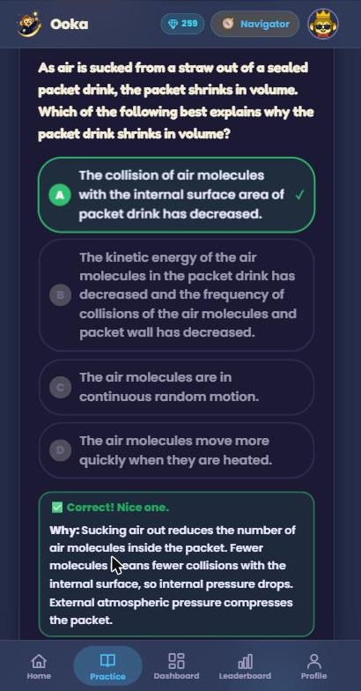
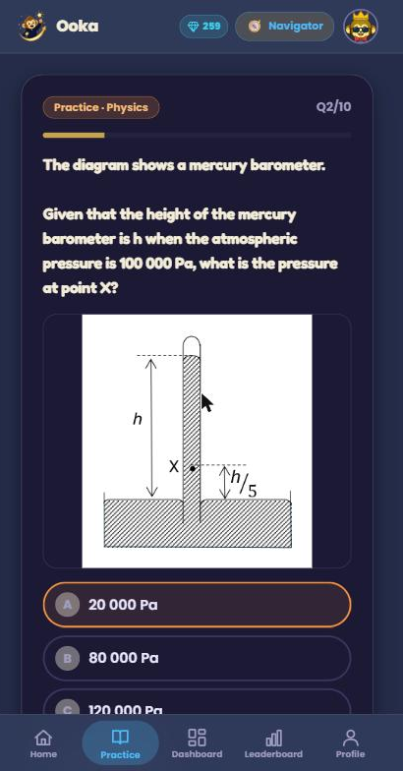
CONCEIVE
FEATURES DESIGNED TO MEET THOSE NEEDS
Practice on real examination questions, not generic ones.
An explanation the instant a question is answered.
Gamified streaks, XP and rewards to make practice consistent.
A teacher dashboard showing where each student is weak.
Planned parent-facing progress over time.
CDIO · CONCEIVE

Slide 7
DESIGN
A KEY DECISION, WHERE TO KEEP THE QUESTION CONTENT
Relational database (MySQL)
Google Sheets + Drive (chosen)
PROS
PROS
Powerful SQL querying and search.
Strong data integrity.
The founder and teachers edit questions directly in a familiar tool.
Built-in comments, history and sharing.
No developer needed for a content change.
CONS
CONS
Teachers cannot edit content without a developer.
Every content change needs my involvement.
No easy comments or version history.
No SQL search, so filtering is done in memory after loading.
I kept only user data in MySQL and put the question content in Google Sheets and Drive, so the people who write the questions own them, not the engineer.

Slide 8
PROJECT TIMELINE
GANTT CHART
Task | W1-2 | W3-4 | W5-6 | W7-8 | W9-10 | W11-12 | W13-14 | W15-16 | W17-18 | W19-20 | W21-22
Research & OCR study
Extraction pipeline
Question bank + review
Core app (auth, quiz, streaks, XP)
Gamification & teacher dashboard
Syllabus update + P6 Math
Performance, testing, deploy
Each phase built on the last. The pipeline made the content, the app turned it into a study loop, then both were extended to new levels and a new subject.
22 WEEKS

Slide 9
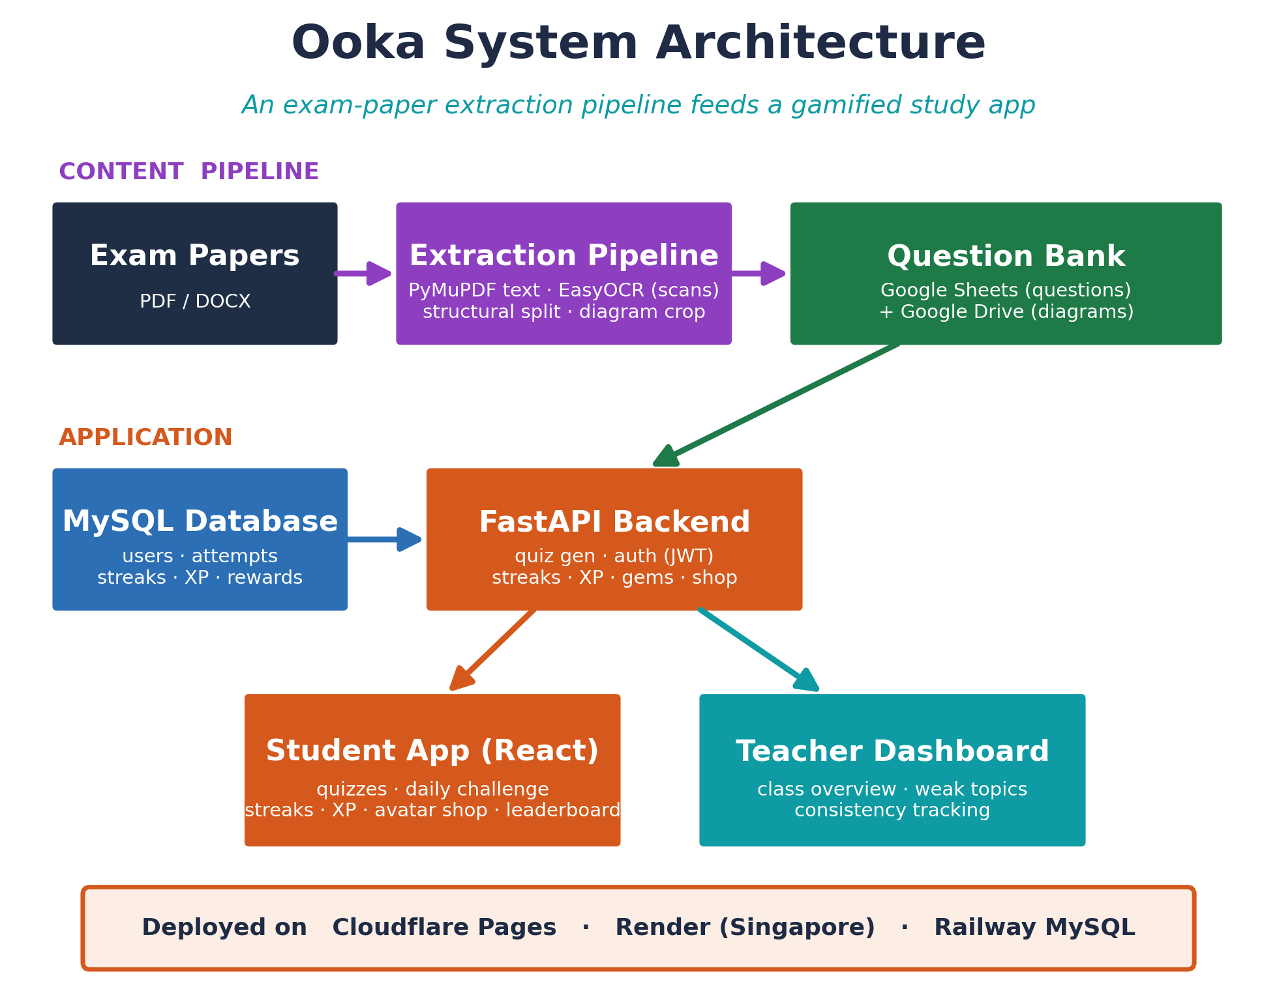
DESIGN
KEY DECISIONS & TRADE-OFFS
One FastAPI app, run as a single process
Simple to iterate as a solo developer, and keeps the in-memory caches correct (scale later with Redis).
Load the whole bank into memory once
Fast quizzes served from RAM (an edit needs a restart).
Split questions in code, interpret with a human in the loop
Deterministic code splits by page structure, and I interpret content with Claude.
Experience points, not grade-style ranks
Rewards consistency and never falls after a bad day.
CDIO · DESIGN

Slide 10
DESIGN
TECH STACK
Purpose | Technology | What is it? | Why chosen
Front end | React · Vite · Tailwind | Component-based web UI | Fast, modern, mobile-first interface
Back end | FastAPI (Python) | High-performance Python API | Rapid iteration for a solo developer
User database | MySQL | Relational database | Reliable store for accounts, XP, streaks
Content store | Google Sheets + Drive | Spreadsheet + file storage | Teachers edit questions without a developer
Text extraction | PyMuPDF + EasyOCR | PDF text reader + OCR engine | Reads digital PDFs directly, EasyOCR for scans
Interpretation | Claude (AI assistant) | Used interactively, not in the code | Human-in-the-loop: answers, explanations, tags
Hosting | Cloudflare · Render · Railway | Cloud platforms (SG region) | Cheap, simple, no servers to manage
Splitting is done in code. The highlighted rows are the content and interpretation layer that make the pipeline work.

Slide 11
DESIGN
SYSTEM ARCHITECTURE
CDIO · DESIGN

Slide 12
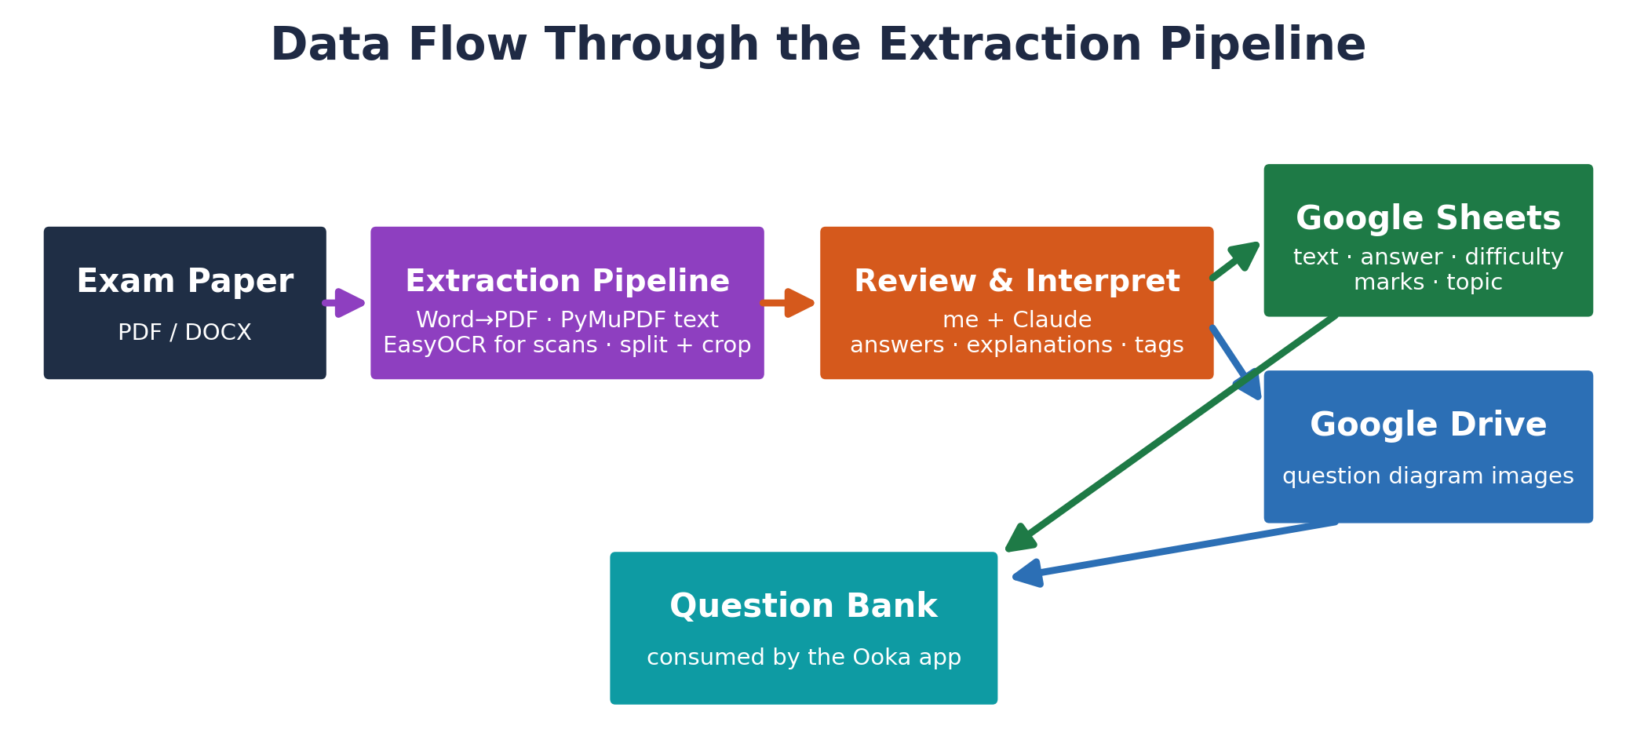
IMPLEMENT
DATA FLOW
A paper is converted to PDF, its text and diagrams are extracted in code, I review the result with Claude, then an upload script stores it in Google Sheets and Drive.
WEEKS 1 – 6

Slide 13
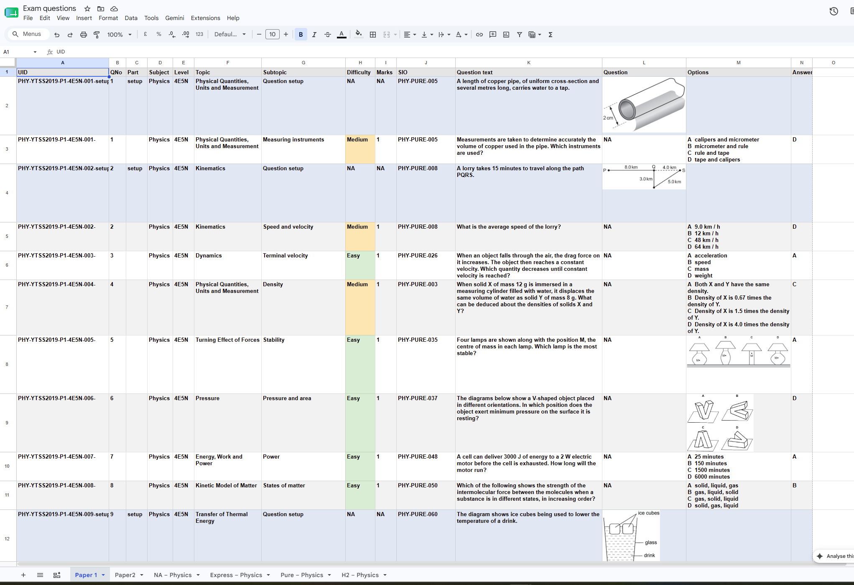
IMPLEMENT
THE EXTRACTION PIPELINE, RUN ONE PAPER AT A TIME
Word documents are converted to PDF (some diagrams are Word shapes that only render via Word's export).
PyMuPDF reads the text of digital PDFs, and EasyOCR handles scanned pages.
The pipeline splits each paper into questions by page structure and crops the diagrams, all in deterministic code.
It outputs cropped images plus machine-readable files: a diagram mapping, an answer key, and the detected paper level.
WEEKS 1 – 6

Slide 14
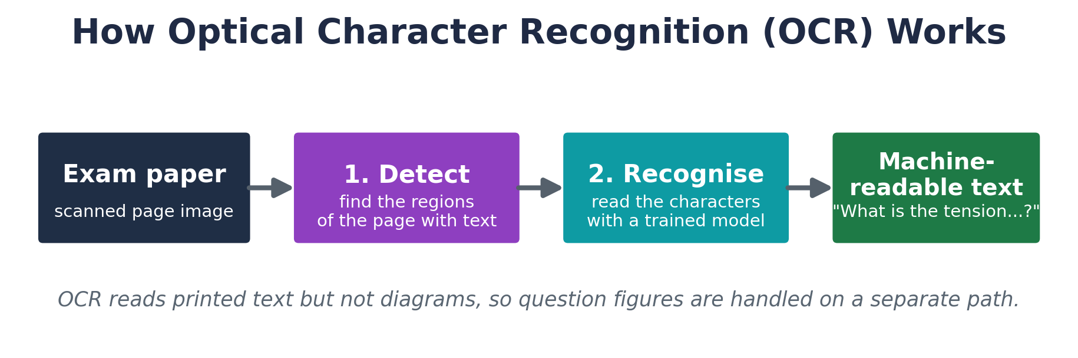
IMPLEMENT
READING TEXT FROM DIGITAL AND SCANNED PAPERS
Most papers are digital PDFs, so the text layer is read directly with PyMuPDF, no OCR needed.
Scanned papers use EasyOCR (pytesseract only as a fallback for answer-key grids).
OCR reads text but not diagrams, so each figure is cropped on a separate path.
WEEKS 1 – 6

Slide 15
IMPLEMENT
THE STEP THAT CANNOT BE CODE, A HUMAN-IN-THE-LOOP REVIEW
For each question the pipeline produces a skeleton record holding the text, options, mapped diagram and extracted answer, with the interpretive fields left blank.
Working through that skeleton with Claude, I fill in what the automated steps cannot:
Confirm or correct the answer.
Write a short explanation where the marking scheme gives only a letter.
Tag the topic against the scheme of work.
Check each diagram crop against the original by eye.
An upload script then writes the text to Google Sheets and the diagrams to Google Drive. The pipeline stays deterministic code, and Claude assists the review rather than running inside the pipeline.
WEEKS 1 – 6

Slide 16
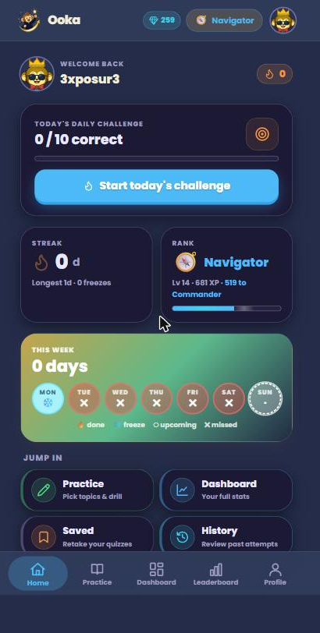
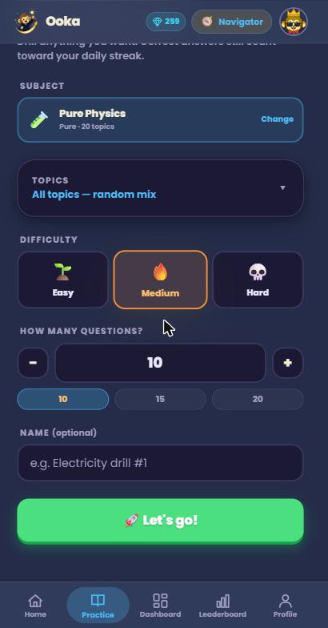
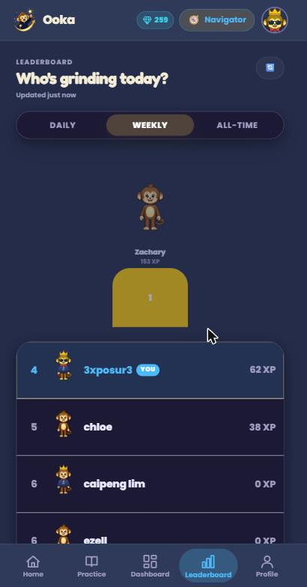
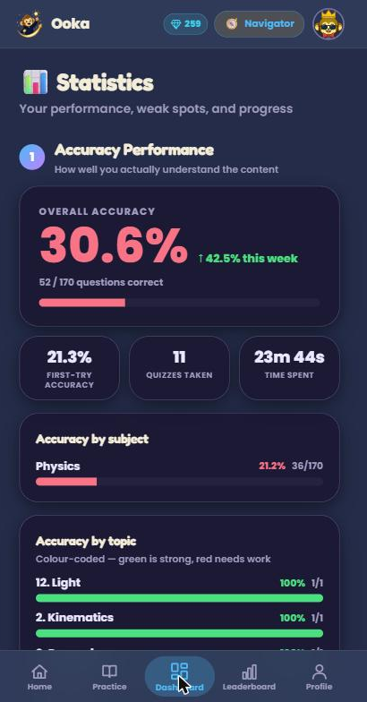
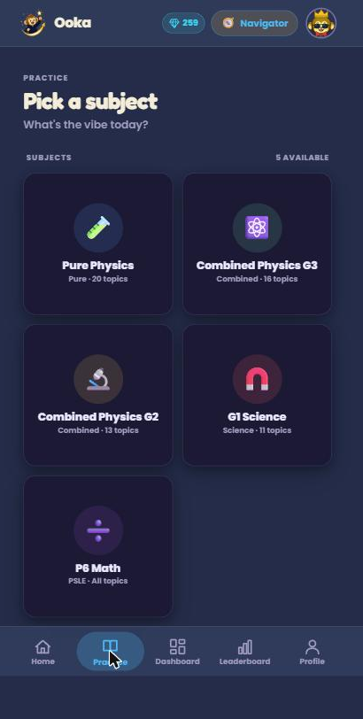
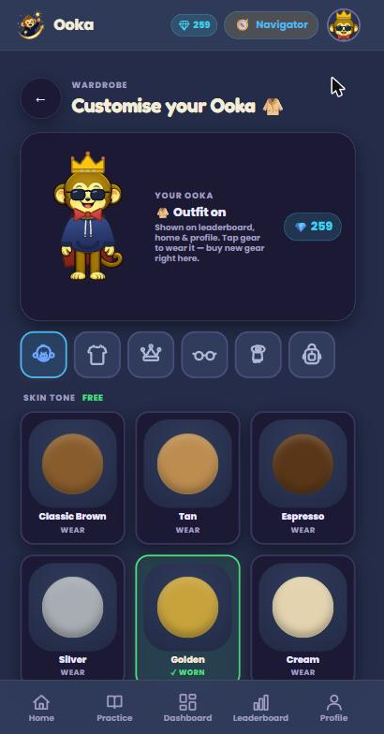
IMPLEMENT
THE OOKA APP, BUILT ON TOP OF THE QUESTION BANK
Quiz builder: pick level, topics, difficulty and count, with live availability checks.
Daily challenge as a running counter, with streaks and a weekly freeze.
XP levelling (never decreases), gems, and an avatar-customisation shop.
Leaderboard across daily / weekly / all-time.
Teacher dashboard: class averages, weakest topics, student consistency.
WEEKS 7 – 16

Slide 17
IMPLEMENT
THE HARDEST PROBLEMS I FACED
1
Reliable diagram extraction
Every paper is laid out differently, so crops broke constantly. I set an acceptance test of five clean extractions in a row. After AI diagram-recreation proved unreliable, we put the hardest papers (Paper 2) on hold and I focused on getting Paper 1 reliably to that standard.
2
Streak and freeze logic edge cases
Streaks looked simple, but the weekly freeze created bugs where the same freeze could be spent twice or fire on a day already completed. I fixed it structurally, with a uniqueness constraint on user, subject and date, a field recording exactly which day a freeze protected, and an explicit reset when a gap exceeds the freeze budget.
3
Performance at scale
In-memory caching of the question bank and diagram images, batched Sheet fetches, and filename-based image URLs kept the app fast and within API quotas as the bank grew.
CDIO · IMPLEMENT

Slide 18
OPERATE
DEPLOYMENT, TESTING, OUTCOME & IMPACT
Deployed to production: Cloudflare Pages (front end) · Render, Singapore (back end) · Railway (MySQL). Secrets kept out of the repo, with reproducible config.
~130
papers
~130 exam papers processed into a structured bank across 5 levels.
Ooka deployed and in testing with ~22 students.
The company now has a working product to test with students, where before it had only an idea.
Produced the exact asset it plans to sell into MOE schools, plus the teacher analytics that make it credible.
5
levels
~22
test students
CDIO · OPERATE

Slide 19
DEMO VIDEO
[ Insert 60–90s screen recording ]
Build a quiz → answer a question → instant explanation → streak / XP update → teacher dashboard.

Slide 20
SKILLS & COMPETENCIES
LEARNT OR PRACTISED ON THE JOB
Full-stack: React front end, FastAPI + MySQL back end.
Authentication, JWT, cloud deployment across three platforms.
Google Sheets & Drive APIs, OCR, and using an AI assistant (Claude) as a human-in-the-loop.
Database design and API structuring.
SOFT SKILLS
Communicating progress through weekly updates.
Framing a problem so a busy supervisor can answer fast.
Prioritising a roadmap with limited time.
My Computer Engineering diploma gave the foundations, and I learnt most of the specific tools (OCR, FastAPI, the Google APIs, deployment) on the job.
CDIO · SKILLS

Slide 21
REFLECTION
SELF-DIRECTED LEARNING & TEAMWORK
Self-directed learning was how the work got done, not an extra on top of it. Curious Lab had no training programme, so instead I was given time to research and people to ask. I learnt OCR, FastAPI, the Google APIs and cloud deployment on the job by building on my diploma foundations. The experiments I abandoned, such as local language models and AI diagram recreation, were information rather than failures, and each ruled out an approach and pointed to the one that worked.
Although I worked alone on the code, the project was collaborative throughout. My supervisor and the founder set the problems and gave frequent, substantial feedback, and the rebrand and the ranks-to-XP change both came out of that loop. Knowing when to persist and when to abandon an approach is the most transferable thing I learnt.
CDIO · REFLECTION

Slide 22
CONCLUSION
Over 22 weeks I designed, built, deployed and maintained an entire production system from a problem statement rather than a specification. That system is an extraction pipeline of ~130 papers across 5 levels, plus Ooka, now in testing with ~22 students and giving them feedback the moment they answer.
I learnt as much from the approaches I abandoned as from the ones that worked, and that a design can be technically correct yet wrong for the people using it.
Above all, building something real students use has made me genuinely interested in this industry and in software engineering as a field.

Slide 23
REFERENCES
Industry & market
MOE, Transforming Education through Technology Masterplan 2030.
National Institute of Education (NTU), Singapore's private tutoring boom.
Nexdigm, Singapore Education Industry Report.
Tracxn, Geniebook and KooBits company profiles.
GovTech, Inside Singapore's digital classroom (SLS).
Tools & technologies
React, FastAPI, MySQL, PyMuPDF, EasyOCR, pytesseract, Google Sheets & Drive APIs, Claude, Cloudflare Pages, Render, Railway.

Slide 24
THANK YOU
Questions & Answers
Internship complete

