Slide 1

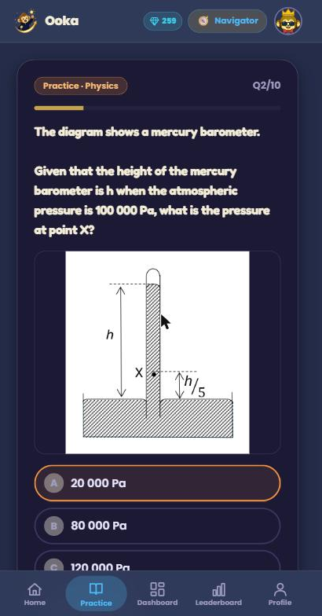
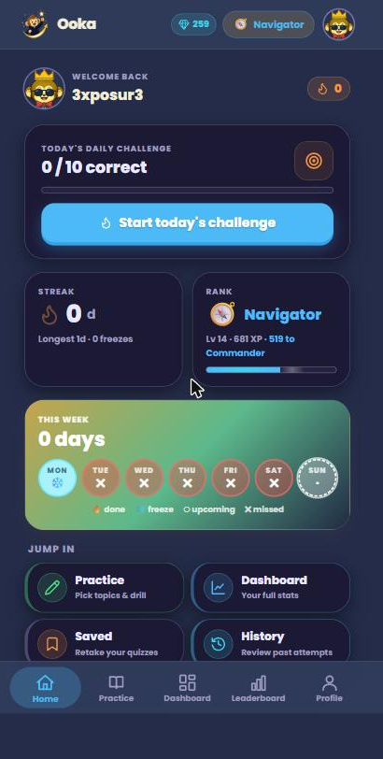
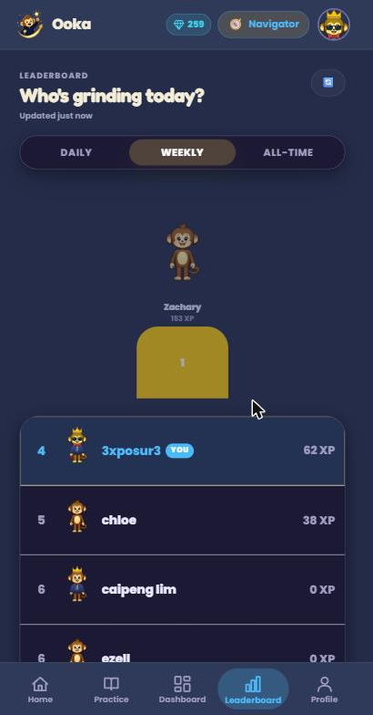
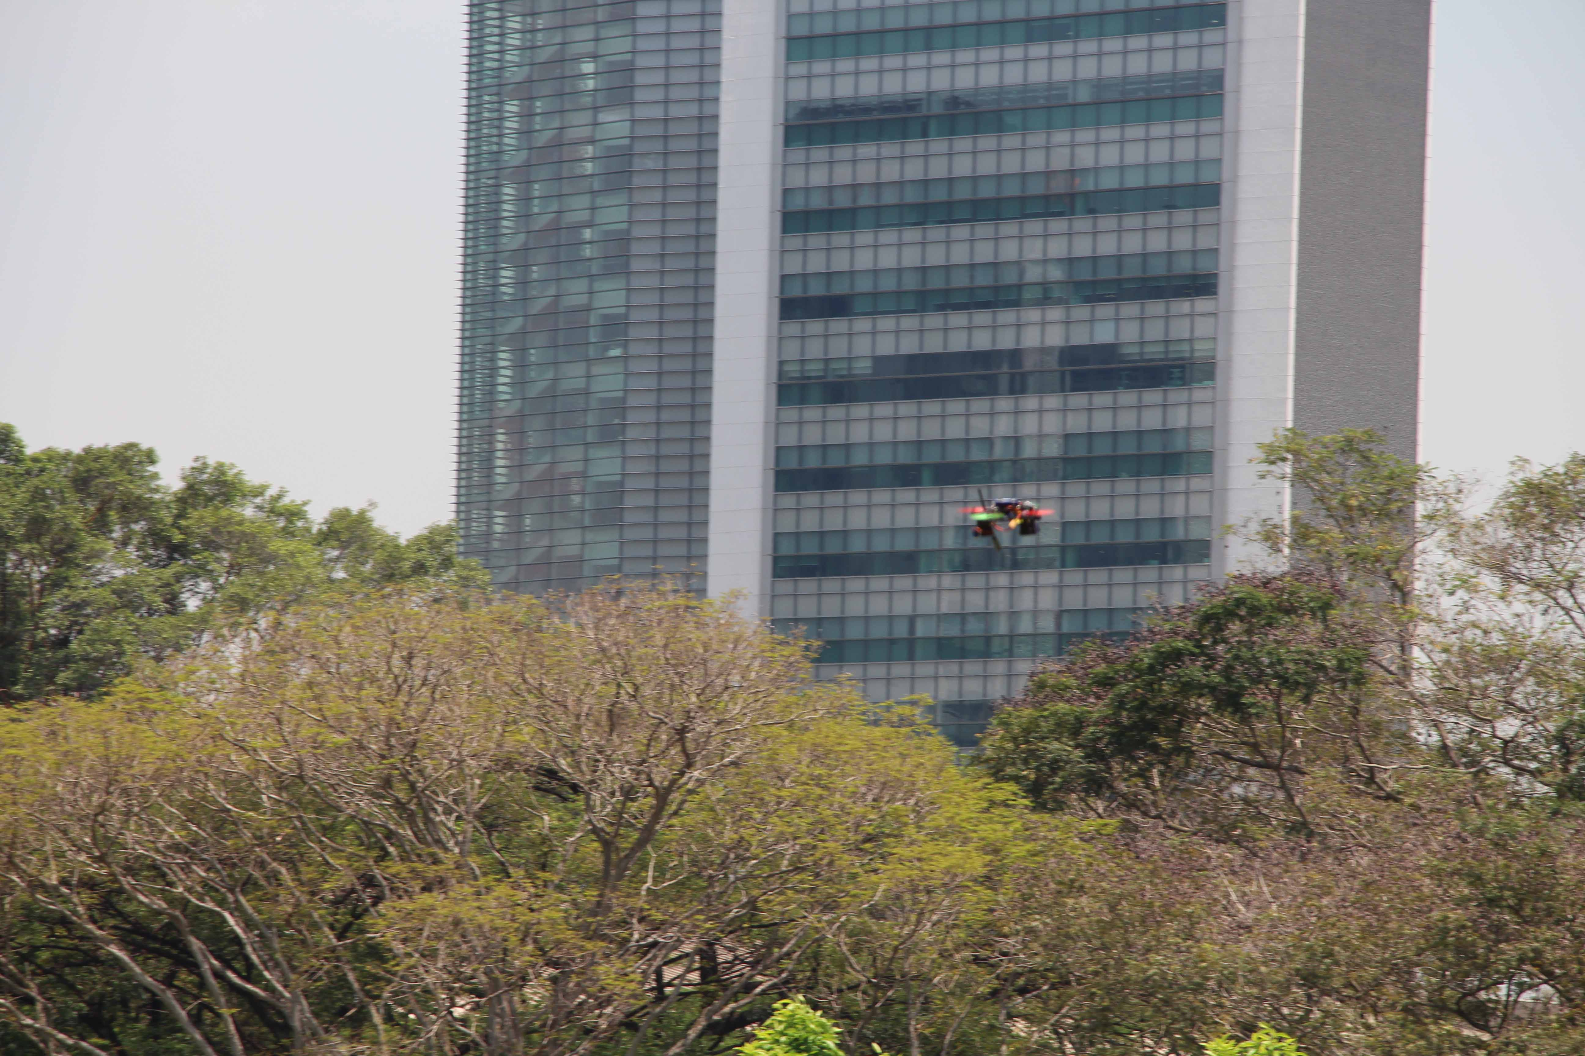
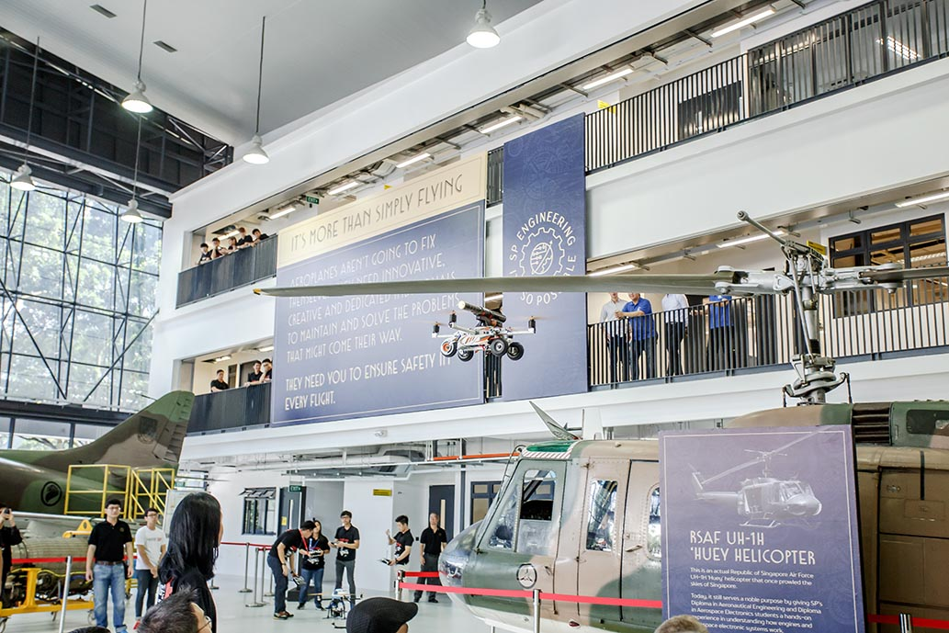
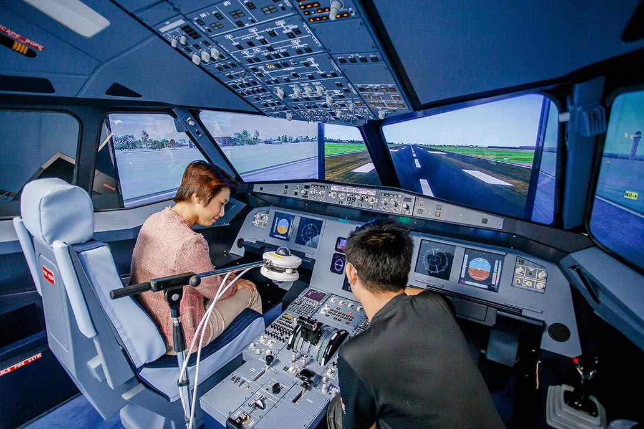
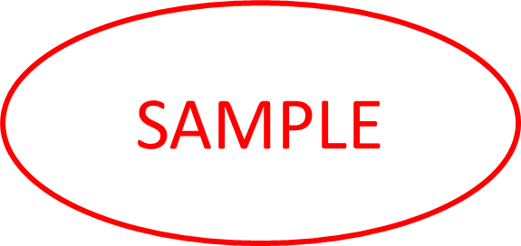
Curious Lab
</>
SOFTWARE ENGINEERING
COMPANY PROFILE:
• Curious Lab is a Singapore educational-technology company that builds digital products to help students learn.
• Works with primary and secondary school students, making studying more effective and consistent.
KEY AREAS OF RESPONSIBILITIES :
• Sole full-stack developer: designed, built and ran the whole system.
• Built an OCR + LLM pipeline that extracts questions, answers and diagrams from exam papers.
• Developed the React front end and FastAPI + MySQL back end: quizzes, streaks, XP, leaderboard, avatar shop, teacher dashboard.
• Vetted question content and deployed to the cloud.
PROJECT TITLE & SYNOPSIS:
A Gamified Study-Habit App Powered by an Exam-Paper Extraction Pipeline
• Builds a consistent daily study habit using real exam questions.
• An automated pipeline turns exam papers into the app's question bank.
• Students get an explanation the moment they answer; streaks and XP keep them practising.
IMPACT & OUTCOME:
• ~130 exam papers processed into a reusable question bank.
• 5 subjects / levels shipped: Pure Physics, Combined G1/G2/G3, P6 Math.
• Deployed to production, now testing with ~22 students.
• Cut feedback from days to instant.
The live Ooka app: a question with its extracted diagram, the daily streak, and the leaderboard.
INTERNSHIP EXPERIENCE:
• Owned the whole product as the only developer, from problem statement to a deployed app.
• Worked closely with my supervisor and the founder through weekly updates and roadmap meetings.
• Helped shape major product decisions, including the rebrand to Ooka and the ranks-to-XP switch.
• Learnt new tools on the job: OCR, FastAPI, Google APIs, cloud hosting.
REFLECTIONS:
• I learned to teach myself new technologies with no formal training, picking up OCR, FastAPI and cloud deployment as the work needed them.
• I learned to build and run a whole production system, not just code that works on my laptop — deploying it, handling real data and keeping it live for students.
• I got much better at communicating my work, framing problems and progress clearly for my supervisor and the founder.
• Most of all, I want to build things that real people use. Seeing students actually learn with Ooka was the most rewarding part.
Student : Ezell Low Qing Wei I Class : DCPE/FT/3B/99
Company : Curious Lab
Company Supervisor : Mr Marcus Yip
LO : Mr Mohamed Ilyas Fakrudeen Abdul Salam

