Slide 1

Course Sign-up System
Ezequiel Pizarro

Slide 2
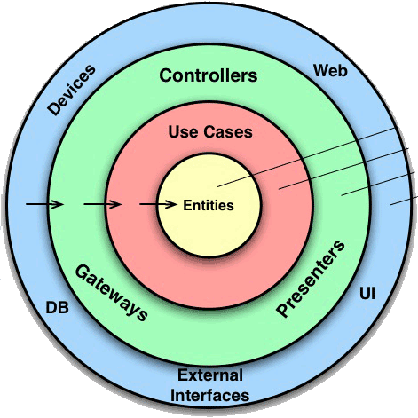
Architecture Decisions
I used Clean Architecture, which is about organizing our code into layers with a very explicit rule governing how those layers may interact.
The overriding rule that makes this architecture work is The Dependency Rule. This rule says that source code dependencies can only point inwards. Nothing in an inner circle can know anything at all about something in an outer circle.

Slide 3
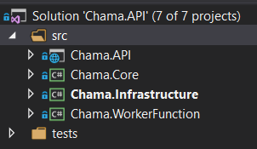
Architecture Decisions
Chama.API: It accepts input in the form of httcontext of our API, this means http requests over the network (e.g., GET/POST/etc.) and returns the output as content formatted as JSON.
Chama.Core: It contains our domain objects and business rules.
Chama.Infrastructure: It holds the Database that defines data entities, database access (typically in the shape of repositories).

Slide 4
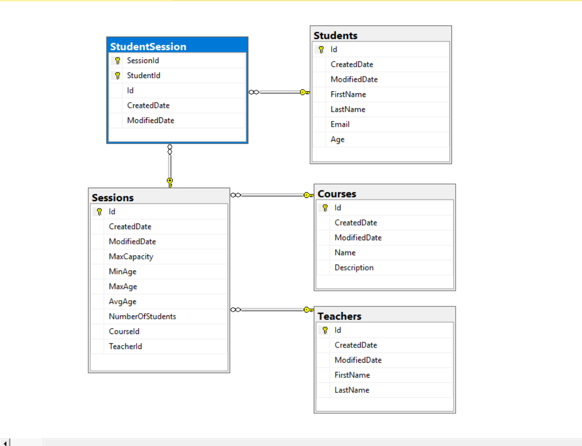
Architecture Decisions
Database design: I generated the database using EF Core code-first approach, creating the domain entities first. Then using migrations to generate the scripts to create the Database.

Slide 5
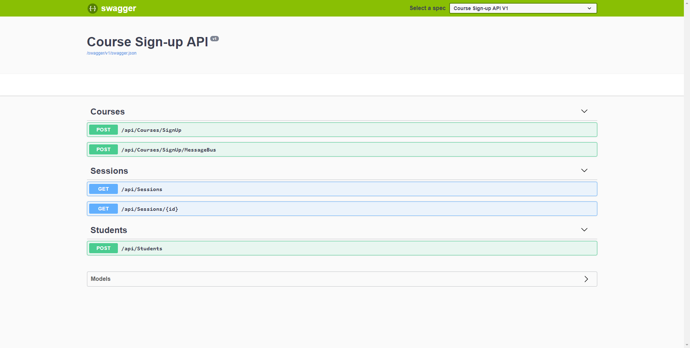
Architecture Decisions
Swagger page for easy access to the API

Slide 6
Tools And Technologies Used
Net core 2.2
Ef Core
SQL Server
Nlog
xUnit
Swagger
Custom exception Handler
Azure Service Bus
Azure Functions
Azure Web app
Automapper

Slide 7
Step 1 – API – Solution Applied
POST /api/Courses/SignUp
First, a request is sent to the API to process a student sign up to a course.
Then, it will validate if that student exists, if there is availability on that session course and if the student is already signed-in in that session.
Finally, a new student session will be created.

Slide 8
Step 2 – Scaling Out – Solution Applied
POST /api/Courses/SignUp/MessageBus
For this approach I used Azure Service Bus.
First, a request is sent to the API.
Then, a message will send to the Service Bus queue.
Finally, an Azure Function will be triggered when a new message is in the queue and it will call the step 1 API to try to sign-up.

Slide 9
Step 3 – Querying – Solution Applied
GET /api/Sessions & GET /api/Sessions/{id}
First, I decided to pre calculate the minimum, maximum and average age, and number of students in each session course, so this information can be access instantly.
Then, I created an API that returns the information of each session course.
Finally, I created an API that also returns the teacher’s and student’s information for a given course.

Slide 10
Problems And Challenges
One of the biggest challenges was how to deliver a good quality project with all best practices and patterns in the shortest time possible.

Slide 11
Future Improvements
Integration tests, like, all the Message bus integration.
More unit tests coverage.
Use of SQL computed columns in Session table to calculate Average, Maximum and Minimum age.

Slide 12
Course Sign-up System
Thank You

