Slide 1


Accelerating the development
with Esri mapping
Ezequias Rocha
Notes:
This presentation has the intent to show how it is possible to accelerate the Esri development using a class mapping model. We use an application to provide a writting of classes that can be used as reference or even as a persistent data to populate correctly the geodatabase feature classes and tables.

Slide 2
Motivation
Notes:
The motivation that drives me to this presentation is the dificulty to interact with the client many times when I first came to a large eletric distribution company. I just taught that if I have an application that could map all feature classes and table structures my development could be much more fast than before.

Slide 3

How much time i’ve lost
Waitting ArcCatalog
Doubt about attribute name
Searching for domain possible values
There are or there isn’t a relationship between Feature Classes and Tables in my geodatabase?
Searching for Geometric Network elements
Is this class versioned or not?
Notes:
Here are some points that makes my development slow.

Slide 4

And if I mustn’t take look at
the database each time?

Slide 5
DAL - Pojos e Related
Notes:
So we can say about many mappin model related, but I hadn’t any in a way I could make a plain object or an active record elements (like a Feature class)

Slide 6
pojo
data access application block
mapeamento
dal
JavaBeans
model
NHibernate
ADO Entity Framework
Notes:
So i took a look in many structureand decied to produce my own model generator.

Slide 7
Experience
Notes:
Some day I wake up with an idea of create my ow class generator. I was very motivated for it.

Slide 8

Class
Generator
Notes:
So the Class Generator came out.

Slide 9
Published at Esri (May 2008)
Notes:
I published it in May 2008 after just one day of work. It was simple but already helped me to much in my next project.

Slide 10
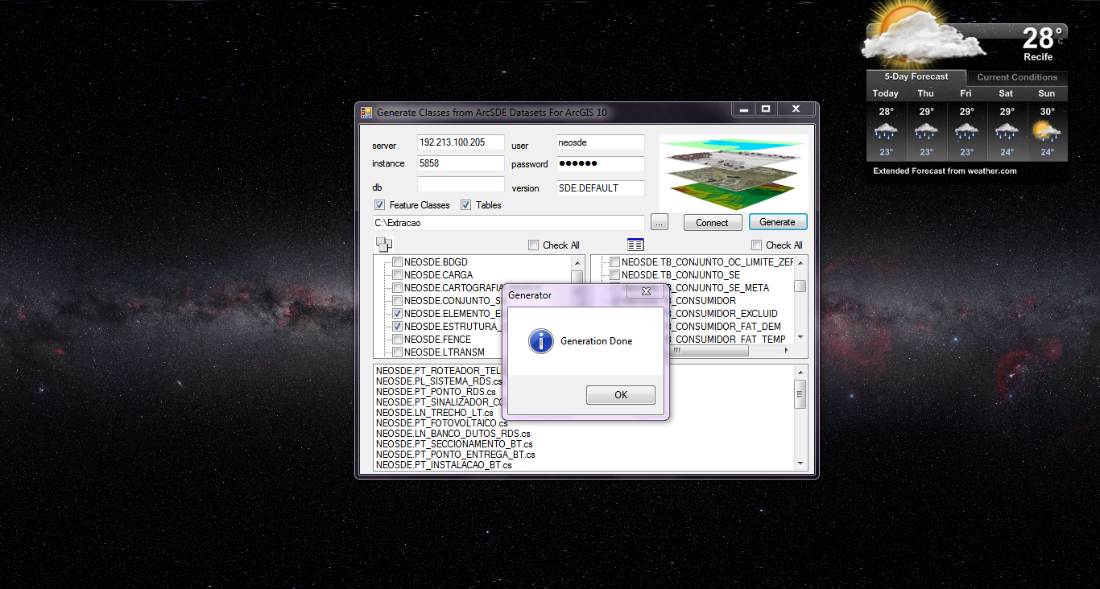

Slide 11
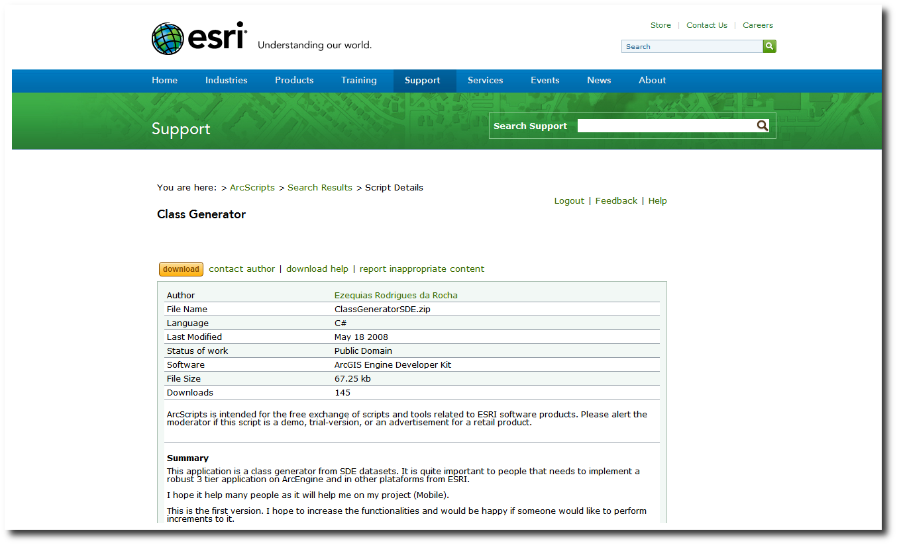
http://arcscripts.esri.com/details.asp?dbid=15592
Notes:
Here is the post in the Esri support page.

Slide 12
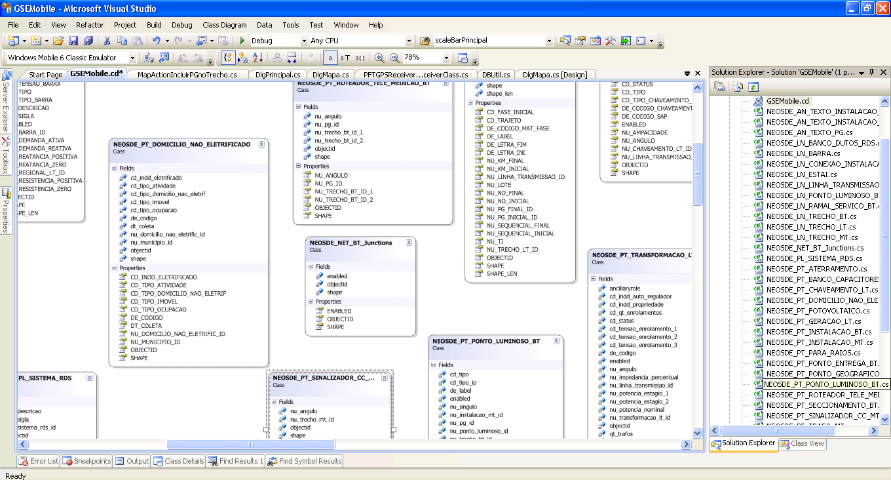
Notes:
Here is a sample I used in the GSEMobile (a Mobile ADF application for a large eletric distribution company)

Slide 13
Advantages
Notes:
Some advantages will be listed in the next slide.

Slide 14
Productivity Increase
  Not need to go to the bank
  Schema in Visual Studio
  Knowing better the geodatabase elements
  Access to possible values via intelisense
    Attributes
    Domains
    Subtypes
    Relationship and other structures
Possibilities in frameworks
  Generic frameworks like GIS CRUD
  Scalable code (gets larger with the same dal)
Notes:
Here are the increase productivity items I listed. It should have much more like asking for a co-worker for some information just becouse your machine (or VM) is too slow to open ArcCatalog.

Slide 15
Illustration
Notes:
Here we make an experience of how to retrieve an unknown data from scrath (open ArcCatalog) and than we do perform an example mapping all data from some geodatabase connection.

Slide 16
Thank you so much!
erocha@img.com.br
Notes:
Have fun and enjoy. Keep in touch.

