Slide 1
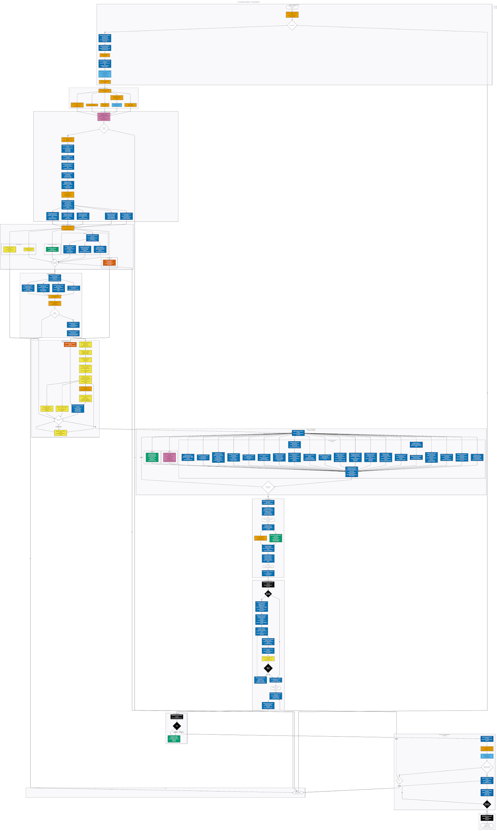
S-1 Production Flowchart — Oil & Gas MLP IPO
VDR Captain: Ezequiel Padilla
62%
LLM + Hybrid
69
automatable steps
111
total work steps
8
professional roles
MLP — publicly traded partnership; pass-through tax (K-1s)
S-1 — SEC registration statement; prospectus + exhibits
ROLES (8)
Company Counsel
68
LLM 22.5% (25)
Flowchart
Issuer (Mgmt)
17
Minor edits only
RACI
Underwriters
3
62%
automatable
Hybrid 39.6% (44)
LLM draft + human review
UW Counsel
4
Human 22.5% (25)
Memo
Accountants
12
Full human judgment
Reserve Engineer
2
External 15.3% (17)
Tax Counsel
2
SEC, auditor, engineer
SEC/FINRA/Exch
3
AUTOMATION BY PHASE
P1
Ready
57%
P2
Team
—
P3
Struct.
79%
P4
DD
44%
P5
Gov.
78%
P6
Financ.
8%
KEY TERMS
DRS
Confidential draft reg.
VDR
Virtual data room (diligence)
P7
Drafting
96%
P8
Filing
75%
P9
SEC Rev.
73%
P10
FINRA
50%
P11
Mktg.
40%
P12
Effect.
—
S-1/A
Public amendment
Comfort letter
Auditor verification
LLM+Hybrid %: ■ 0 ■ mid ■ high
CORRESP
SEC response letter
Section 11
Securities Act liability
Notes:
CONTEXT DEFINITIONS (for presenter reference): MLP: A Master Limited Partnership is a publicly traded partnership — not a corporation — that typically owns midstream oil & gas infrastructure. Pass-through entity for tax: investors get K-1s, not 1099s. GP manages; limited partners hold publicly traded units. S-1: SEC registration statement required to go public. Contains prospectus (narrative disclosure, financials, risk factors) and exhibits (legal opinions, material contracts, consents). Scope: 111 work steps across 12 phases, 8 professional roles, from IPO trigger through SEC effectiveness. Precedent: Mach Natural Resources LP (S-1 filed 2023-09-22; 3 S-1/A amendments; effective 2023-10-24, 32 days). CIK 0001980088. TIER DEFINITIONS: LLM (22.5%, 25 steps): Senior reviewer accepts output with only minor, non-substantive edits. Hybrid (39.6%, 44 steps): LLM produces draft; human makes material decisions on content, framing, or legal sufficiency. Human (22.5%, 25 steps): Requires human judgment throughout the production activity. External (15.3%, 17 steps): Performed by external party (SEC, FINRA, auditor, reserve engineer).

