Slide 1
Desarrollo del
Linux Kernel
Ezequiel García
(Greg Kroah-Hartman)
github.com/gregkh/kernel-development
Notes:
I'm going to discuss the how fast the kernel is moving, how we do it all, and how you can get involved.

Slide 2
¿Qué diablos es el kernel?
$ strace cp .bashrc a_copy
open(".bashrc", O_RDONLY|O_LARGEFILE) = 3
fstat64(3, {st_mode=S_IFREG|0644, st_size=192, ...}) = 0
open("a_copy", O_WRONLY|O_CREAT|O_EXCL|O_LARGEFILE, 0644) = 4
fstat64(4, {st_mode=S_IFREG|0644, st_size=0, ...}) = 0
read(3, "\nexport LD_LIBRARY_PATH=$LD_LIBR"..., 32768) = 192
write(4, "\nexport LD_LIBRARY_PATH=$LD_LIBR"..., 192) = 192
read(3, "", 32768) = 0
close(4) = 0
close(3) = 0

Slide 3
38.566 archivos
15.384.000 lineas
2.6.20 to 2.6.24-rc8
Kernel release 3.4.0
Notes:
This was for the 3.2 kernel release, which happened January 4, 2012.

Slide 4
2.833 contribuidores
373 empresas
Kernel releases 3.0.0 – 3.4.0
May 2011 – May 2012
Notes:
This makes the Linux kernel the largest contributed body of software out there that we know of.
This is just the number of companies that we know about, there are more that we do not, and as the responses to our inquiries come in, this number will go up.

Slide 5
10,500 lineas
agregadas
8,400 lineas
removidas
2,300 lineas
modificadas
¡TODOS
LOS
DÍAS!
Kernel releases 3.0.0 – 3.4.0
May 2011 – May 2012
2.6.20 to 2.6.24-rc8

Slide 6
5,79
cambios
por hora
Kernel releases 3.0.0 – 3.4.0
May 2011 – May 2012
2.6.20 to 2.6.24-rc8
Notes:
This is 24 hours a day, 7 days a week, for a full year.
We went this fast the year before this as well, this is an amazing rate of change.
Interesting note, all of these changes are all through the whole kernel.
For example, the core kernel is only 5% of the code, and 5% of the change was to the core kernel. Drivers are 55%, and 55% was done to them, it's completely proportional all across the whole kernel.

Slide 7
¿Cómo no se
vuelven
locos?
Releases periódicos
Cambios incrementales
2.6.20 to 2.6.24-rc8
Notes:
This is 24 hours a day, 7 days a week, for a full year.
We went this fast the year before this as well, this is an amazing rate of change.
Interesting note, all of these changes are all through the whole kernel.
For example, the core kernel is only 5% of the code, and 5% of the change was to the core kernel. Drivers are 55%, and 55% was done to them, it's completely proportional all across the whole kernel.

Slide 8

Nuevo release cada
2 meses y chirolas
Kernel releases 2.6.20 – 3.4.0
Notes:
84 days to be exact, very regular experience.

Slide 9
v3.3: 18 marzo
v3.4: 20 mayo
v3.5: 21 julio
¿ v3.6: 30 setiembre ?

Slide 10
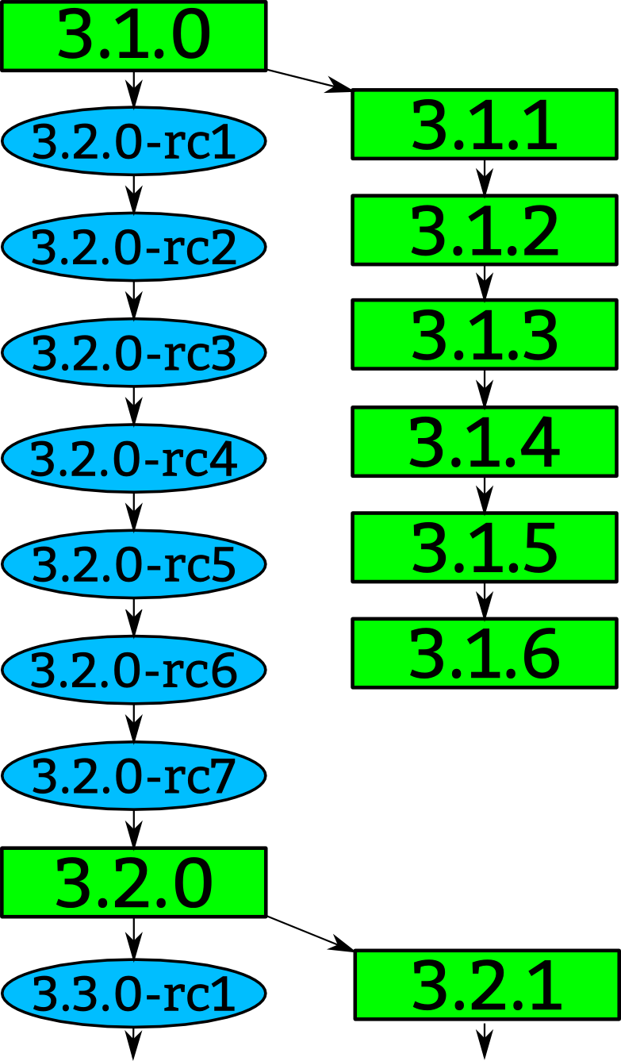
Notes:
How a kernel is developed.
Linus releases a stable kernel
- 2 week merge window from subsystem maintainers
- rc1 is released
- bugfixes only now
- 2 weeks later, rc2
- bugfixes and regressions
- 2 weeks later,rc3
And so on until all major bugfixes and regressions are resolved and then the cycle starts over again.

Slide 11
Notes:
Greg takes the stable releases from Linus, and does stable releases with them, applying only fixes that are already in Linus's tree.
Requiring fixes to be in Linus's tree first ensures that there is no divergence in the development model.
After Linus releases a new stable release, the old stable series is dropped.
With the exception of “longterm” stable releases, those are special, the stick around for much longer...

Slide 12

Notes:
Like mentioned before, we have almost 2900 individual contributors. They all create a patch, a single change to the Linux kernel. This change could be something small, like a spelling correction, or something larger, like a whole new driver.
Every patch that is created only does one thing, and it can not break the build, complex changes to the kernel get broken up into smaller pieces.

Slide 13
Notes:
The developers send their patch to the maintainer of the file(s) that they have modified.
We have about 700 different driver/file/subsystem maintainers

Slide 14
commit ecf85e481a716cfe07406439fdc7ba9526bbfaeb
Author: Robert Jarzmik <robert.jarzmik@free.fr>
AuthorDate: Tue Apr 21 20:33:10 2009 -0700
Commit: Greg Kroah-Hartman <gregkh@suse.de>
CommitDate: Thu Apr 23 14:15:31 2009 -0700
USB: otg: Fix bug on remove path without transceiver
In the case where a gadget driver is removed while no
transceiver was found at probe time, a bug in
otg_put_transceiver() will trigger.
Signed-off-by: Robert Jarzmik <robert.jarzmik@free.fr>
Acked-by: David Brownell <dbrownell@users.sourceforge.net>
Signed-off-by: Greg Kroah-Hartman <gregkh@suse.de>
--- a/drivers/usb/otg/otg.c
+++ b/drivers/usb/otg/otg.c
@@ -43,7 +43,8 @@ EXPORT_SYMBOL(otg_get_transceiver);
void otg_put_transceiver(struct otg_transceiver *x)
{
- put_device(x->dev);
+ if (x)
+ put_device(x->dev);
}
Notes:
This is an example of a patch.
It came from Robert, was acked by David, the maintainer at the time of the usb on-the-go subsystem, and then signed off by by me before it was commited to the kernel tree.
The change did one thing, it checked the value of the pointer before it was dereferenced, fixing a bug that would have crashed the kernel if it had been hit.
This is also a “blame” trail, showing who changed each line in the kernel, and who agreed with that change.
If a problem is found, these are the developers that you can ask about it.
Because of this, every line in the Linux kernel can be traced back to at least two developers who are responsible for it.
This is better than any other body of code.

Slide 15
Developer's Certificate of Origin
(http://elinux.org/Developer_Certificate_Of_Origin)
(a) Soy el autor del cambio; o
(b) Me basé en un trabajo anterior con
una licencia compatible; o
(c) Alguien me hizo este cambio,
cumpliendo (a), (b), o (c)
y no lo modifiqué.
(d) Esta contribución es pública
Notes:
This is what “Signed-off-by:” means.
All contributions to the Linux kernel have to agree to this, and every single patch has at least one signed-off-by line, usually all have at least two.
This is also a “blame” trail, showing who changed each line in the kernel, and who agreed with that change.
If a problem is found, this is the developers that you can ask about it.
Because of this, every line in the Linux kernel can be traced back to at least two developers who are responsible for it.
This is better than any other body of code.

Slide 16
Notes:
After reviewing the code, and adding their own signed-off-by to the patch, the file/driver maintainer sends the patch to the subsystem maintainer responsible for that portion of the kernel.
We have around 150 subsystem maintainers

Slide 17
Notes:
Linux-next gets created every night from all of the different subsystem trees and build tested on a wide range of different platforms.
We have about 150 different trees in the linux-next release.
Andrew Morton picks up patches that cross subsystems, or are missed by others, and releases his -mm kernels every few weeks. This includes the linux-next release at that time.

Slide 18
Notes:
Every 3 months, when the merge window opens up, everything gets sent to Linus from the subsystem maintainers and Andrew Morton.
The merge window is 2 weeks long, and thousands of patches get merged in that short time.
All of the patches merged to Linus should have been in the linux-next release, but that isn't always the case for various reasons.
Linux-next can not just be sent to Linus as there are things in there that sometimes are not good enough to be merged just yet, it is up to the individual subsystem maintainer to decide what to merge.

Slide 19

¿Quién saca la billetera?
1. “Amateurs” 14.2%
2. Red Hat 10.1%
3. Intel 8.6%
4. Unknown Individuals 5.2%
5. Novell 4.0%
6. IBM 3.7%
7. Texas Instruments 3.6%
8. Broadcom 3.0%
9. Consultants 2.3%
10. Wolfson Micro 2.1%
Kernel releases 3.0.0 – 3.4.0
Notes:
So you can view this as either 20% is done by non-affiliated people, or 80% is done by companies.
Now to be fair, if you show any skill in kernel development you are instantly hired.
Why this all matters: If your company relies on Linux, and it depends on the future of Linux supporting your needs, then you either trust these other companies are developing Linux in ways that will benefit you, or you need to get involved to make sure Linux works properly for your workloads and needs.

Slide 20
¿Quién saca la billetera?
11. Samsung 1.9%
12. Google 1.8%
13. Oracle 1.7%
14. Freescale 1.5%
15. MiTAC 1.4%
16. Qualcomm 1.4%
17. Microsoft 1.3%
18. Linaro 1.2%
19. Nokia 1.2%
20. AMD 1.1%
Kernel releases 3.0.0 – 3.4.0
Notes:
Samsung 980 patches
Qualcomm 707 patches

Slide 21
¿Cómo participar?
2.6.20 to 2.6.24-rc8
10,900 lines added
5,500 lines removed
2,200 lines modified
per day 2008 - 2009

Slide 22

¿Cómo participar?
2.6.20 to 2.6.24-rc8
10,900 lines added
5,500 lines removed
2,200 lines modified
per day 2008 - 2009
Notes:
This book tells you how to build and install a kernel on your machine.
Free online

Slide 23
¿Cómo participar?
Documentation/HOWTO
Documentation/development-process
2.6.20 to 2.6.24-rc8
Notes:
These documents in the kernel source directory are the best place to start if you want to understand how the development process works, and how to get involved.
The HOWTO file has links to almost everything else you ever wanted..

Slide 24
¿Cómo participar?
Quedensén a la prósima charla ;-)
2.6.20 to 2.6.24-rc8
Notes:
This is a video of a talk I gave at FOSDEM, going through the steps, showing exactly how to create, build, and send a kernel patch.

Slide 25

Cada vez somos más...
(supongo)
Notes:
Obligatory Penguin Picture

