Slide 1
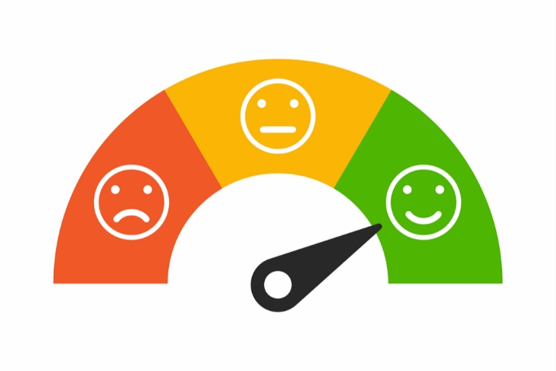


COVID19 Sentiment Analysis on Tweets
Ezgi NAZMAN

Slide 2
Data Description
50K tweets
Excluding «retweets» and «nativeretweets»
Language: EN
Date: September 21
Query: #COVID19
Time: 5 days

Slide 3
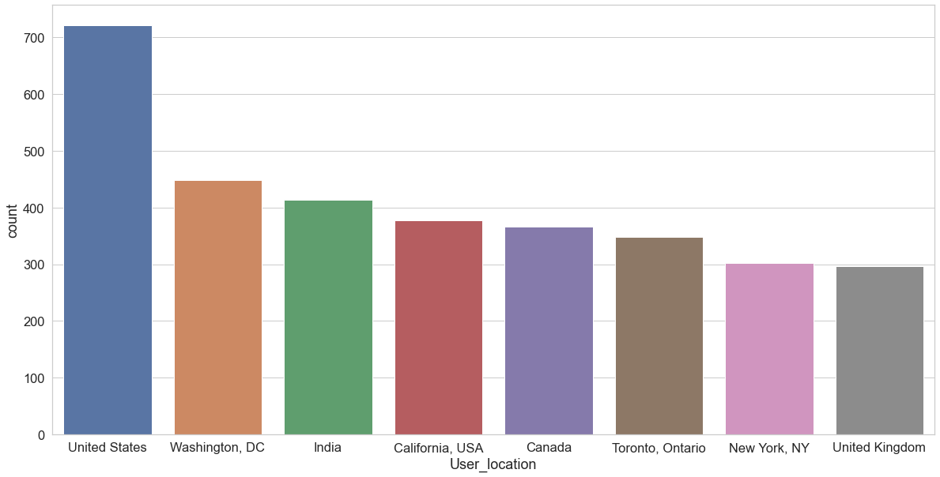
User Location Counts

Slide 4
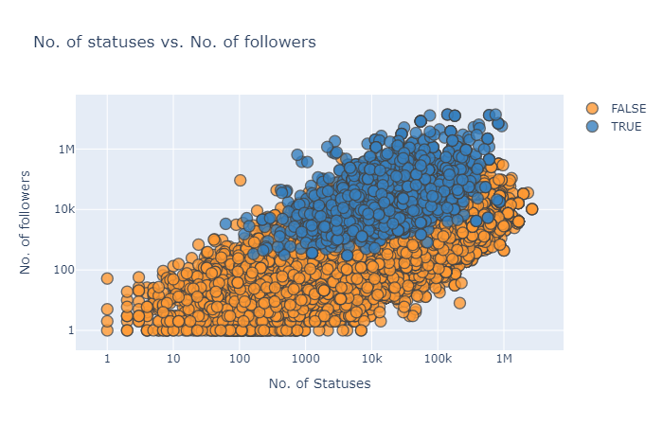

Slide 5
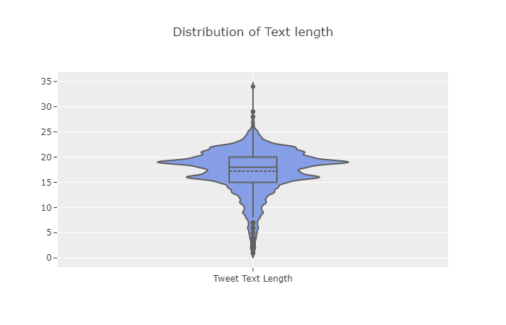

Slide 6
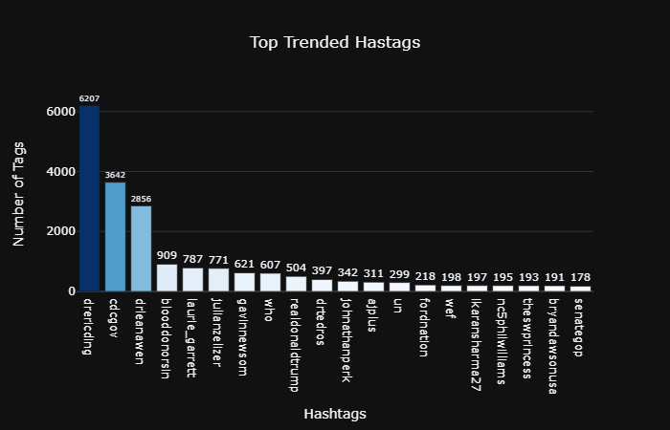

Slide 7
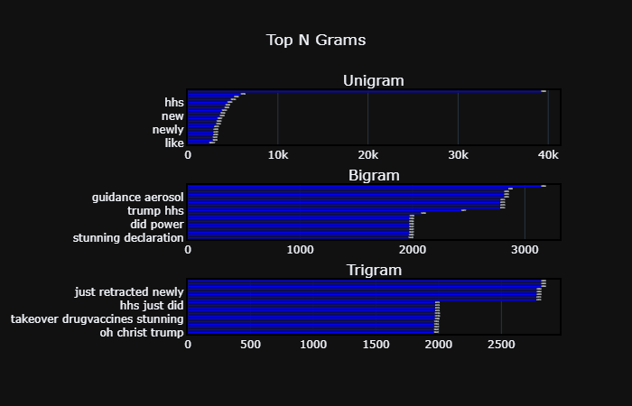

Slide 8
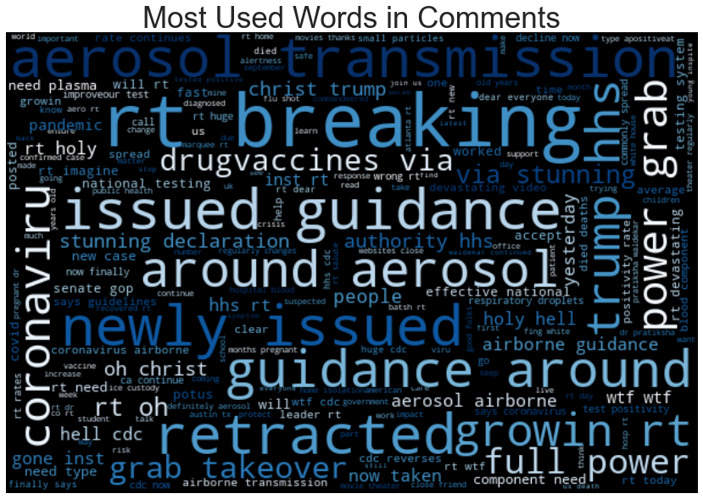

Slide 9
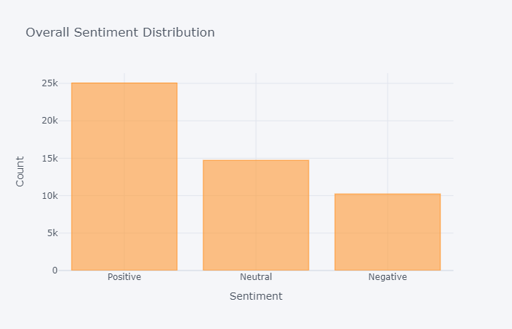

Slide 10
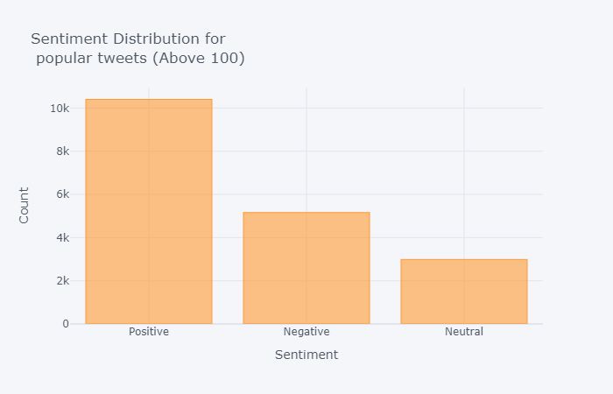

Slide 11
☺ Thank You ☺

