Slide 1


Credit Card Fraud Detection
Ezgi NAZMAN

Slide 2
Data Set
The datasets contains transactions made by credit cards in September 2013 by european cardholders.
This dataset presents transactions that occurred in two days, where we have 492 frauds out of 284,807 transactions.
It contains only numerical input variables which are the result of a PCA transformation.
Due to confidentiality issues, data does not Show the original features and more background information about the data.

Slide 3
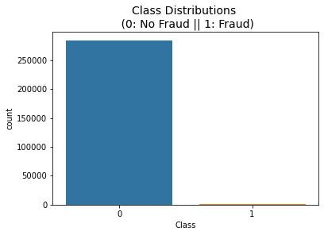
Feature 'Class' is the response variable and it takes value 1 in case of fraud and 0 otherwise.
The dataset is highly unbalanced, the positive class (frauds) account for 0.172% of all transactions.

Slide 4
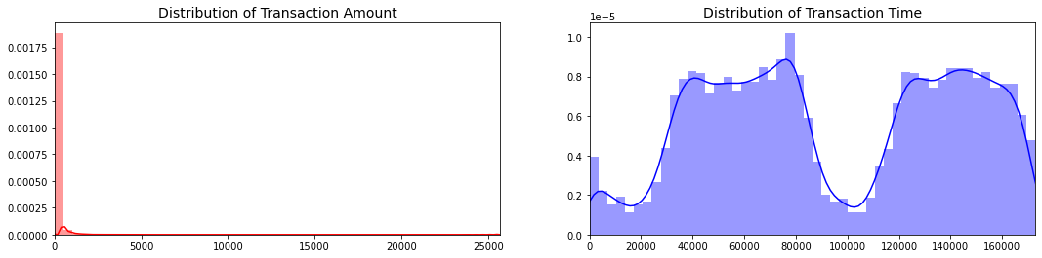
Feature 'Time' contains the seconds elapsed between each transaction and the first transaction in the dataset. The feature 'Amount' is the transaction Amount, this feature can be used for example-dependant cost-senstive learning.

Slide 5
Features V1, V2, … V28 are the principal components obtained with PCA
The only features which have not been transformed with PCA are 'Time' and 'Amount'.
There so many outliers in all components
Robust Scaler was applied to the features in order to drop outliers.

Slide 6
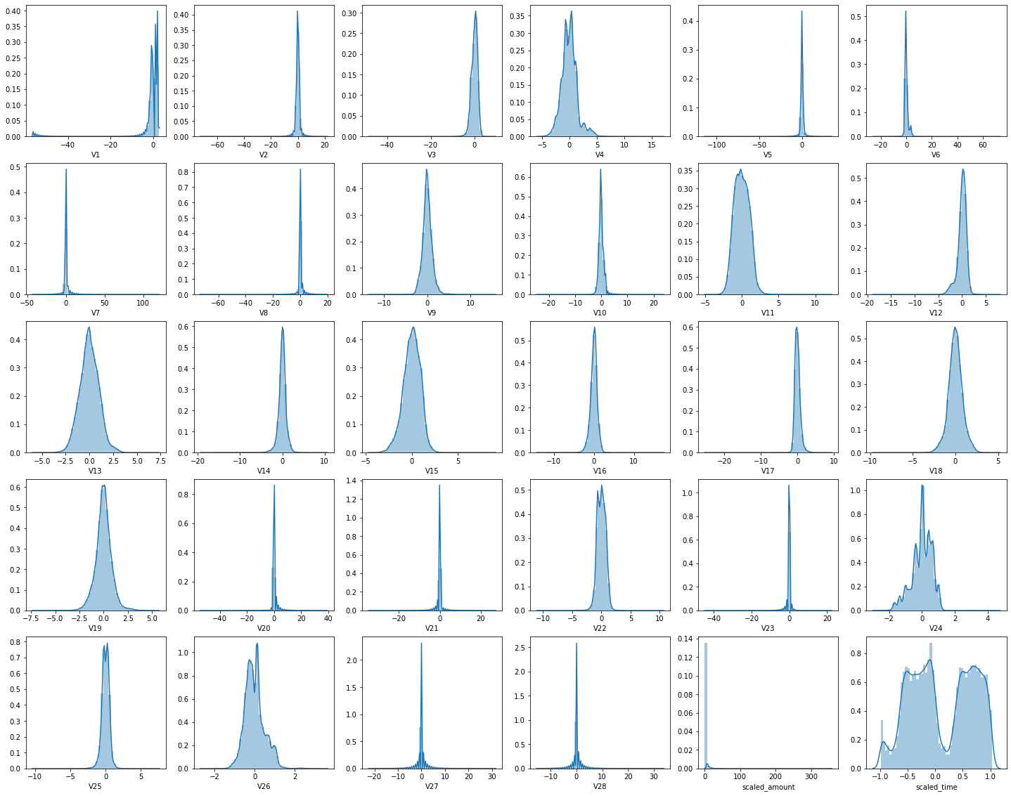

Slide 7
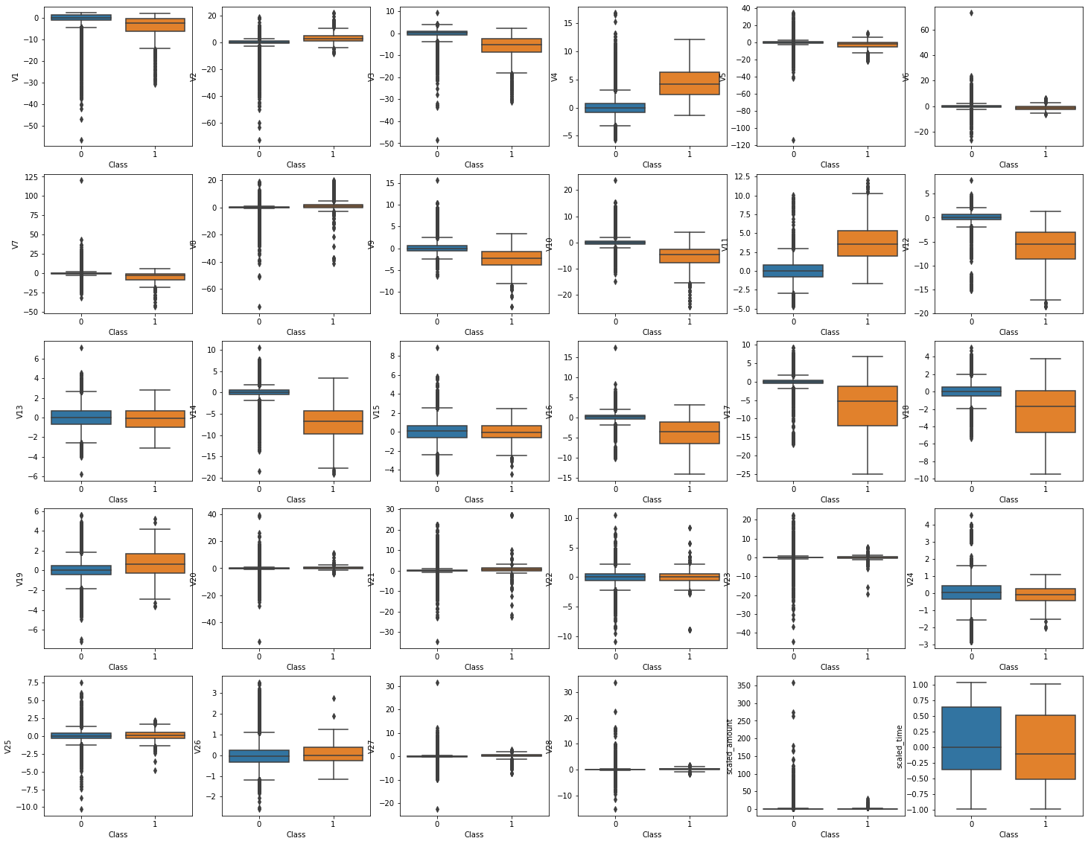

Slide 8
Machine Learning Methods
Binary Logistic Regression
Support Vector Machine
Gradient Boosting
Bagging Decision Tree
Random Forest
Extra Tree
AdaBoost
Stochastic Gradient Boosting
Voting Ensemble
XGBoost

Slide 9
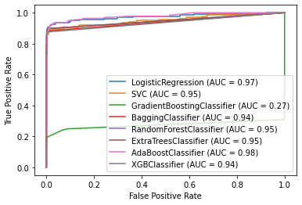
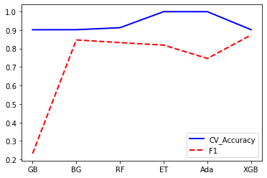
Comparison Results

Slide 10
