Slide 1



Model of the Particle Accelerator
Group 4
Ezgi Demir
Robin Umut Kızıl
EEE 351 Project Presentation

Slide 2

Introduction
ELECTRONIC PAPER
Project Focus & Goal
Applications of Electromagnetic Fields in Our Project
Project Description
Referances

Slide 3

PROJECT FOCUS & GOAL
Focus:
Design and implementation of a magnetic accelerator. specifically using electromagnetic coils to push forward a metal ball through a tube.
Goal:
Develop a functional prototype of a magnetic accelerator that can demonstrate acceleration and kinetic energy transfer from electromagnetic coils to a ferromagnetic material.

Slide 4
APPLICATIONS OF ELECTROMAGNETIC FIELDS IN OUR PROJECT
Coil:
4 coil in the accelerator is responsible for generating a concentrated magnetic field. When electric current flows through the coil, it creates a magnetic field perpendicular to the coils windings. This field creates a force on the metal ball.
Metal Ball:
Ferromagnetic material of the metal ball easily magnetized when exposed to the magnetic fields generated by the coils.

Slide 5

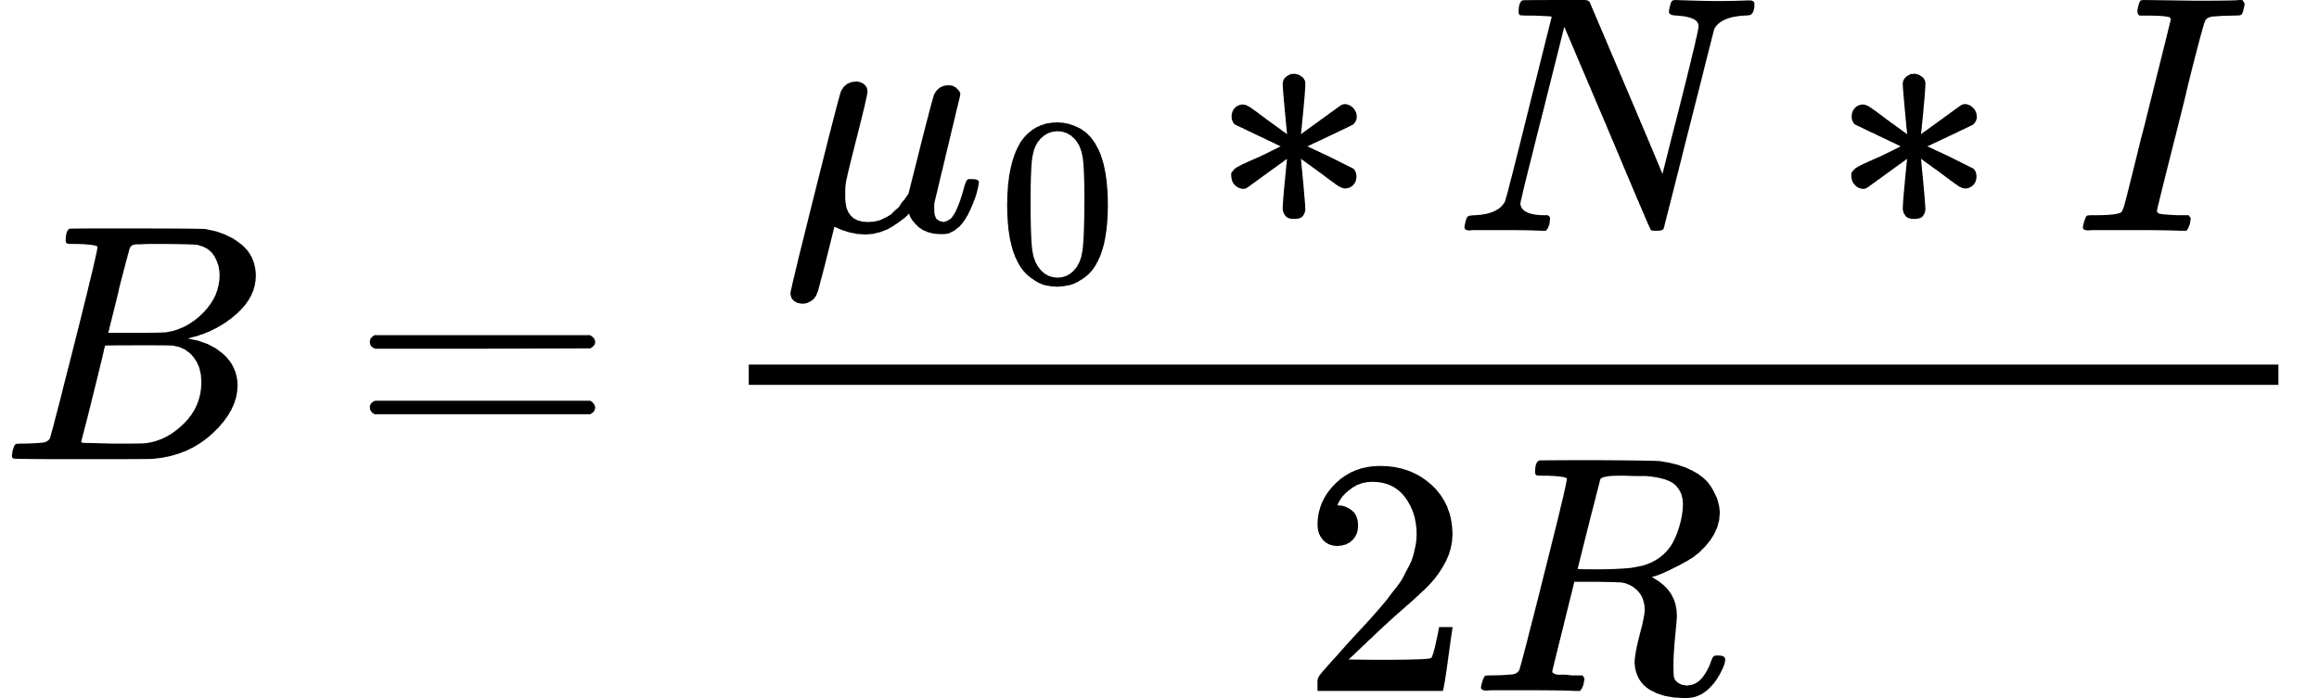

MAGNETIC FIELD GENERATION
Magnetic field formula of the coil is:
B is the magnetic field inside the solenoid.
𝜇 ​is the permeability .
N is the number of turns per unit length of the solenoid.
I is the current through the solenoid.
R is the radius of the coil.
When there is a current flow on the coil, it creates an magnetic field(B) that pull the metal ball to the center of the coil.

Slide 6

FERROMAGNETIC BALL INTERACTION
Magnetic force on the can be calculated by following formula:
m is the magnetic moment of the ball.
B is the magnetic field strength
∇(m⋅B) represents the gradient of the magnetic force field
B is determined by the coil.

Slide 7
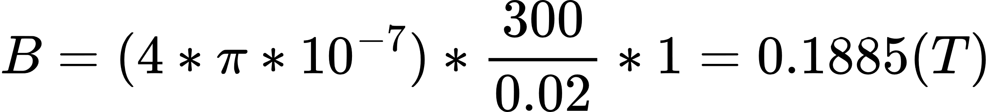
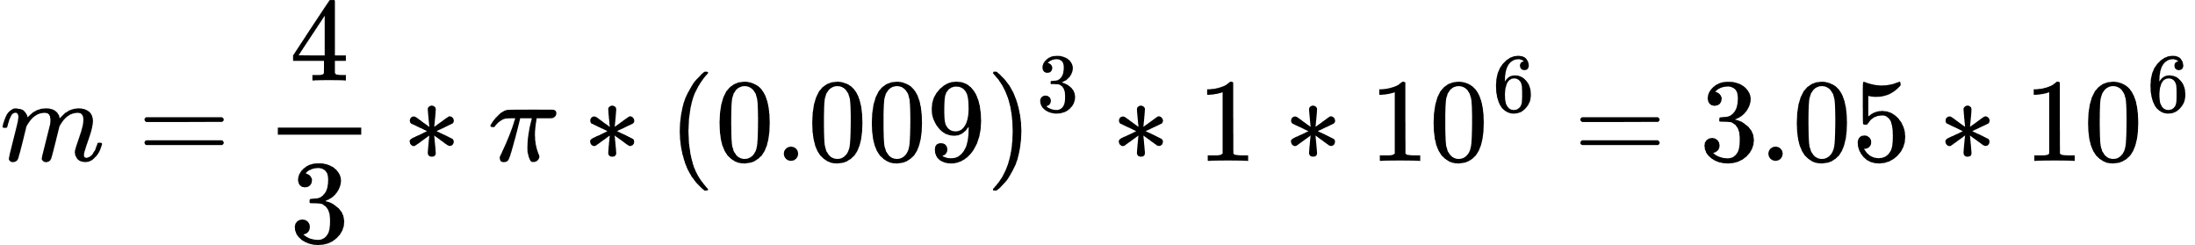
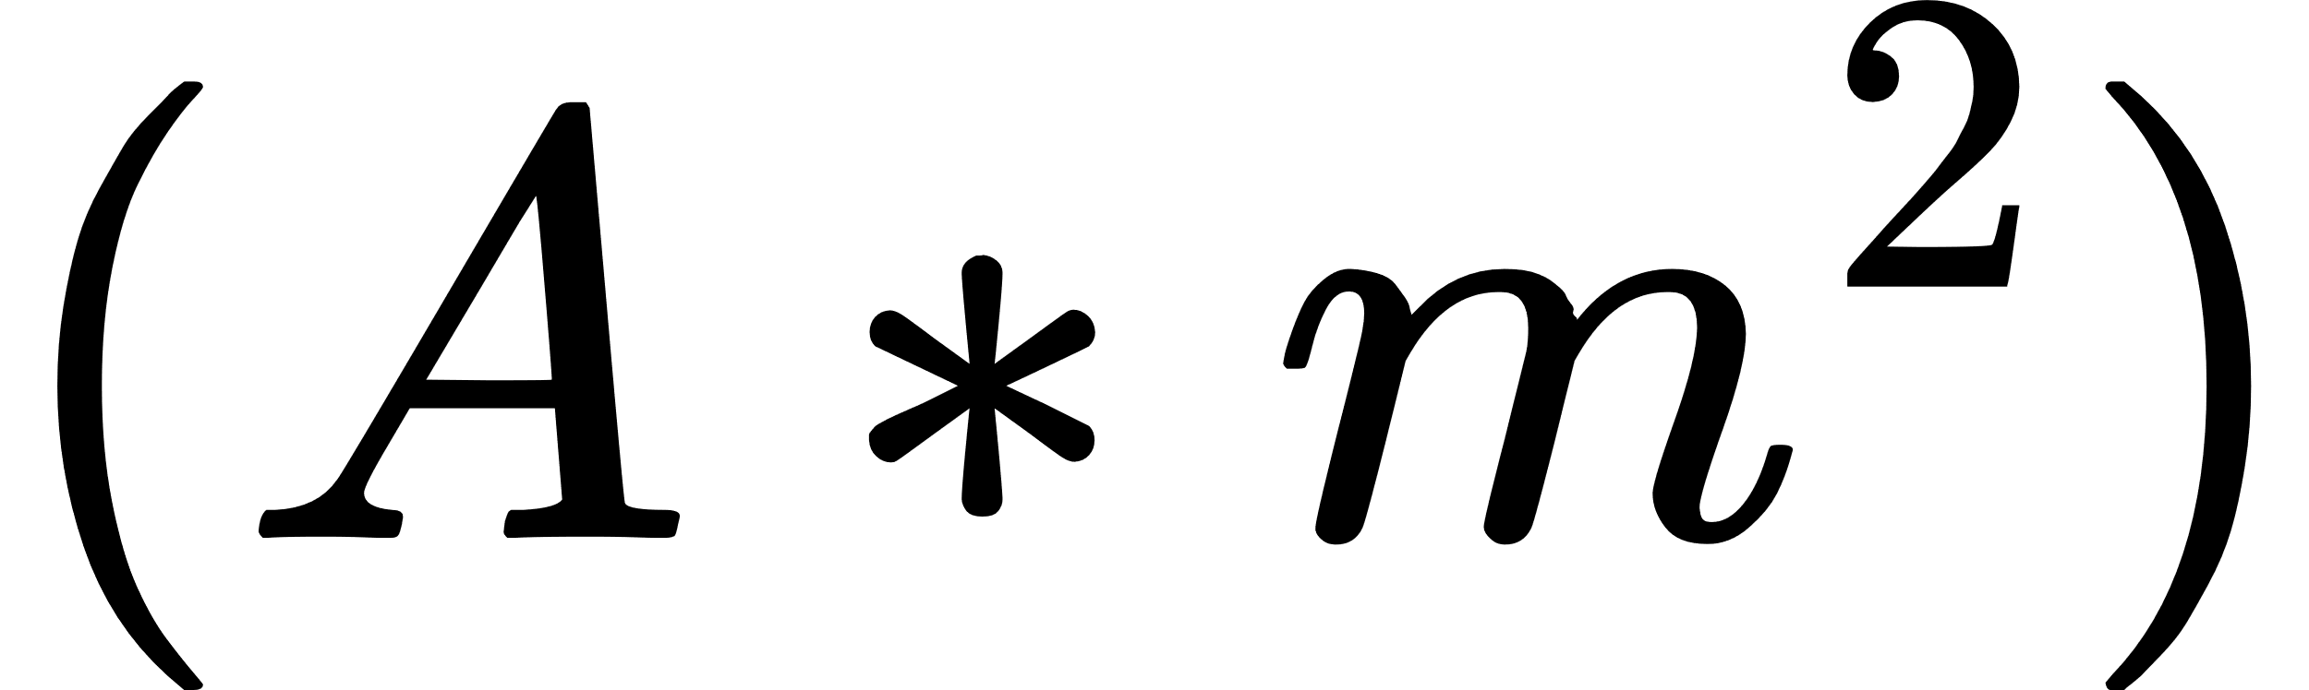
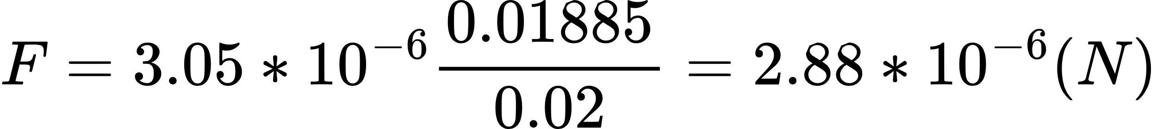
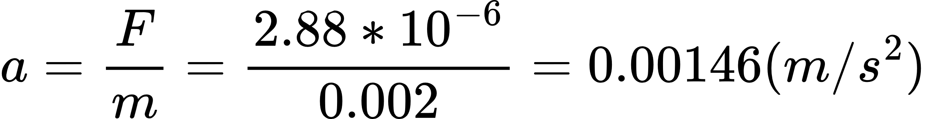
CALCULATIONS
Our specsifications:
Winding: 300 turns
Current: 10V-1A in first trial
coil radius is 1cm
Ball radius is 9mm
time of the force is 0.05s
Ball mass 0.002 kg
Magnetic Field Calculation:
Magnetic Moment Estimation:
Force Calculation:
Speed Calculation:

Slide 8
PROJECT DESCRIPTION
Steps of the project:
Design and Fabrication of the Circular Area of the Accelerator Holding the Sphere Ball
Material Selecting
System Integration and Programming
Testing Project

Slide 9
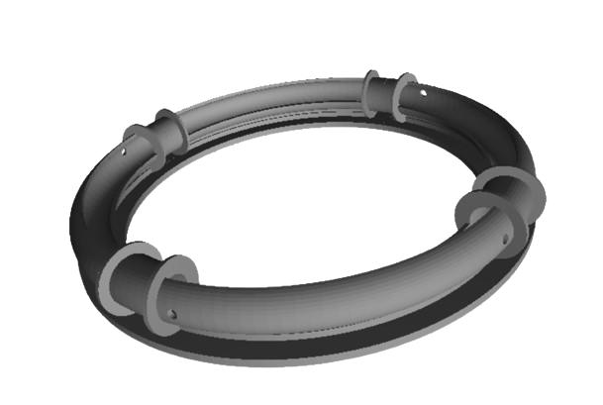
CIRCULAR AREA OF THE ACCELERATOR
Circular area designed and printed in 3d printer.
Design spesifications:
4 coil area to wind copper cable
Base to hold metal ball
figure 1: stl file of Circular Area

Slide 10
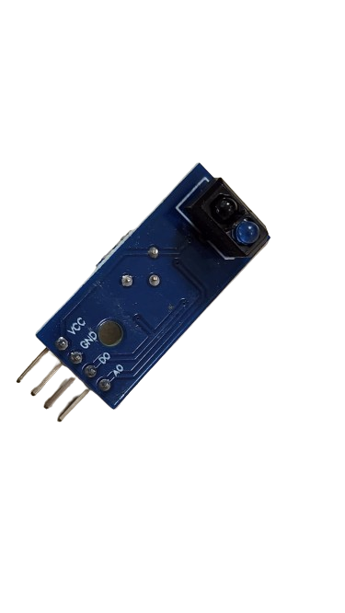
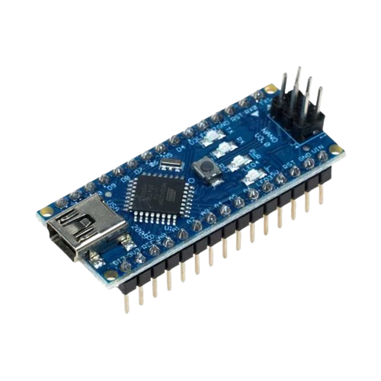
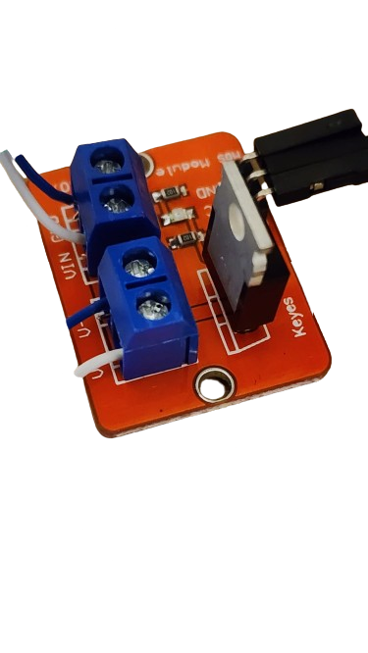
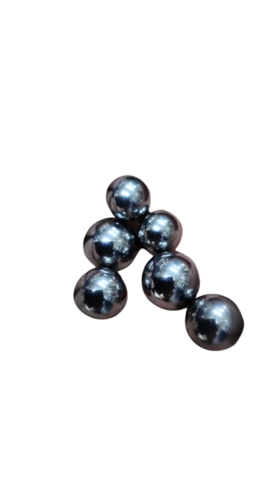
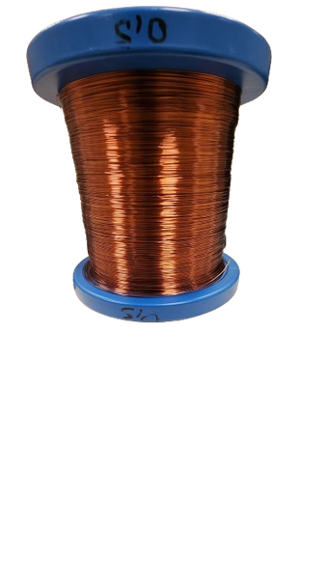
MATERIAL SELECTING
Material for the circuit and coil is selected:
Materials:
Ardunio Nano
IR sensor
Copper coil
Motor driver
Metal ball
figure 2: materials pictures

Slide 11
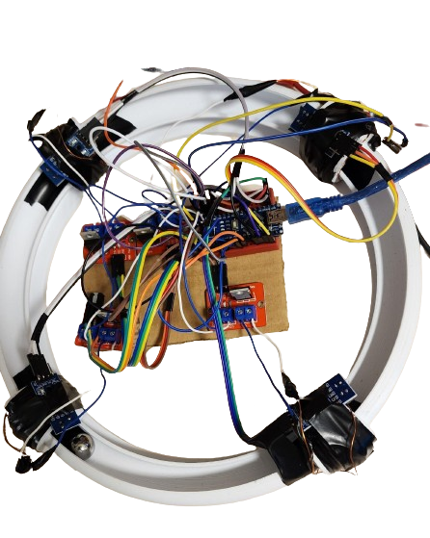
SYSTEM INTEGRATION AND PROGRAMMING
Steps of the Integration of the Circuit:
Coils are winded on the Printed model.
Motor Drivers and ardunio is placed on the center of the Project.
Ir sensors are placed on the coils.
Necessary jumpers are connected.
Ardunio is coded.
figure 3: System Integration

Slide 12
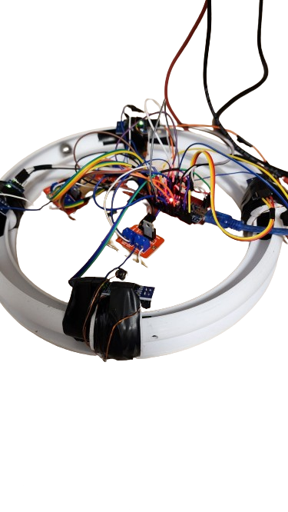
TESTING PROJECT
5V and 10V-1A is given to motor driver and coils, respectively, and ardunio code is run.
First trial:
Observed that, current on the coils are not sufficient to push metal to next coil.
Current on the coils increased to the 3A.
Second trial:
Optimal ball velocity is reached.
figure 4: Picture of Test Process

Slide 13
REFERENCES
"Magnetic Field Formula," Toppr. [Online]. Available: https://www.toppr.com/guides/physics-formulas/magnetic-field-formula/. [Accessed: May 7, 2024].
"Ignition Coil - Basic Principles," DENSO Automotive. [Online]. Available: https://www.denso-am.eu/news/deneur21_04_ignition-coil-basic-principles. [Accessed: May 8, 2024].
"How Ignition Systems Work," Champion Auto Parts. [Online]. Available: https://www.championautoparts.com/Technical/Tech-Tips/How-Ignition-Systems-Work.html. [Accessed: May 8, 2024].

