Slide 1
HELP DESK TICKETING SYSTEM
DATABASE PROJECT
BY OUTSIDERS
JANUARY 2021

Slide 2
CONTENT
INTRODUCTION
- What is help desk?
- Why do we need the help desk system?
PLANNING AND ANALYSIS
- System purpose, functions, roles
- Overview to help desk system
- Database tables
SQL QUERIES
-Views, stored procedures, functions,
transactions, triggers, cursors etc.
DATABASE BACK UP STRATEGIES
- Job creation

Slide 3
INTRODUCTION

Slide 4

WHAT IS…?
HELP DESK SYSTEM
?
?

Slide 5
PLANNING AND ANALYSIS

Slide 6
PURPOSE
In this project, the help desk system was designed for
a company operating in the software industry
CONVENIENCE FOR CUSTOMER
EFFICIENCY FOR EMPLOYEE
HELP DESK SYSTEM
AGILITY FOR BUSINESS

Slide 7
FUNCTIONS
TRACKING OF SOFTWARE PRODUCTS
TRACKING OF EMPLOYEES
TRACKING OF CUSTOMERS
TRACKING OF TICKETS

Slide 8
ROLES
SYSTEM ADMIN
EMPLOYEE
COMPANY ADMIN
COMPANY USER

Slide 9
SYSTEM FLOW
?
?
Agent 1
…
…
Agent 2
Agent 3
Customer
(Problem or question)
Agent 4
Agent accepts
Agent contacts customer
Help Desk Database
(New ticket)
New ticket sent
?
Solution by agent
Is company user satisfied the solution?
Informing customer
Informing customer
Closing ticket
Closing statement for ticket

Slide 10
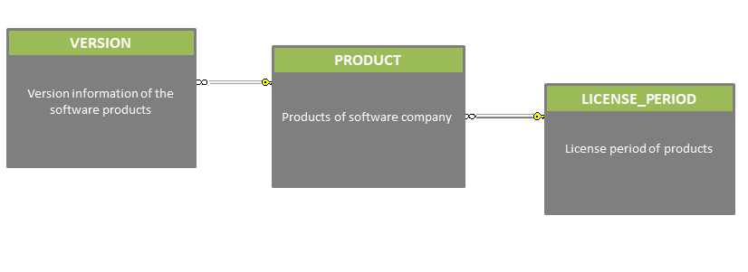
DATABASE TABLES
TRACKING OF SOFTWARE PRODUCTS

Slide 11
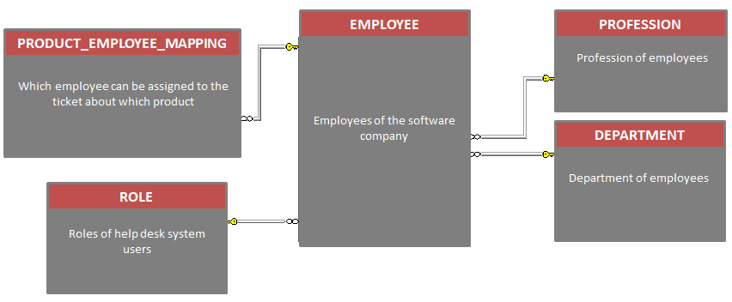
TRACKING OF EMPLOYEES

Slide 12
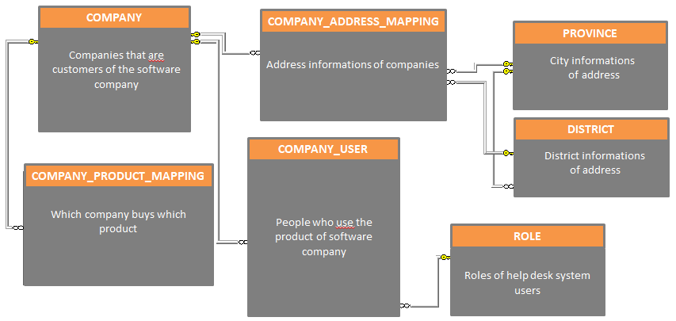
TRACKING OF CUSTOMERS

Slide 13
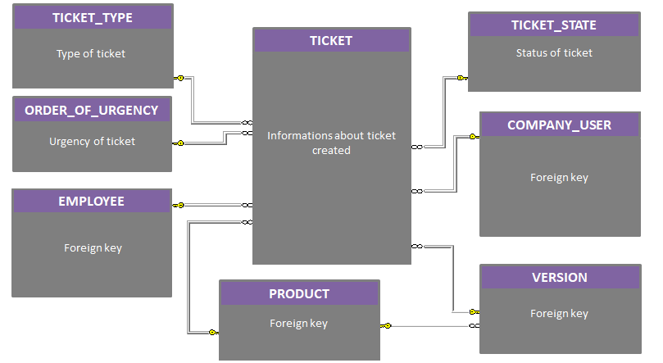
TRACKING OF TICKETS

Slide 14
SQL QUERIES

Slide 15


FUNCTIONS
f_FORMAT_PHONE_NUMBER
f_GET_TICKETS_FOR_COMPANY_USERID
f_GET_PRODUCTS_FOR_EMPLOYEE_ID
f_GET_ALL_TICKET_STATES_FOR_EMPLOYEEID
f_GET_ALL_TICKET_TYPES_FOR_EMPLOYEEID
f_GET_ALL_TICKET_FOR_COMPANY
f_GET_ALL_TICKET_FOR_EMPLOYEEID
f_GET_ALL_TICKET_AND_STATES_FOR_EMPLOYEEID
f_GET_ALL_TICKET_URGENCY_FOR_EMPLOYEEID
f_GET_TICKET_BY_PRODUCT_ANNUAL
f_COUNT_OF_TICKET_FOR_COMPANY_BY_STATE
f_COUNT_OF_COMPANY_PRODUCT_FOR_COMPANYID
f_GET_TICKET_BY_COMPANY_ANNUAL
f_COUNT_OF_TICKET_FOR_COMPANY_USERID_BY_STATE
f_GET_TICKET_BY_PRODUCT_MONTHLY
f_GET_TICKET_BY_COMPANY_MONTHLY
f_GET_ALL_TICKET_ANNUAL

Slide 16
f_FORMAT_PHONE_NUMBER
Scalar-valued function returning the true format for the given telephone number
Returns
varchar (13)
@phoneNumber
varchar (11)
Input parameter

Slide 17
f_GET_PRODUCTS_FOR_EMPLOYEE_ID
Table-valued function returning the product name for the given employee id
Returns
table type
@EMPLOYEEID
int
Input parameter / a valid EMPLOYEEID from the EMPLOYEE table

Slide 18
f_GET_TICKETS_FOR_COMPANY_USERID
Table-valued function returning the all columns of ticket table for the given company user id
Returns
table type
@Company_UserId
int
Input parameter / a valid Company_UserId from the COMPANY_USER table

Slide 19
f_GET_ALL_TICKET_URGENCY_FOR_EMPLOYEEID
Table-valued function returning the urgency types and total number of ticket
on the basis of urgency type for the given employee id
Returns
table type
@EMPLOYEEID
int
Input parameter / a valid EMPLOYEEID from the EMPLOYEE table

Slide 20
f_GET_ALL_TICKET_TYPES_FOR_EMPLOYEEID
Table-valued function returning the ticket types and total number of tickets on the basis of
ticket type for the given employee id
Returns
table type
@EMPLOYEEID
int
Input parameter / a valid EMPLOYEEID from the EMPLOYEE table

Slide 21
f_GET_ALL_TICKET_STATES_EMPLOYEEID
Table-valued function returning the ticket states and total number of tickets on the basis of
ticket state for the given employee id
Returns
table type
@EMPLOYEEID
int
Input parameter / a valid EMPLOYEEID from the EMPLOYEE table

Slide 22
f_GET_ALL_TICKET_FOR_EMPLOYEEID
Table-valued function returning the tickets for the given employee id
Returns
table type
@EMPLOYEEID
int
Input parameter / a valid EMPLOYEEID from the EMPLOYEE table

Slide 23
f_GET_ALL_TICKET_FOR_COMPANY
Table-valued function returning the all columns of ticket table for the given company id.
Returns
table type
@CompanyId
int
Input parameter / a valid CompanyId from the COMPANY table

Slide 24
f_COUNT_OF_TICKET_FOR_COMPANY_BY_STATE
Table-valued function returning the ticket state and count of ticket on the basis of
ticket state for the given company id
Returns
table type
@CompanyId
int
Input parameter / a valid CompanyId from the COMPANY table

Slide 25
f_GET_ALL_TICKET_AND_STATES_FOR_EMPLOYEEID
Table-valued function returning the all tickets and ticket states for the given employee id
Returns
table type
@EMPLOYEEID
int
Input parameter / a valid EMPLOYEEID from the EMPLOYEE table

Slide 26
f_COUNT_OF_TICKET_FOR_COMPANY_USERID_BY_STATE
Table-valued function returning the ticket state and count of ticket on the basis of
ticket state for the given company user id
Returns
table type
@Company_UserId
int
Input parameter / a valid Company_UserId from the COMPANY_USER table

Slide 27
f_COUNT_OF_COMPANY_PRODUCT_FOR_COMPANYID
Scalar-valued function returning count of product for the given company id
Returns
int
@CompanyId
int
Input parameter / a valid CompanyId from the COMPANY table

Slide 28
f_GET_TICKET_BY_PRODUCT_ANNUAL
Table-valued function returning product names and count of ticket for given years
Returns
table type
@Start_Year
int
Input parameter
@End_Year
int
Input parameter

Slide 29
f_GET_TICKET_BY_COMPANY_ANNUAL
Table-valued function returning company names and count of ticket for given years
Returns
table type
@Start_Year
int
Input parameter
@End_Year
int
Input parameter

Slide 30
f_GET_TICKET_BY_PRODUCT_MONTHLY
Table-valued function returning product names and count of ticket for the given year and month
Returns
table type
@Year
int
Input parameter
@Month
int
Input parameter

Slide 31
f_GET_TICKET_BY_COMPANY_MONTHLY
Table-valued function returning company names and count of ticket for the given year and month
Returns
table type
@Year
int
Input parameter
@Month
int
Input parameter

Slide 32
f_GET_ALL_TICKET_ANNUAL
Table-valued function returning all tickets between selected years.
Returns
table type
@Start_Year
int
Input parameter
@End_Year
int
Input parameter

Slide 33
VIEWS
vw_GET_ALL_TICKET
All ticket columns
vw_GET_ALL_PRODUCT
Productid,name,license period and version with join statements
vw_GET_ALL_COMPANY
Company name, email, website and phone number
vw_GET_ALL_COMPANY_USER
Company user name and surname
vw_GET_ALL_TICKET_WITH_NAMES
All ticket columns with names

Slide 34
STORED PROCEDURES
sp_CREATE_PRODUCT
sp_CREATE_VERSION
sp_CREATE_EMPLOYEE
  sp_CREATE_PROFESSION
sp_CREATE_COMPANY
sp_CREATE_DEPARTMENT
sp_CREATE_COMPANYUSER
sp_ASSIGN_PRODUCT_TO_EMPLOYEE
sp_ADD_COMPANY_ADDRESS
sp_ASSIGN_PRODUCT_TO_EMPLOYEE_MULTIPLE
sp_ADD_PRODUCT_TO_COMPANY
sp_ASSIGN_TICKET
sp_CREATE_TICKET
sp_UPDATE_TICKET
sp_DELETE_EMPLOYEE
sp_CLOSE_TICKET
sp_DELETE_TICKET
sp_DELETE_COMPANY_USER

Slide 35
sp_CREATE_PRODUCT
Stored procedure using INSERT query to adding new product
1
2
@RoleId
@Product_Name
3
4
@License_PeriodId
@VersionNo

Slide 36
sp_CREATE_VERSION
Stored procedure using INSERT query for adding new version
1
2
3
@RoleId
@ProductId
@VersionNo

Slide 37
sp_CREATE_EMPLOYEE
Stored procedure using INSERT query to adding new employee and product to employee
1
2
3
@RoleIdForCreator
@Employee_Name
@Employee_Surname
4
5
6
@Mobile_Number
@Employee_Email
@ProfessionId
7
8
9
@DepartmentId
@RoleId
@ProductId

Slide 38
sp_CREATE_PROFESSION
Stored procedure using INSERT query to add profession
1
2
@RoleId
@Profession_Name

Slide 39
sp_CREATE_DEPARTMENT
Stored procedure using INSERT query to add department
1
2
@RoleId
@Department_Name

Slide 40
sp_CREATE_COMPANYUSER
Stored procedure using INSERT query to add new company user
1
2
@RoleIdForCreator
@Company_User_Name
3
@Company_User_Surname
4
5
@Mobile_Number
@Company_User_Email
6
7
@CompanyId
@RoleId

Slide 41
sp_CREATE_COMPANY
Stored procedure using INSERT query to adding new company and address to company
1
2
@RoleId
@Company_Name
3
4
@Website
@Company_Email
5
6
@Fixed_Number
@Province_Name
7
8
@District_Name
@Address_Line

Slide 42
sp_ADD_COMPANY_ADDRESS
Stored procedure using INSERT query to adding new address to the company
1
2
@RoleId
@Company_Name
3
@Province_Name
4
5
@District_Name
@Address_Line

Slide 43
sp_ADD_PRODUCT_TO_COMPANY
Stored procedure using INSERT query to adding new product to company
1
2
3
@RoleId
@ProductId
@CompanyId

Slide 44
sp_ASSIGN_PRODUCT_TO_EMPLOYE
Stored procedure using INSERT query to adding new product to employee
1
2
3
@RoleId
@ProductId
@EmployeeId

Slide 45
sp_ASSIGN_PRODUCT_TO_EMPLOYE_MULTIPLE
Stored procedure using INSERT query to adding new products to the company
1
2
3
@RoleId
@Products
@EmployeeId

Slide 46
sp_CREATE_TICKET
Stored procedure using INSERT query to adding new ticket
1
2
@RoleId
@Title
3
4
@Text
@Ticket_TypeId
5
6
@Order_Of_UrgencyId
@Company_UserId
7
8
@ProductId
@VersionId

Slide 47
sp_ASSIGN_TICKET
Stored procedure using UPDATE query to assign ticket to employee
1
2
3
@RoleId
@TicketId
@EmployeeId

Slide 48
sp_UPDATE_TICKET
Stored procedure using UPDATE query to update ticket
1
2
@RoleId
@TicketId
3
@NewText
4
5
@Ticket_TypeId
@Order_Of_UrgencyId

Slide 49
sp_CLOSE_TICKET
Stored procedure using UPDATE query to closing ticket
1
2
@TicketId
@EmployeeId
3
@RoleId
4
5
@Closing_statement
@Solved_Hour

Slide 50
sp_DELETE_TICKET
Stored procedure using UPDATE query to delete ticket record
1
2
@TicketCreatorId
@TicketId

Slide 51
sp_DELETE_EMPLOYEE
Stored procedure using UPDATE query to delete employee record
1
2
@RoleId
@EmployeeId

Slide 52
sp_DELETE_COMPANY_USER
Stored procedure using UPDATE query to company user record
1
2
@RoleId
@CompanyUserId

Slide 53
TRIGGER
trg_TICKET_ASSIGNMENT_NOTIFICATION
After Update

Slide 54
DATABASE BACK UP STRATEGIES

Slide 55





Drag and drop images onto circles to place.
PROJECT TEAM MEMBERS
SELECT * FROM OUTSIDERS WHERE ID =‘1’
SELECT * FROM OUTSIDERS WHERE ID =‘2’
EZGİ GÖKDEMİR
MELİKE KINIŞ
linkedin.com/in/ezgigokdemir
linkedin.com/in/kns-melike
gokdemirezgi7@gmail.com
kinismelike@gmail.com
SELECT * FROM OUTSIDERS WHERE ID =‘3’
SELECT * FROM OUTSIDERS WHERE ID =‘4’
MURAT SÜNGÜ
ZEYNEP TOPÇU
linkedin.com/in/murat-sungu
linkedin.com/in/zeynep-topcu
muratsng@outlook.com
zeyneeptopcuu@gmail.com

