Slide 1
URMC: Ventilator Allocation
22 February 2022

Slide 2
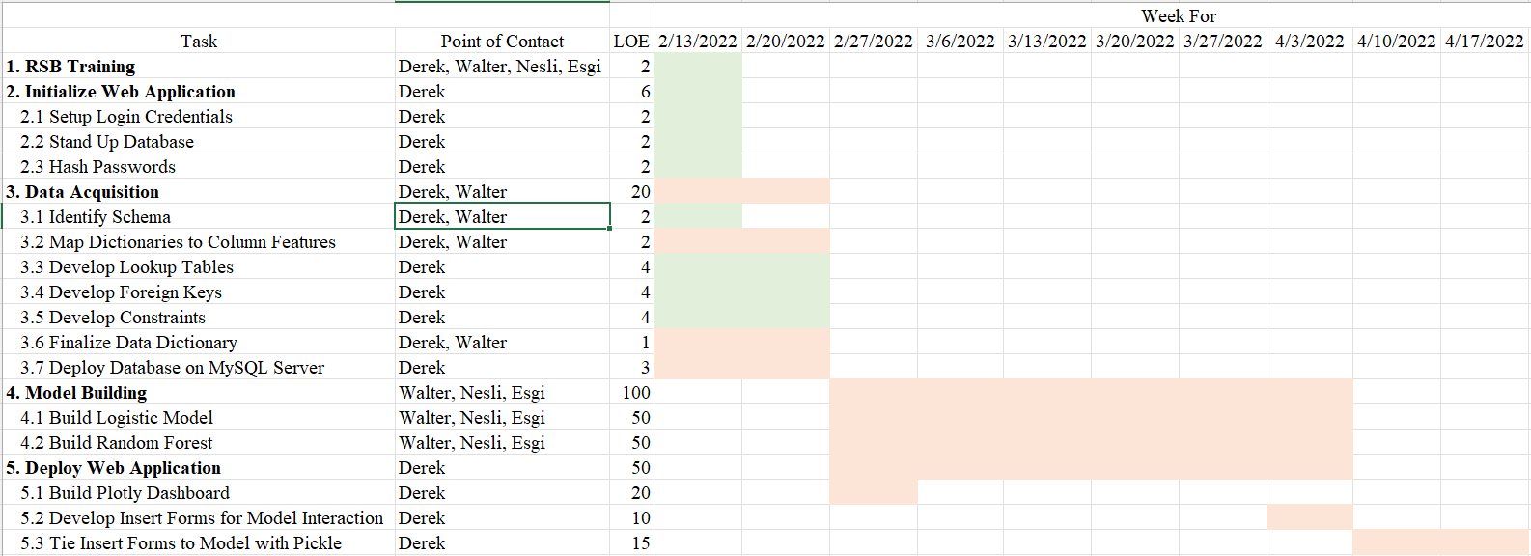
Gantt Chart Review

Slide 3

Objectives

Slide 4
Objectives
Identify if demographic disparities exist in survival outcomes
Observe if demographic disparities exists in the predictive value of initial triage priority
Determine if initial triage priority is predictive of survival

Slide 5

Achievements

Slide 6
Dataset
4,605 encounters
Race
Ethnicity
Sex
Discharge Status
Length of Stay
Age of Admission
15,569 assessment points
SOFA score
Intubation number
Assessment time point
Duration on vent
Color code (red, yellow, blue)
Five Tables
Study_Cohort
Admission_DXs
Insurance
COVID_Status
BLIS_ASSESSMENT

Slide 7
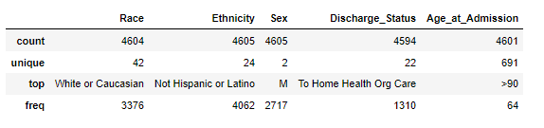
Study_Cohort
Descriptive Statistics of Study_Cohort table

Slide 8
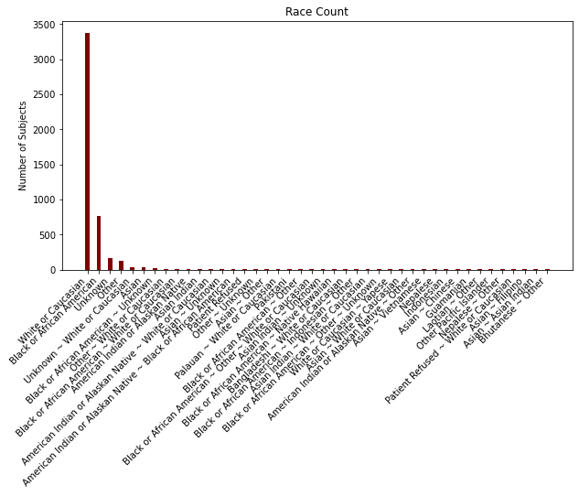
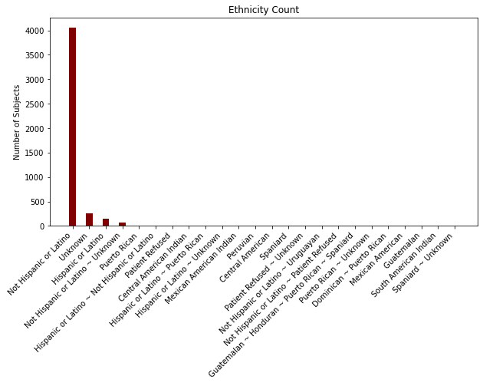

Slide 9
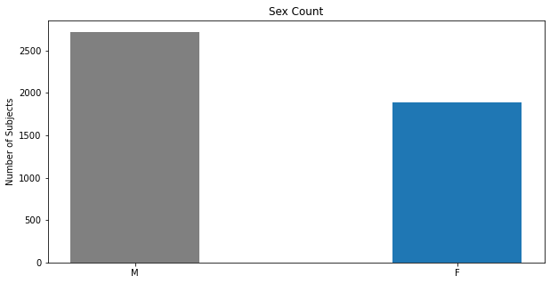
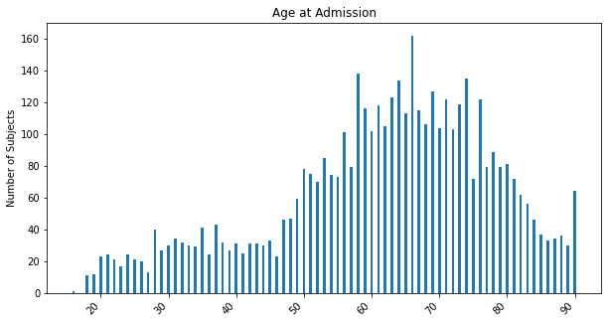

Slide 10
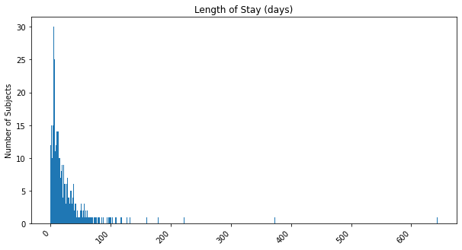
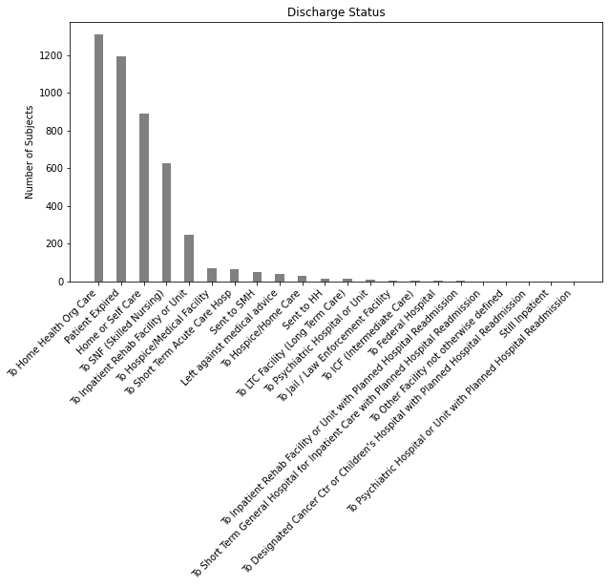

Slide 11

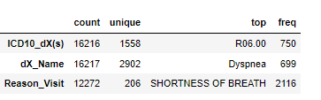
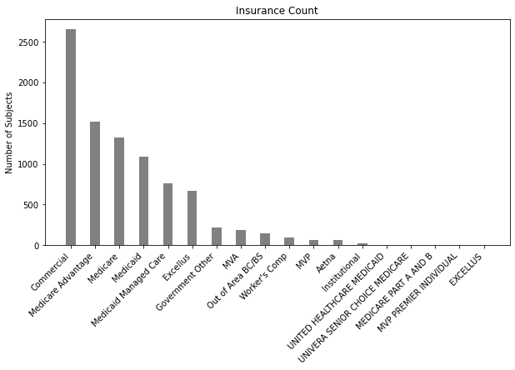
Admission_DXs
Insurance
Descriptive Statistics of Insurance table
Descriptive Statistics of Admission_DXs table

Slide 12
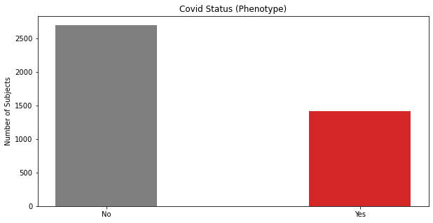
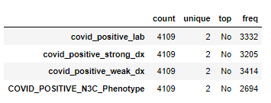
COVID_Status
Descriptive Statistics of COVID_Status table

Slide 13
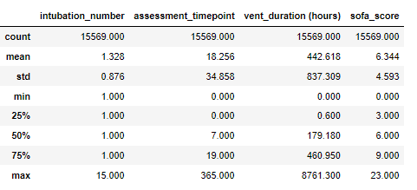
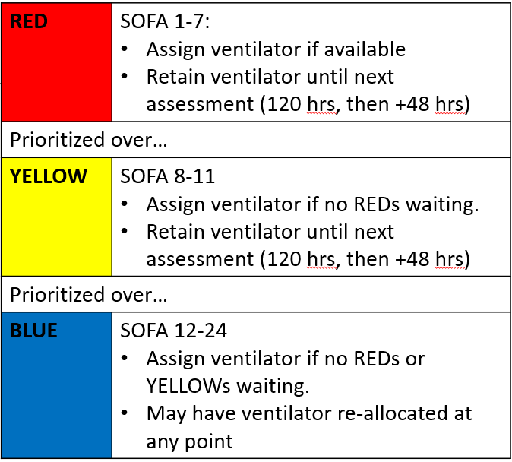
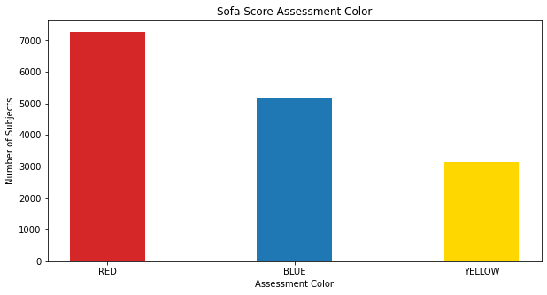
BLIS_ASSESSMENT
Descriptive Statistics of BLIS_ASSESSMENT table

Slide 14
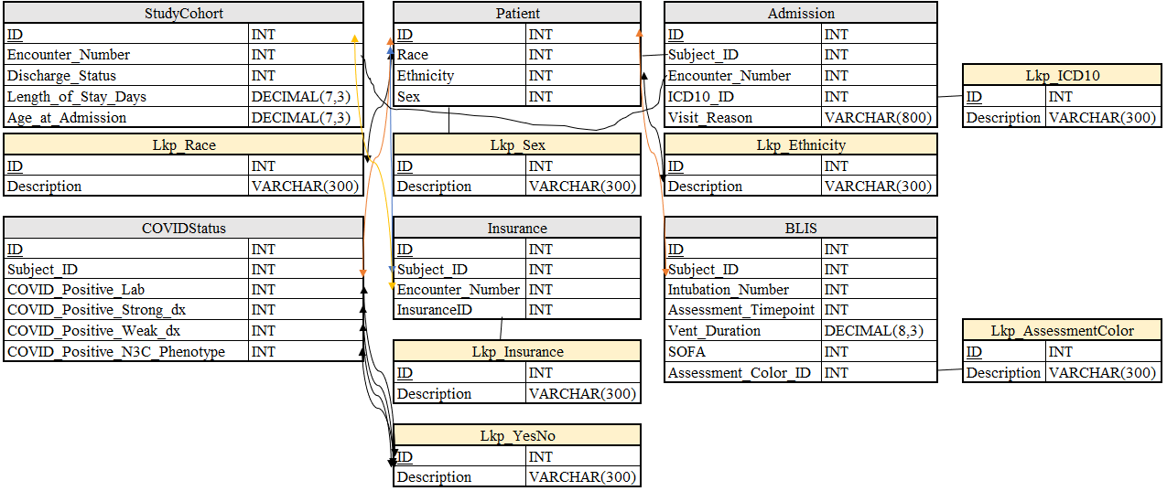
Achievements
Completed data security training
Acquired data
Built Data Model
Built database with foreign key relationships
Stood up web interface

Slide 15

Challenges

Slide 16
Challenges
Poor foreign key relationships
Too many races & insurance types
Obstacle for model integrability

Slide 17

Next Steps

Slide 18
Next Steps
Deploy SQLLite database to AWS MySQL server
1
Deploy Plolty Dashboard to AWS
2
Acquire Charter Approval
3
Begin Baseline Model
4

