Slide 1
Modelling COVID Ventilator Allocation Protocols
URMC – Department of Health Humanities & Clinical and Translational Science Institute
Primary Contact: Jon Herington – Jonathan.Herington@rochester.edu

Slide 2
Problem Statement
RED | SOFA 1-7: Assign ventilator if available Retain ventilator until next assessment (120 hrs, then +48 hrs)
Prioritized over…
YELLOW | SOFA 8-11 Assign ventilator if no REDs waiting. Retain ventilator until next assessment (120 hrs, then +48 hrs)
Prioritized over…
BLUE | SOFA 12-24 Assign ventilator if no REDs or YELLOWs waiting. May have ventilator re-allocated at any point
During public health emergencies, may need to ration ICU resources
In March 2020, URMC developed criteria to ration ventilators
Goal is to SAVE THE MOST LIVES to discharge
Prioritizd patients as “Red”, “Yellow” or “Blue” based on a clinical organ failure score (SOFA)
Patients re-assessed every 48 hours
Never implemented, but all ICU patients assigned priority between 03/2020 – 04/2021

Slide 3
Problem Statement
Are reported national demographic disparities in survival of COVID patients replicated in our dataset?
Does our triage protocol predict who is likely to survive, if given a ventilator?
Are there demographic disparities in how well our triage protocol predicts survival?

Slide 4
Project Outcome
1. Are there demographic disparities in survival outcomes?
By age, sex, race, & insurance status
For all patients AND for COVID+ only
2. Is initial triage priority predictive of survival?
For all patients AND for COVID+ only
3. Are there demographic disparities in the predictive value of initial triage priority?
By age, sex, race, & insurance status
For all patients AND for COVID+ only
Survival Outcomes by… | All patients | COVID+ patients
Age
Sex
Race
Insurance Status
Initial Triage Color

Slide 5
Problem Outcome (Stretch Goal)
What are the predicted survival outcomes if the URMC triage protocol was used to allocate ventilators under moderate scarcity?
Open questions:
How to model scarcity of ventilators?
How to model the sequential allocation of ventilators?
How to model the re-allocation of ventilators? (see time series dataset)
Will work with Faculty mentors, URMC Quality Institute, and Biostatistics consultant to investigate appropriate (simple) simulation model.

Slide 6
Dataset
4,600 encounters
Age
Race
Sex
Insurance Status
Admission Diagnosis
Discharge Status
COVID status
15,570 assessment points
SOFA score
Duration on vent
Color code (red, yellow, blue)
Five Tables
Study_Cohort
Admission_DXs
Insurance
COVID_Status
BLIS_ASSESSMENT
Keys: Encounter and Subject
Data Dictionary embedded

Slide 7
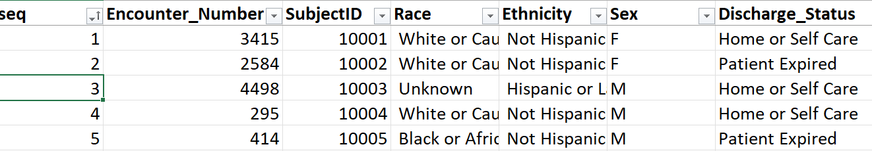
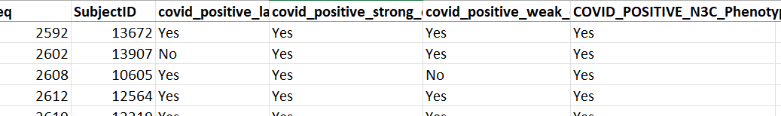
Encounter-Level Tables Overview

Slide 8
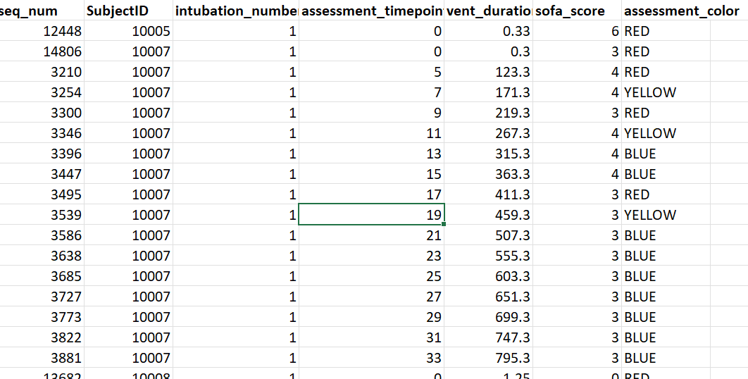
Triage Assessments (Time Series)

Slide 9
Project Logistics
Dataset ~3MB, available via Box
Will require RSRB training, but dataset is de-identified (no PHI)
Project Contacts
MAIN: Jon Herington (Philosophy)
Clinical: Jessica Shand (Pediatrics & Bioethics)
Biostats: Irena Boyce (URMC Quality Institute)
Dataset: Jeanne Holden-Wiltse (CTSI)

Slide 10
YES
Vulnerable Yellow?
Allocate / Retain Vent
T > 120 hrs
Red
YES
+24 hrs
NO
NO
SOFA
Eval.
Vulnerable Blue?
Yellow
YES
Death
Patient Requires Vent
NO
Open Vent?
Blue
YES
NO
Extubation
+24 hrs
Ward
Discharge

