Slide 1
URMC: Ventilator Allocation
22 February 2022

Slide 2
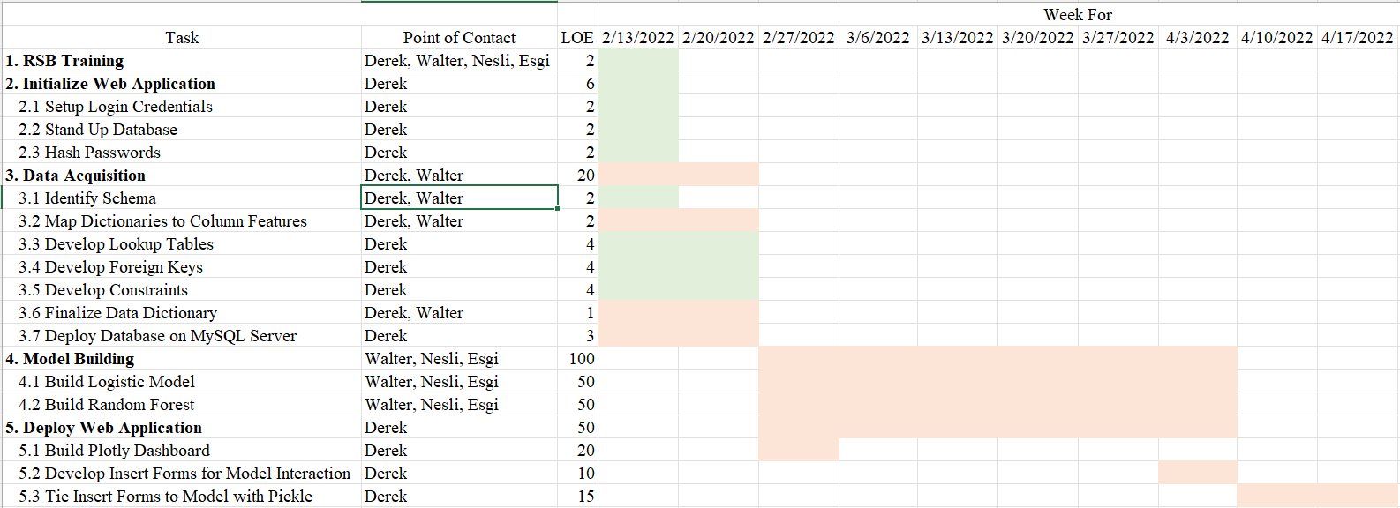
Gantt Chart Review

Slide 3

Objectives

Slide 4
Objectives
Identify if demographic disparities exist in survival outcomes
Observe if demographic disparities exists in the predictive value of initial triage priority
Determine if initial triage priority is predictive of survival

Slide 5

Achievements

Slide 6
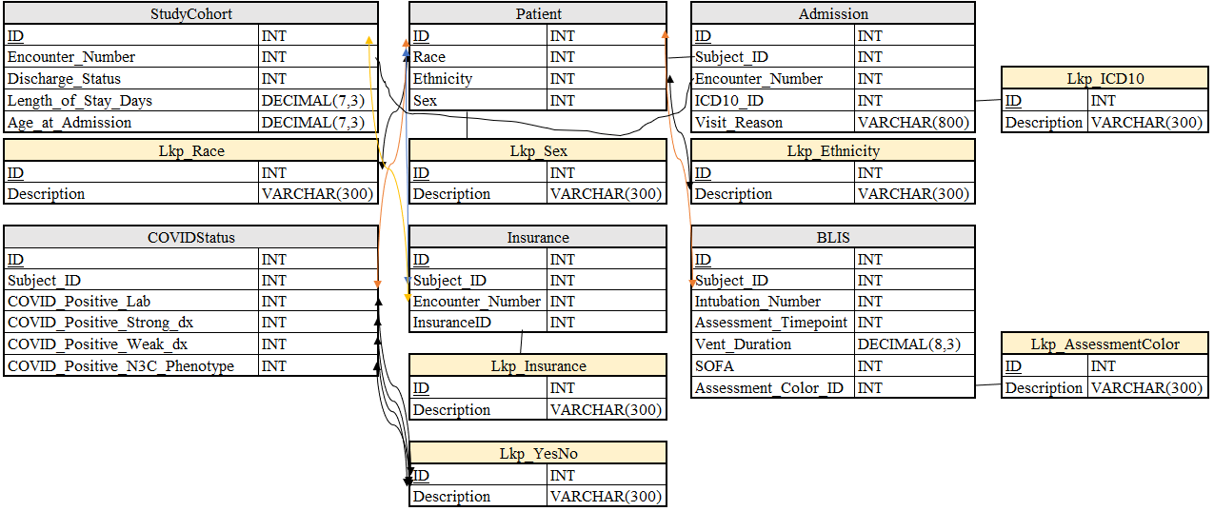
Achievements
Completed data security training
Acquired data
Built Data Model
Built database with foreign key relationships
Stood up web interface

Slide 7

Challenges

Slide 8
Challenges
Poor foreign key relationships
Too many races & insurance types
Obstacle for model integrability

Slide 9

Next Steps

Slide 10
Next Steps
Deploy SQLLite database to AWS MySQL server
1
Deploy Plolty Dashboard to AWS
2
Acquire Charter Approval
3
Begin Baseline Model
4

