Slide 1
URMC Ventilator Allocation
14 February 2022

Slide 2

Introductions

Slide 3
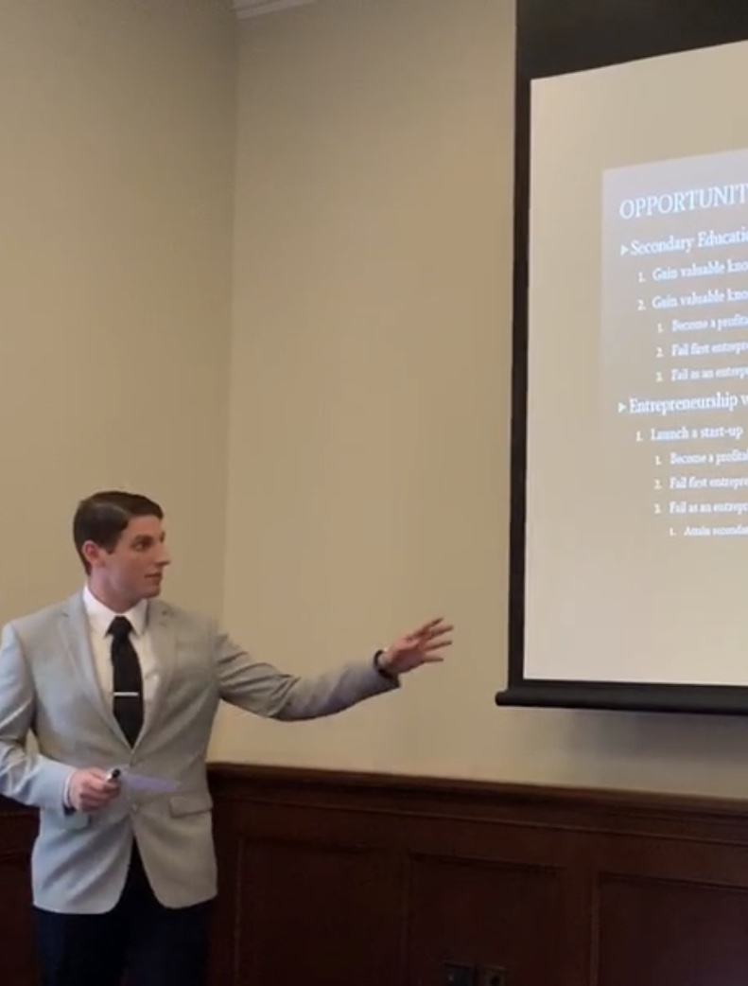
Derek Caramella
Profession: Functional Analyst @ Tiber Creek Consulting
Academica: Economics BA, Business Management BS, & Political Science BA
Pending: Data Science, MS
Specialization(s): Forecasting, web-development, database management, & dimensionality reduction

Slide 4
Ezgi Siir Kibris
Profession:
Academica:
Pending: Data Science, MS
Specialization(s):

Slide 5

Nefle Nesli Oruc
Pending: Data Science, BS Digital Media Studies, BA
Specialization(s): Descriptive analyses, database management systems

Slide 6

Walter Burnett
Profession: Decision Support Analyst & Product Owner
Academica: Applied Mathematics and Statistics BA
Pending: Data Science, MS
Specialization(s): Medical data analytics, hospital financial data analytics, and Tableau dashboards

Slide 7

Project Deliverables

Slide 8
Questions & Deliverables
Are there demographic disparities in survival outcomes?
A simple yes or no with confidence levels
A grid showing all the possible situations at their likelihood for survival
A web interface that displays demographic qualities compared to survival
Is initial triage priority predictive of survival?
A simple yes or no with confidence levels
A probability (likelihood) that the priority level leads to death
A web interface that displays initial triage priority compared to survival
Are the demographic disparities in the predictive value of initial triage priority?
A simple yes or no with confidence levels
The predicted probability (likelihood) of initial triage priority based on SOFA & demographics
How to model scarcity of ventilators
A web-interface model that takes information: Gender, Race, Insurance, Age, SOFA, & number of available ventilators to determine which individuals receive the ventilator
How to model the sequined allocation of ventilators?
A web-interface model that takes information: Gender, Race, Insurance, Age, SOFA, & number of available ventilators to determine which individuals receive the ventilator

Slide 9

Data Handoff

Slide 10
Web Hosted Database (PaaS)
Any concerns:
Password Protected PaaS Database to host data?
Yes or No
Web-interface with login to interface with the model
Yes or No

Slide 11
An Eye to the Future

Slide 12
Next Meeting Deliverables
Project Charter
Need to be signed by Jon
PaaS database
MySQL & Python scripts (Foreign Keys & Batch Upload)
Schema
Data Dictionary
Dashboard Outline

