Slide 1
URMC: Ventilator Allocation
22 February 2022

Slide 2
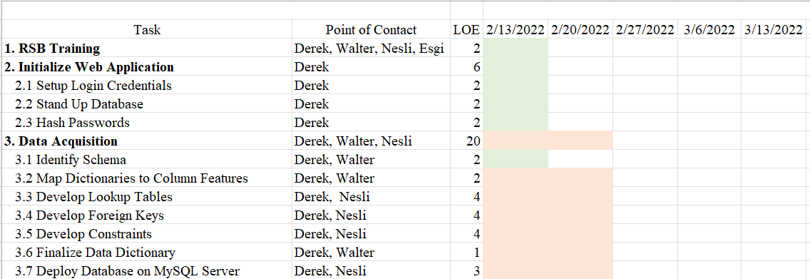
Gantt Chart Review

Slide 3

Objectives

Slide 4
Upcoming Objectives
Reduce Race, Ethnicity, Insurance granularity
Acquire Charter Approval
Build SQL database
Identify relationship between COVID table and repeated encounters
Build Dashboard

Slide 5

Achievements

Slide 6
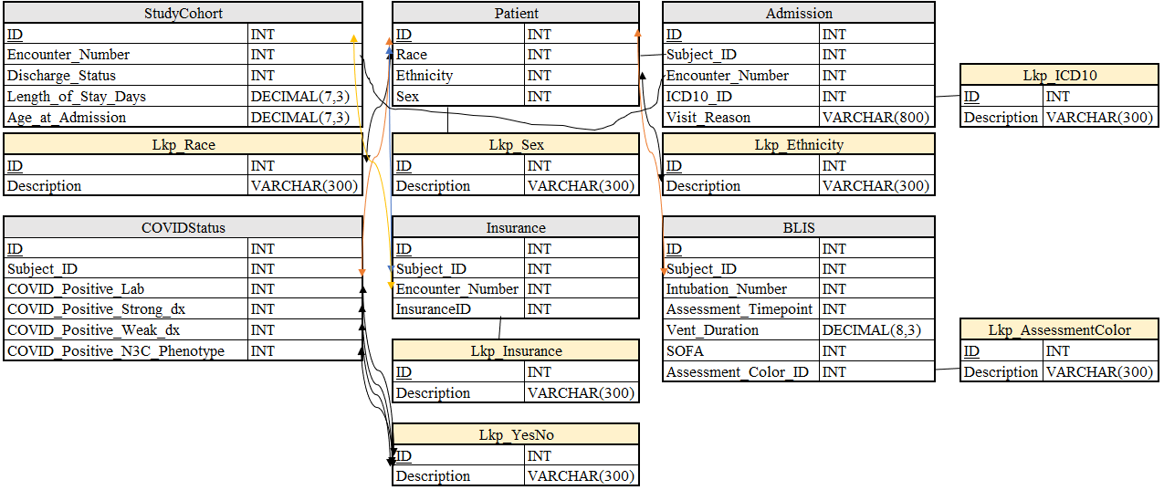
Achievements
Completed data security training
Acquired data
Completed Charter Draft
Pending Approval
Built Data Model
Stood up web interface

Slide 7

Challenges

Slide 8
Challenges
Poor foreign key relationships
Too many races & insurance types
Obstacle for model integrability

Slide 9

Next Steps

Slide 10
Next Steps
Develop SQLLite database
1
Deploy onto SQLLite database to AWS MySQL server
2
Deploy Plolty Dashboard to AWS
3
Acquire Charter Approval
4

