Slide 1
URMC Ventilator Allocation
21 February 2022

Slide 2
Week Review

Slide 3
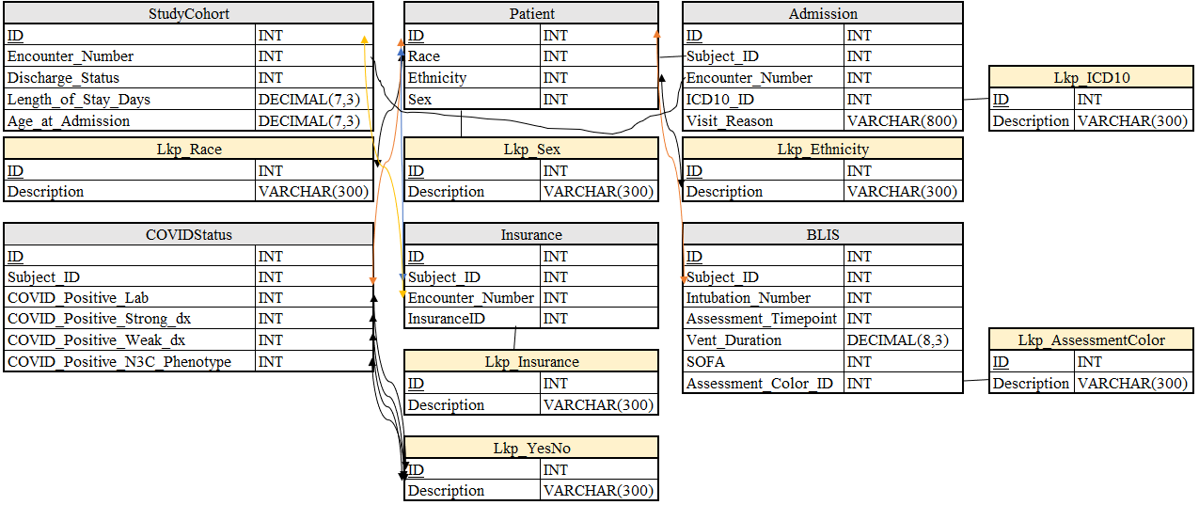
Week Review
Project Charter
Will deliver at the end of meeting for your emailed approval.
PaaS database
Any updates from Jon?
Schema

Slide 4
Dashboard Design
Age
Length of Stay
Vent Duration
SOFA
Sex
Ethnicity
Race
Insurance
COVID Status
Sex
Sankey Diagram
Sex
Race
Insurance
Tree Diagram

Slide 5

Working Meeting

Slide 6
Race

Slide 7
Ethnicity

Slide 8
Insurance

Slide 9
BLIS

Slide 10
COVID Status

Slide 11
An Eye to the Future

Slide 12
Next Meeting Deliverables
Database Deployment
Dashboard Delivery
Preliminary Machine Learning Findings

